Slide 1
Stock market movement estimation using neural networks
By: k. čavić, k. ilišinović, f. milković, a. nekić, m. raguž

Slide 2

Problem
STOCK MARKET PRICE PREDICTION
PROFIT

Slide 3
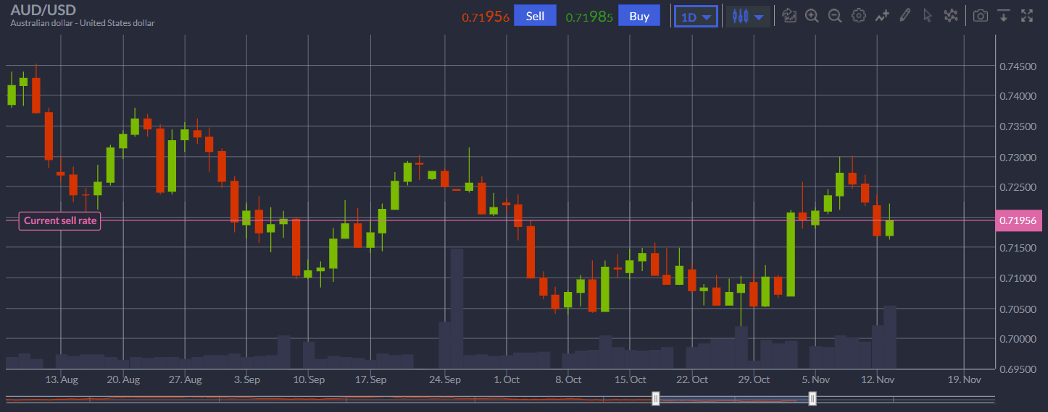
Description

Slide 4
Approach
Neural network
Long Short-Term Memory - LSTM
1 input layer, 4 lstm layers and 1 output layer
Input : close price and volume per day for the last 60 days (60*2)
Output : close price for the next day (1)
Keras neural network library

Slide 5
Input
Iexfinance python API
Historical data
Short stock name, start date, end date
4 years data
200 days testing

Slide 6
Different strategies
Multiple stocks as input
Difference calculation
Different parameters

Slide 7
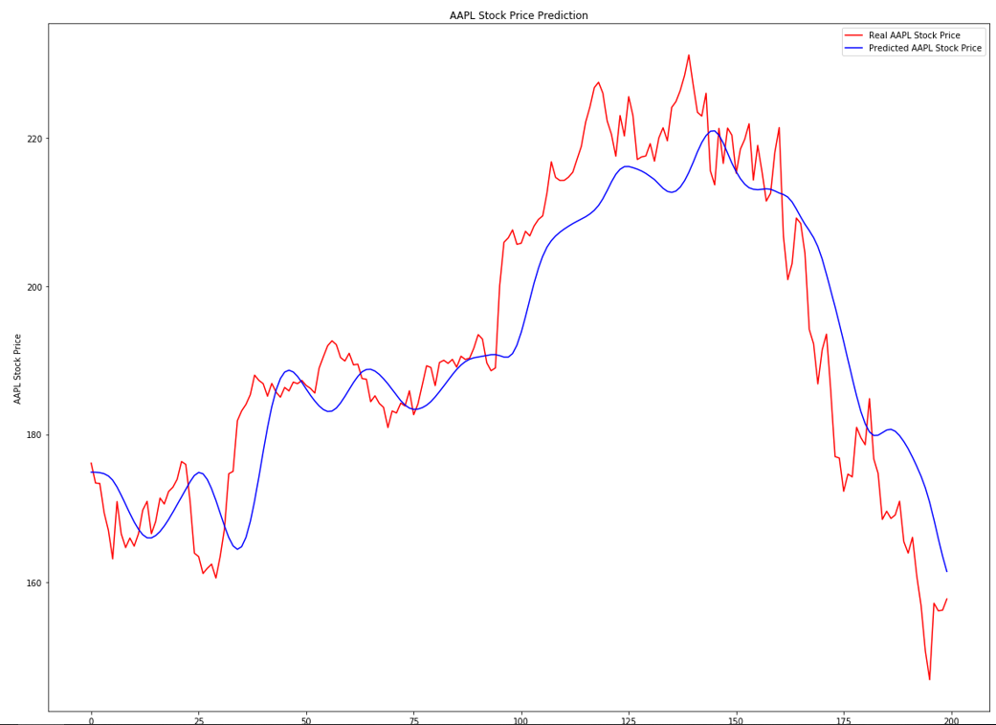
results

Slide 8

Profits

Slide 9
Profits
Microsoft – 4.4%
Apple – 11.9%
Amazon – 12.1%
Google – 14.9 %
Facebook – 19.2%

Slide 10


