Slide 1
LENDING CLUB CLASSIFICATION
CHIRAG M NAIK
CHANDAN KUMAR SINHA
KUNAGU SAI CHARAN
SMRUTHI SRINIVAS BHANDIWAD
SWATI SHRIVASTAVA
MENTOR - Mr. ROMIL GUPTA

Slide 2
PROBLEM STATEMENT
1.Business problem statement (GOALS)
1.1 Business Problem Understanding
While taking a loan most of us dedicate a very good amount of time in choosing the lender i.e. the bank or organisation where we will be applying for the loan. Any formal loan agreement takes lot of time and is generally not a hassle free process.
1.2 Business Objective
In order to make the process of taking loans seamless and providing the customer with ‘n’ no of choices the idea of lending club was conceptualised.

Slide 3
1.3 Approach
The basic idea of connecting two people one who wants to take the loan and the other person/organisation who wants to make a profit by investing their capital. Lending Club provides the platform for this peer-to-peer loan arrangement. Both parties have their due advantages, as a customer you have more choices and as an investor you have the assurance as we verify the profiles of the borrower and the loan is processed only if they meet certain criteria.
1.4 Conclusions
Using EDA and various Machine Learning models the applicant would be verified and if he matches the criteria then he will be connected with the Lender.

Slide 4
Understanding the Data
Original Data set contains 39786 Rows & 150 Columns of data .
The objective of the study is to predict whether the customer taking the loan from the bank will fully pay the loan back or he/she will be charged off.
Based on this the lending club will sanction the loan to the customer.
Our target variable will be “loan_status”.

Slide 5
Data Cleaning & Missing Values Imputation
Firstly we have dropped the columns having null values greater than 50%. These steps reduced the columns from 150 to 58.
Columns with just a single unique categories are removed.
We also removed redundant entries such as ‘%’ sign using rstrip.
Removed columns like address state(addr_state) and ‘title’ after checking their impact on the dataset.
After doing the above mentioned steps we were left with three columns that still had some missing values.

Slide 6
Data Cleaning & Missing Values Imputation
The “pub_rec_bankruptcies” was imputed using majority category.
“revol_util” column was imputed using mode
Finally rows with null values in “emp_length” were dropped as we couldn’t establish any relation for their imputations. Finally we were left with 21 columns which we will be using for training the model.

Slide 7
Data Cleaning & Missing Values Imputation
We have removed some redundant columns based on our domain understanding.
After treating the missing values , we have transformed “grade” and “emp_length” to integer values by doing manual label encoding so that they provide information to our model.
Since ‘fico_high_score’ and ‘fico_low_score’ are highly correlated so we have made a column by name ‘fico_avg’ which will be the average of these two for every customer.
Feature selection is done by performing ANOVA and Chi square test on the independent variable.

Slide 8
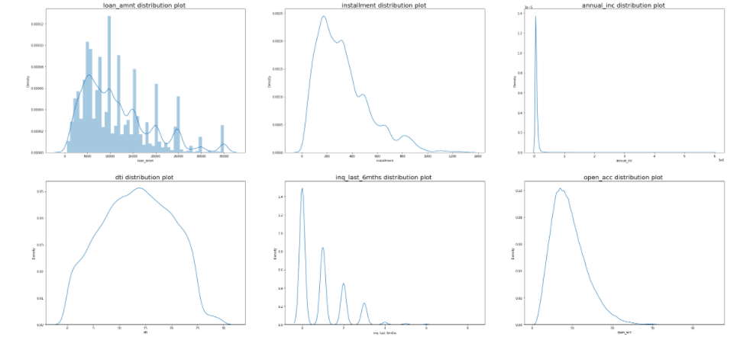
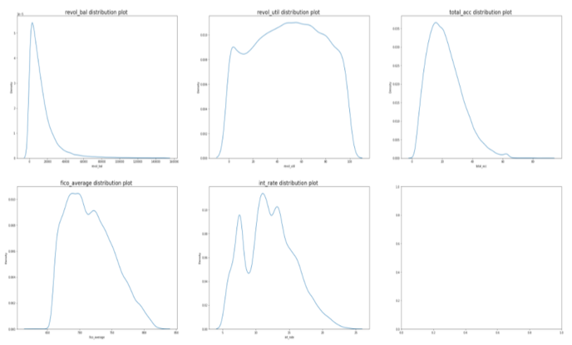
Univariate Analysis:
(1)From the KDE plot we can infer that some distribution is highly skewed and most distribution are not normal.
(2) Most of the loan interest rates lies between 9% to 14%.

Slide 9
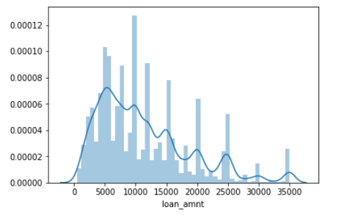
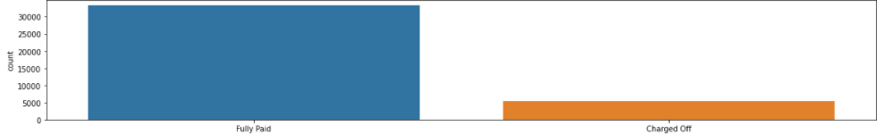
The distribution is slightly right skewed and it is multimodal. Most of the loan amount revolves around
4000 to 20000 as we can see it from the graph.
From the count plot we can infer that the target variable loan status is imbalanced.

Slide 10
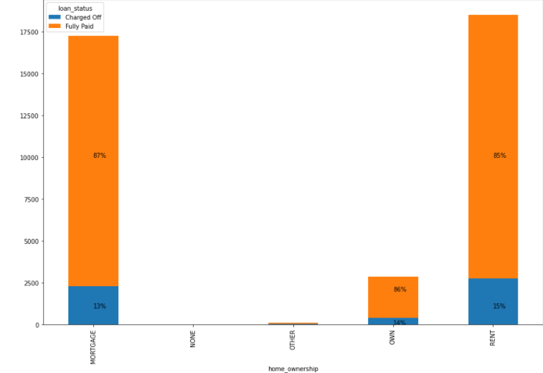
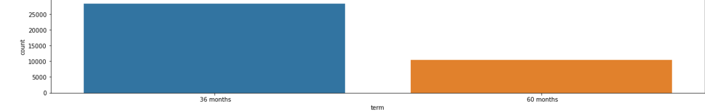
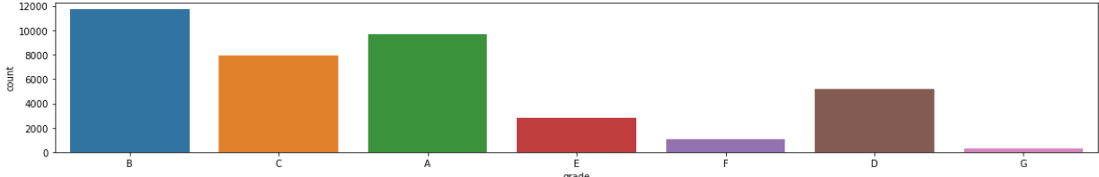
As we don’t know what comes under “OTHER” and “NONE” category, we will drop rows having these two categories as it will make our model more accurate. Also we can see majority of customers do not have their own home.
Count plot for term i.e. the number of months they will be paying instalments for .
Count plot for ‘GRADE’ The number of people belonging to ‘A’, ‘B’, ‘C’ grade is higher.

Slide 11
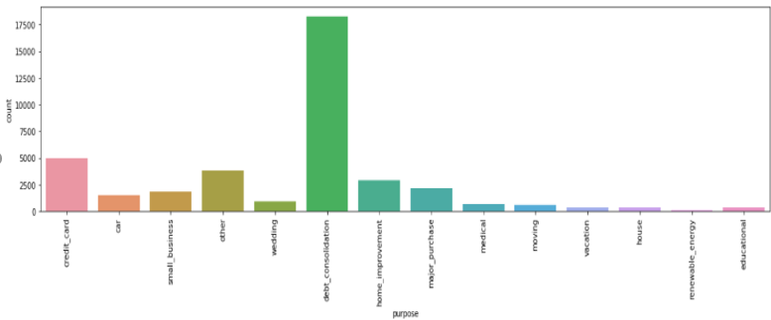
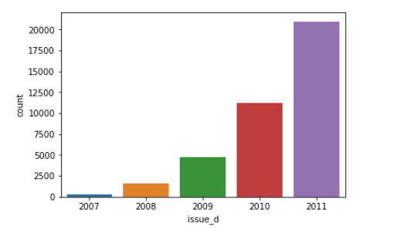
We can clearly see that 60% people take loans to pay their old debts and credit loans.
The demand for the loans has increased over the years which we can see from the graph.

Slide 12
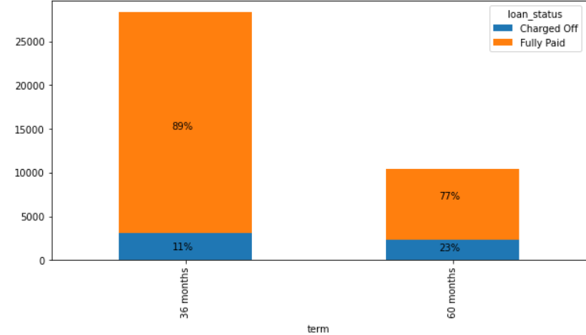
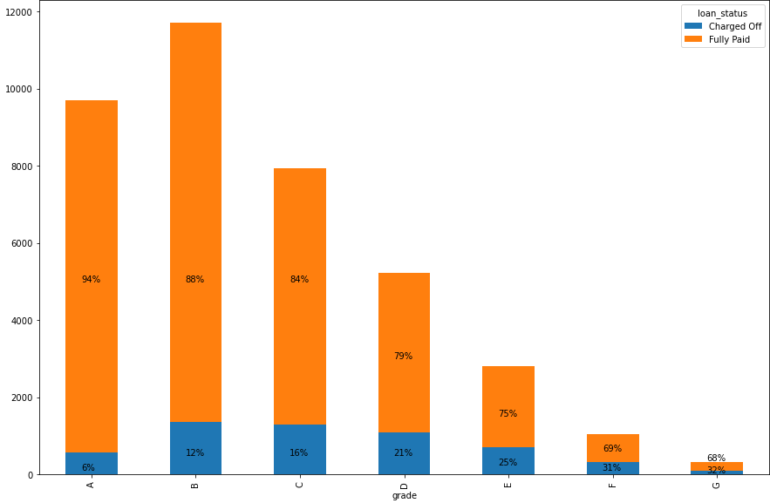
BIVARIATE ANALYSIS:
We can infer that there is a significant relationship between ‘Term’ and term with loan status.
We can clearly see that there is a significant relationship between ‘Grade’ a with loan status.

Slide 13
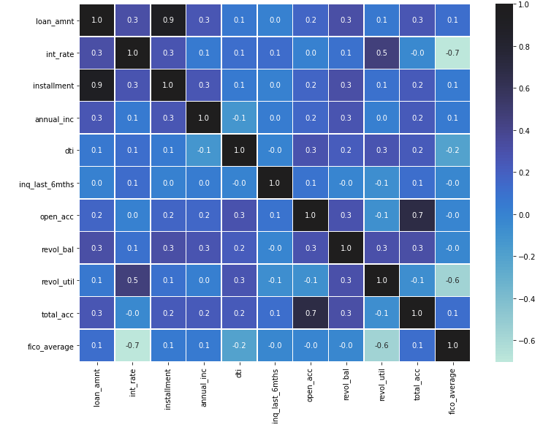
MULTIVARIATE ANALYSIS:
From the heat map we can infer that there is very strong corelation between these four pair of features:
Total_acc and Open_Acc(0.7)
Pub_rec_bankruptcies and pub_rec(0.8)
Loan and installment(0.9)
Revol_util and fico_avg(-0.6)
HEAT MAP

Slide 14
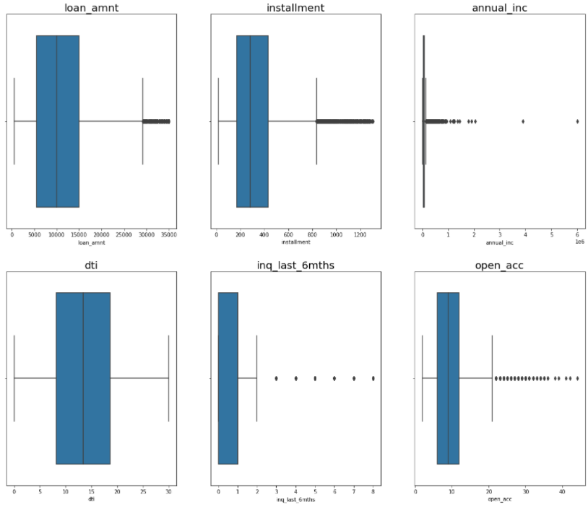
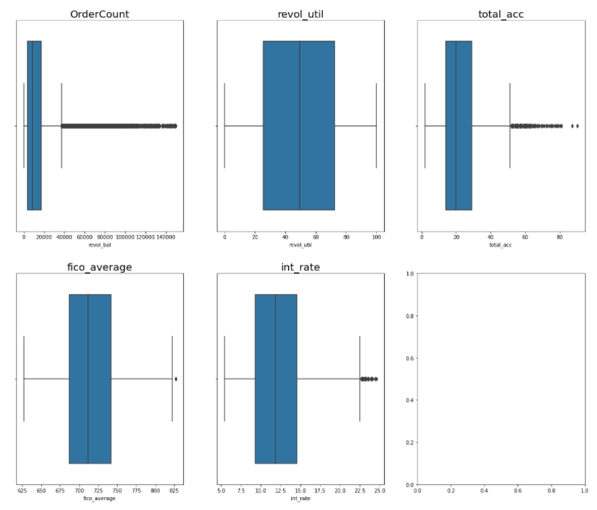
OUTLIER HANDLING
We have not capped for loan amount & annual income because there is a high chance of genuine outlier which is required for prediction.
We have used capping technique for other columns to treat the outliers for better performance of the model.
We have capped outliers with 99 percentile and first percentile before starting the modelling.

Slide 15
DATA PREPARATION
We have label encoded for the ‘grade’ and ‘employment length’(emp_length)
Then we have applied Scaling for better accuracy and less biasness in our model.
We have used Standard Scaling method.
We have used one-hot encoding for converting other categorical variables into dummies.
The scaled data is split into train and test data. The Train data contains 70% data and the Test data contains 30% data.

Slide 16
DATA MODELLING
We have used decision tree as our base model.
After checking feature importance we have dropped home_ownership_NONE, purpose_house.
Using ‘vif’ because of multicollinearity between loan amount and instalment we have dropped loan amount, grade and instalment.
Finally we fit our model on the train data and used it to predict the test data.
We performed logistic regression, Naïve-Bayes, SVM model, XG boosting and then applied different classifiers such as KNN,ADA booster, Random forest on our modelled data set.
The average Train Accuracy of the model is: 0.8947193875566825 ≈ 0.90
The average Test Accuracy of the model is: 0.9008848239024759 ≈ 0.90

Slide 17
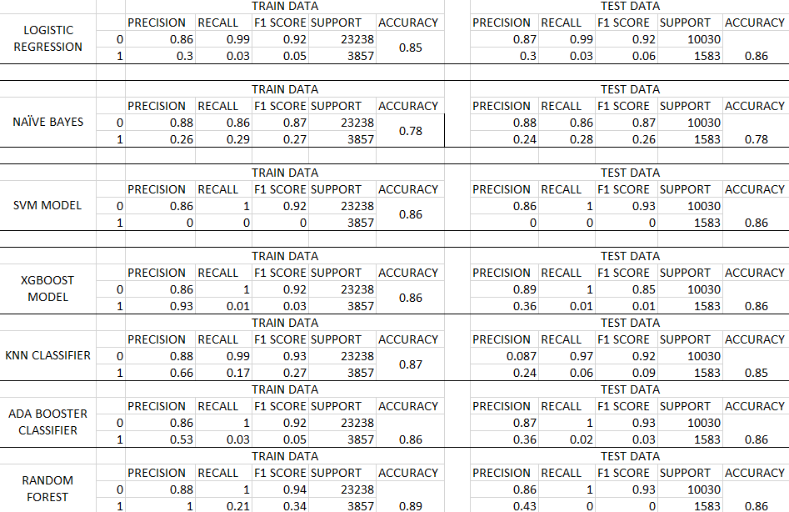
From the above results we are taking Random forest and AdaBoost into further tuning

Slide 18
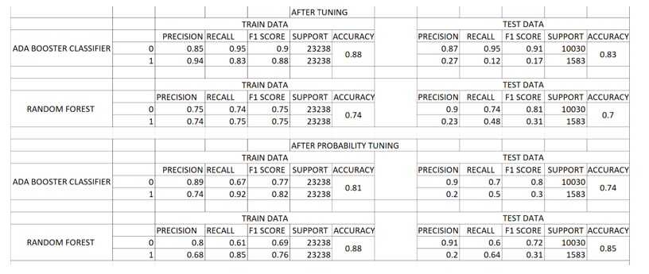
SUMMARY TABLE AFTER TUNING RANDOM FOREST & ADA BOOST CLASSIFIER

Slide 19
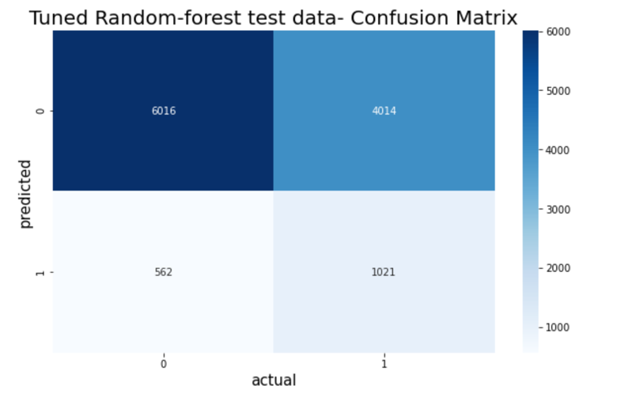
Model Tuning
We have applied SMOTE to treat imbalance.
Further we used Grid search for hyperparameter tuning and then probability tuned our adaboost model and random forest model to get better recall.
INFERENCE- TUNED RANDOM FOREST MODEL GIVES THE BEST RESULT WITH TEST AND TRAIN RECALL & ACCURACY

Slide 20
KEY POINTS TO CONSIDER FOR LOAN APPROVAL:
Borrowers with high interest rate are more likely to default.
Borrowers with higher annual income are less likely to default.
Borrowers who have higher revolving balance amount left are likely to default.
Borrowers with high debt to income ratio are more likely to default.

