Slide 1
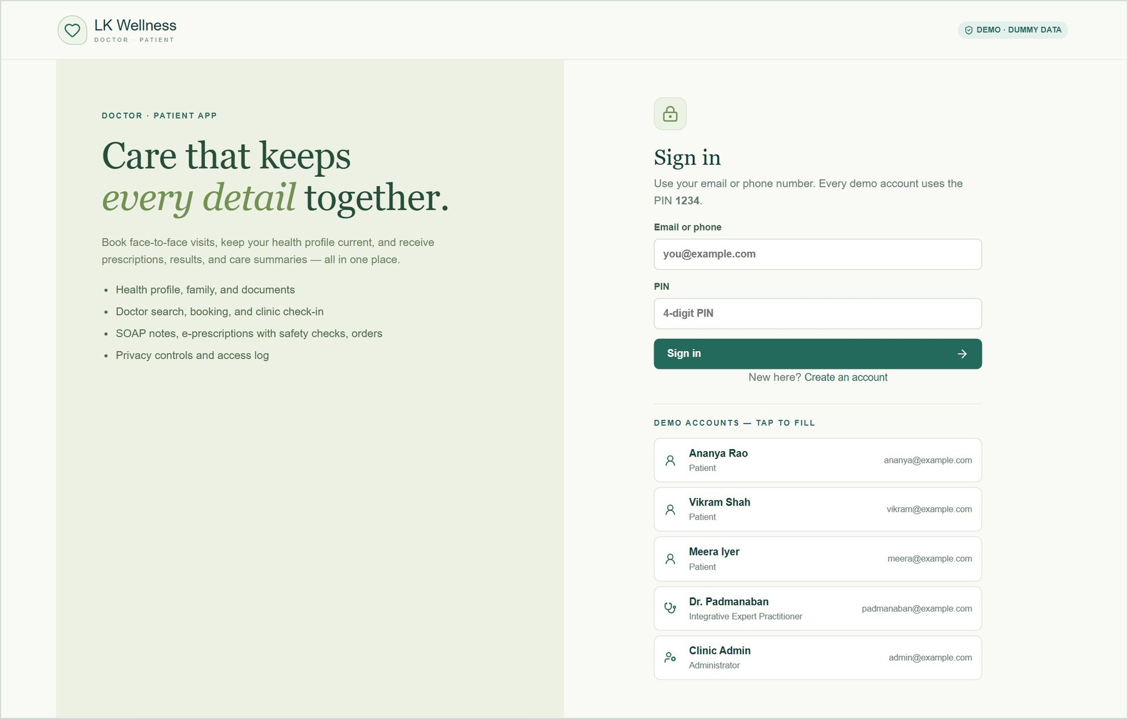
Proof of concept
demo
LK WELLNESS · DOCTOR–PATIENT APP
A working patient portal, doctor portal and admin area with dummy data. Walkthrough as of 2 October 2026.
Sign in with any demo account · PIN 1234
Notes:
Introduce the POC: one web app covering the components in the Doctor_Patient_App_Components document. Everything you will see runs on dummy data stored in a JSON file. There is no database. Every account signs in with the PIN 1234.

Slide 2
What the proof of concept covers
AT A GLANCE
3
25
1
46
portals in one app
Patient, doctor, admin
record types
Each can be created, viewed, edited and deleted
doctor
Dr. Padmanaban, Integrative Expert Practitioner
automated tests passing
32 API tests and 14 browser tests
Decisions applied from the components document
PIN 1234 login
for every demo account; OTP and biometrics come later
Face-to-face only
check-in on arrival replaces the video waiting room
Payments to be decided
fees are shown; payment is collected at the clinic
No database
one JSON file of dummy data, reset at any time
Notes:
Three areas in one app. Every record type supports full create, read, update and delete. There is one doctor, Dr. Padmanaban, as requested. The app passed 32 API tests and 14 browser tests before this deck was made. The decisions noted in the document are applied: PIN 1234 login, face-to-face consultations only, and payments left to be decided.

Slide 3
Demo accounts: every one uses PIN 1234
BEFORE THE DEMO
Ananya Rao
ananya@example.com
Patient
Rich history, a son (Aarav), a visit today at 10:30
Run it
From the codebase folder:
npm.cmd run data:reset
npm.cmd run build
npm.cmd run start
Open http://127.0.0.1:3000
A reset moves dummy dates to today, so there is always a clinic queue.
Vikram Shah
vikram@example.com
Patient
Diabetes; already checked in for 10:00 today
Meera Iyer
meera@example.com
Patient
New patient; booking request waiting
Dr. Padmanaban
padmanaban@example.com
Doctor
Integrative Expert Practitioner; today's queue, requests, alerts
Clinic Admin
admin@example.com
Admin
Doctor verification, users, analytics
Notes:
The sign-in page lists every account; clicking one fills it in. Reset the data before each demo so the dates line up with today. Two browser windows, one normal and one private, let you keep a patient and the doctor signed in side by side.

Slide 4
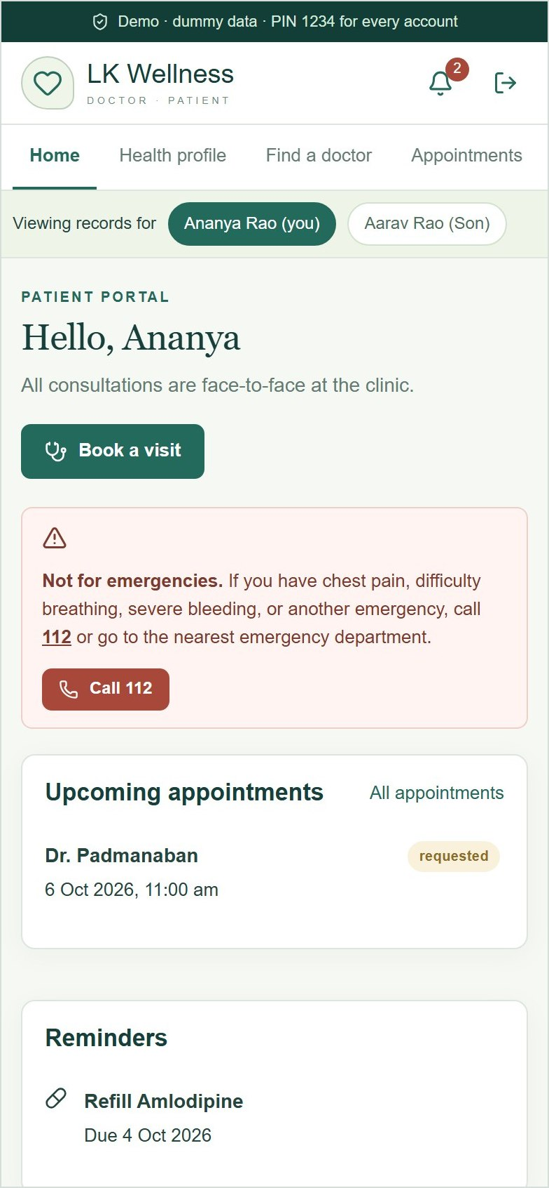
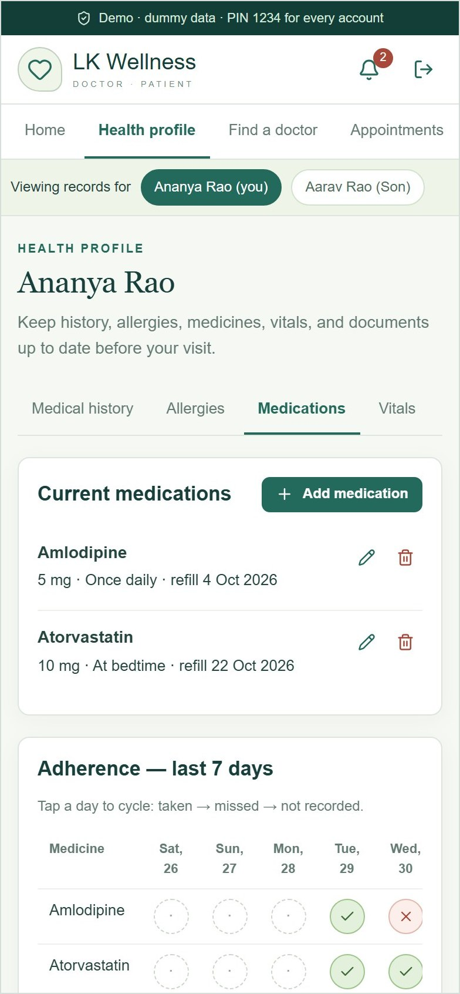
Patient portal
01
Health profile and family, booking with pre-visit questions, check-in, results, e-prescriptions, messages, and privacy controls.
Notes:
The patient portal. Sign in as Ananya for an established patient, or Meera for a new patient.

Slide 5
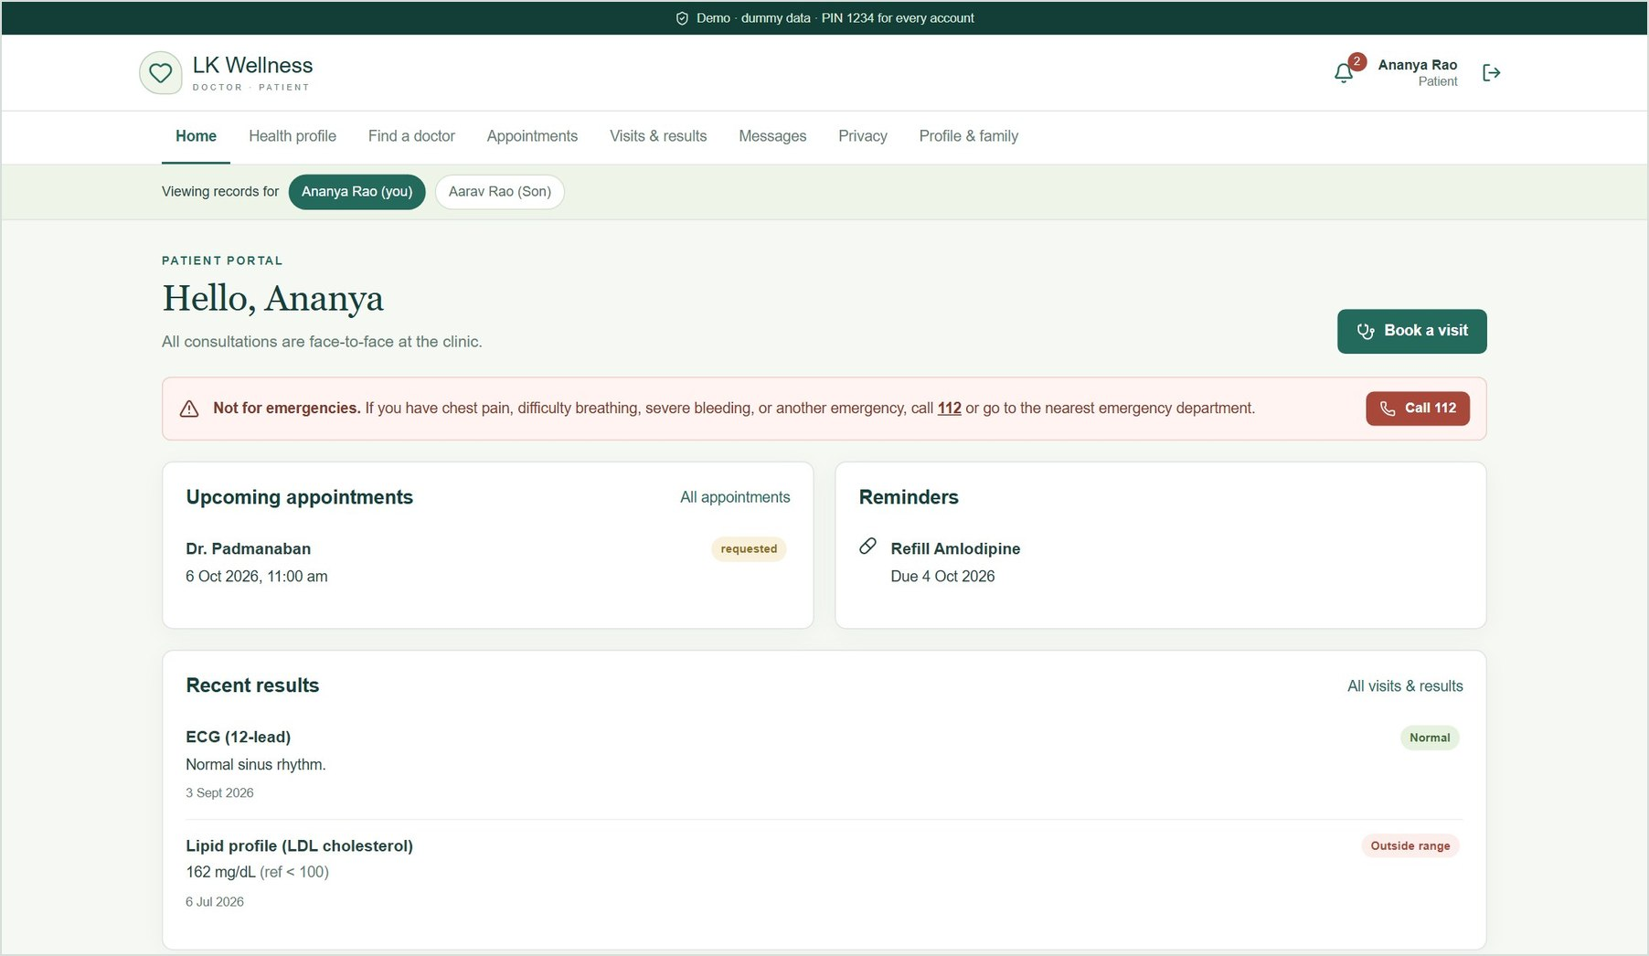
Everything a patient needs on one page
PATIENT · HOME
1
Upcoming visits
Requests show as "requested" until the doctor accepts them.
2
Reminders and results
Refill reminders, and recent results with out-of-range values flagged.
3
Family switcher
Ananya can view and manage her son Aarav's records.
4
Not for emergencies
A permanent notice with a one-tap call to 112.
Notes:
Ananya's home page. Point out the family switcher under the menu, the refill reminder, the flagged cholesterol result, and the emergency notice.

Slide 6
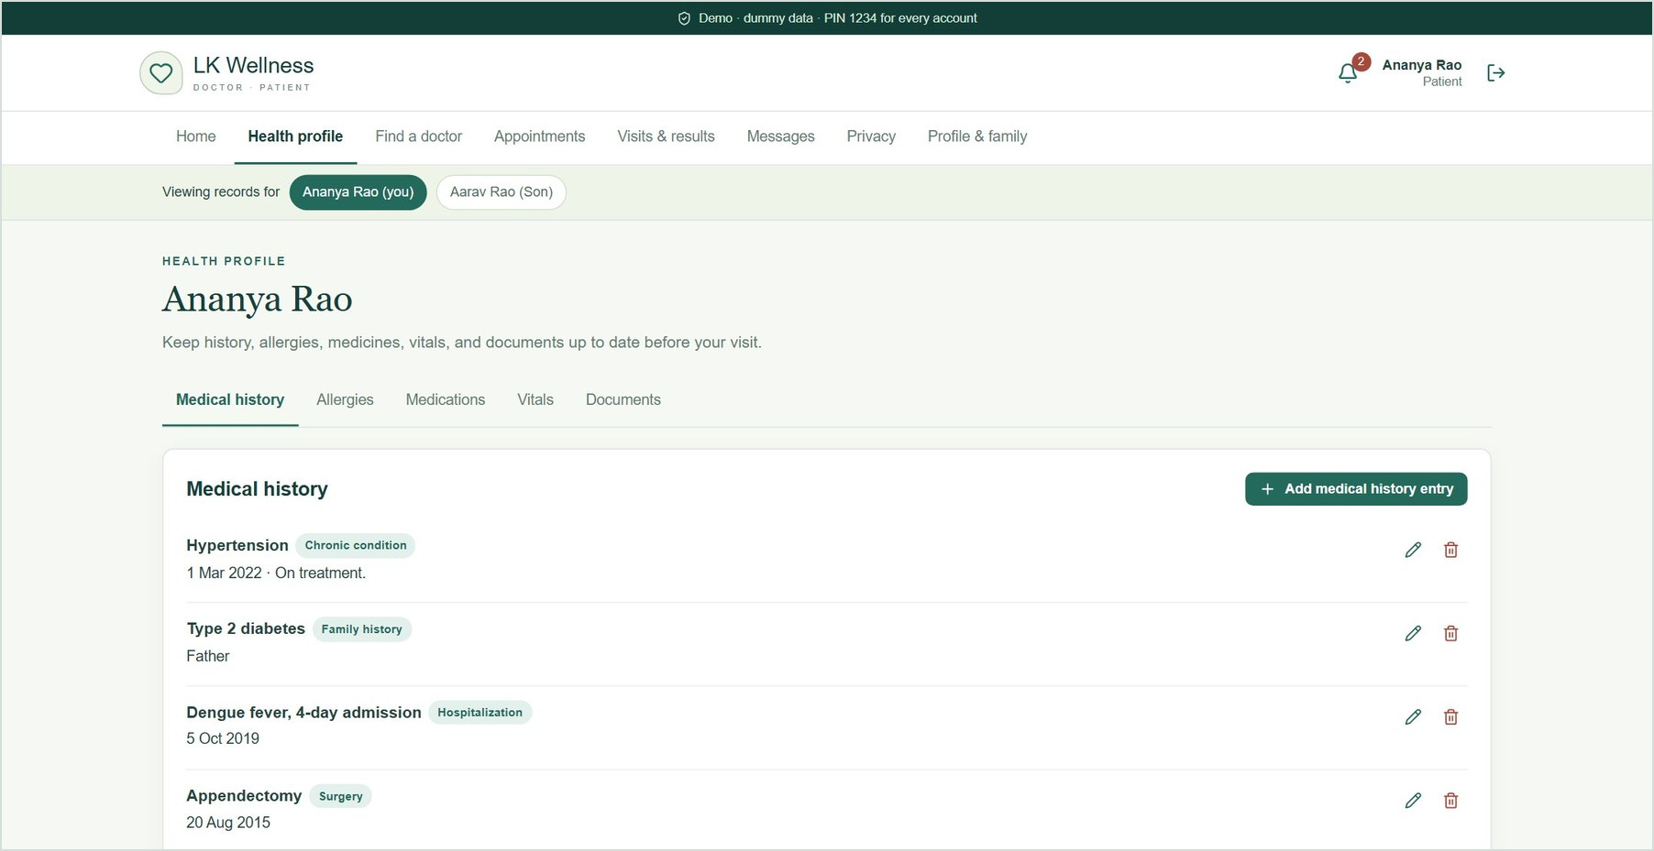
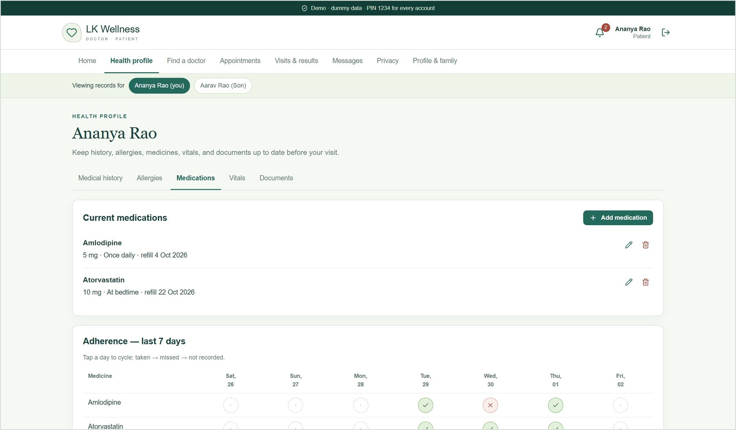
A health profile the patient keeps up to date
PATIENT · HEALTH PROFILE
Medical history: chronic, family, hospitalisation, surgery
Medications with a 7-day adherence tracker
Notes:
Five tabs: medical history, allergies, medications, vitals and documents. Every entry can be added, edited and deleted. The adherence tracker cycles taken, missed and not recorded. Documents accept PDF, PNG and JPEG uploads up to 5 MB.

Slide 7
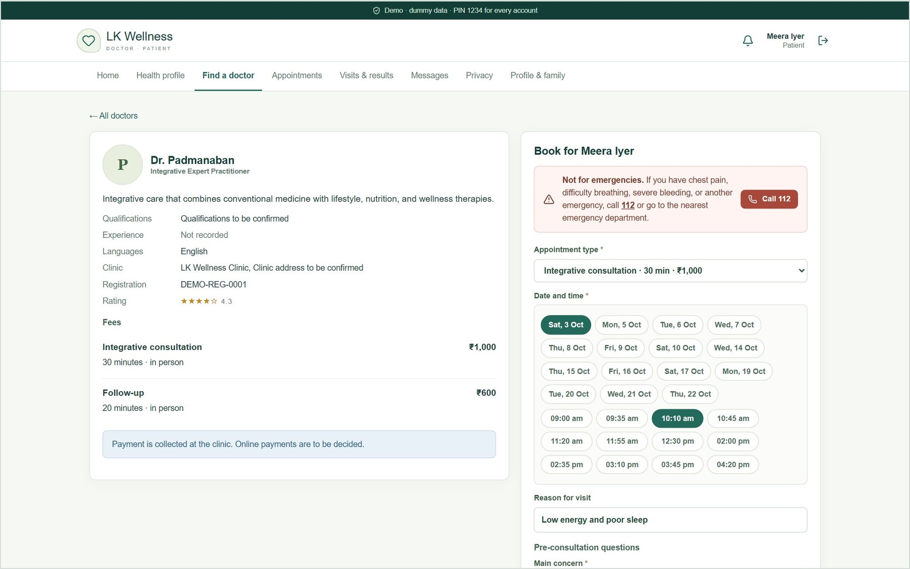
Find a doctor and book a real free slot
PATIENT · BOOKING
1
Search and filter
By specialty, language, fee, availability and rating.
2
Pick a slot
Built from working hours, breaks, buffers, leave and existing bookings.
3
Answer pre-visit questions
Main concern, symptoms, duration, fever, current medicines.
4
Request
The doctor accepts or rejects it, and the patient is notified.
Notes:
Sign in as Meera. Find a doctor, View & book. Show the fee, the slot grid (Sunday is skipped because the clinic is closed), and the pre-visit questions. Send the request; it appears under Appointments as requested.

Slide 8
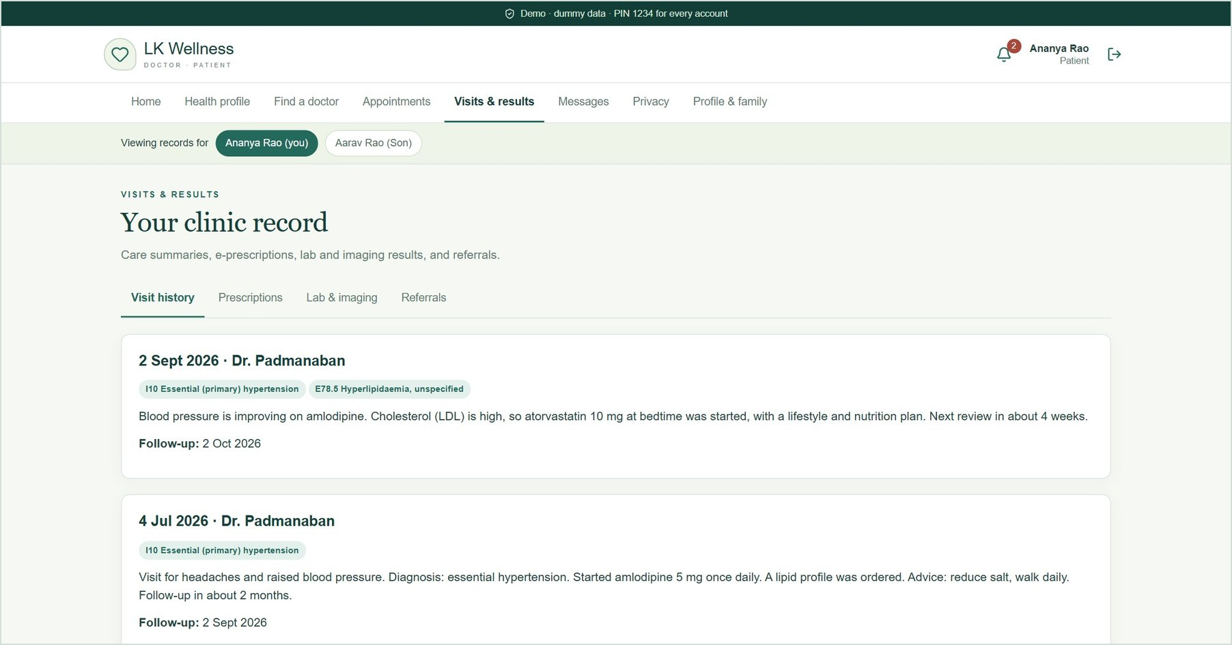
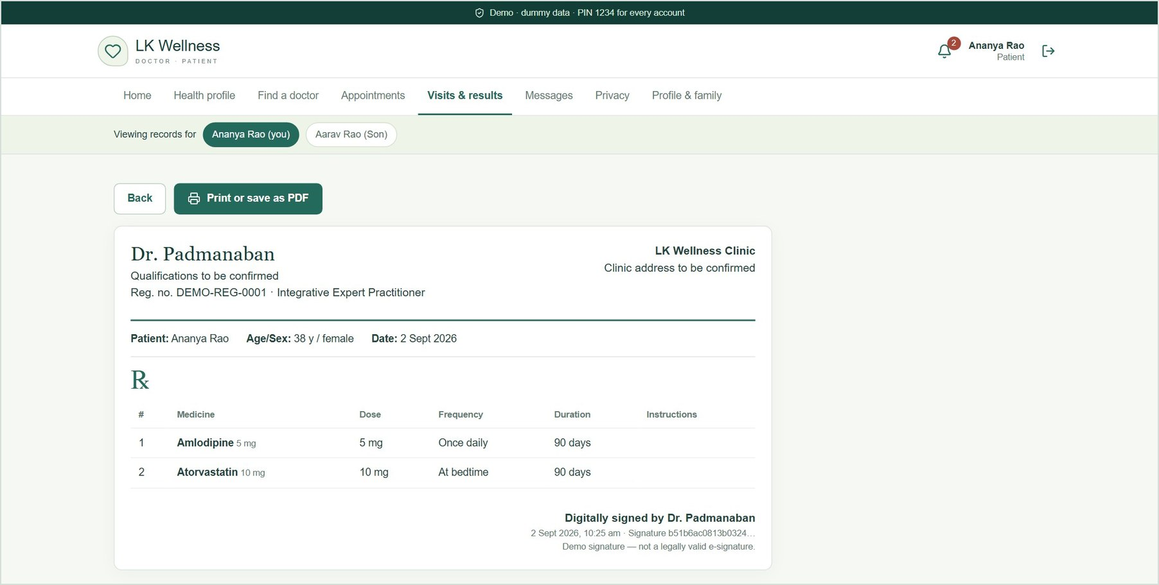
Care summaries, results and e-prescriptions
PATIENT · AFTER THE VISIT
Visit history with care summaries and ICD-10 diagnoses
Signed e-prescription, ready to print or save as PDF
Notes:
After each visit the patient sees the plain-language care summary, the diagnoses, signed e-prescriptions, and lab or imaging results with out-of-range flags. The prescription carries the doctor's registration number and a simulated digital signature. Patients can rate each visit.

Slide 9
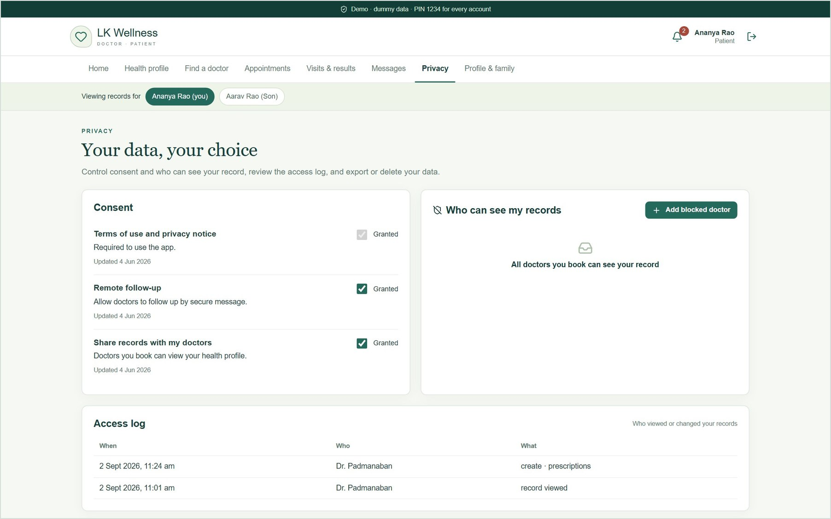
The patient controls who sees the record
PATIENT · PRIVACY
1
Consent
Terms, remote follow-up and data sharing, editable at any time.
2
Block a doctor
A blocked doctor immediately loses access to the record.
3
Access log
Who viewed or changed the record, and when.
4
Export or delete
Download all data as JSON, or delete the account and its data.
Notes:
Privacy screen. The access log shows Dr. Padmanaban's earlier views and changes. Blocking him removes Ananya from his patient list straight away.

Slide 10
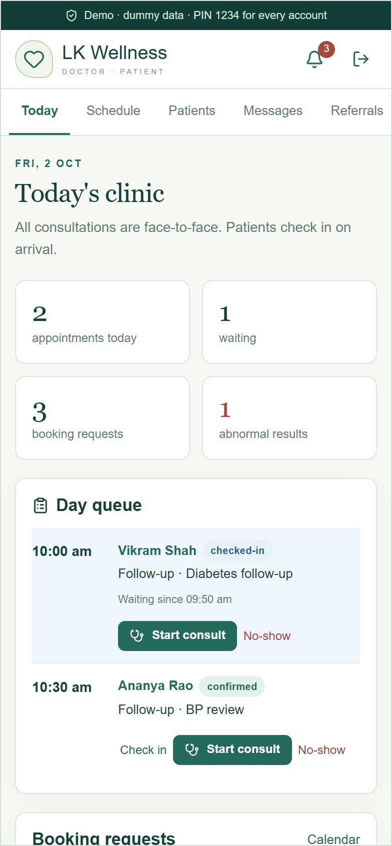
Doctor portal
02
Dr. Padmanaban, Integrative Expert Practitioner: clinic queue, schedule, patient record, consultation and safety-checked e-prescriptions.
Notes:
Sign in as padmanaban@example.com.

Slide 11
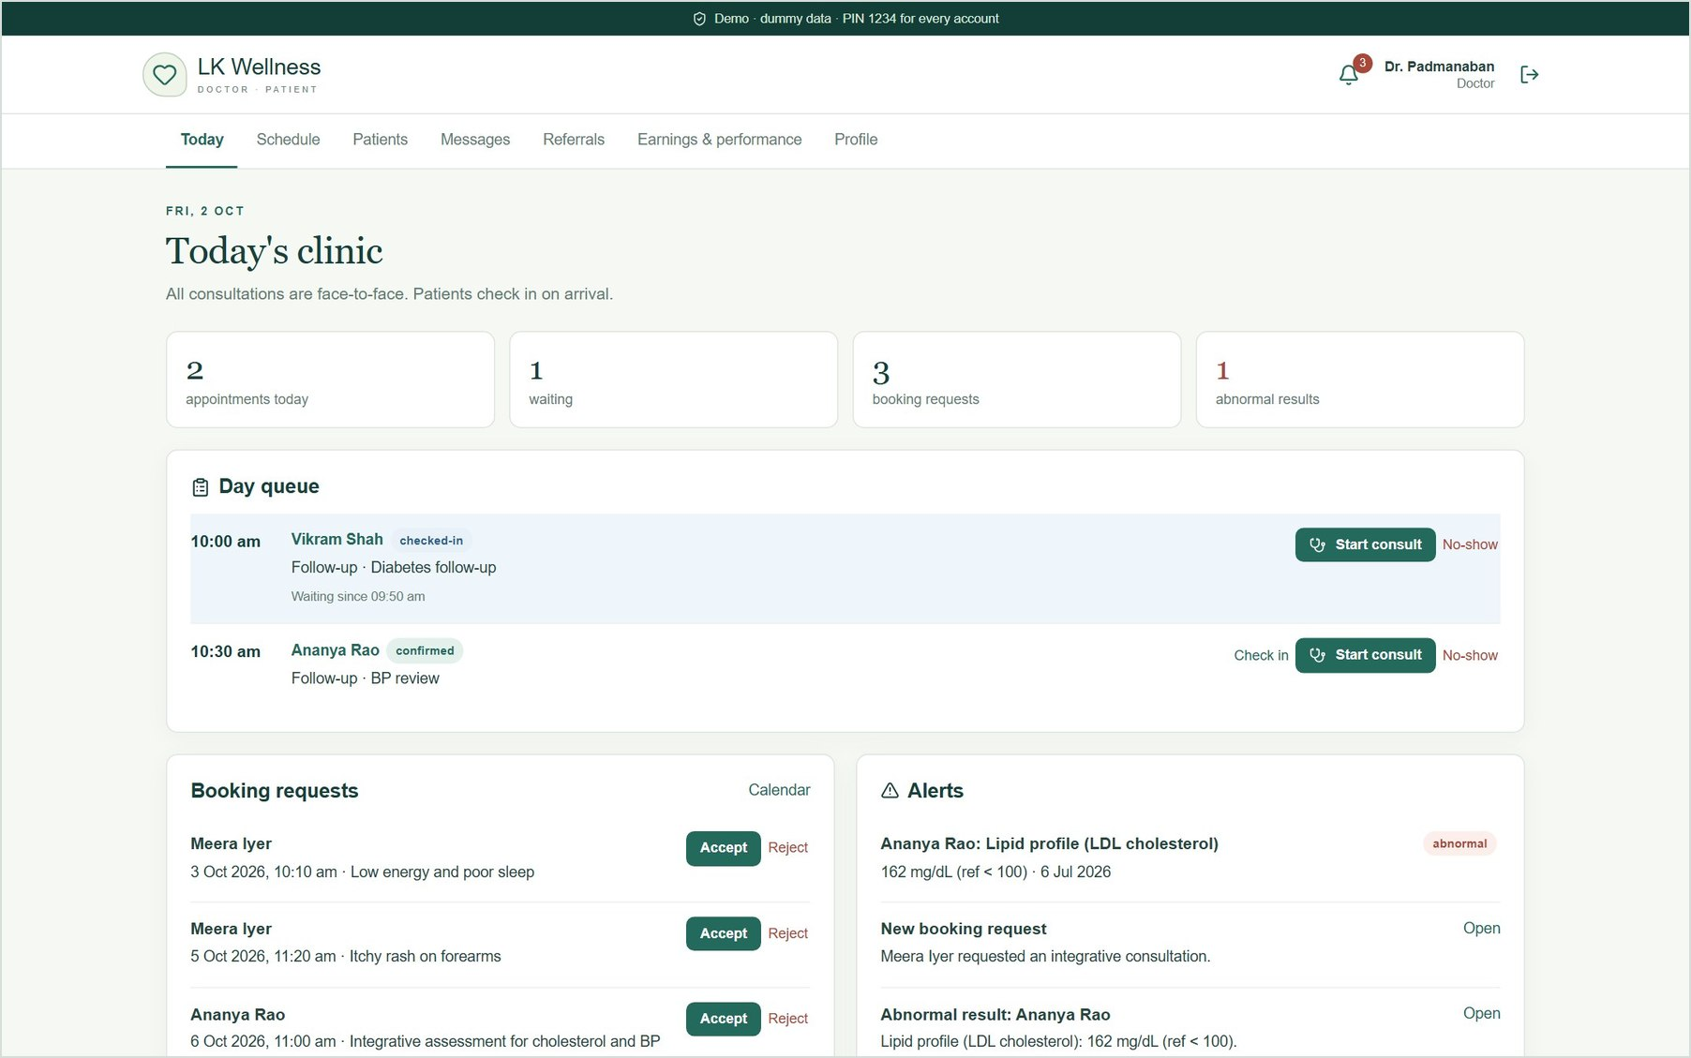
Today's clinic at a glance
DOCTOR · TODAY
1
Day queue
Patients in time order; checked-in patients are highlighted as waiting.
2
Booking requests
Accept or reject in one click.
3
Alerts
Abnormal results and new requests.
4
Start consult
Opens the consultation workspace for the patient.
Notes:
The doctor's home page. Vikram has checked in for 10:00. Ananya is due at 10:30. Accept Meera's request here, then check in Ananya and start her consultation.

Slide 12
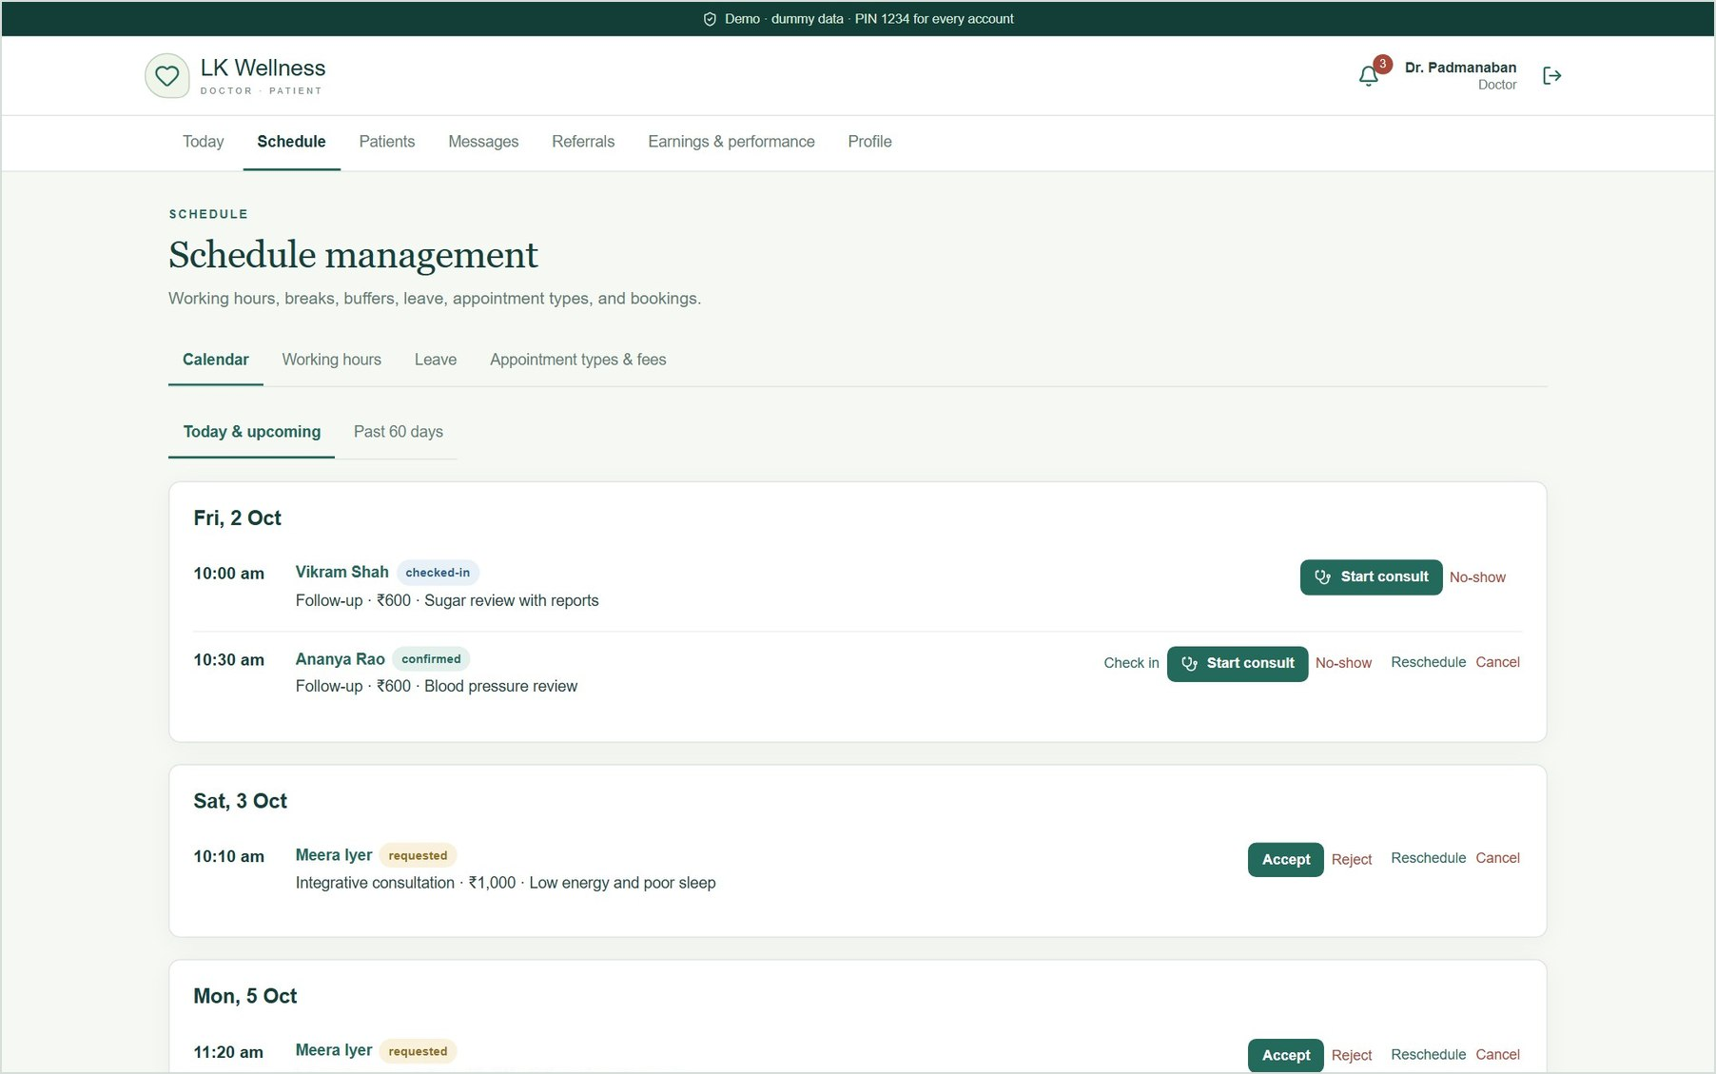
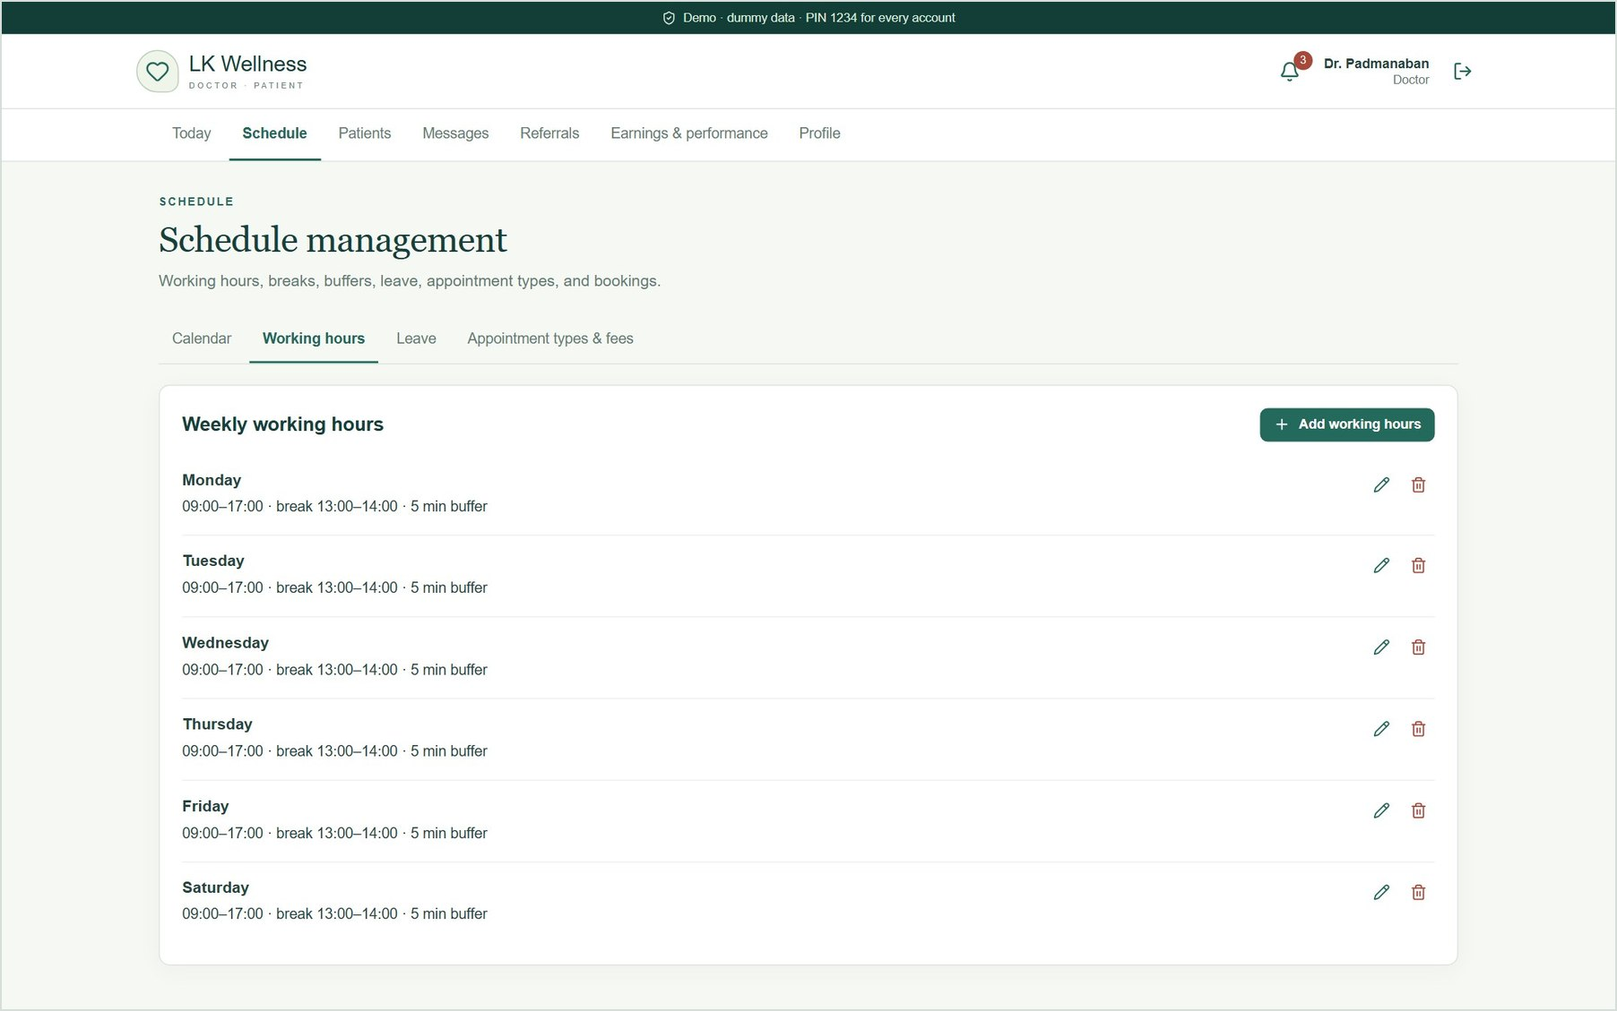
The doctor controls availability and fees
DOCTOR · SCHEDULE
Calendar: accept, reject, reschedule, cancel
Working hours with lunch break and 5-minute buffer
Notes:
Four tabs: calendar, working hours, leave, and appointment types and fees. The demo fees are an integrative consultation (30 minutes, ₹1,000) and a follow-up (20 minutes, ₹600). Patient booking slots are calculated from these settings, so changes show up immediately.

Slide 13
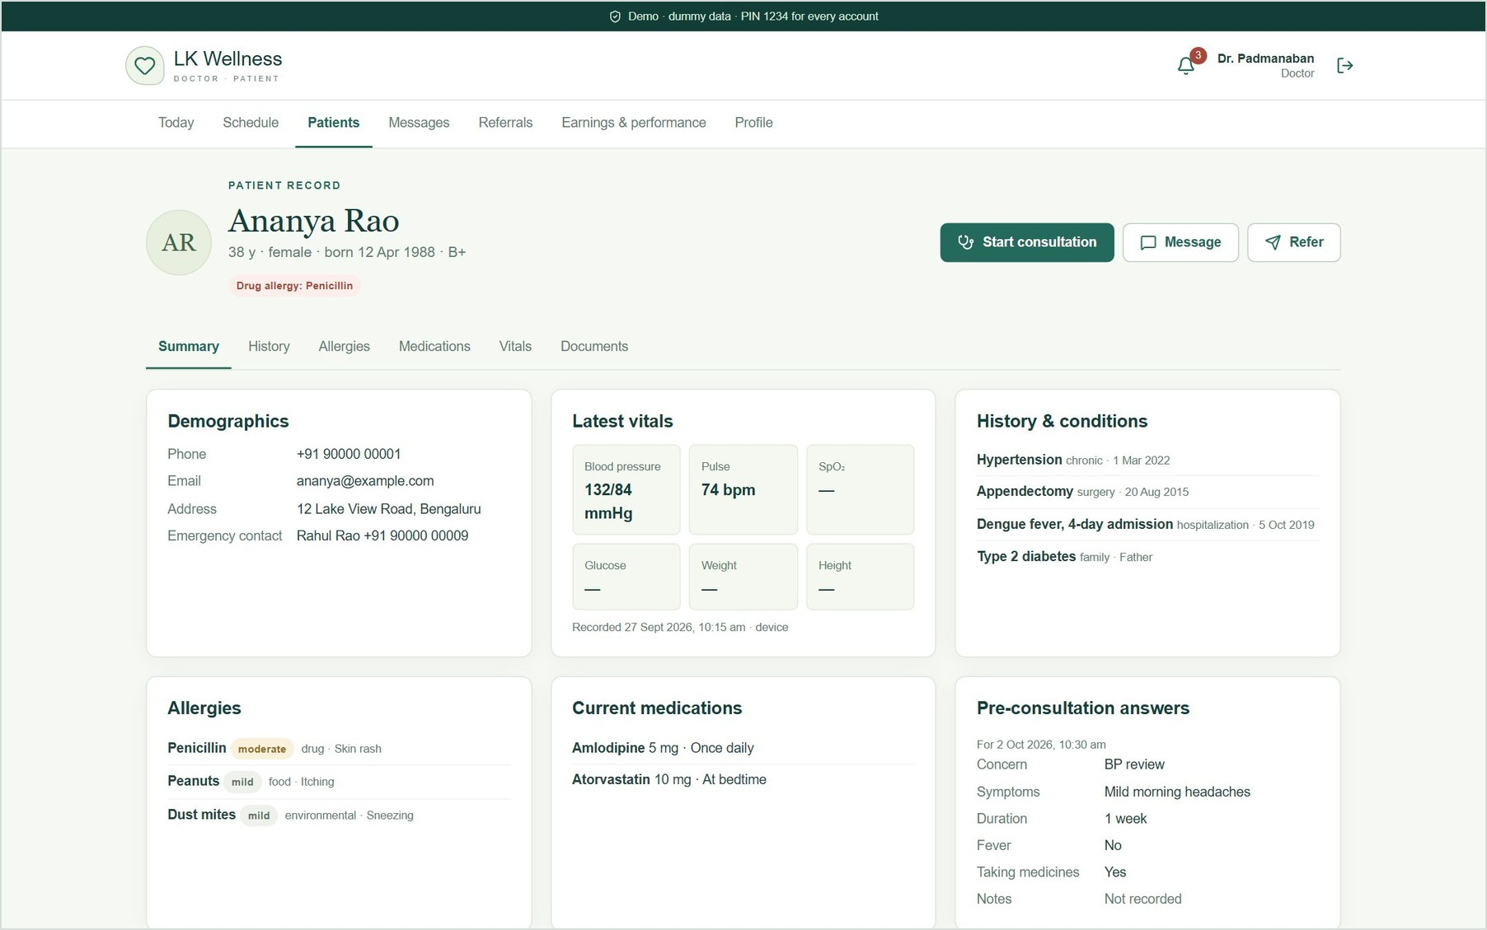
The whole patient record on one screen
DOCTOR · PATIENT RECORD
1
Summary first
Demographics, vitals, history, allergies and current medicines.
2
Pre-visit answers
What the patient told us when booking.
3
History
Past consultations, prescriptions, results and uploaded reports.
4
Access by relationship
Only patients with a booking, visit or referral appear.
Notes:
The single-screen record. The drug allergy badge sits next to the name. Doctors only see patients they have a care relationship with, and lose access if the patient blocks them.

Slide 14
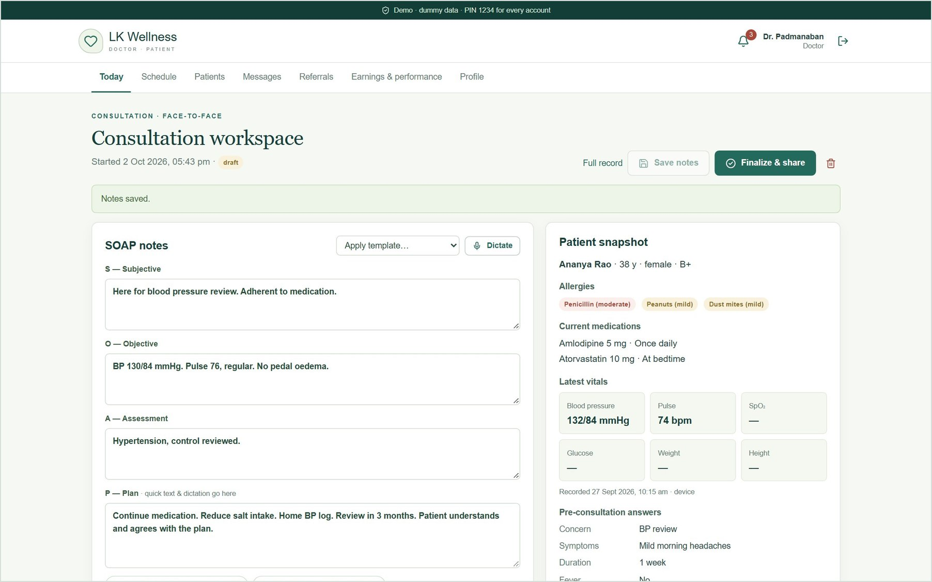
Consultation workspace
DOCTOR · CONSULTATION
1
SOAP notes
Prefilled from the pre-visit answers; templates and quick text.
2
Voice dictation
In Chrome or Edge, using the browser's speech recognition.
3
ICD-10 coding
Search by code or term (built-in demo subset).
4
Patient snapshot
Allergies, medicines and vitals stay in view.
Notes:
Apply the Hypertension review template, add a quick-text line, and code I10. Save notes. The patient snapshot on the right keeps allergies and current medicines in view while prescribing.

Slide 15
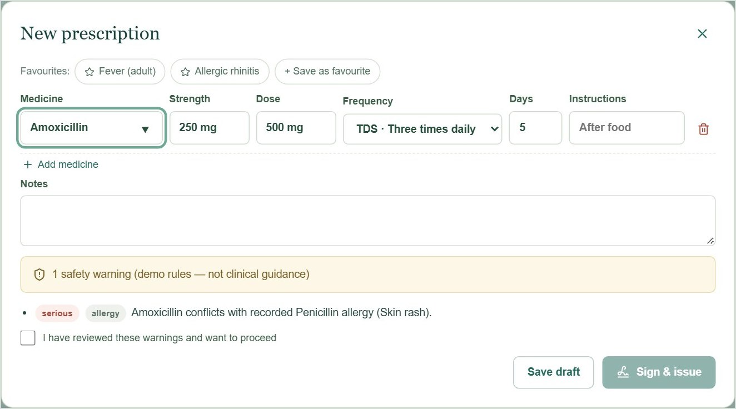
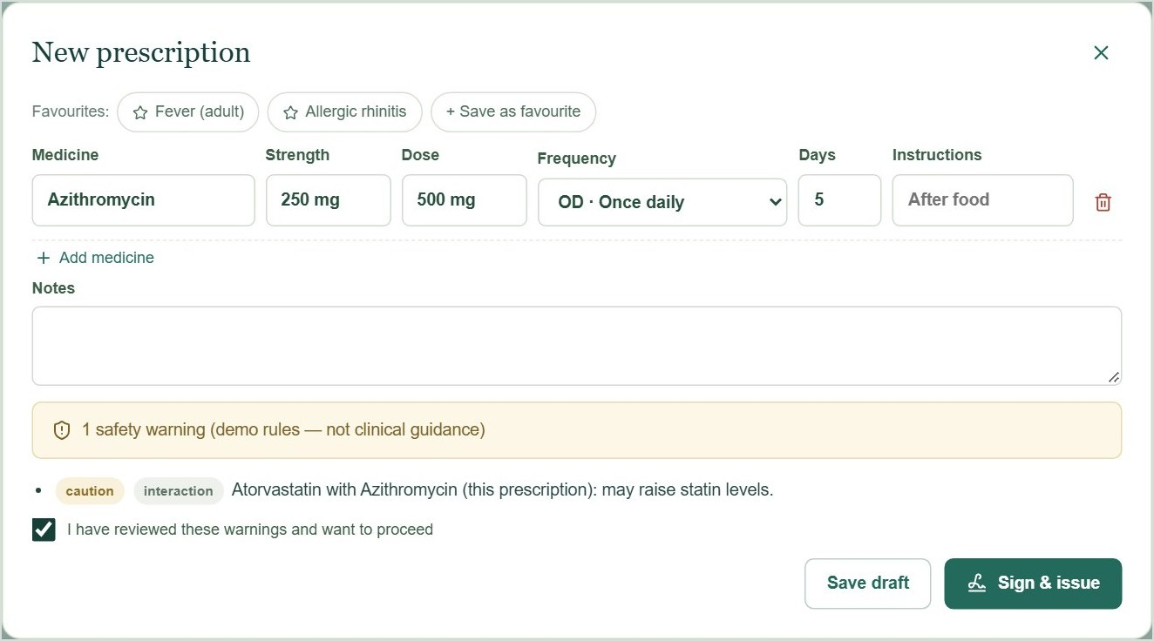
Safety checks run while the prescription is written
DOCTOR · E-PRESCRIPTIONS
Allergy conflict: signing blocked
Interaction: acknowledge, then sign
Amoxicillin for a patient with a recorded penicillin allergy. "Sign & issue" stays disabled until the warning is acknowledged.
Azithromycin with her current atorvastatin. The doctor ticks the acknowledgement, and the prescription is signed.
Checks: allergy conflicts · interactions · duplicate therapy · dose limits. Demo rules, not clinical guidance.
Notes:
New prescription: type Amoxicillin. The strength, dose and frequency fill in, and the allergy warning appears. Switch to Azithromycin: the interaction caution with atorvastatin appears. Tick the acknowledgement and click Sign & issue. Favourite prescriptions are one click away at the top.

Slide 16
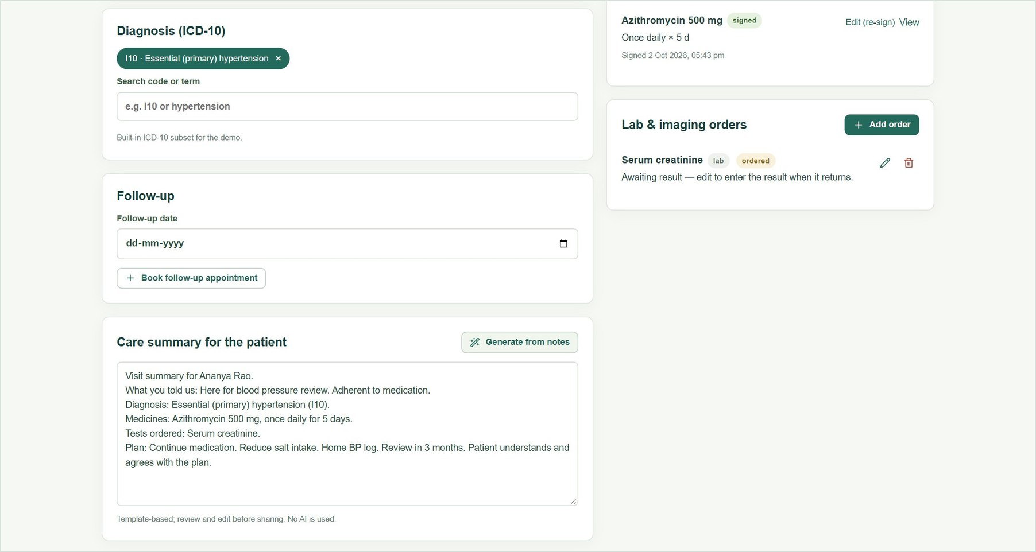
Orders, care summary, and sharing with the patient
DOCTOR · FINISHING THE VISIT
1
Lab and imaging orders
Results return to the record and raise alerts when abnormal.
2
Generate from notes
A plain-language care summary, template-based (no AI) and editable.
3
Finalize & share
The patient sees the summary and the signed prescription.
4
Complete visit
Counts towards earnings and performance.
Notes:
Add a serum creatinine order, generate the care summary, then Finalize & share and Complete visit. Switch to Ananya to show the new summary and prescription under Visits & results.

Slide 17
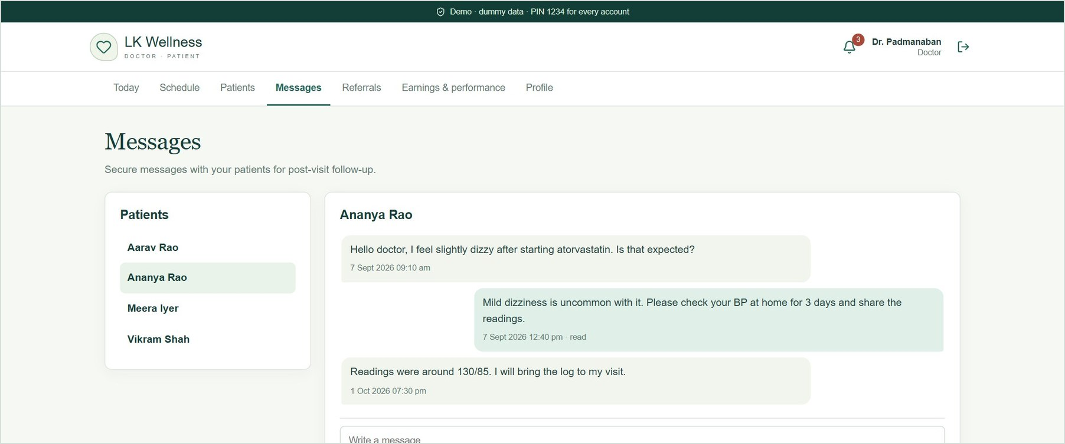
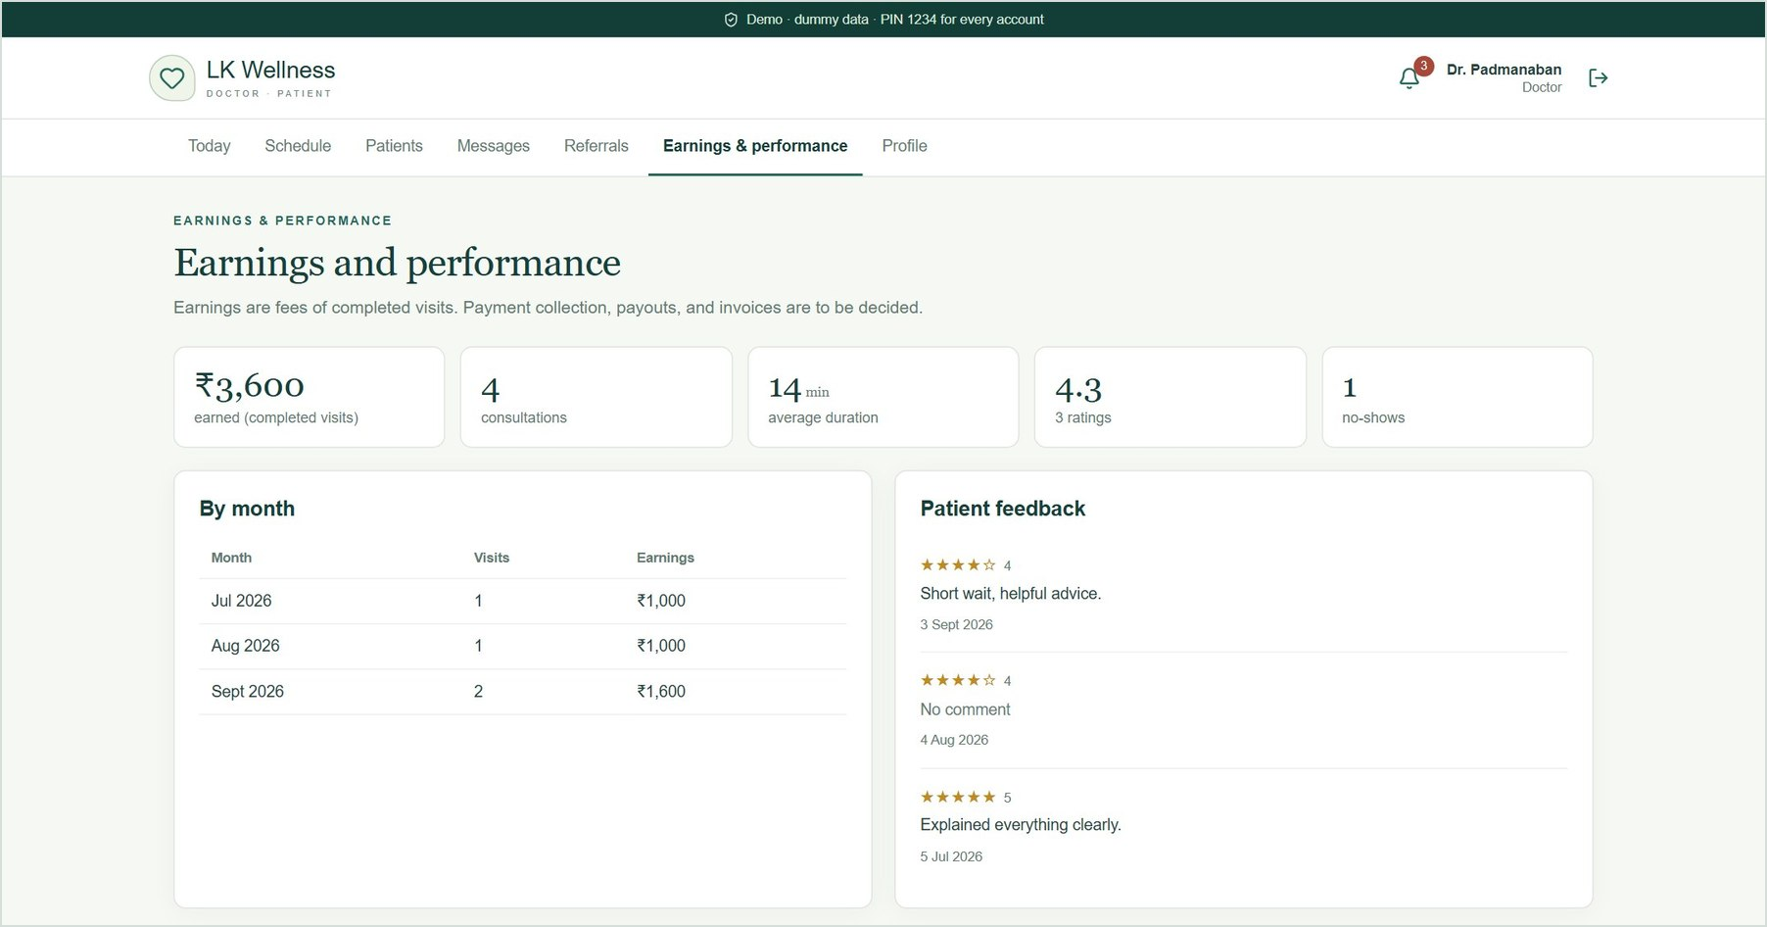
Messages, earnings and feedback
DOCTOR · CONTINUITY AND PERFORMANCE
Secure messaging with patients
Earnings from completed visits, ratings and feedback
Notes:
Secure messaging supports post-visit follow-up, with read receipts. Earnings and performance shows fees from completed visits, the number of consultations, average duration, no-shows, ratings and feedback. Payouts and invoices wait for the payments decision.

Slide 18
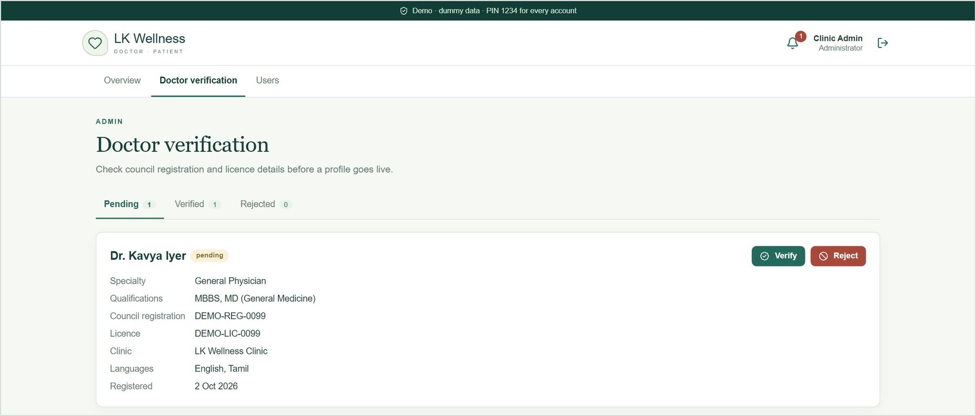
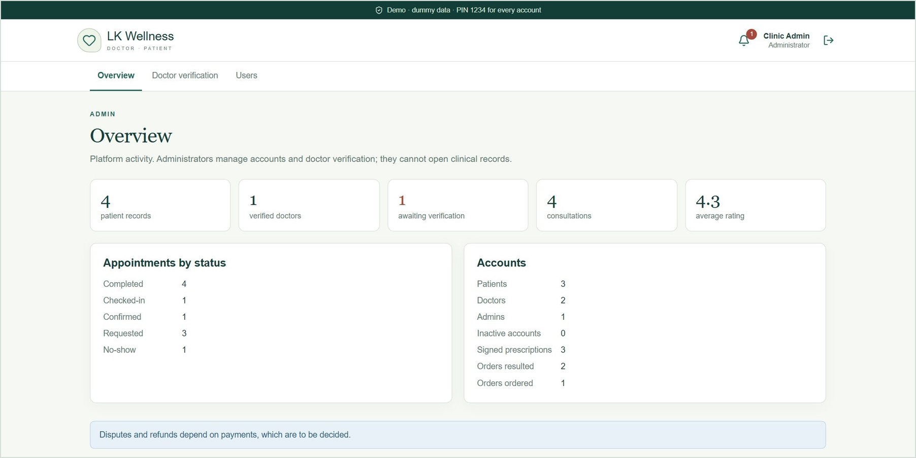
Admins verify doctors but cannot open clinical records
ADMIN
New doctors stay pending until verified
Platform overview and analytics
Notes:
Sign in as admin. A doctor who registers stays pending and is hidden from patient search until the admin checks the council registration and licence and clicks Verify. Admins manage users but never see clinical records.

Slide 19
The same app works on a phone
RESPONSIVE
1
One codebase
Patients and doctors use the same app on desktop and phone.
2
Checked automatically
Browser tests open every page at 390 px wide: no errors, no sideways scrolling.
3
Prints cleanly
E-prescriptions print or save as PDF from the browser.
Patient home
Medications and adherence
Doctor's day queue
Notes:
The layout adapts to phone screens. The menu scrolls sideways and cards stack. Every page is tested at phone width.

Slide 20
Coverage against the components document
COVERAGE
Built
Simulated
To be decided
Not in the POC
Registration, consent, family profiles
Health profile and documents
Search, booking, check-in
Schedule, leave, fees, day queue
Patient record and consultation workspace
E-prescriptions with safety checks
Orders, results, referrals, messages
Earnings, privacy controls, admin panel
SMS, email and push delivery
Device vitals
Digital signature (SHA-256 hash)
Voice dictation uses the browser
Payments, invoices, refunds
Payouts
Disputes in the admin panel
OTP, email verification, biometrics
Pharmacy routing (optional)
Encryption at rest, compliance
FHIR, SNOMED, LOINC
Notes:
Most of the document is built and working. External services are simulated so the flows work end to end. Payments are to be decided. Production sign-in, compliance, encryption at rest and health-data standards are for the next phase.

Slide 21
NEXT STEPS
Decisions for the next phase
01
Confirm the doctor's details
Registration and licence numbers, qualifications, clinic address, fees and hours (placeholders today).
04
Move to a managed database
Replace the JSON file; add encryption at rest and backups.
02
Decide on payments
Online or at the clinic, invoices, refunds and payouts.
05
Plan compliance and clinical content
DPDP (and ABDM if needed), and agreed sources for drugs and coding.
03
Choose production services
Sign-in method (OTP or passwords) and SMS, email and push providers.
All names and records in this demo are fictional dummy data.
Notes:
Close with the decisions that unblock the next phase. The doctor's registration details, qualifications and clinic address are placeholders today and print on e-prescriptions, so confirming them is the first step.

