Slide 1
Pricing Optimization & Profit Simulation Model
Business Analytics Project
Comprehensive Strategy & Risk Analysis

Slide 2
Business Problem: Pricing vs Profit Trade-off
• Pricing is a critical lever for profitability.
• Lower Price: Increases Demand/Volume but narrows Profit Margin per unit.
• Higher Price: Increases Margin but risks significant loss in Volume.
• Problem: Identifying the exact point where volume and margin intersect for maximum total profit.

Slide 3
Objective of the Model
• Determine the Optimal Price point using quantitative analysis.
• Quantify the impact of price changes on demand and total revenue.
• Assess financial risk through Monte Carlo simulations.
• Provide data-driven recommendations for pricing strategy.

Slide 4
Model Framework & Assumptions
• Demand Model: Linear/Elasticity-based decay.
• Base Price: $100.0 | Base Demand: 1000.0 units.
• Price Elasticity: -1.5.
• Variable Cost: $40.0 per unit.
• Fixed Operating Costs: $20000.0.

Slide 5
Methodology: Excel, Sensitivity & Solver
• Model Building: Created a dynamic financial model in Excel.
• Sensitivity Analysis: Generated tables to observe profit trends across price ranges.
• Solver Optimization: Used Excel Solver (GRG Nonlinear) to find the absolute profit peak.
• Simulation: Ran 500 iterations to account for market volatility.

Slide 6
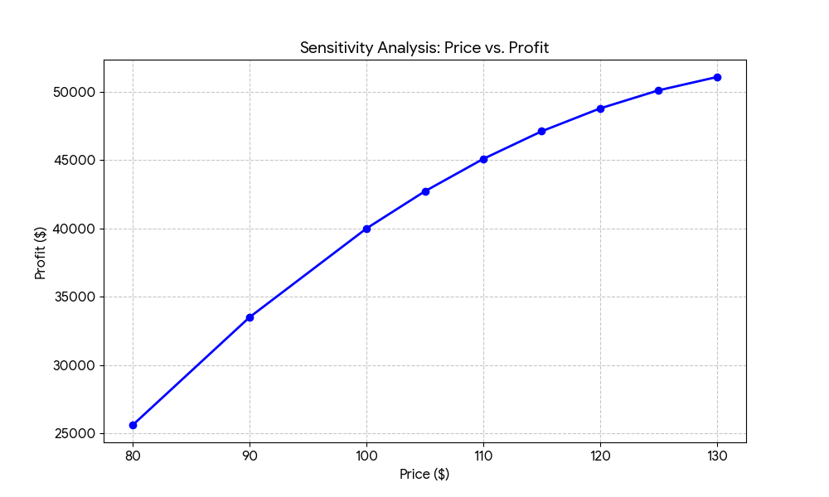
Sensitivity Analysis: Price vs Profit
Profit peaks around ₹140, indicating an optimal pricing zone which illustrates the parabolic nature of profit relative to price.

Slide 7
Optimization Results (Solver Output)
The Solver identified the following optimal configuration:
• Optimal Price: $141.43
• Projected Demand: 710 units
• Total Revenue: $100414.29
• Maximized Profit: $52014.29

Slide 8
Key Insight: Margin vs Demand Trade-off
• Critical Finding: The peak profit occurs significantly above the base price.
• Margin Gains: At $141, the margin per unit is much higher than at $100.
• Volume Threshold: Demand remains high enough at the $141 price point to sustain overhead costs.

Slide 9
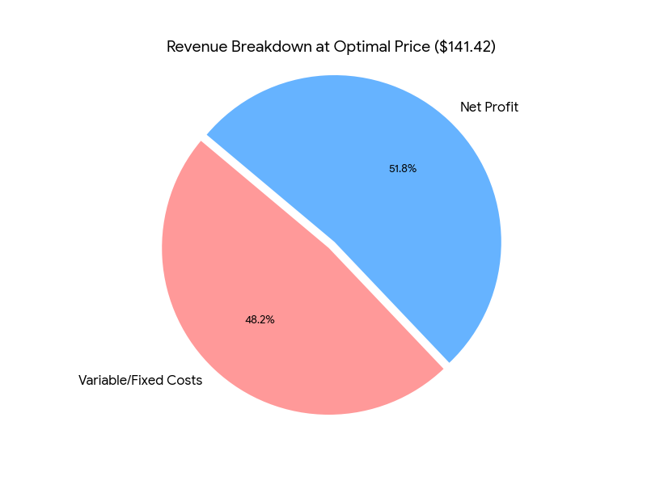
Impact of Demand Sensitivity on Pricing
• Elasticity is set at -1.5, indicating moderate price sensitivity.
• Low Price: Demand is saturated, but margins are too thin to cover fixed costs.
• High Price: Demand falls off sharply, leading to underutilization of resources.

Slide 10
Business Recommendations
1. Implement Price Increase: Move from $100 toward the $141 target.
2. Monitor Competitors: Elasticity can change if competitors lower prices.
3. Cost Control: Reducing variable costs by 10% would shift the optimal price lower and increase volume.
4. Risk Mitigation: Maintain reserves for low-demand simulation scenarios.

Slide 11
Conclusion & Key Takeaways
• Data-driven pricing eliminates guesswork in revenue management.
• The model successfully located a profit peak at $141.43.
• Simulation shows high confidence in profitability under current assumptions.
• The trade-off between volume and margin is the most vital metric for this product.

