Slide 1
COMPREHENSIVE FINANCIAL HEALTH ASSESSMENT
MAHINDRA & MAHINDRA LTD.
BY
SMRUTI RANJAN ROUT

Slide 2
AGENDA
INTRODUCTION
FINANCIAL STATEMENT OVERVIEW
FINANCIAL RATIO ANNALYSIS
SWOT ANNALYSIS
RISK ASSESSMENT
STRATEGIC RECOMMENDATION
CONCLUSION

Slide 3
INTRODUCTION
Objective
To provide actionable strategic recommendations aimed at improving the company's financial health.
Focus on cost management, revenue enhancement, risk mitigation, and investment opportunities.
Purpose of the Assessment
The primary purpose of this assessment is to conduct a thorough analysis of the company's financial health.
The evaluation aims to identify key financial strengths, weaknesses, opportunities, and risks.
Scope of the Assessment
Financial Data: Analyzing 3-5 years of financial statements, including the balance sheet, income statement, and cash flow statement.
Market Trends: Reviewing current and historical market trends to understand external influences on financial performance.
Competitor Analysis: Assessing the financial health of key competitors to benchmark performance and identify areas for improvement.
Economic Indicators: Incorporating relevant economic indicators that impact the company’s financial environment.

Slide 4
FINANCIAL STATEMENT OVERVIEW

Slide 5
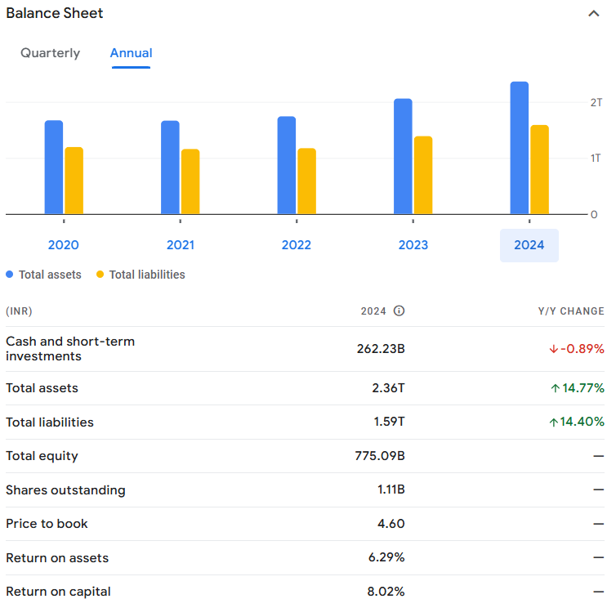
BALANCE SHEET
Total assets (blue bars) and Total liabilities (yellow bars) have increased consistently from 2020 to 2024.
In 2024, the total assets are the highest across the years shown, and liabilities have also seen a significant increase.
This balance sheet suggests a healthy growth in assets and equity, though liabilities have also grown, indicating potential leveraging or financing activities.
The returns on assets and capital are positive, reflecting efficient use of resources.

Slide 6
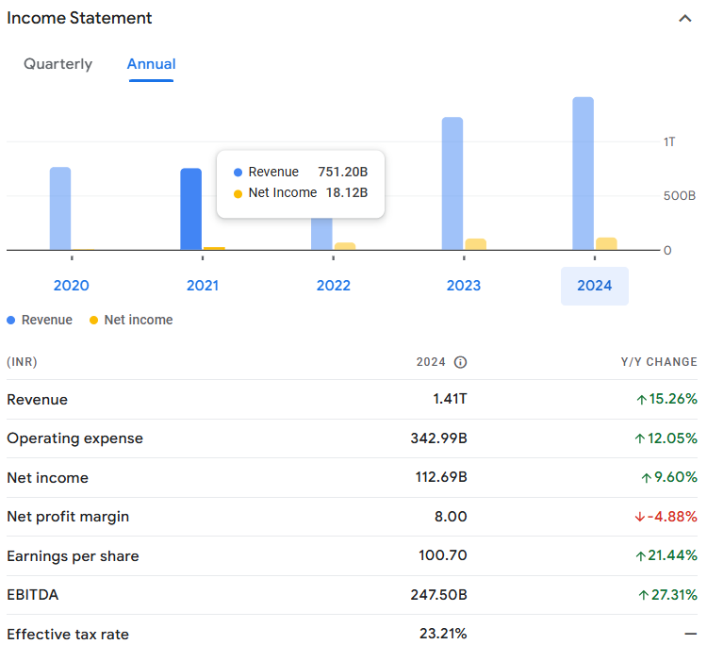
INCOME STATEMENT
Revenue (blue bars) has increased consistently from 2020 to 2024.
Net income (yellow bars) has fluctuated but shows a notable increase in 2024.
The net profit margin has decreased slightly in 2024 despite the increase in revenue and net income, indicating that profitability per unit of revenue has slightly decreased.
EBITDA shows a strong increase, reflecting higher earnings before interest, taxes, depreciation, and amortization.
This income statement reflects solid revenue growth, improved net income, and a significant rise in EPS and EBITDA, indicating a robust operational performance.
The slight decline in the net profit margin suggests that costs may have risen or that there were other financial factors impacting profitability.

Slide 7
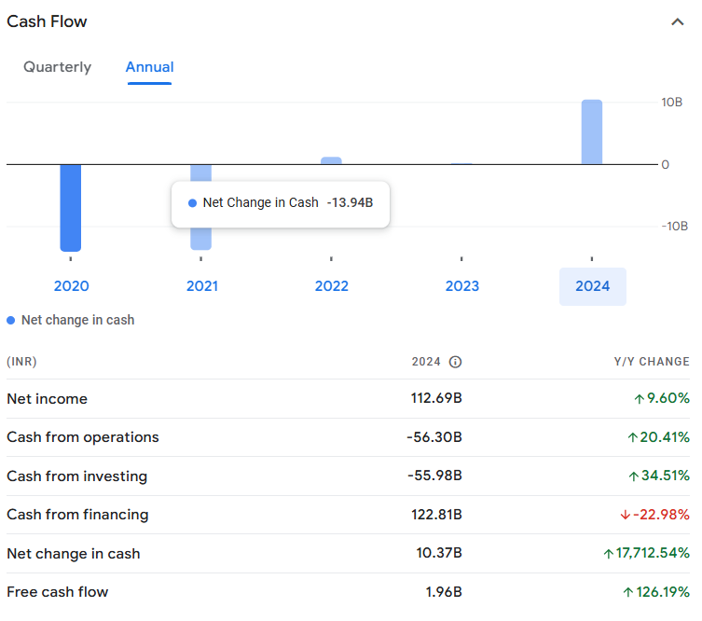
CASHFLOW STATEMENT
Net change in cash (blue bars) shows significant fluctuations, with a large increase in 2024 compared to previous years.
Net income and free cash flow have both improved in 2024.
Cash from operations and cash from investing are both negative but have improved compared to previous years.
Cash from financing has decreased, indicating less reliance on external financing or repayments of debt.
This cash flow statement reflects a significant improvement in cash flow management in 2024, with a strong increase in net cash despite challenges in operational and investing cash flows.
The increase in free cash flow and a positive net change in cash are positive indicators of the company's financial health.

Slide 8
FINANCIAL RATIO ANALYSIS

Slide 9
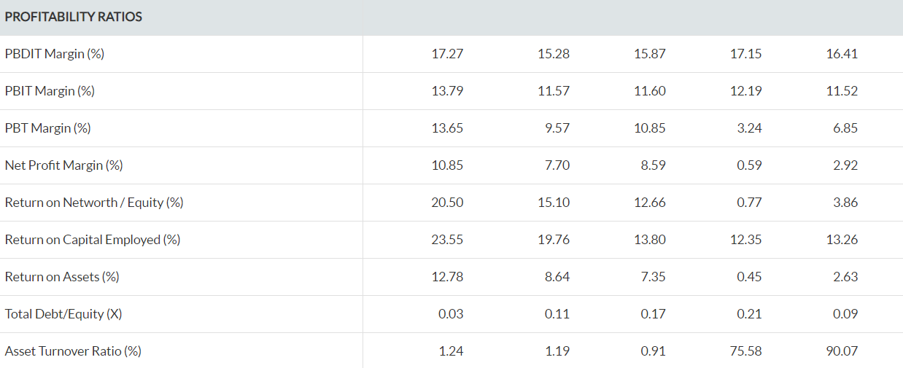
PROFITABILITY RATIO

Slide 10
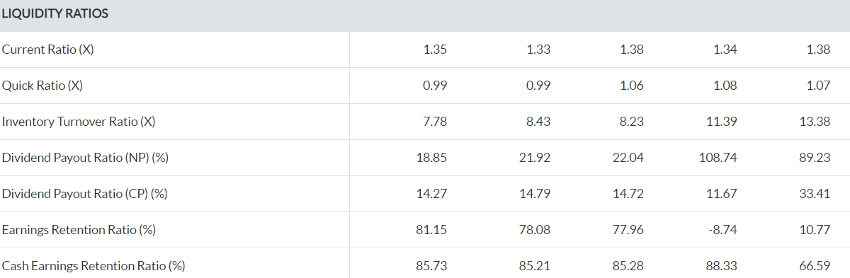
LIQUIDITY RATIO

Slide 11
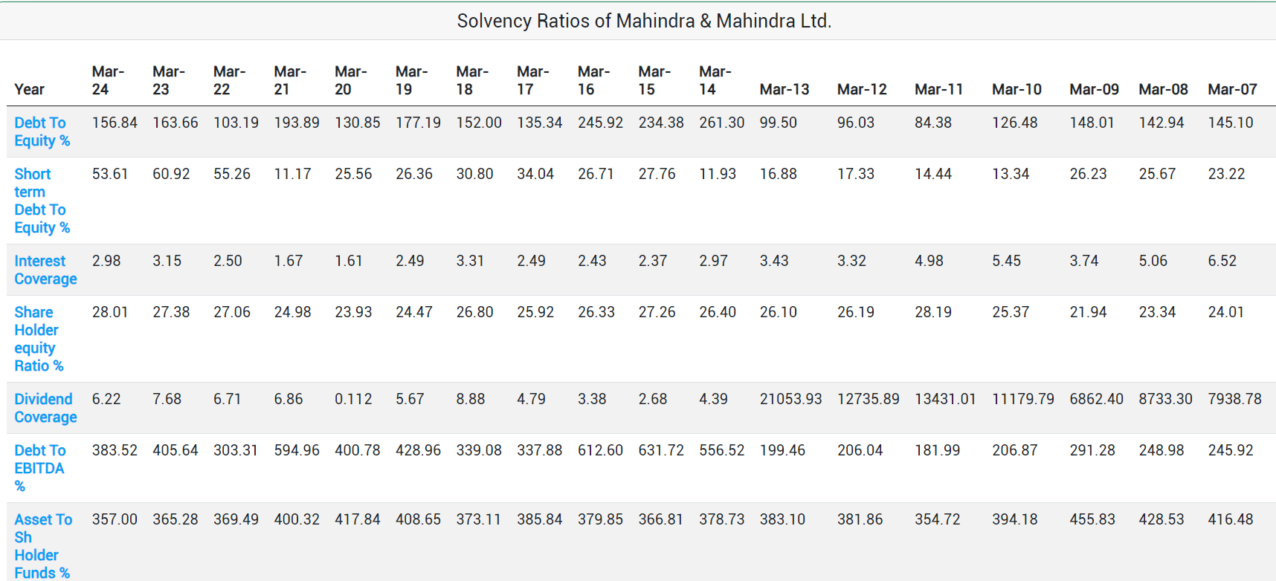
SOLVENCY RATIO

Slide 12
SWOT ANALYSIS

Slide 13
STRENGTHS
Business strengths are competitive advantages that allow a firm to outcompete, generate value and achieve efficiency.
Market Leader in Multiple Automotive Segments: Mahindra & Mahindra has a leading market share in tractors as well as in the utility vehicles segment.
Strong Research & Development (R&D): M&M has a highly focused R&D department constantly focusing on developing new products and technologies.
Excellent Products According to Indian Road Conditions: Mahindra & Mahindra's SUVs are suited perfectly to Indian road conditions especially, Mahindra Scorpio which has been an outstanding performer for many years.
• Low After-Sale Cost: M&M has a competitive advantage on after-sale cost since it is lower than the industry average and also has a high availability of spare parts in different parts of the country.
• E-commerce: One of the biggest strengths of M&M is that with the use of e-commerce M&M is achieving results from both sides one in which the business wants to head from an outcomes point of view and how digitalization in business can help them achieve those results, and another side is addressing the needs of their customers.

Slide 14
THREATS
Threats include anything that can negatively affect your business from the outside, such as supply-chain problems, shifts in market requirements, or a shortage of recruits.
Competition in Other Businesses Puts Pressure on M&M: Mahindra group faces strong competition in other businesses as well.
Stringent Regulations: M&M is subject to strict regulations by the government and environmental agencies in terms of emission levels, noise levels, etc. Such regulations keep changing and thus increase compliance costs for the companies.
It's vital to anticipate threats and to take action against them before you become a victim of them and your growth stalls.

Slide 15
WEAKNESSES
A company weakness is any resource or process that your business lacks but needs to succeed. Weaknesses limit your company's ability to reach its full potential.
Geographic Dependence: Mahindra & Mahindra is dependent on the majority of its revenue (over 60%) from India, which would affect its business in case of any economic slowdown or high inflation.
Overdependence on the Automotive Industry: Mahindra & Mahindra's major part of revenues comes from its automotive business which makes it vulnerable to any breakthrough in the industry or slowdown in the market.
Product Recalls Affect Brand Image: Mahindra & Mahindra has had to recall many of its products in the recent past. For instance, In February 2015, M&M recalled XUV500 manufactured before July 2014. Such incidents affect the brand image of the company and consequently affect sales.

Slide 16
OPPORTUNITIES
In the market, there also exist a lot of opportunities through which a company can grow. Let's see some among them.
• Growth in the Indian Automotive Industry: The Indian automotive industry is growing year on year with over 12% growth from the previous 3 years. The industry is expected to grow at a CAGR of 13% in the next 4 years. This growth can be beneficial for M&M.
• Increasing Demand for Hybrid Electric Vehicles: There is an increasing demand for Hybrid Electric Vehicles (HEVs) around the world. The demand for HEVs is expected to grow at a CAGR of 19% in the next 3 years. M&M has a strong portfolio of HCVs and is set to benefit from the growing demand.
Emerging Nations: M&M should look forward to tapping the emerging nations around the world that have high potential. M&M should build over its global footprint to tap emerging markets.

Slide 17
RISK ASSESSMENT

Slide 18
COST MANAGEMENT
Operational Efficiency:
Lean Manufacturing: Mahindra & Mahindra Ltd. focuses on lean manufacturing principles to streamline production processes, reduce waste, and enhance efficiency. For example, the company has implemented initiatives to optimize production lines in its automotive and tractor divisions.
Cost Control Measures:
Regular audits and cost control measures are employed to identify and eliminate inefficiencies. The company uses tools like Six Sigma to improve process quality and reduce operational costs.
Supply Chain Optimization:
Vendor Management: The company collaborates with suppliers to negotiate better terms and prices. Strategic sourcing and long-term partnerships with key suppliers help in securing favorable pricing and reducing supply chain costs .
Inventory Management: Advanced inventory management systems are utilized to minimize carrying costs and reduce excess inventory. This includes Just-in-Time (JIT) inventory practices to lower holding costs.

Slide 19
REVENUE ENHANCEMENT
Product Diversification:
New Product Launches: Mahindra & Mahindra Ltd. regularly introduces new products and models to cater to different customer segments. Recent launches in the automotive and agricultural sectors help attract new customers and retain existing ones.Geographic Expansion: Expanding into new geographic markets is a key revenue strategy. The company has been exploring opportunities in emerging markets and international expansion to increase its market presence.
Marketing and Sales Strategies:
Digital Marketing: Leveraging digital marketing strategies, including social media and online advertising, helps in reaching a broader audience and driving sales.Sales Promotions: The company runs various sales promotions, discounts, and incentives to boost sales and attract customers. For instance, seasonal promotions and trade-in offers can drive higher sales volumes.
Customer Experience Improvement:
Enhanced Service Offerings: Improving customer service and after-sales support enhances customer satisfaction and loyalty. Offering value-added services can lead to repeat business and referrals .
Customer Feedback: Utilizing customer feedback to refine products and services helps in aligning offerings with market needs, leading to increased sales.

Slide 20
INVESTMENT OPPORTUNITIES
Technology and Innovation:
R&D Investments: Investing in research and development (R&D) for new technologies and innovative products is crucial for growth. For example, Mahindra & Mahindra Ltd. invests in electric vehicle (EV) technology and advanced agricultural machinery.
Digital Transformation: Investment in digital technologies and IT infrastructure supports operational efficiency and innovation. This includes advancements in manufacturing technologies and digital customer engagement platforms.
Strategic Acquisitions:
Mergers and Acquisitions: The company explores strategic acquisitions to enter new markets, acquire technology, and enhance its product portfolio. Recent acquisitions may include companies in automotive, agribusiness, or related sectors.
Joint Ventures: Forming joint ventures and partnerships with other firms can provide access to new technologies, markets, and distribution channels.

Slide 21
STRATERGIC RECOMENDATION

Slide 22
OUTLINE ACTIONABLE STEPS FOR EACH RECOMENDATION
Develop a Comprehensive Digital Strategy:
Conduct a digital maturity assessment.
Define clear objectives and KPIs for digital transformation.
Invest in Advanced Technologies:
Identify key areas for technological investment (e.g., IoT, AI, blockchain).Pilot new technologies in select departments.
Pilot new technologies in select departments.
Identify New Market Opportunities:
Conduct market research to identify high-growth regions.
Analyze competitive landscape and customer needs in target markets
Localize Products and Services:
Adapt product designs and features to meet local preferences and regulations.
Set up regional R&D teams to support localization.
Strengthen Distribution Channels:
Evaluate and select distribution partners or establish regional hubs.
Invest in logistics and infrastructure improvement

Slide 23
SHORT TERM GOALS(1-2YEARS)
Market Expansion:
Objective: Increase market share in existing markets or enter new regional markets.
Actions: Launch new marketing campaigns, enhance distribution networks, or tailor products to local preferences
Product Development:
Objective: Introduce or upgrade products to meet current market demands.
Actions: Accelerate R&D efforts, streamline production processes, or release new models.
Operational Efficiency:
Objective: Improve operational efficiencies to reduce costs and enhance productivity.
Actions: Implement lean manufacturing principles, upgrade technology, or optimize supply chain management.
Customer Satisfaction:
Objective: Enhance customer service and satisfaction levels.
Actions: Implement feedback mechanisms, improve after-sales service, or address common

Slide 24
LONG TERM GOALS(3-5+YEARS)
Sustainability and Innovation:
Objective: Lead in sustainable practices and innovation in the automotive and other sectors.
Actions: Invest in electric and hybrid vehicles, develop eco-friendly technologies, or pursue sustainable business practices.
Global Leadership:
Objective: Strengthen position as a global leader in key markets and industries.
Actions: Expand global presence through strategic partnerships, acquisitions, or market penetration strategies.
Diversification:
Objective: Continue diversifying product and service offerings to reduce dependency on specific markets or sectors.
Actions: Explore new business lines or industries, and invest in emerging technologies and sectors.
Technological Advancement.
Objective: Stay at the forefront of technological advancements.
Actions: Invest in research and development, foster innovation, and adopt cutting-edge technologies in products and processes.

Slide 25
CONCLUSSION

Slide 26
In summary, our analysis of Mahindra & Mahindra Ltd. reveals several key findings.
Market Positioning and Growth Opportunities: Mahindra & Mahindra is well-positioned in the automotive and agribusiness sectors, with significant growth opportunities in emerging markets and electric vehicle (EV) segments. The company's strong brand equity and diversified portfolio provide a solid foundation for expansion.
Innovation and Sustainability: Investing in innovation, particularly in EV technology and sustainable practices, is crucial for maintaining competitive advantage and meeting evolving consumer expectations. Mahindra's commitment to sustainability can also enhance its market reputation and appeal to environmentally-conscious customers.
Recommendations:
Expand EV Portfolio: Accelerate the development and marketing of electric vehicles to capture the growing demand for eco-friendly transportation options.
Enhance Operational Practices: Implement advanced technologies and lean management techniques to boost efficiency and reduce operational costs.
.

Slide 27
THANK YOU

