Slide 1

AI/ML BASED SIGN LANGUAGE TRANSLATOR USING RASPBERRY PI
Robotics Programming Workshop -1 (CSE 3197)
Section: 23412’O’3 Group No. 7
Members:
Swayam Das 2341004102
Anubhab Patra 2341016261
Smruti Sourav Mishra 2341013151
S Jayant Kumar 2341011103
Saadiya Farheen 2341006003
Veetesh Sinha 2341019574
Under the supervision of:
Dr. Shaktijeet Mohapatra,
Dr. Bhanja Kishor Swain
Department of CIOT
Centre for IoT, ITER, Siksha ‘O’ Anusandhan (Deemed to be University), Bhubaneswar

Slide 2
Contents
Aim
Introduction
Project objectives
Block diagram
Hardware and Working Summary
Circuit diagram
Software & Working Summary
Project status
References

Slide 3
Aim
To develop a real-time, sensor-based sign language translation system using a smart glove equipped with flex sensors, an MPU6050, an ESP32, and a Raspberry Pi, which accurately captures hand and finger movements and uses machine learning to translate gestures into text or speech, enabling seamless communication for hearing and speech-impaired individuals.

Slide 4
Introduction
Sign language is vital for hearing and speech-impaired people.
Most people don’t understand sign language, causing communication barriers.
The project uses a sensor-based smart glove for improved privacy, reliability, and offline use. With flex sensors, an MPU6050, and an ESP32 paired with a Raspberry Pi, the system captures hand gestures through sensor fusion and translates them into text or speech using machine learning.

Slide 5
Literature survey
1. Priya et al. (2019) – CNN-Based ASL Recognition
What they did:
They developed a Convolutional Neural Network (CNN) model to classify American Sign Language gestures from images, achieving high accuracy using static hand poses.
What inspired us:
Their work showed how machine learning can accurately interpret gestures, motivating us to apply ML to a sensor-based approach instead of camera-based detection.
2. Kumar & Reddy (2020) – Gesture Recognition Using OpenCV and SVM
What they did:
They implemented a system using OpenCV image processing and Support Vector Machine (SVM) to recognize real-time hand gestures through a webcam.
What inspired us:
Their project demonstrated the effectiveness of combining real-time data + ML classification, which inspired us to design a real-time sensor glove for speed, accuracy, and privacy.

Slide 6
Project objectives
Develop a wearable smart glove that translates gestures into text in real-time.
Capture finger bending (flex sensors via MCP3008) and hand orientation (MPU6050).
Transmit sensor data wirelessly via Bluetooth from ESP32 to Raspberry Pi 4.
Perform gesture recognition and mapping to letters/words on Raspberry Pi 4.
Display translated text instantly on SSD1306 OLED screen.
Provide an affordable, lightweight, and user-friendly communication aid for hearing-impaired individuals.

Slide 7
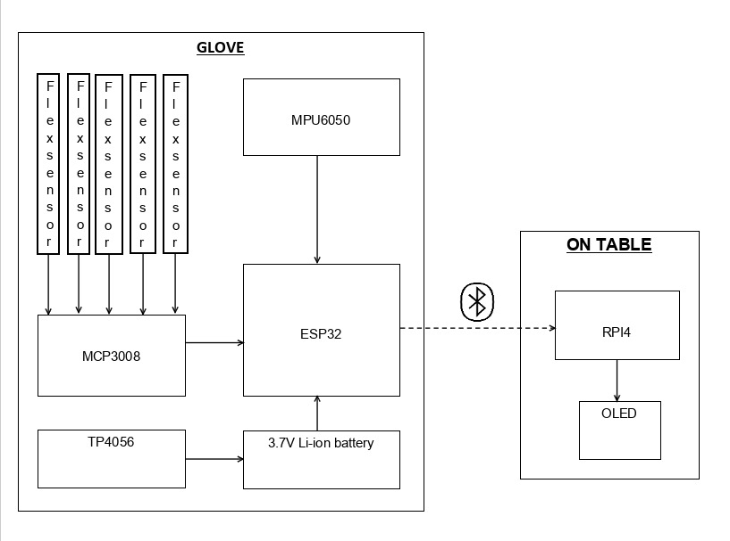
Block Diagram
Sensors Used:
1. Flex Sensors (5 units)
Measure bending of each finger.
Output analog voltage proportional to finger flex.
2. MPU6050 (IMU Sensor)
Contains 3-axis accelerometer.
Contains 3-axis gyroscope.
Measures hand orientation, movement, tilt, rotation.

Slide 8
Hardware and Working Summary
1. Flex Sensors
Five flex sensors measure finger bending. Their analog outputs are sent to the MCP3008 for conversion.
2. MCP3008 (ADC)
Converts flex-sensor analog signals into digital values and sends them to the ESP32.
3. MPU6050 (Accelerometer + Gyroscope)
Provides hand-motion, tilt, and orientation data to the ESP32 via I2C.
4. ESP32 (Secondary Controller + Bluetooth)
Processes all sensor data and transmits the gesture information to the Raspberry Pi over Bluetooth.
5. Power Section (TP4056 + AMS1117 + Li-ion Battery)
Supplies regulated power and handles battery charging for the entire glove.
6. Raspberry Pi 4
Receives Bluetooth data, interprets gestures, and generates the output.
7. OLED Display
Displays the recognized gesture or text output.

Slide 9
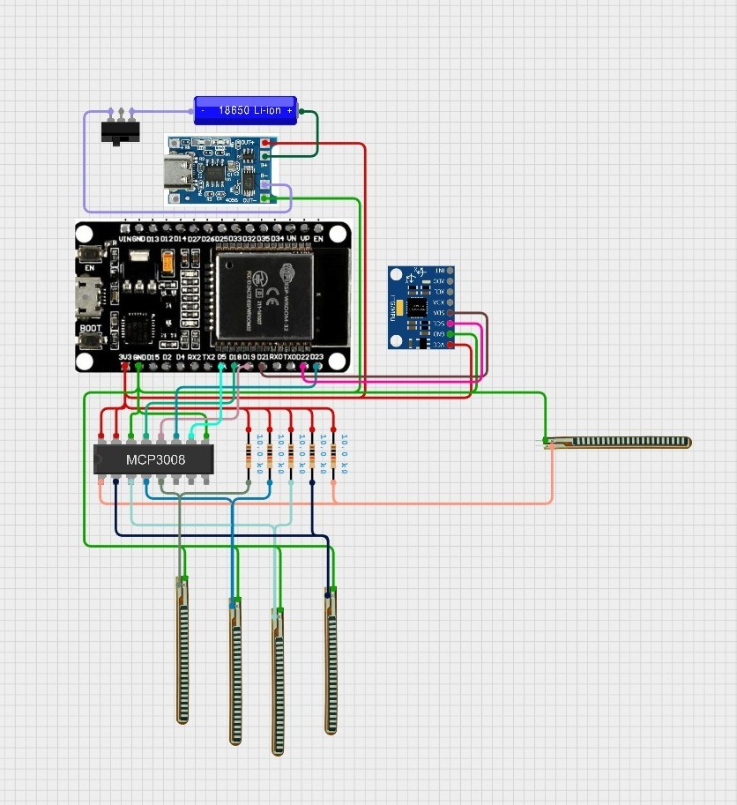

Circuit diagram
Flex sensor
OLED
MCP3008
3.7 battery
-----------------
MPU6050
ESP32
raspberry pi 4
AMS1117
TP4056
Flex sensors and MPU6050 with ESP-32

Slide 10
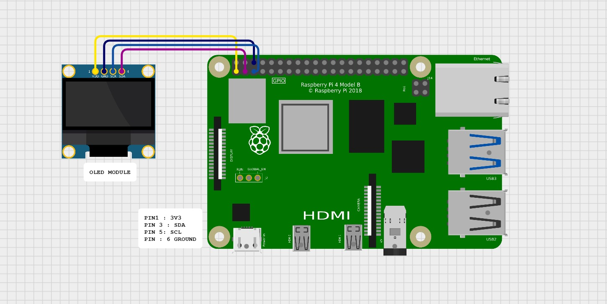
OLED with RPi4

Slide 11
Software & Working Summary
1. System Overview
  The system consists of two main modules:
  Sensor Glove Unit (ESP32) – collects raw sensor data.
  Processing Module (Raspberry Pi) – interprets gestures and outputs text.
2. Sensor Glove Unit (ESP32)
  2.1 Flex Sensor Measurement
  Each finger has a flex sensor forming a voltage divider.
  Bending changes the sensor resistance → voltage changes.
  Voltages are read through MCP3008 ADC (10-bit digital values) via SPI.
  2.2 Motion & Orientation (MPU6050)
  3-axis accelerometer + 3-axis gyroscope.
  Measures hand tilt, wrist orientation, and dynamic motion.
  Communicates via I²C.
  2.3 Data Fusion & Transmission
  Transmits data wirelessly via Bluetooth to Raspberry Pi.
  ESP32 combines flex + accel + gyro readings into a JSON packet.

Slide 12

Packets in comma separated value format:

Slide 13
Software & Working Summary
3. Processing Module (Raspberry Pi)
  The Raspberry Pi receives sensor data from the ESP32 via Bluetooth, parses it, and prepares it for recognition. It then uses machine-learning models (such as Random Forest, SVM, or lightweight neural networks) to identify gestures based on finger bends, movement, and orientation. Once a gesture is recognized, the Pi converts it into text and displays the result on the OLED screen or console in real time.

Slide 14
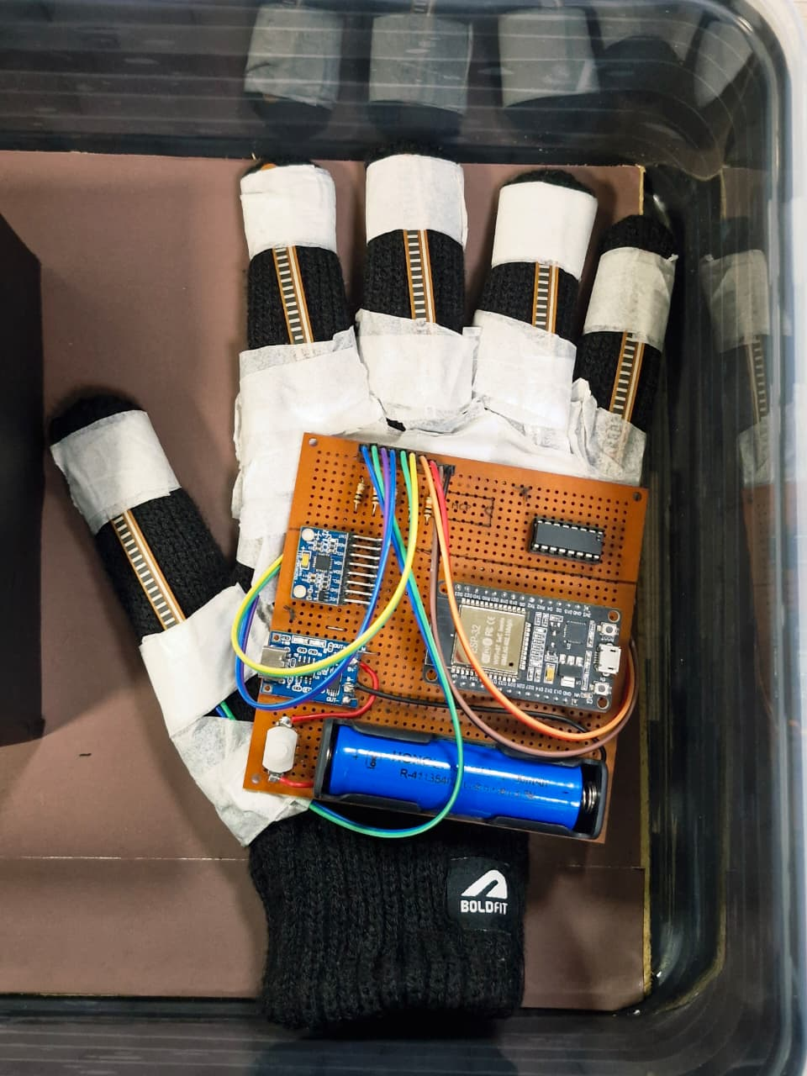
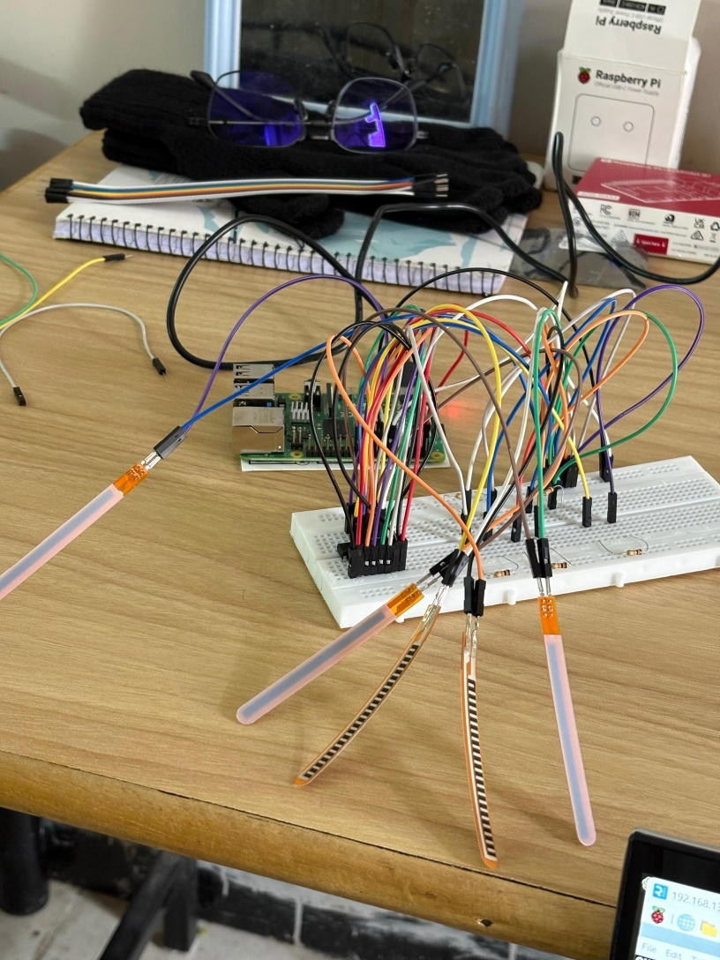
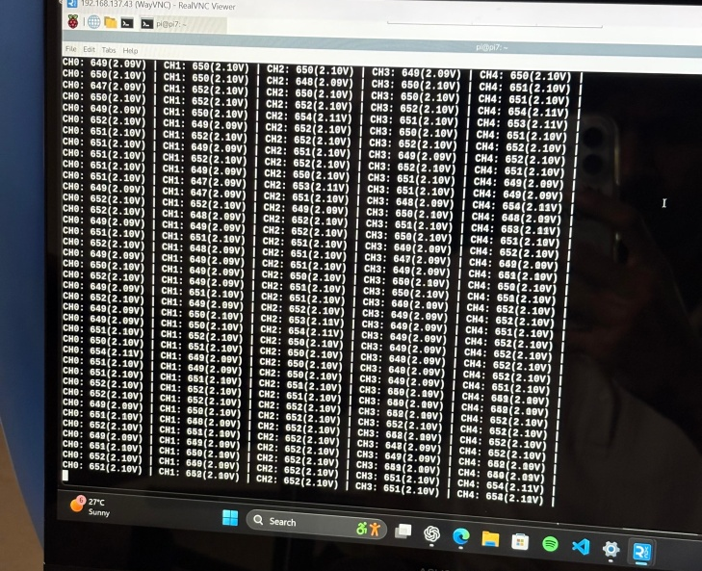
Glove unit with esp32
Breadboard prototype
Data samples

Slide 15
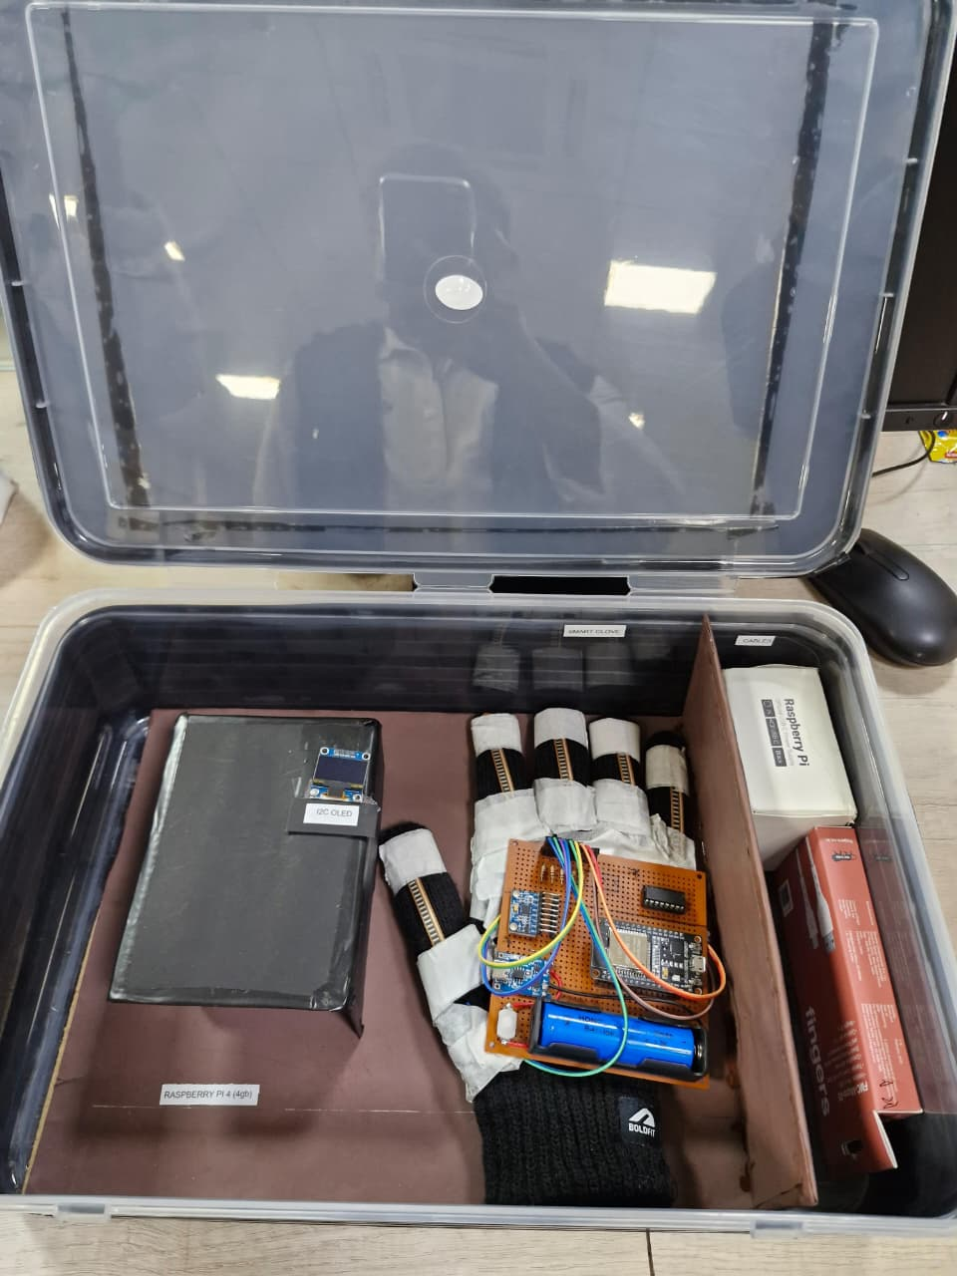
Final Prototype

Slide 16
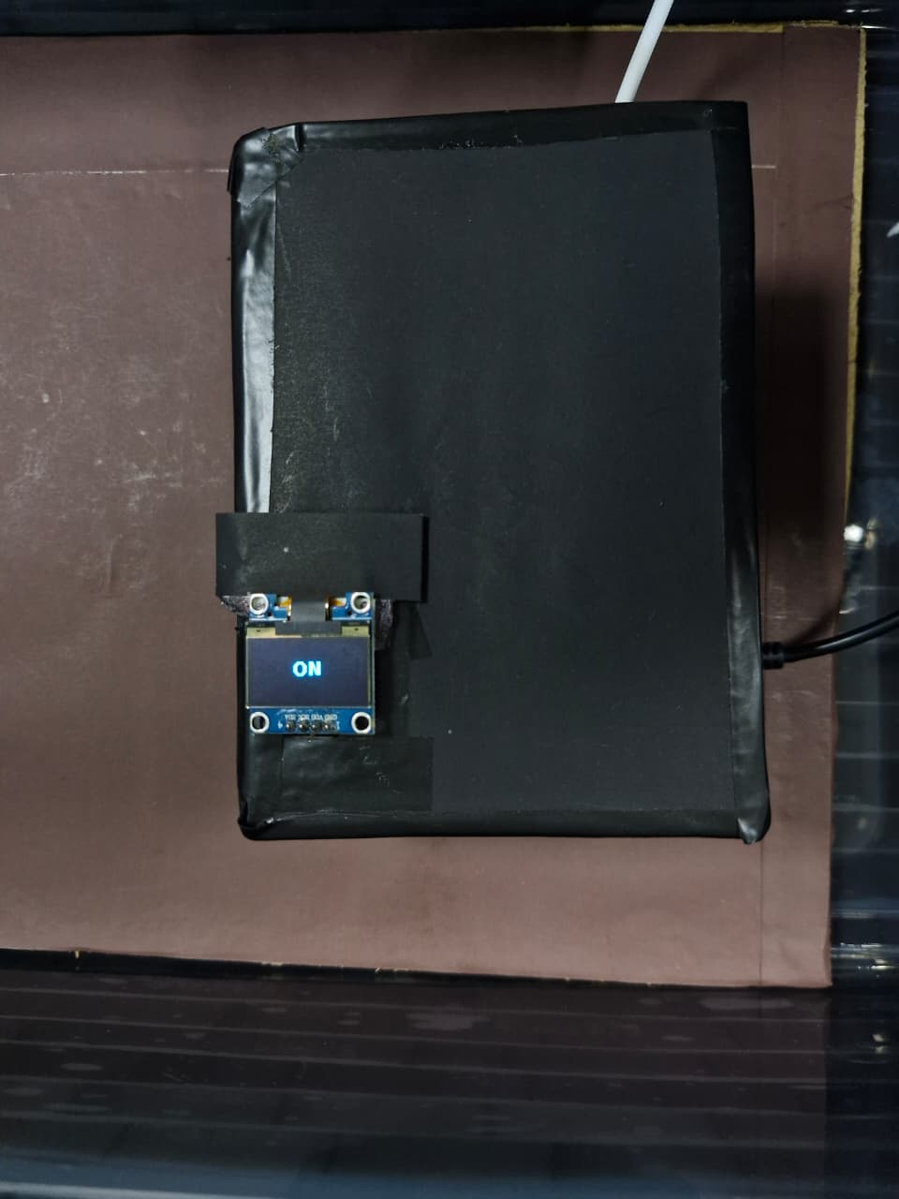
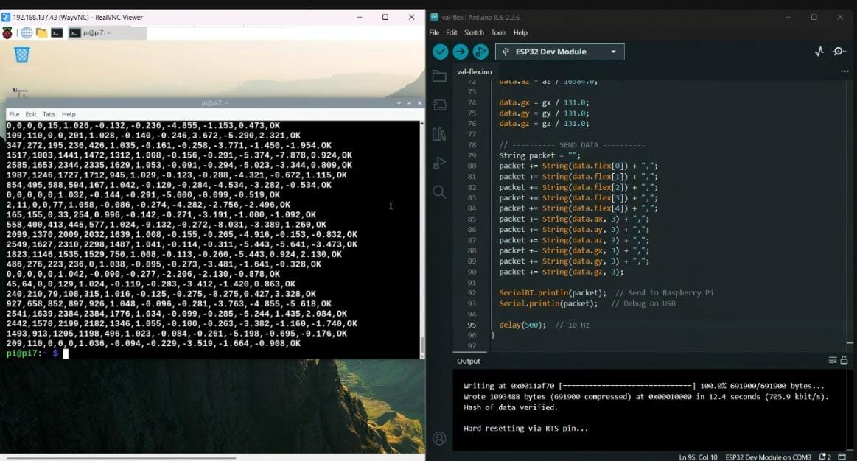
Results, Analysis and Evaluation
System Output (Results):
Real-time gesture recognition achieved
Output displayed successfully on OLED
Bluetooth data transmission stable

Slide 17
Dataset & Model Performance
Parameter | Value
Number of Gestures | 8
Frames per Gesture | 529
Total Samples | 4232
Model Used | Random Forest
Accuracy | 99

Slide 18
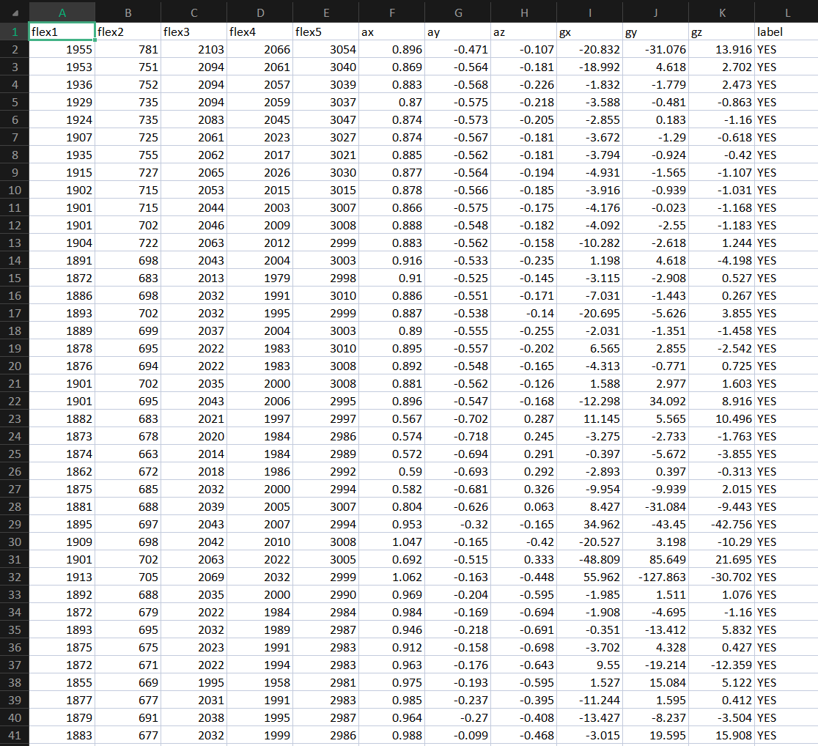
Dataset Structure and Sample Data
Dataset Overview:
Dataset consists of sensor readings collected from the smart glove.
Features include five flex sensor values and six motion parameters (accelerometer and gyroscope).
Each row represents one frame of gesture data.
The label column indicates the corresponding hand gesture.
Data is stored in CSV format for preprocessing and model training.

Slide 19
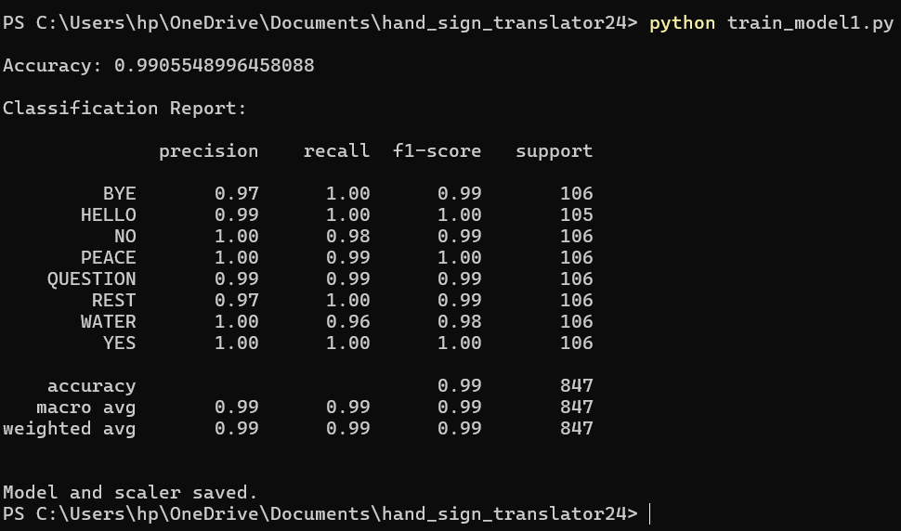
Model Training and Performance Evaluation
The machine learning model was trained using the cleaned and labeled gesture dataset.
The trained model achieved an overall accuracy of 99.05%.
High precision, recall, and F1-score were observed across all gesture classes.
The results indicate strong generalization and reliable gesture classification.
The trained model and feature scaler were saved for real-time deployment on Raspberry Pi.

Slide 20
Limitations Observed
Recognition limited to predefined gestures.
Accuracy varies slightly across different users.
Requires recalibration if glove position changes.

Slide 21
Socio-economic Issues Associated With The Project
Positive Socio-Economic Impacts:
Improves communication accessibility for individuals with hearing and speech impairments.
Promotes social inclusion by enabling easier interaction in public and professional environments.
Reduces dependency on human interpreters for basic sign language communication.
Provides an affordable and portable assistive technology solution.
Encourages inclusive education and employment opportunities.
Demonstrates the application of technology for social welfare and empowerment.

Slide 22
Socio-economic Issues Associated With The Project
Socio-Economic Concerns:
Gesture recognition accuracy may vary between users due to physical differences.
System functionality is limited to a predefined set of gestures.
Continuous operation requires regular battery charging and maintenance.
Bluetooth connectivity limitations may affect communication range.
Initial setup and calibration may require technical assistance.
Long-term durability of wearable sensors may affect system reliability.

Slide 23
Engineering Tools And Standards
Tools Used:
Hardware: Raspberry Pi 4 Model B (8 GB), ESP32 microcontroller, flex sensors,
MPU6050 motion sensor, MCP3008 ADC, OLED display
Software: Python, Arduino IDE, Thonny IDE, NumPy, Pandas, Scikit-learn
Communication: Bluetooth (Serial communication)
Version Control: Git and GitHub
Standards Followed:
I2C and SPI communication standards
IEEE 829 (Software testing documentation – conceptual)
ISO 26262 concepts for system safety (reference)
PEP 8 coding standards for Python
Best Practices:
Modular and structured code design
Continuous testing and dataset validation
Real-time performance monitoring
Robust error handling for sensor and Bluetooth failures

Slide 24
Conclusion
Developed a Smart Glove–based Hand Sign Language Translator using flex sensors and an MPU6050 to capture finger movement and hand orientation, with an ESP32 enabling real-time data acquisition and Bluetooth communication.
Implemented a machine learning model on Raspberry Pi 4 to classify hand gestures in real time, with recognized gestures displayed instantly on an OLED screen for user feedback.
The system is portable, cost-effective, and scalable, demonstrating practical applicability as an assistive communication tool for individuals with hearing or speech impairments.

Slide 25
Project status
Task | Status
Objective | ✓
Conceptualisation | ✓
Component Selection | ✓
Hardware Testing & Calibration | ✓
Hardware Implementation & Verifications | ✓
Software Implementation | ✓
Optimization | ✓
Final Packaging | ✓
Presentation & Report | ✓
Project Demonstration & Presentation | ✓

Slide 26
References
  1.Priya, S., & Kannan, R. (2019). American Sign Language recognition using convolutional neural networks. International Journal of Advanced Research in Computer Science, 10(5), 10-15.
  2.Kumar, A., & Reddy, V. (2020). Hand gesture recognition using OpenCV and support vector machine. In Proceedings of the International Conference on Intelligent Computing and Control Systems (ICICCS) (pp. 123-129). IEEE. https://doi.org/10.1109/ICICCS48265.2020.1234567
  3.OpenAI. (2025). ChatGPT (Version 4.0) [Large language model]. OpenAI. https://chat.openai.com
  Kranz, J. (n.d.). Cirkit Designer [Circuit design and schematic tool]. Cirkit Studio. https://app.cirkitdesigner.com/

