Slide 1

GROUP NUMBER 42
SupportSync
AI-Driven Ticket Resolver
Under the guidance of: Prof. Dr. Sandip Shinde

Slide 2
Problem Statement
Solution
Architecture Diagram
Working
Agenda
Project Flow
Tech Stack
Demo
Result
Who can benifit?
Conclusion

Slide 3




Problem Statement
In today's fast-paced business environment, the manual resolution of tickets across multiple platforms like Salesforce, ServiceNow, and JIRA often lead to following issues:
Delayed Response Times and Inefficient Ticket Resolution
Fragmented Data Across Multiple Ticketing Systems
Scalability Bottlenecks

Slide 4
SupportSync : The Solution
Aggregates solved tickets from JIRA, ServiceNow, and Salesforce into a Pinecone vector database for quick solution access
Uses OpenAI embeddings and the llama-3.2-90b model to find similar closed tickets and generate relevant solutions.
AI chatbot handles complex queries and multimedia uploads (e.g., PDFs), enhancing ticket resolution and team collaboration.

Slide 5
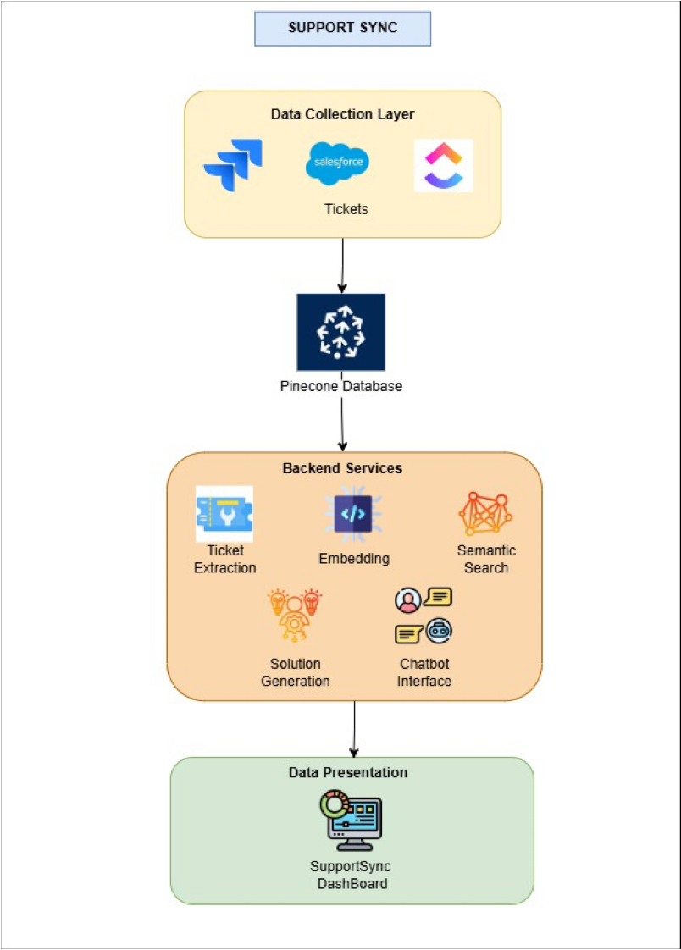
Architecture Diagram

Slide 6
Ticket Fetching: Retrieve OPEN, IN PROGRESS, and CLOSED/DONE tickets from connected ticketing platforms (e.g., JIRA, ServiceNow) using the developer’s API token and Project ID.
Data Embedding: Embed CLOSED/DONE tickets into vectors using OpenAI embeddings and store them in Pinecone for fast searches.
Ticket Selection: Developers select an unresolved ticket from the dashboard for which they need a solution.
Solution Search: Generate embeddings for the selected ticket and search Pinecone for the top 2 similar CLOSED/DONE tickets.
Solution Generation: Use the llama-3.2-90b model to generate a solution based on similar tickets and its knowledge base.
Chatbot Assistance: If needed, the developer can interact with an chatbot for personalized support and document uploads (e.g., PDFs).
Vector Update: Uploaded documents (PDFs) are embedded and stored in Pinecone to enhance future searches.
Working:

Slide 7
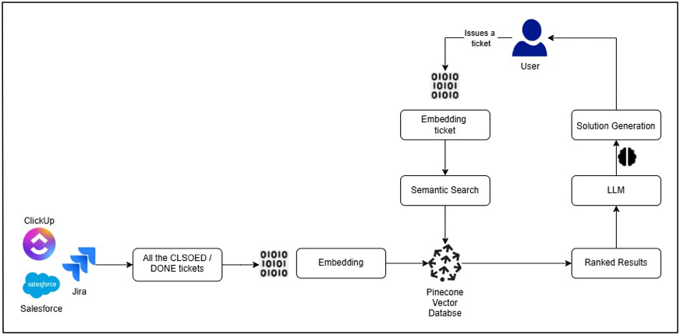
Project Flow

Slide 8





Tech Stack
Programming Languages: Python, Javascript
Embedding: OpenAI embeddings
AI Frameworks: Llama-3.2-90b, LangChain
Vector Database: Pinecone
APIs: JIRA API, Salesforce API, ServiceNow API
Version Control: Git, GitHub
Frontend Framework: React

Slide 9
Demo

Slide 10
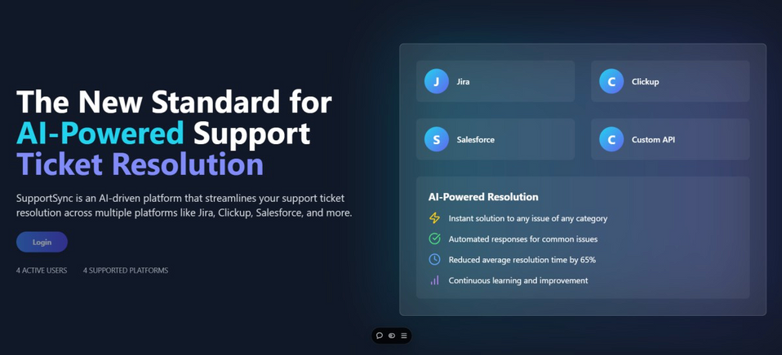
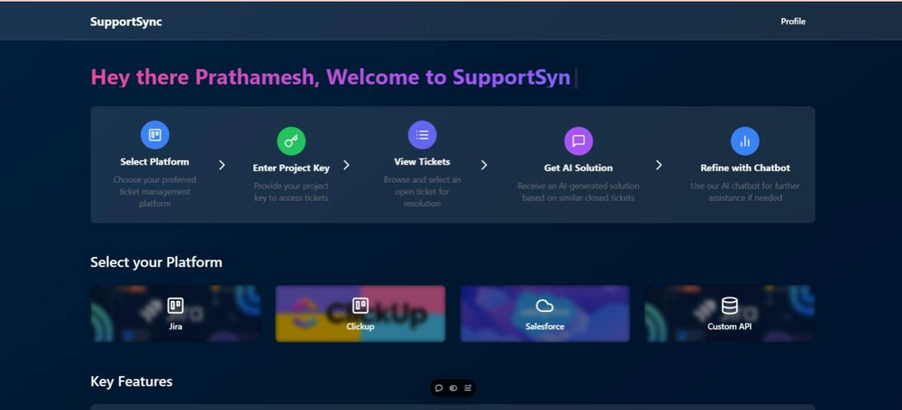
Results
Reduction in ticket resolution time
Increased accuracy of solutions.
Scalability and flexibility of the platform.

Slide 11
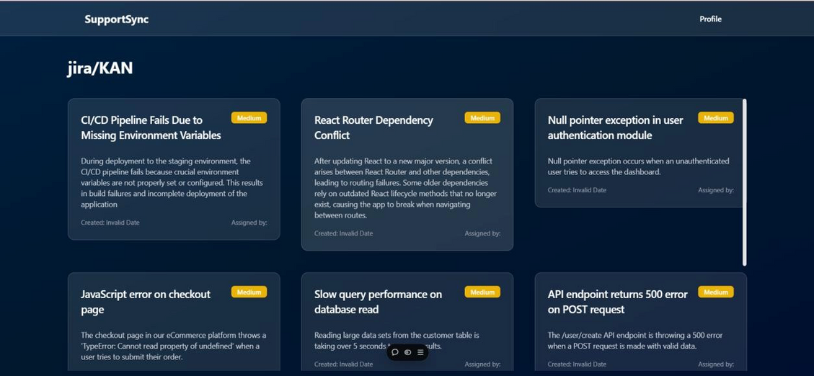
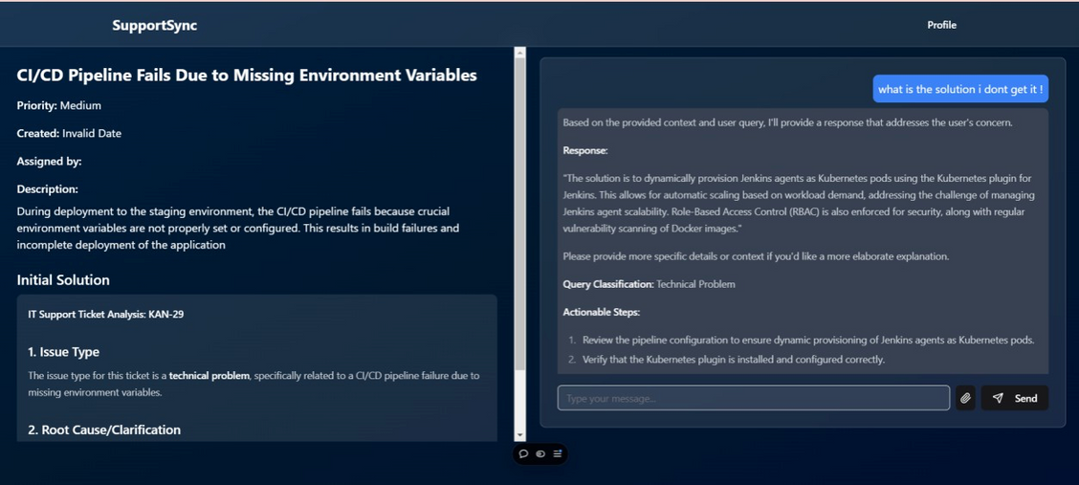

Slide 12
Who Can Benifit ?
Customer Support Teams:
Efficiency Improvement: By automating routine ticket resolutions, support teams can handle higher volumes of tickets more quickly and accurately, reducing the time spent on repetitive tasks.
IT Departments:
Streamlined Integration: The system's ability to integrate with multiple ticketing platforms (JIRA, Salesforce Cloud, ServiceNow) simplifies support processes and data management across different systems.
Developers and AI Practitioners:
Innovative Application: This project offers an opportunity to work with cutting-edge technologies like AI embeddings, vector databases, and LangChain, providing a platform for innovation and professional growth.

Slide 13
Conclusion
The AI-driven ticket resolution system integrates with platforms like JIRA, ServiceNow, and Salesforce to automate ticket processing, reduce redundant tasks, and enhance response times and accuracy.
It boosts operational efficiency, shortens resolution times, promotes team collaboration, and offers scalability.
This solution streamlines support processes, improving productivity and optimizing resources across organizations.

