Slide 1
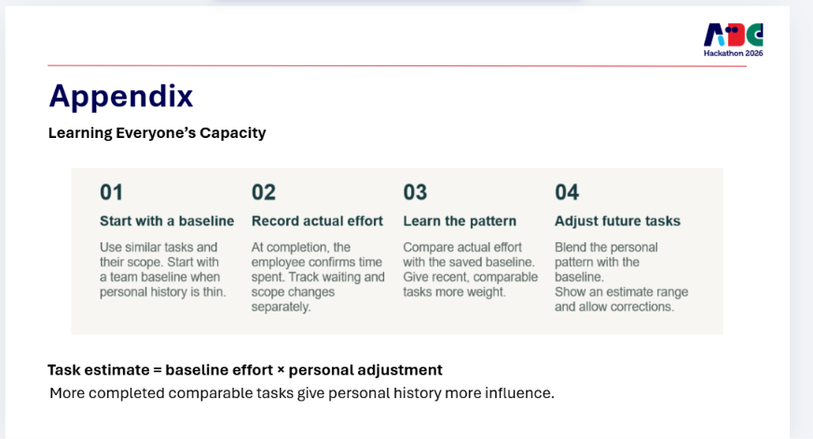
Appendix
Privacy in Message Capture and Conflict Management
01
02
03
04
Check locally
Choose what to add
Request AI help
Protect schedules
Keywords or on-device AI flag possible work requests. Message copies stay encrypted on the device.
A private alert asks whether to add a task. Only reviewed, approved task details sync to Headroom.
Only an “AI breakdown” click sends approved task details to the AI service. Original messages stay local.
Check conflicts using free/busy time. Managers see capacity and approved proposals, without personal event details.
Employees control what becomes a task and what others can see.
Calendar changes need approval. Disconnect sources or delete local copies anytime.
Notes:
Suggested narration: Headroom first checks incoming work messages on the employee's device. Keywords or a small local model flag a possible request and show a private alert. The employee decides what to add and can edit the task before it syncs. A second, explicit action, the AI breakdown button, sends only the approved task details to an AI provider. For conflict management, Headroom needs availability, not the reason for an appointment. Managers see capacity and approved proposals. The employee approves calendar changes.
This is a proposed production privacy architecture, not a statement that the prototype already implements these protections.
MESSAGE ACCESS AND DEVICE STORAGE
Implement local intake in a desktop companion or browser extension using permitted platform access and explicit account/workspace consent. A normal hosted website cannot read arbitrary Gmail, Teams or Zalo messages or inspect unrelated app notifications. Each connector needs a supported device-side access path and the applicable platform/organization approval. For unsupported sources, use employee-initiated copy/share. In particular, do not promise background access to all personal Zalo conversations. An OA webhook that uploads message bodies to a Headroom server would not satisfy this local-only promise, so it is excluded from this mode. Where allowed, notifications can contain only change identifiers and the device fetches content directly from the original service. Catch-up occurs when the device/app is available.
Use an encrypted device database with keys protected by the operating system, a short configurable retention period and clear deletion controls. Do not use plain browser localStorage for raw messages or tokens. Avoid raw text in telemetry, crash reports and server logs. Local keyword matching or a bundled small model handles screening without a remote inference request. Hide notification content on the lock screen by default. A local classifier can make mistakes, so an alert is a suggestion rather than an automatic task.
The local-only claim concerns additional copies held by Headroom and its AI providers. The original Gmail, Teams or Zalo service already hosts the conversation. Before approval, incoming raw message content must not go to Headroom servers or model providers. On Add task, preview and sync only selected structured task fields, such as title, deliverable and deadline, plus a source reference if approved. These task details can still be sensitive and require encryption, access controls and retention/deletion policies. Do not attach or forward the entire conversation automatically. Deleting local copies does not delete the original platform message or an already-synced task, which has its own deletion control.
AI BREAKDOWN
Clicking the breakdown button is a separate sharing decision. Make the destination and fields clear. Send only the approved task fields, and omit unrelated conversation context. In production, use a model provider/plan and agreement that support the required retention and training controls. Do not claim that no data ever leaves the device when cloud breakdown is enabled. The current free-tier Gemini demo must not be presented as an enterprise privacy guarantee.
SCHEDULE PRIVACY AND CONFLICT MANAGEMENT
With separate employee permission, retrieve the minimum calendar data needed. Use free/busy intervals where available. If a connector returns subjects, locations or attendees, discard those details on the device before any Headroom sync. Keep exact private busy intervals local where possible and run the collision check there. Sync only aggregate available hours and the specific proposed times the employee chooses to share. Coarse availability can still reveal patterns, so scope manager access and explain exactly what is shared. Managers see confirmed work commitments and remaining capacity, not raw calendars or personal event descriptions. Resolve conflicts by suggesting an available slot, scope change or reassignment, then require approval before writing a calendar change. Provide disconnect, deletion and manual availability entry options.
Official references supporting the calendar integration approach, checked September 22, 2026:
Google Calendar Freebusy: https://developers.google.com/workspace/calendar/api/v3/reference/freebusy
Google Calendar freeBusy.query scopes and busy-interval response: https://developers.google.com/workspace/calendar/api/v3/reference/freebusy/query
Microsoft Graph getSchedule: https://learn.microsoft.com/en-us/graph/api/calendar-getschedule?view=graph-rest-1.0
Microsoft schedule responses may include extra event details depending on permissions. The device-side stripping and aggregate-only sharing are proposed Headroom controls, not automatic guarantees of the platform API.
Visual source: user-provided screenshot codex-clipboard-92908cbe-460b-425c-b46a-00ad0b5c1141.png. Logo reused by cropping the supplied reference in the slide. All new text remains editable.

