Slide 1

Web Engineering
Course Code: CSE 417
Anup Majumder

Slide 2
New Perspectives on Creating Web Pages with HTML
Tutorial 1: Developing a Basic Web Page

Slide 3
The Internet
The Internet consists of millions of interconnected computers that enable users to communicate and share information.
Many Internet tools required users to master an array of terms, acronyms, and commands before they could navigate the Internet.
The World Wide Web was developed to make the Internet easier to use and give quick access to users.

Slide 4

Structure of the Internet

Slide 5
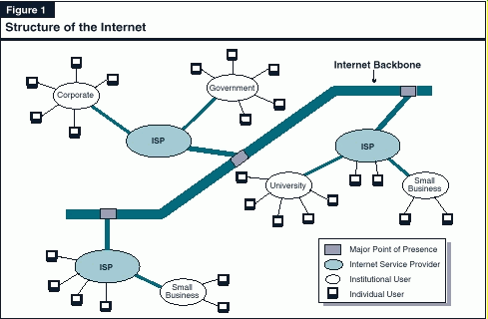
Structure of the Internet

Slide 6
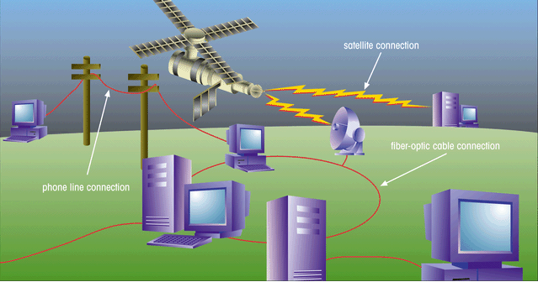
Structure of the Internet
This figure shows the physical structure of the Internet, which uses fiber-optic cables, satellites, phone lines, and other telecommunications media to send data back and forth.

Slide 7
Hypertext Documents
Hypertext offers a better way of locating information.
When you read a book, you follow a linear progression, reading one page after another.
With hypertext, you progress through pages in whatever way is best suited to you and your objectives.
Hypertext lets you skip from one topic to another.

Slide 8
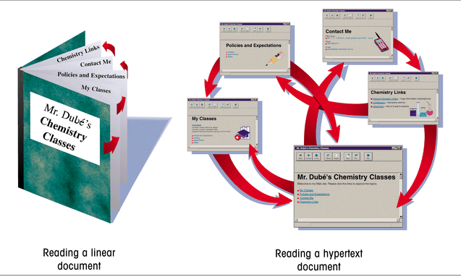
Linear Versus Hypertext Documents
This figure shows how topics can be related in a hypertext fashion,
as opposed to a linear fashion.

Slide 9
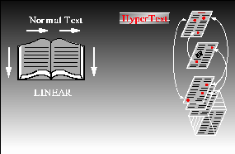
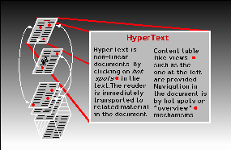
Linear Versus Hypertext Documents (cont..)

Slide 10
Hypertext Documents (cont..)
The key to hypertext is the use of links, which you activate to move from one topic to another.
  a link can open a document on a computer anywhere in the world
Hypertext has become the dominate method of sharing and retrieving information on the Internet, becoming known as the World Wide Web, or the Web.
Documents on the Web are known as Web pages.

Slide 11
Web Pages and Web Browsers
A Web page is stored on a Web server, which makes the page available to users of the Web.
To view a Web page, the user runs a Web browser, a software program that retrieves the page and displays it.
A Web browser can either be text-based, or graphical.

Slide 12
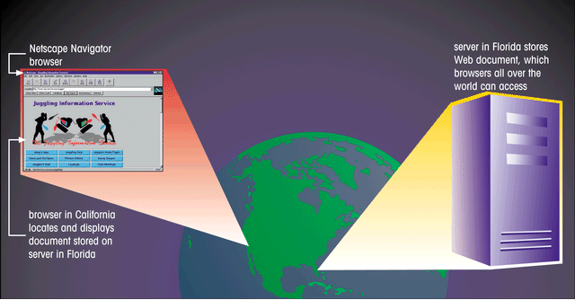
Using a Browser to View a Web Document on a Server
This figure shows to view web pages, the user runs a Web browser,
a software program that retrieves the page and displays it.

Slide 13

Web Page with Interesting Fonts, Graphics, and Layout
This figure shows a Web page is not only a source of information, it can also be a work of art.
graphic image
links
interesting fonts
The Web designer has a great deal of control over the format of the page.

Slide 14
HTML: The Language of the Web
Web pages are text files, written in a language called Hypertext Markup Language or HTML.
A markup language is a language used to describe the content and format of documents.

Slide 15
Hypertext Markup Language (HTML)
HTML allows Web authors to create documents that can be displayed across different operating systems.
HTML code is easy to use, that even nonprogrammers can learn to use it.
HTML describes the format of Web pages through the use of tags.
  it’s the job of the Web browser to interpret these tags and render the text accordingly

Slide 16
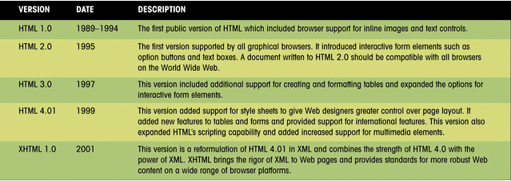
Versions of HTML
This figure presents a history of the various versions of HTML that have been released by the World Wide Web Consortium (W3C).

Slide 17
Hypertext Markup
Language (HTML) Continued
HTML has a set of rules, called syntax.
  syntax are a set of standards or specifications developed by a consortium of Web developers, programmers, and authors called the World Wide Web Consortium (W3C)

Slide 18
Web Development
Web designers need to determine which browsers and browser versions support their web pages.
In the future, Web development is focusing more on XML (Extensible Markup Language) and XHTML (Extensible HyperText Markup Language) for developing document content.
  XML combined with style sheets provides the same functionality as HTML, but with greater flexibility
  XHTML was designed to overcome some of the problems with competing HTML standards

Slide 19
Tools for Creating HTML Documents
HTML documents are text files, which a text editor such as Windows NotePad can be used to create.
You can also use an HTML converter or an HTML editor e.g. Dreamwaver.

Slide 20

Creating an HTML Document
It’s always a good idea to plan the appearance of your Web page before you start writing code.
heading 1
image
horizontal line
paragraph
list
heading 3
bold and italic text

Slide 21
HTML Syntax
Document content is what the users sees on the page, such as headings and images.
Tags are the HTML codes that control the appearance of the document content.
  tag is the name of the HTML tag
  attributes are properties of the tag
  document content is actual content that appears in the Web page

Slide 22
HTML Tags
Tags can be one-sided or two-sided.
  two-sided tags contain an opening tag <b> that tells the browser to turn on a feature and apply it to the contact that follows, and a closing tag </b> that turns off the feature
  one-sided tags are used to insert noncharacter data into the Web page, such as a graphic image or video clip <tag attribute>
Tags are not case sensitive. The current standard is to display all tags in lowercase letters.

Slide 23
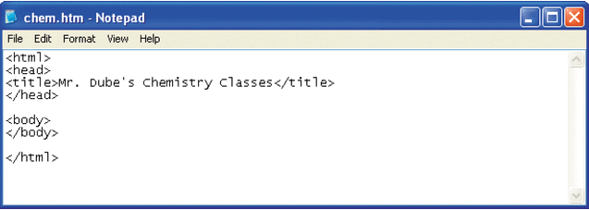
Initial HTML Tags in Notepad
Your text editor may not display the file extension in the title bar. This is okay.
<html> tag indicates that this file is written in HTML
<title> tag contains
the Web page title
Page content will
go between the
<body> tags
<head> tag contains information about the Web page

Slide 24
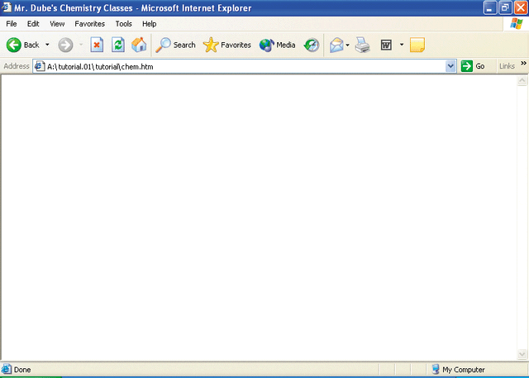
The Initial HTML File in
Internet Explorer
the title you entered between the <title> tags
address box indicates the name and location of the HTML file
You should occasionally view the formatted page with different Web browsers to check compatibility, verify that there are no syntax errors, or other problems.
page content will appear here

Slide 25
Creating Heading Tags
HTML supports six levels of headings, numbered <h1> through <h6>, with <h1> being the largest and most prominent.
Headings are always displayed in a bold font.

Slide 26
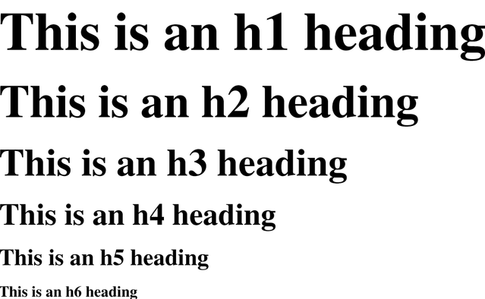
Six Heading Levels
This figure illustrates the general appearance of the six heading styles. Your browser might use slightly different fonts and sizes.

Slide 27
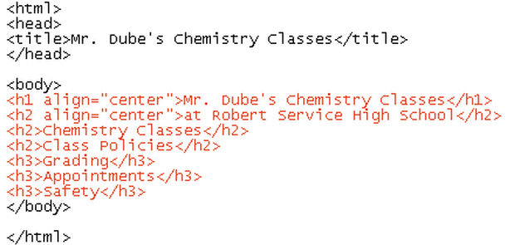
Entering Heading Tags and Text
heading tags
As of HTML 3.2, the heading tag can contain additional attributes, one of which is the alignment attribute.

Slide 28
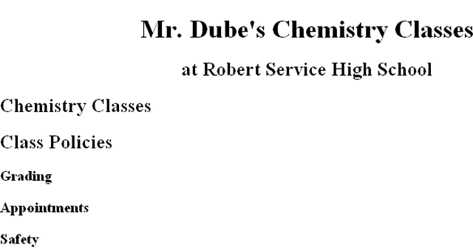
Headings As They Appear in the Browser
<h1>
<h2>
<h3>

Slide 29
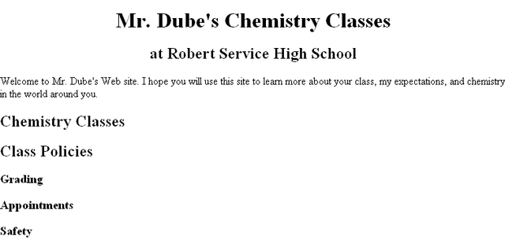
Paragraph Text in the Browser

Slide 30
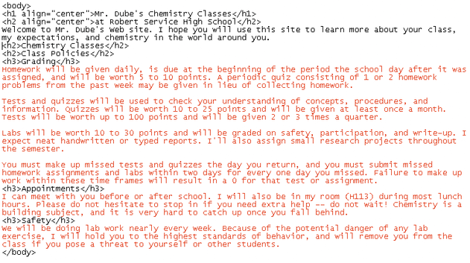
Adding Paragraphs
adding
paragraphs

Slide 31
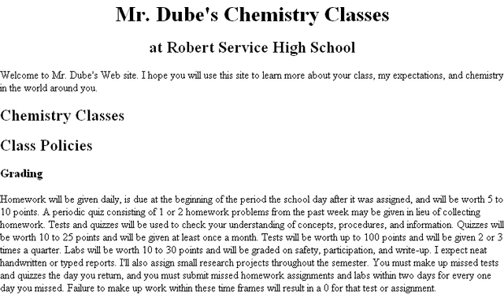
The Paragraphs Displayed by the Browser
Remember: HTML formats text only through the use of tags and ignores such things as extra blank spaces, blank lines, or tabs.
four grading
paragraphs are not
separated

Slide 32
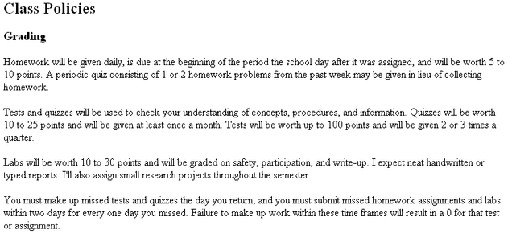
The Grading Text Separated into Paragraphs
To add space between paragraphs, you use the paragraph tag <p>.
text is now separated into four paragraphs

Slide 33
Creating Lists
HTML supports three kinds of lists:
  an ordered list, which is used to display information in a numeric order
  an unordered list, which list items are not listed in a particular order i.e. bullets
  a definition list, which is a list of terms, each followed by a definition line that is typically indented slightly to the right

Slide 34
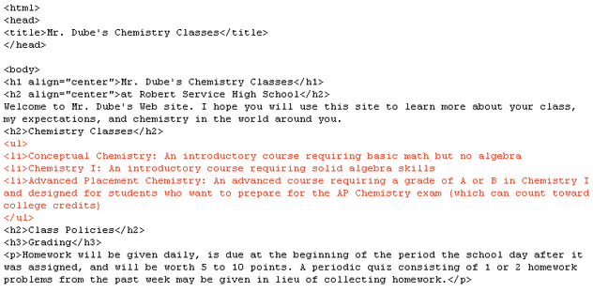
Entering an Unordered List
<ul> unordered
list tag
<li> list item tag

Slide 35
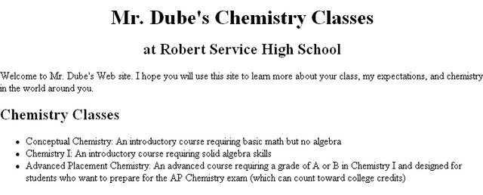
The Unordered List
An unordered list is a bulleted list.
unordered
list

Slide 36
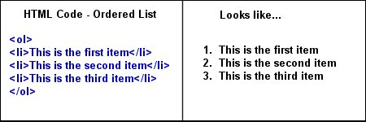
The Ordered List

Slide 37
Creating Character Tags
HTML also lets you format individual characters.
A tag that you apply to an individual character is called a character tag. There are two types of character tags:
  logical character tag
  physical character tag

Slide 38
Common Logical Character Tags
<FONT SIZE=“+2”> Two sizes bigger</FONT>
The size attribute can be set as an absolute value from 1 to 7 or as a relative value using the “+” or “-” sign. Normal text size is 3 (from -2 to +4).
<B> Bold </B>
<I> Italic </I>
<U> Underline </U>
Color = “#RRGGBB” The COLOR attribute of the FONT element. E.g., <FONT COLOR=“#RRGGBB”>this text has color</FONT>
<PRE> Preformatted </PRE> Text enclosed by PRE tags is displayed in a mono-spaced font. Spaces and line breaks are supported without additional elements or special characters.

Slide 39
Common Logical Character Tags(cont..)
<EM> Emphasis </EM> Browsers usually display this as italics.
<STRONG> STRONG </STRONG> Browsers display this as bold.
<TT> TELETYPE </TT> Text is displayed in a mono-spaced font. A typewriter text, e.g. fixed-width font.
<CITE> Citation </CITE> represents a document citation (italics). For titles of books, films, etc. Typically displayed in italics. (A Beginner's Guide to HTML)

Slide 40
Example
<P> <FONT SIZE=“+1”> One Size Larger </FONT> - Normal –
<FONT SIZE=“-1”> One Size Smaller </FONT> <BR>
<B> Bold</B> - <I> italics</I> - <U> Underlined </U> -
<FONT COLOR=“#FF0000”> Colored </FONT> <BR>
<EM> Emphasized</EM> - <STRONG> Strong </STRONG> <BR>
One Size Larger - Normal – One Size Smaller
Bold - italics - Underlined - Colored
Emphasized - Strong

Slide 41
Inserting a Graphic
Images can be displayed in two ways: as inline images or as external images.
  an inline image displays directly on the Web page and is displayed when the page is accessed by a user
  an inline image can be placed on a separate line in your HTML code, or it can be placed directly within a line of text
  inline images should be in one of two file formats: GIF (Graphics Interchange Format) or JPEG (Joint Photographic Experts Group)

Slide 42
Inserting a Graphic Continued
  an external image is not displayed with the Web page, the browser must have a file viewer, which is a separate program that the browser launches when it encounters an external image file
  external images are represented by an icon that a user clicks to view the image
  external images are not limited to GIF or JPEG formats

Slide 43
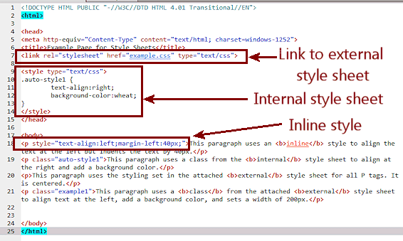
Inserting a Graphic

Slide 44
Special Characters
Occasionally you will want to include entities or special characters in your Web page that do not appear on your keyboard. For example:
  registered trademark symbol ®
  copyright symbol ©
HTML supports the use of character symbols that are identified by a code number or name.

Slide 45
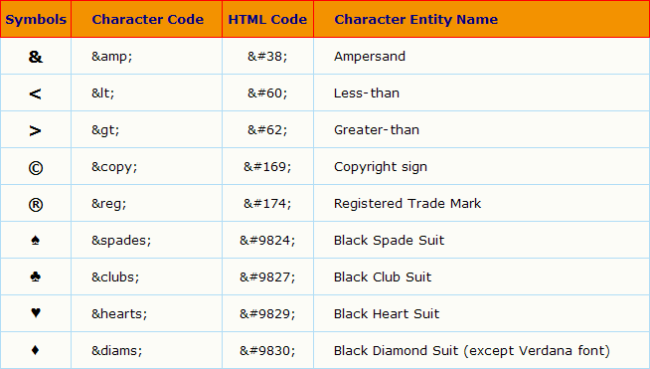
Special Characters and Codes
This figure shows some HTML symbols and the corresponding code numbers or names.

Slide 46
Inserting Horizontal Lines
A horizontal line can improve the appearance of a Web page.
The syntax for creating a horizontal line is:
  <hr align=“align” size=“size” width=“width” color=“color” noshade>

Slide 47
Inserting Horizontal Lines
The HTML horizontal syntax includes the following:
  align specifies the horizontal alignment of the line on the page (center, left, or right)
  size specifies the height of the line in pixels or percentage of the screen width
  width indicates the width of the line in pixels or percentage of the screen width
  color indicates the color of the line
  noshade specifies that the browser display a solid line

Slide 48
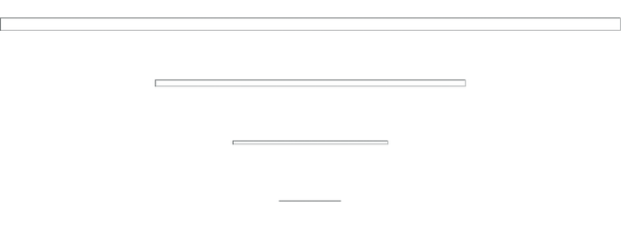
Different Line Styles
size=12
width-100%
<hr align=“center” size=“12” width=“100%”>
<hr align=“center” size=“6” width=“50%”>
size=6
width-50%
<hr align=“center” size=“3” width=“25%”>
size=3
width-25%
size=1
width-10%
<hr align=“center” size=“1” width=“10%”>
You can use line styles to improve the appearance of your Web page.

Slide 49
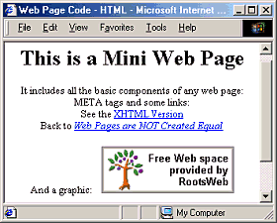
Write the HTML code

Slide 50
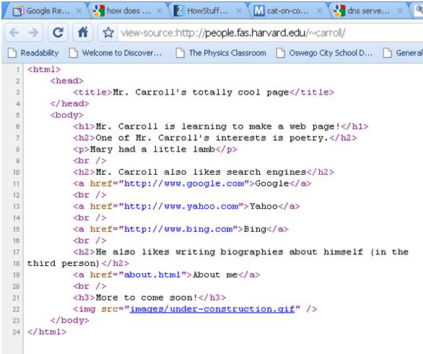
Make your HTML Page

Slide 51


