Slide 1

JavaScript Window Object
Selena Vargas
PWA1
1/30/14

Slide 2

Introduction
I am intrigued about JavaScript and its’ Window Object. I have yet to learn more information about it and the way it works in the java world. Furthermore here is what Window Object is about.

Slide 3
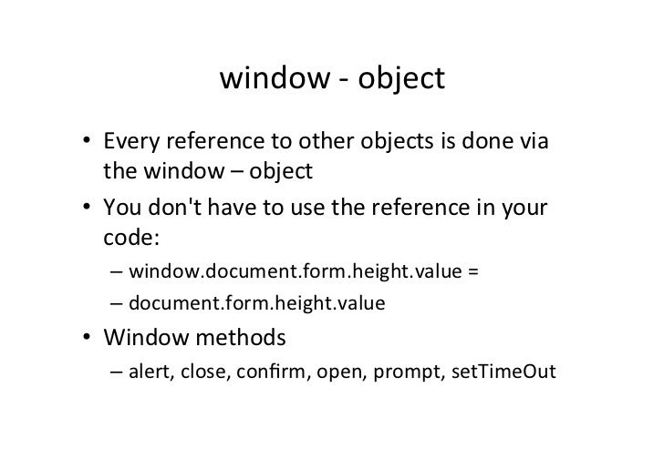

Slide 4

Topic/Point A: Explaining What It Is
The window object as defined by w3schools.com is supported by all browsers. It represents the windows browser. It is also known as the BOM (Browser Object Model).

Slide 5
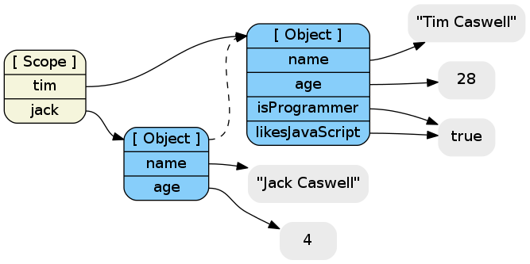
-Details: Main concept
It is the highest level of JavaScript object which corresponds to the web browser window.

Slide 6
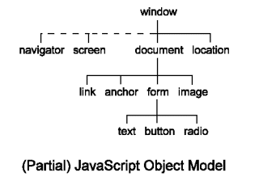
-Details: Properties, etc.
There are a few different properties that entail with Window Object. These properties include:
-Client Information -Closed (Boolean value that indicates whether the window is closed)
-Default Status
-Status
Etc

Slide 7
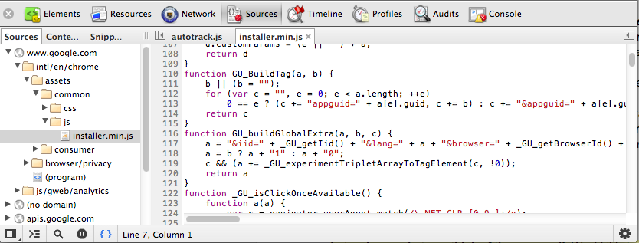
Topic/Point B: Compatibility
As was stated earlier, it Works with every browser.

Slide 8
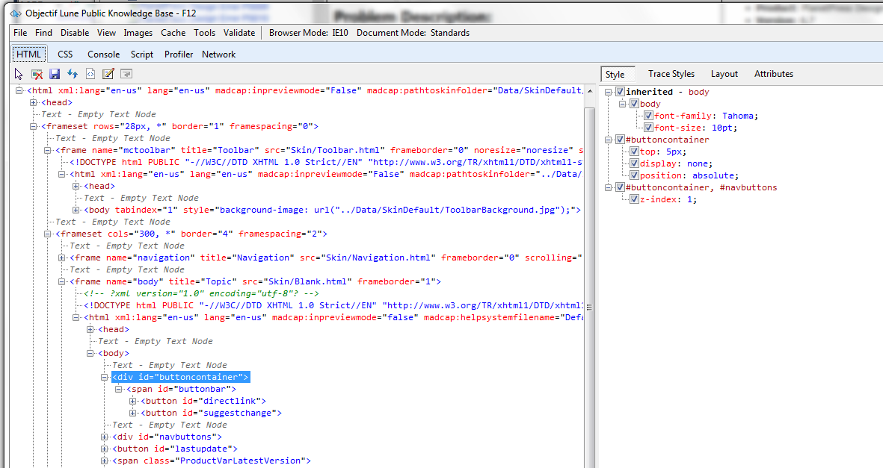
-Details: How it Works
You use the window object in JavaScript to retrieve code from the html without having to retype the JavaScript Code. These examples will help to further understand the concept of how it works.

Slide 9
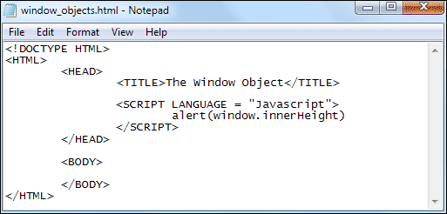
Examples
-Example A: Window.document.getElementById("header");
-Example B
Window.document.form.height.value =
-Example C
document.form.height.value

Slide 10
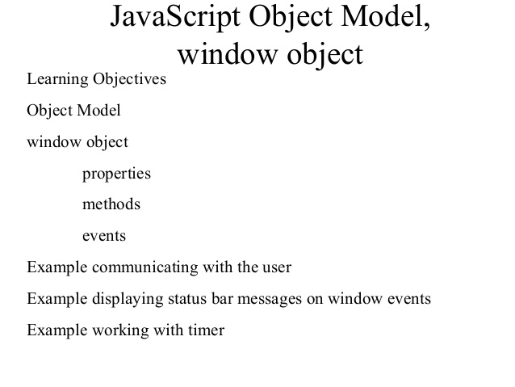
Methods
-Alert
-Close
-Confirm
-Open
-Prompt
setTimeOut

Slide 11
Conclusion
The window object is a code you write without having to reference any other code again. Every reference to other objects is used with window object. This is not only one of the highest levels of JavaScript but it is also one of the most non time consuming methods because of it’s easy to write code without having to rewrite the html code. Window object sets itself to being available on every browser along with letting the user interact with everything on it.

Slide 12
Sources
-JavaScript: Dressing up Web pages with ease
http://www.lexisnexis.com.oclc.fullsail.edu:81/hottopics/lnacademic/
-JavaScript editor; Acadia Infuse injects interactivity into Web pages; Visual editing tool enhances your HTML apps by using scripting language
http://www.lexisnexis.com.oclc.fullsail.edu:81/hottopics/lnacademic/
-JavaScript Window - The Browser Object Model
http://www.w3schools.com/js/js_window.asp

