Slide 1
Software Engineering
Project:
SMART HOME
(Home Automation System)

Slide 2
Problem Statement:
This project aims at automation and control of household appliance from a single point remotely.
Purpose:
This automation system with high range of connectivity allows users to control their homes easily and efficiently via a user-friendly interface using smart phones and/or laptops regardless of time and location. This will use Wi-Fi facility and sensors to integrate the appliances. Proposed system considers safety and security. For this project we will be focusing on lights, security camera and fans in the house. This can be further elaborated and applied to other appliances as well.

Slide 3
Scope:
Our proposed system is an Arduino based home automation system done with Arduino connected to a sensor and it’s security system is implemented using Wi-Fi facility that will be controlled via android app. This system has two main modules: The hardware interface module and the software interface module. At the core of this system is the Arduino UNO microcontroller. All communication in this system passes through the microcontroller. It offers switching functionalities to control lighting, fans and other home appliances connected to the relay system. With this in mind, an internet and sensor based home automation system is designed.

Slide 4
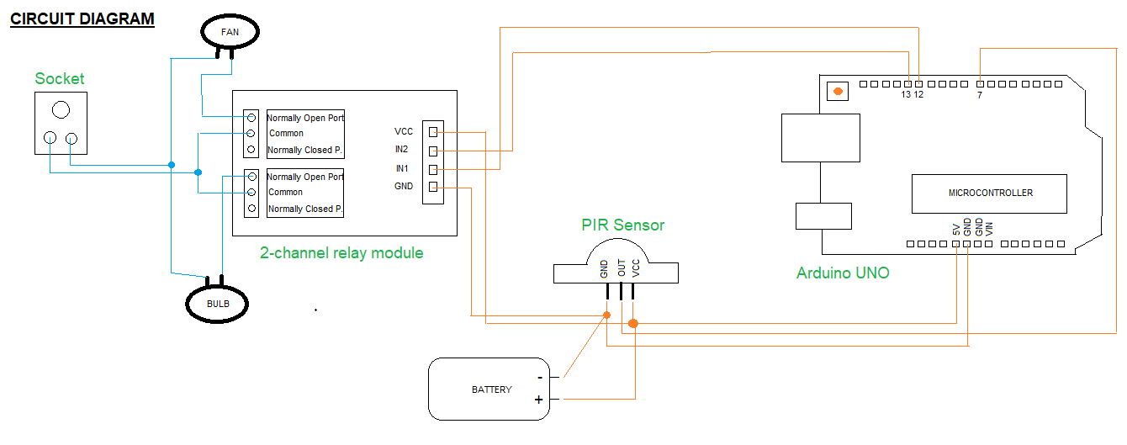
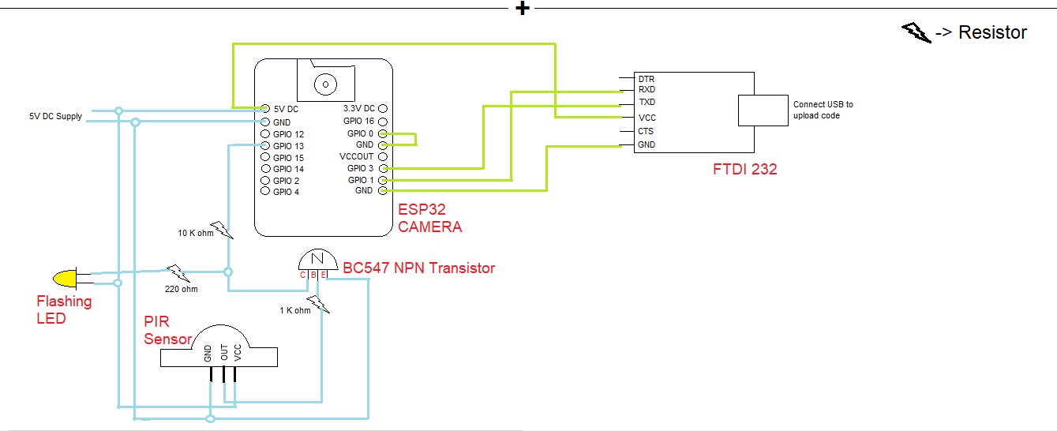

Slide 5
CODE FLOW
ARDUINO CODE: (in circuit 1)
int Relay1=12;
int Relay2=13;
int pir_pin=7;
int value=0;
int pirState=LOW;
void setup() //acts as entry point
{
pinMode(Relay1,OUTPUT); //to configure behaviour of a specific pin
pinMode(Relay2,OUTPUT);
pinMode(pir_pin,INPUT);
Serial.begin(9600); //passes value to speed parameter tells arduino tells arduino
to get ready to exchange message with serial monitor at data
rate of 9600 bits per second.
}
void loop() //runs over and over
{
value=digitalRead(pir_pin); //reads values from specified pin
if(value==HIGH){
digitalWrite(Relay1,HIGH);
digitalWrite(Relay2,HIGH);
}
else{
digitalWrite(Relay1,LOW);
digitalWrite(Relay2,LOW);
}
}
Start
Setup()
loop()

Slide 6
Arduino UNO
This component is coded using C++/C language using Arduino IDE Software. Uploaded code defines the working of whole system like what should we do with read input and where to proceed on a particular output etc.
It consist of:-
Atmega 328 Microcontroller chip
TX(0)/RX(1) pins to send & receive data from GPS Bluetooth or Wi-Fi module.
Digital Pins(0-13) to connect output LCD/LED/Relay Modules etc.
Analog Pins(A1-A6) to connect input (sensors)
Power Supply for input & output components
Power Jack to give power to Arduino
Reset Button to restart Arduino code
5V pin when component needs 5V power
3.3V pin when component needs 3.3V power
GND to ground the circuit
Limitations:-
I/O pins are limited to 40 mA current before get damaged. Suggested 20 mA.
VCC & GND pins of AtMega328 chip limited to 200mA total. So, it means that 10 I/O pins could run at a time with 20mA per I/O. But, actually could run only 9 pins at a time because need some amount of current for rest of the chip.
Operating Voltage: 5 Volts
Input Voltage: 6-20 Volts
Digital I/O Pins DC current: 40 mA
3.3 V Pin DC current: 50 mA
Clock Speed: 16 MHz
Flash Memory (non-volatile memory): 32 KB

Slide 7
PIR Sensor
This is an electronic motion sensor that measures infrared lights radiating from objects. It sense motion in terms of heat & light. Ideally suited where a defined detection pattern is required like rooms. It is covered with Fresnel Lens which is used as focusing system for infrared radiations. This sensor has 3 pins for connections:-
VCC (Voltage at Common Collector) Pin corresponding to drain terminal of device & connected to the +ve supply of 5V DC
OUT(Output) Pin corresponding to source terminal of device that carries detected IR signals to amplifier.
GND(Ground) Pin connected to ground
Limitations:-
It has lower sensitivity & less coverage as compared to microwave sensors. (But, here can’t use microwave sensor because these sensors can see through walls, glasses and plastic. So, unsuitable for closed areas)
Working problems in corner regions. So, should be ideally placed.
It doesn’t operate in environments with temperature > 35 degree C
It’s insensitive to very slow motions.

Slide 8
Relay Module
This is relay interface board that can be controlled directly by a wide range of microcontrollers such as Arduino. It connects multiple AC powered devices that needs to be controlled and uses low-level triggered control signals (3.3-5 V DC) for controlling purpose. Every relay module consist of channels for each particular connected device. And, each channel has 2 parts:-
INPUT PART
This part consist of 3 pins: INP (signal trigger port), VCC (acts as DC +ve), GND (acts as DC –ve)
2. OUTPUT PART
It consist of 3 points: Normally Open Port (NOP), Common, Normally Closed Port (NCP). And, triggering relay operates NOP or NCP.
Whenever INP pin reads a HIGH voltage then common port gets in touch with NOP (because flowing current through coil of relay generates magnetic field that attracts Common lever and change switch contacts) & circuit gets completed. When it reads a LOW voltage, common port touches with NCP & circuit remains incomplete. In this way, when Arduino provides a +ve voltage then relay of particular device completes circuit and device gets powered on.

Slide 9
ESP32 CAM (AI Thinker)
This module is an ESP32 development board (dual core i.e., it has 2 processors, built-in Wi-Fi & Bluetooth module and have clock frequency upto 240 MHz) with an OV2640 Camera, microSD card support, on board flash lamp and several General purpose Input-Output (GPIOs) to connect peripherals.
Features:-
Here, GPIO1 & GPIO3 are serial pins needed to upload code to the board.
When GPIO0 connected to GND, it implies that ESP32 is in flashing mode i.e., white LED present on this camera will illuminate the object while capturing.
Clock Speed: upto 160 MHz
Supports Wi-Fi image upload
Built-in flash LED
Camera has 2MP sensor & image transfer rate of 15-60 frames per second.
FTDI 232 USB to serial interface board
This device is used to transmit & receive data between computer and external devices such as microcontroller, development modules, etc. Here, it will be used to program ESP32 CAM.. It supports data transfer rates from 300 Baud to 3MBaud at TTL (Transistor-Transistor logic; it is a serial communication commonly found in methods used by microcontrollers) levels.
It consist of 6 pins:-
GND – Black
CTS – Brown – Clear To Send
VCC – Red - +ve voltage output (+5V)
TXD – Orange – Transmit Asynchronous Data Output
RXD – Yellow – Receive asynchronous data input
RTS – Green – Request to send

Slide 10
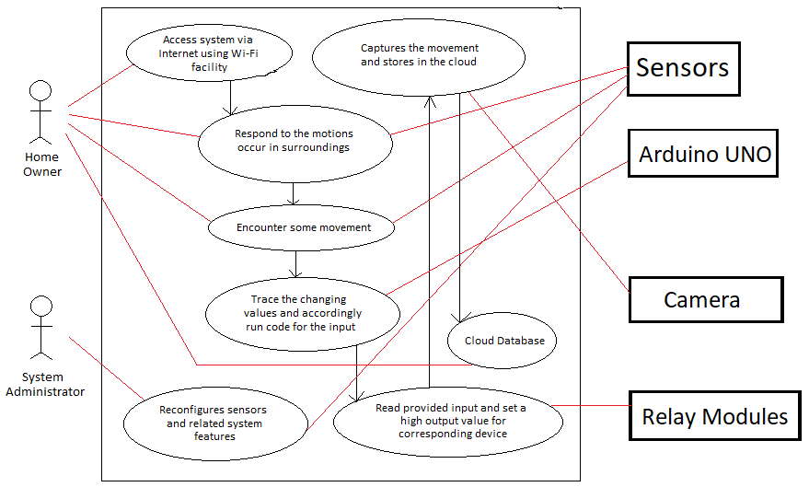
Use-Case Diagram:

Slide 11
PROCEDURE:-
In this Home automation system, we are going to automate 3 devices that are lights, fans and security system. So, we are dividing this whole system into 2 parts:-
To automate lights and fans of a room.
To automate security system that will send a notification whenever it encounters any movement around house gate and also allows the house owner who have access to this system to capture the image anytime.
First Part
(Connections)
Connect VCC pin of PIR Sensor to 5V pin of Arduino.
Connect GND pin of PIR sensor to GND pin of Arduino.
Connect OUT pin of PIR sensor to Digital pin 7 of Arduino.
Now, connect VCC pin of PIR Sensor to VCC pin of 2-channel Relay module.
Connect GND pin of PIR sensor to GND pin of 2-channel Relay module.
Connect IN2 pin of Relay to Digital pin 13 of Arduino.
Connect IN1 pin of Relay to Digital pin 12 of Arduino.
Now, connect common ports of both relay channels and insert in a socket block.
Connect one wiring of both appliances with NOP of each channel.
Finally, Connect second wirings of both appliances and insert into another socket block.
Lastly, connect a Battery for providing current in the circuit. For this, join –ve terminal of battery with common GND wiring and join +ve terminal of battery with common VCC wiring.
(Working)
This circuit doesn’t need any external connection like Wi-Fi or Bluetooth. Just after plugging final wiring in socket, turn on the switch and then circuit will be in working state. Now, when sensor will sense any motion then it sends a HIGH signal to Arduino & that will sends a HIGH signal to both devices using relay module. In this way, circuit of both devices gets completed and devices will get turned on. When it stop sensing anything, then it will sends a LOW signal to turn off devices.

Slide 12
Second Part
To implement this, firstly we need to program ESP32 CAM using FTDI 232.
Connect VCC pin of FTDI to 5V DC pin of CAM.
Connect RXD pin of FTDI to GPIO1 pin of CAM.
Connect TXD pin of FTDI to GPIO3 pin of CAM.
Connect GND pin of FTDI to GND pin of CAM.
Connect GPIO0 pin of CAM to GND pin of CAM.
After completing all connections, download BLYNK android app -> New project -> give a name -> choose a board(ESP32 DEV Board) -> Create -> receive a Authentication token that will be used in code that we will upload. To upload code, connect a USB between FTDI and your computer. After successfully uploading code, disconnect all above connections and now we will connect this coded CAM with PIR Sensor for final system.
Connect GND pin of Sensor to Emitter pin of BC547 NPN transistor.
Connect GND pin of Sensor to GND pin of CAM.
Connect Base pin of transistor to OUT pin of Sensor using a 1 K ohm resistor.
Connect VCC pin of sensor & 1 pin of LED to 5V DC pin of CAM.
Connect Common pin of transistor to 2nd LED pin using a 220 ohm resistor and to GPIO13 pin of CAM using 10 K ohm resistor.
Finally, connect 5VDC pin & GND pin of CAM to a 5V DC supply.
Now, all connections are done. In this circuit, when sensor detect any motion the OUT pin become HIGH & will give HIGH pulse to BASE pin of transistor. Then, transistor will get turned on & it’ll Ground the GPIO13 pin of CAM and when it gets LOW then CAM will start taking pictures. When transistor gets turned on, it’ll also turns on connected LED. Now, in app go to your created project -> + icon -> Add views to project like ImageGallery, Button, Notification. Now, supply power to circuit to enable it and turn on play button on blink app. Use circuit for intended purpose.

Slide 13
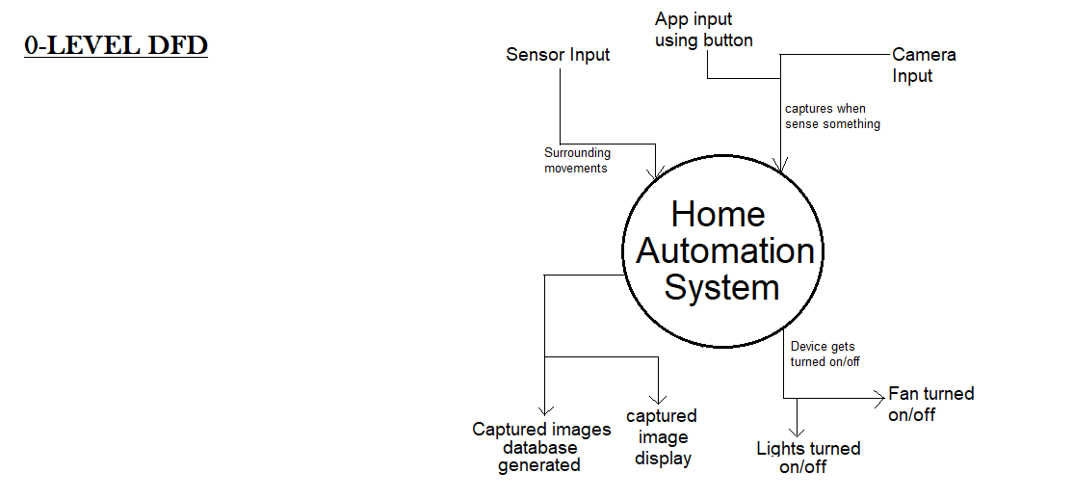
Data Flow Diagram (DFD):
( 0-LEVEL DFD )

Slide 14
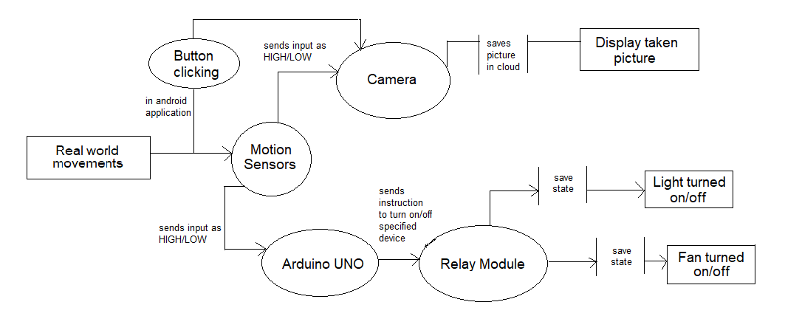
( 1-LEVEL DFD )

Slide 15
Implementation of Project at a large-scale :-
We don’t think that this project could be implemented at a large-scale with these same components because Arduino component that we are using has current and voltage limitations that are very low. But, we can replace those components with the ones which have higher specifications but same workings like Arduino UNO with Arduino Mega and similar like this.
So, the conclusion is - this project is modifiable and possible to be implemented at large-scale.

