Slide 1
Cognitive Computing
Introduction to Natural language processing (NLP)

Slide 2
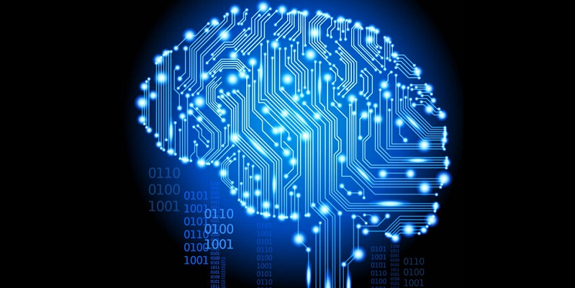
Role of NLP in Cognitive System
Cognitive System
Mimic human-like reasoning and decision making
Generate and Score Hypothesis
Alternative answers – each with a degree of confidence
Cognitive system vs other data‐driven techniques
Capability to manage, understand, and analyze unstructured data in context with the questions being asked. (rely on large amount of text data)
Unstructured information must be parsed and tagged to find the elements of meaning
Understand meaning and intent behind text
Extensive NLP for human like responses
E.g.: IBM Watson, ChatGPT
Works with Structured Data (like tables) and relies on schemas to add context and meaning to data
Identifies patterns but lacks deeper understanding
Limited NLP
SQL-based systems, basic ML models

Slide 3
Role of NLP in Cognitive System (contd..)
Tools for this process of identifying the meaning of the individual words include categorization, ontologies, tagging, catalogs, dictionaries, and language models (NLP).
This is where Natural Language Processing (NLP) techniques come in.
Remember - Not all unstructured data is text.
There is a requirement in some cognitive computing systems to support images, video, speech, and sensor data, depending on how the data will be used.

Slide 4
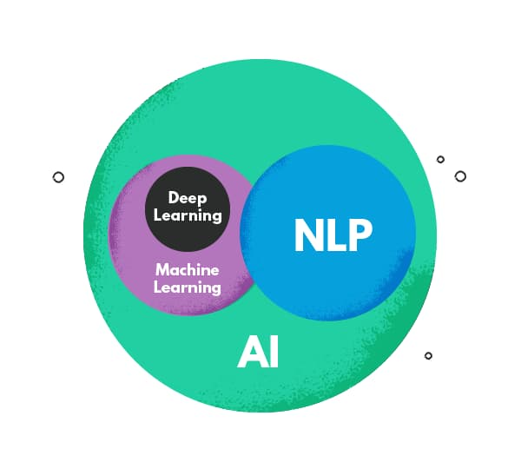
Natural Language Processing (NLP)
A field of artificial intelligence (AI) that enables computers to understand, interpret, and generate human language.
It combines linguistics, machine learning, and computational techniques to process and analyze large amounts of text and speech (unstructured) data.
NLP – Set of techniques that extract meaning from text
Notes:
Linguistics - The rule-based modeling of human languages

Slide 5
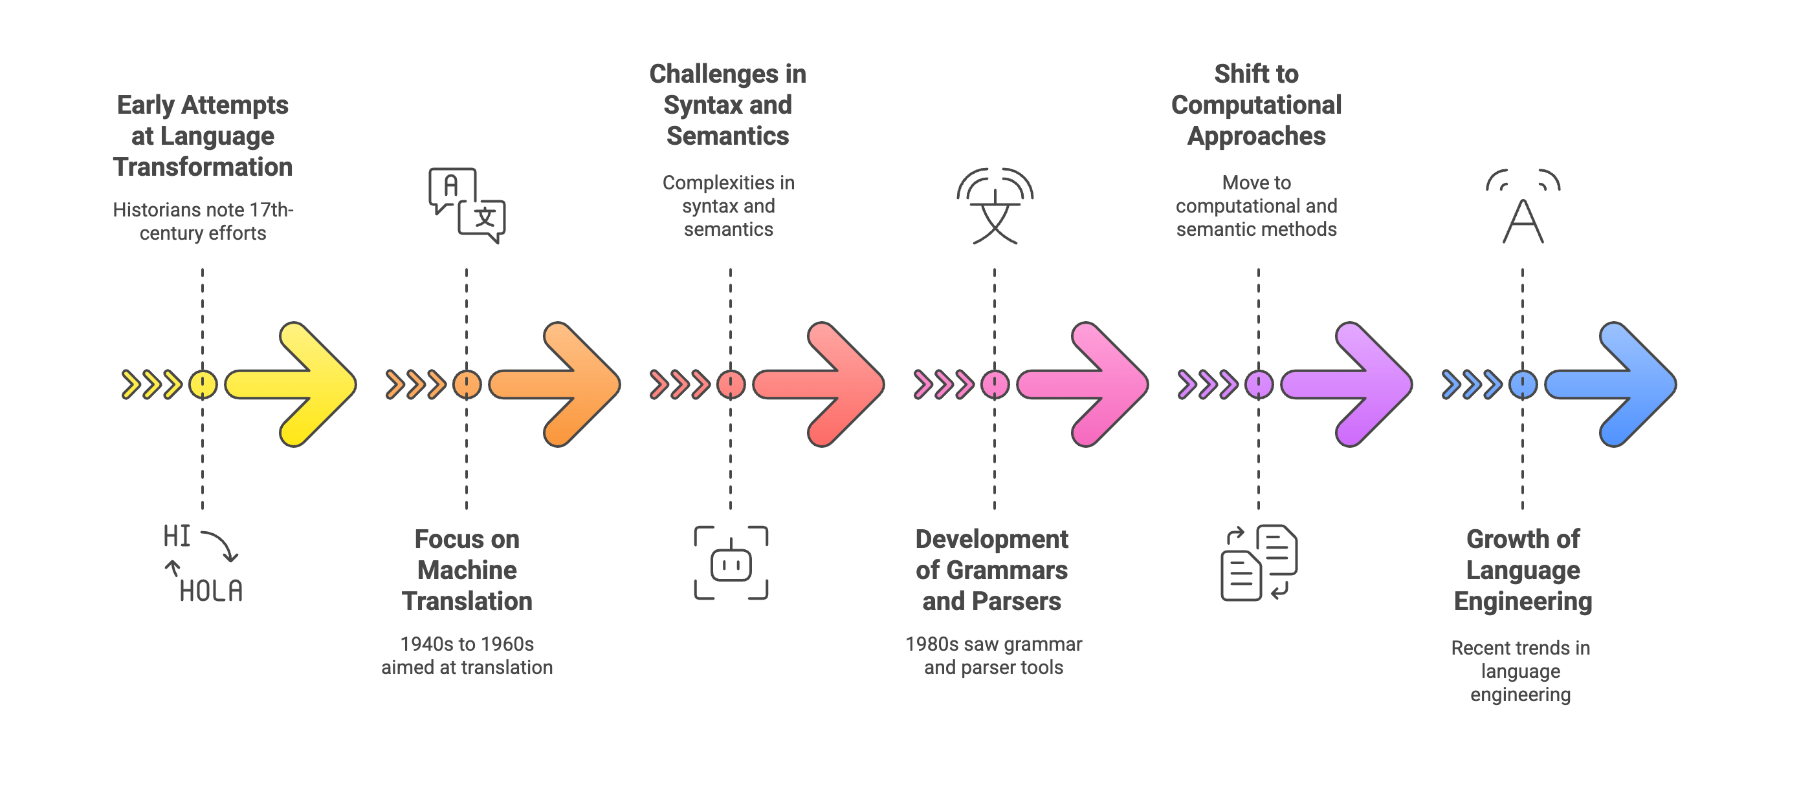
THE HISTORY OF NLP
Notes:
Syntactic processing (understanding sentence structure). Semantic processing (understanding meaning and context). Direct word-for-word translation often led to incorrect or unnatural sentences.
The 1980s: Shift to Computational Approaches
Key Advancements:
Parsers & Grammars – Systems began analyzing not just words but also sentence structure and rules.
Word Sense Disambiguation (WSD) – Understanding words with multiple meanings (e.g., "bank" as a financial institution vs. "bank" of a river).
Probabilistic Models & Statistical Methods – Instead of relying on fixed rules, systems used probabilities to improve accuracy.
Impact: Marked the transition from a mechanical approach (rule-based translation) to a computational and semantic approach (understanding meaning and context).
Language engineering is about applying NLP techniques to create functional, real-world language tools. It plays a critical role in AI-powered communication, making human-computer interactions more natural and efficient. 🚀

Slide 6
THE HISTORY OF NLP
Early approaches relied on word-to-word dictionary translations, where each word was looked up in a bilingual dictionary and replaced with its counterpart.
Challenges:
This method was slow and inefficient.
It failed to capture sentence structure, syntax, and meaning (e.g., idioms and context-dependent words).
Notes:
Syntactic processing (understanding sentence structure). Semantic processing (understanding meaning and context). Direct word-for-word translation often led to incorrect or unnatural sentences.
The 1980s: Shift to Computational Approaches
Key Advancements:
Parsers & Grammars – Systems began analyzing not just words but also sentence structure and rules.
Word Sense Disambiguation (WSD) – Understanding words with multiple meanings (e.g., "bank" as a financial institution vs. "bank" of a river).
Probabilistic Models & Statistical Methods – Instead of relying on fixed rules, systems used probabilities to improve accuracy.
Impact: Marked the transition from a mechanical approach (rule-based translation) to a computational and semantic approach (understanding meaning and context).
Language engineering is about applying NLP techniques to create functional, real-world language tools. It plays a critical role in AI-powered communication, making human-computer interactions more natural and efficient. 🚀

Slide 7
THE HISTORY OF NLP
Syntactic processing (understanding sentence structure).
Semantic processing (understanding meaning and context).
Direct word-for-word translation often led to incorrect or unnatural sentences.
Notes:
The 1980s: Shift to Computational Approaches
Key Advancements:
Parsers & Grammars – Systems began analyzing not just words but also sentence structure and rules.
Word Sense Disambiguation (WSD) – Understanding words with multiple meanings (e.g., "bank" as a financial institution vs. "bank" of a river).
Probabilistic Models & Statistical Methods – Instead of relying on fixed rules, systems used probabilities to improve accuracy.
Impact: Marked the transition from a mechanical approach (rule-based translation) to a computational and semantic approach (understanding meaning and context).
Language engineering is about applying NLP techniques to create functional, real-world language tools. It plays a critical role in AI-powered communication, making human-computer interactions more natural and efficient. 🚀

Slide 8
THE HISTORY OF NLP
A grammar is a set of rules that define the structure of a language. It specifies how words and phrases can be combined to form valid sentences.
Eg. - Context-Free Grammar (CFG)
Parsers & Grammars – Systems began analyzing not just words but also sentence structure and rules.
Word Sense Disambiguation (WSD) – Understanding words with multiple meanings (e.g., "bank" as a financial institution vs. "bank" of a river).
A parser is a computational tool that takes a sentence and analyzes its grammatical structure based on a given grammar. It helps in:
Identifying parts of speech (POS tagging).
Understanding sentence structure.
Resolving ambiguity in meaning.
Eg.- Top-Down and Bottom-up parsing
Notes:
Syntactic processing (understanding sentence structure). Semantic processing (understanding meaning and context). Direct word-for-word translation often led to incorrect or unnatural sentences.
The 1980s: Shift to Computational Approaches
Key Advancements:
Parsers & Grammars – Systems began analyzing not just words but also sentence structure and rules.
Word Sense Disambiguation (WSD) – Understanding words with multiple meanings (e.g., "bank" as a financial institution vs. "bank" of a river).
Probabilistic Models & Statistical Methods – Instead of relying on fixed rules, systems used probabilities to improve accuracy.
Impact: Marked the transition from a mechanical approach (rule-based translation) to a computational and semantic approach (understanding meaning and context).
Language engineering is about applying NLP techniques to create functional, real-world language tools. It plays a critical role in AI-powered communication, making human-computer interactions more natural and efficient. 🚀

Slide 9
THE HISTORY OF NLP
Probabilistic Models & Statistical Methods – Instead of relying on fixed rules, systems used probabilities to improve accuracy.
Impact: Marked the transition from a mechanical approach (rule-based translation) to a computational and semantic approach (understanding meaning and context).
Notes:
Syntactic processing (understanding sentence structure). Semantic processing (understanding meaning and context). Direct word-for-word translation often led to incorrect or unnatural sentences.
The 1980s: Shift to Computational Approaches
Key Advancements:
Parsers & Grammars – Systems began analyzing not just words but also sentence structure and rules.
Word Sense Disambiguation (WSD) – Understanding words with multiple meanings (e.g., "bank" as a financial institution vs. "bank" of a river).
Probabilistic Models & Statistical Methods – Instead of relying on fixed rules, systems used probabilities to improve accuracy.
Impact: Marked the transition from a mechanical approach (rule-based translation) to a computational and semantic approach (understanding meaning and context).
Language engineering is about applying NLP techniques to create functional, real-world language tools. It plays a critical role in AI-powered communication, making human-computer interactions more natural and efficient. 🚀

Slide 10
THE HISTORY OF NLP
About applying NLP techniques to create functional, real-world language tools
Notes:
Syntactic processing (understanding sentence structure). Semantic processing (understanding meaning and context). Direct word-for-word translation often led to incorrect or unnatural sentences.
The 1980s: Shift to Computational Approaches
Key Advancements:
Parsers & Grammars – Systems began analyzing not just words but also sentence structure and rules.
Word Sense Disambiguation (WSD) – Understanding words with multiple meanings (e.g., "bank" as a financial institution vs. "bank" of a river).
Probabilistic Models & Statistical Methods – Instead of relying on fixed rules, systems used probabilities to improve accuracy.
Impact: Marked the transition from a mechanical approach (rule-based translation) to a computational and semantic approach (understanding meaning and context).
Language engineering is about applying NLP techniques to create functional, real-world language tools. It plays a critical role in AI-powered communication, making human-computer interactions more natural and efficient. 🚀

Slide 11
How does NLP work? General Framework
Understand Language Structure
Using Dictionaries and Word Patterns
Extract Meaning from Text
Analyzing Multiple Documents
NLP systems analyze language by recognizing patterns, structures, and meanings in words and sentences.
Example: "The cat is sleeping on the mat."
NLP identifies "cat" as a noun, "sleeping" as a verb, and "on the mat" as location information.
Computers use dictionaries (word meanings) and patterns of how words appear together to understand context.
Example: "Apple is a fruit." 🍏 → Here, Apple refers to food.
"Apple released a new iPhone." 📱 → Here, Apple is a company.
NLP can recognize the difference using context!
NLP can find important information like names, locations, events, and actions from a document. Example: If you give a computer a news article about "Elon Musk launching a SpaceX rocket from Florida", NLP can extract:
Person: Elon Musk; Company: SpaceX; Action: Launching; Location: Florida
NLP is not limited to one sentence—it can compare and analyze multiple documents!
Example: If two news articles mention "the same accident but use different wording", NLP can still identify it’s the same event.

Slide 12
Example

Slide 13
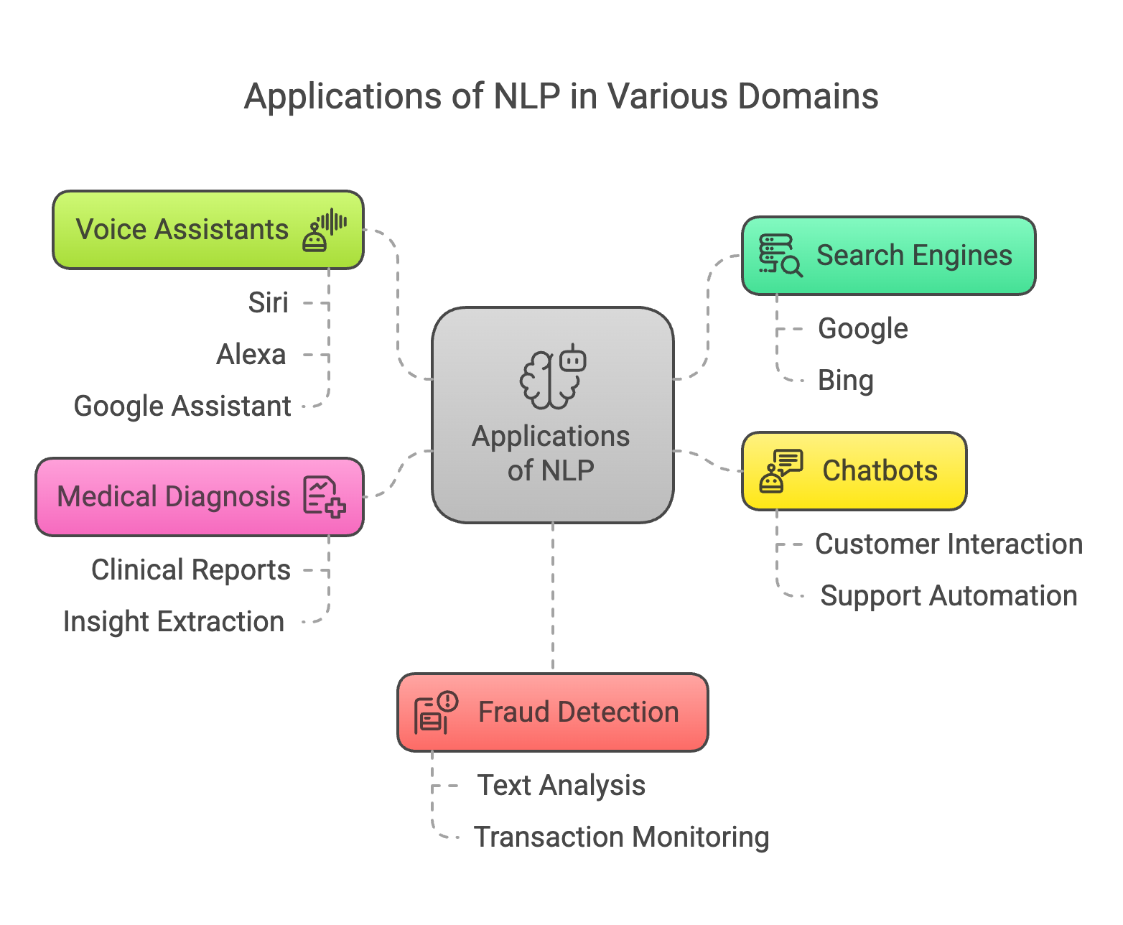
Applications of NLP

Slide 14
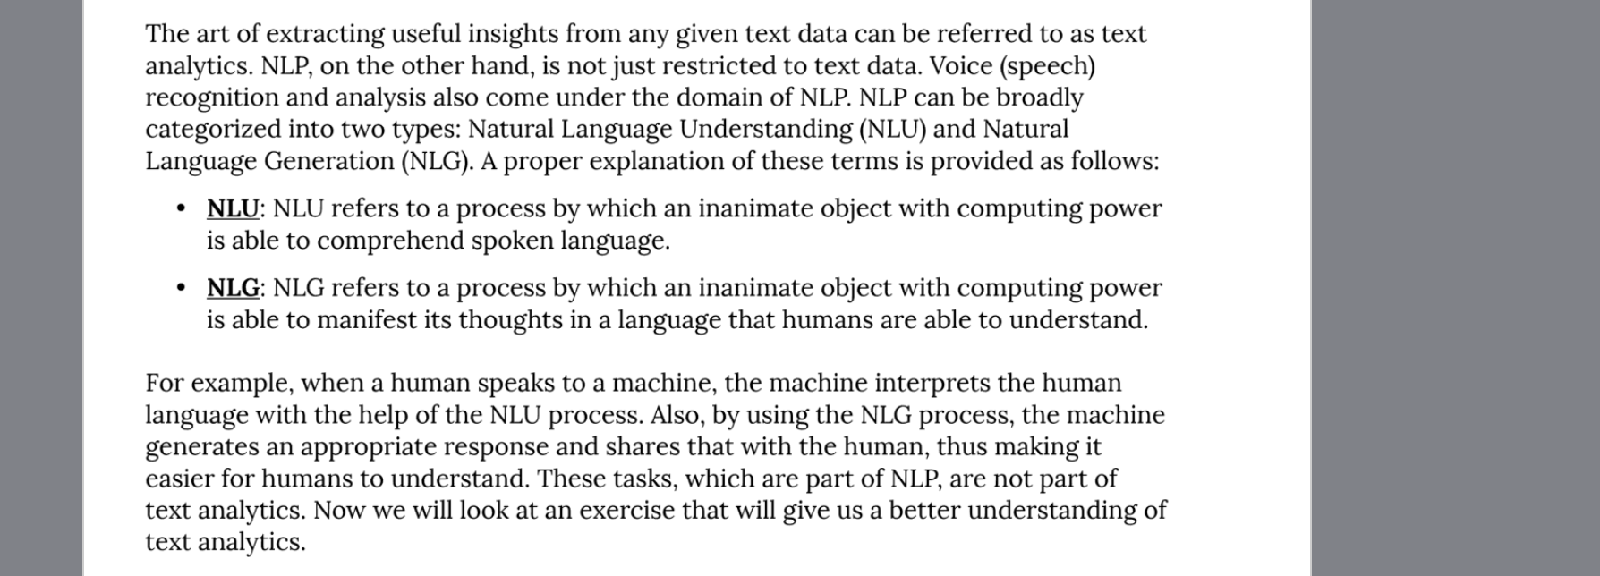
Broad Categories of NLP
NLP
Natural Language Understanding (NLU)
Natural Language Generation
(NLG)
NLP seeks to convert unstructured language data into a structured data format to enable machines to understand speech and text and formulate relevant, contextual responses. Its subtopics include natural language processing and natural language generation
Natural language understanding (NLU) focuses on machine reading comprehension through grammar and context, enabling it to determine the intended meaning of a sentence.
Natural language generation (NLG) focuses on text generation, or the construction of text in English or other languages, by a machine and based on a given dataset.
Understanding human input.
NLU refers to a process by which an inanimate object with computing power is able to comprehend spoken language
Generating meaningful responses.
NLG refers to a process by which an inanimate object with computing power is able to manifest its thoughts in a language that humans are able to understand

Slide 15
NLP as the Parent Field
NLP encompasses both NLU and NLG, along with other subfields like speech recognition, translation, and information retrieval.
NLU and NLG work together to create a seamless human-computer interaction experience.
🔹 Relation in a Chatbot Example
NLU (Understanding User Input)
User: "What’s the weather in Paris today?"
NLU extracts: Intent = Weather Inquiry, Entity = Paris, Date = Today.
NLP (Processing and Decision Making)
The system retrieves weather data from an API.
NLG (Generating a Response)
Chatbot: "Today’s weather in Paris is sunny with a temperature of 22°C."

Slide 16
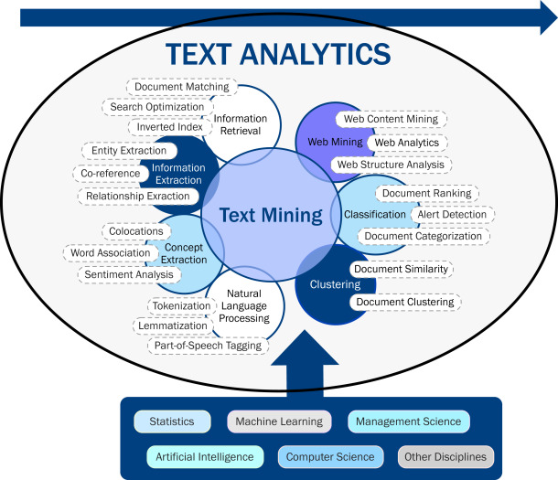
Text Analytics vs NLP
Text Analytics - The art of extracting useful insights and answering questions from any given text data.
NLP – Not just restricted to text data. Voice (speech) recognition and analysis also come under domain of NLP.

Slide 17
Understanding Linguistics
NLP = Linguistics + ML + Computational Techniques
Linguistics – The Study of Language
Linguistics is the scientific study of language and its structure, including how it is formed, used, and understood.
It explores both the rules that govern languages and how humans acquire and process them.

Slide 18
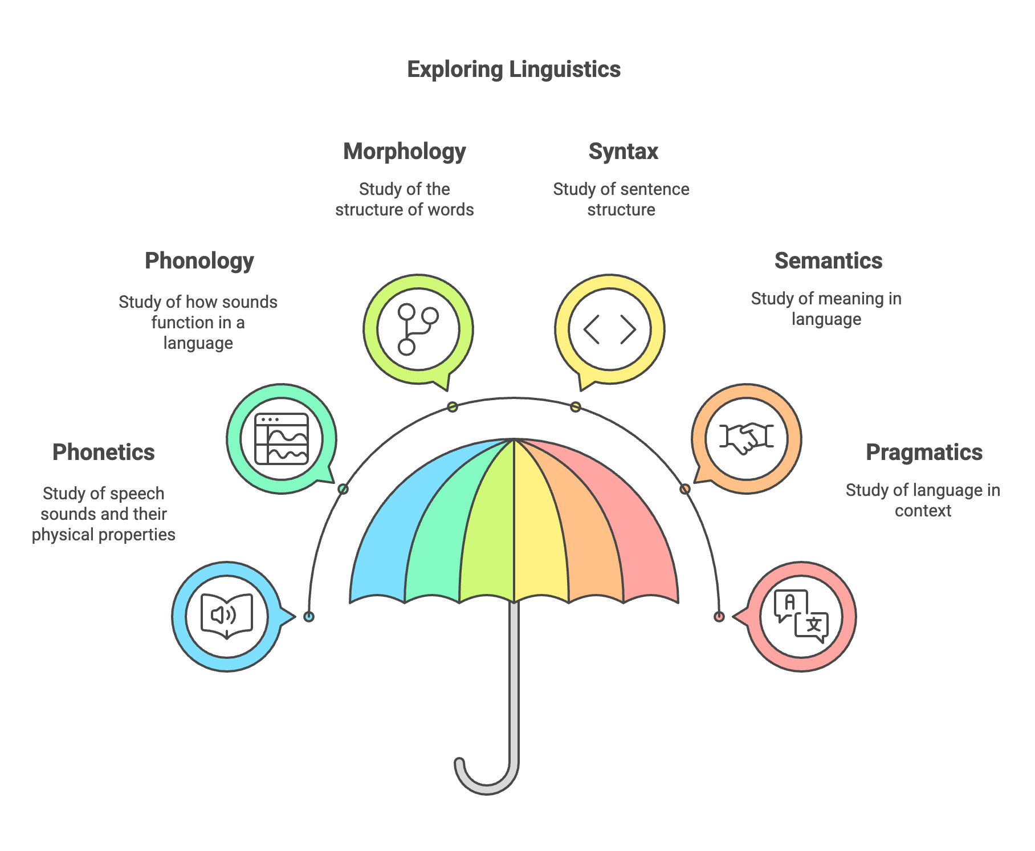
Branches of Linguistics/NLP Terminology
Replaying" → "re-" (prefix) + "play" (root) + "-ing" (suffix).
"The cat chased the mouse" vs. "The mouse chased the cat" (same words, different meanings).
In English, "ng" appears at the end of words (e.g., "sing") but never at the beginning.
difference between pronouncing "p" (with a puff of air) and "b" (without a puff of air).
pitch, loudness, frequency
"Can you open the window?" is a request, not just a question about ability.
It goes beyond the literal meaning of words to understand how language is used in real-world situations.
Notes:
Types of Morphemes: Root Morpheme: The base word (e.g., "happy" in "unhappiness").
Affixes: Prefixes and suffixes that modify meaning (e.g., "un-" (prefix) and "-ness" (suffix) in "unhappiness").
Correct Syntax: "She loves music." Incorrect Syntax: "Loves she music." (Wrong word order in English but acceptable in some languages).

Slide 19
Role of Linguistics in NLP
Role in NLP :
Linguistic analysis breaks down the text to provide meaning.
Linguistics provide rules and structures in NLP that help AI systems understand and generate human language.
For example:
Syntax & Parsing help computers understand sentence structure.
Semantics improves meaning extraction in chatbots.
Phonetics & Speech Processing aid in voice recognition technologies.

Slide 20
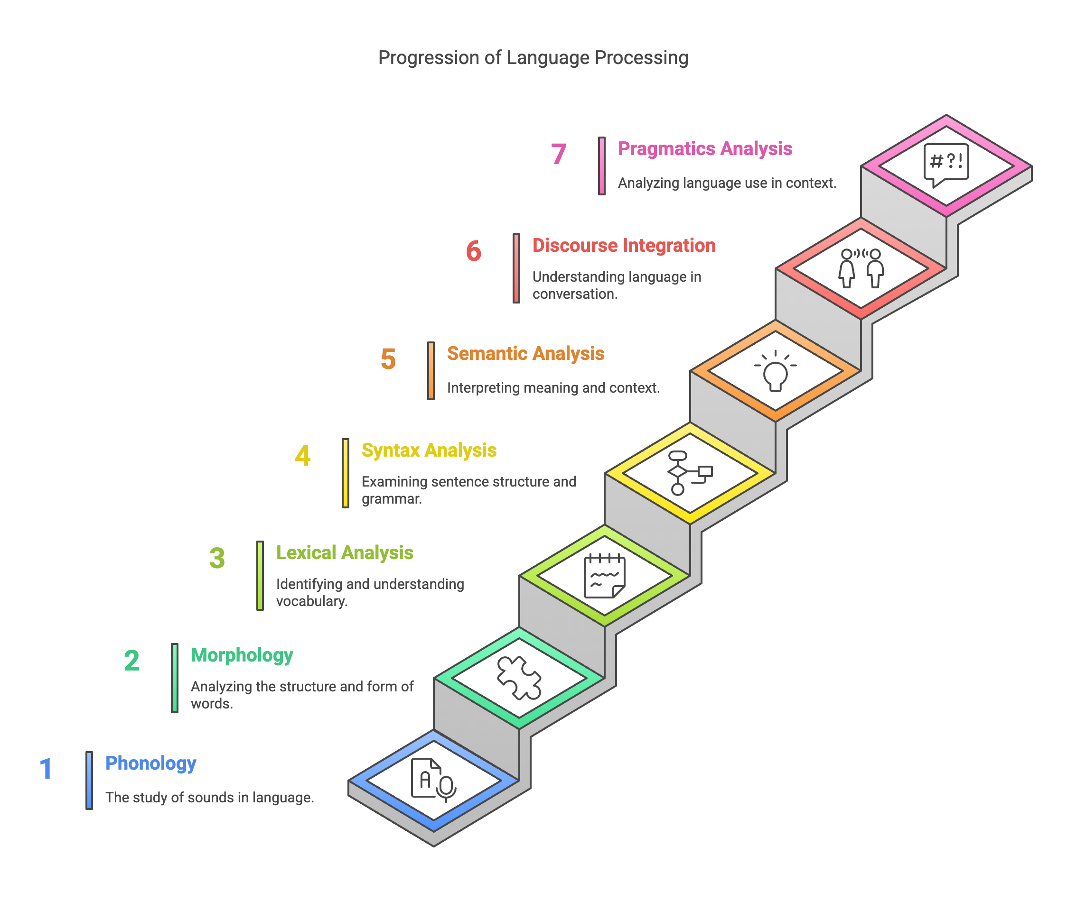
Main Steps/Phases/Levels of NLP
Phonology
Morphology
Lexical Analysis
Syntax Analysis
Semantic Analysis
Discourse Integration
Pragmatics Analysis
Deal with the lower-level processing of language, focusing on sounds and word structures
Deal with higher-level meaning and context understanding

Slide 21
Phonology in NLP
Phonology is the study of the physical sounds of a language and how those sounds are uttered in a particular language.
This area is important for speech recognition and speech synthesis but is not important for interpreting written text.
However, to understand, for instance, the soundtrack of a video, or the recording of a call center call, not only is the pronunciation of the words important (regional accents such as British English or Southern United States), but the intonation patterns.
A person who is angry may use the same words as a person who is confused; however, differences in intonation will convey differences in emotion.
When using speech recognition in a cognitive system, it is important to understand the nuances of how words are said and the meaning that articulation or emphasis conveys.

Slide 22
Phonology in NLP
Phonemes – The smallest unit of sound that can change meaning.
Example: In English, /p/ and /b/ are phonemes because they distinguish words like pat and bat.
Why is Phonology important?
Helps in understanding speech patterns and accents.
Essential for language learning and speech therapy.
Useful in speech recognition and text-to-speech systems (e.g., Alexa, Google Assistant).

Slide 23
Morphology
Morphology refers to the structure of a word.
It breaks words into morphemes (smallest units of meaning).
Types of Morphemes:
Root Morpheme: The base word (e.g., "happy" in "unhappiness").
Affixes: Prefixes and suffixes that modify meaning (e.g., "un-" (prefix) and "-ness" (suffix) in "unhappiness").

Slide 24
Step 1. Lexical Analysis/ Text Preprocessing
In any analysis of incoming text, the first process is to identify which language the text is written in and then to break the text apart into separate sentences.
Later, separate the sentences into words (Tokenization).
Step 1.1 Tokenization: Process of splitting a sentence into its constituents i.e. separate words or tokens.
Eg. “I am reading a book.” ---------------------------------> “I”, “am”, “reading”, “a”, “book”, “.”
Lexical Analysis (Word-Level Processing)
Includes Text Preprocessing
Breaks text into tokens (words, sentences).
Assigns POS tags (nouns, verbs, adjectives).
Identifies Named Entities (places, names, dates).
n-gram refers to a sequence of n items from a given text.
These tokens are called Unigrams (one token at a time)
Unigrams – One token at a time
Bigrams- Extract two tokens at a time
Trigrams – Extract three tokens at a time
Eg: I would love to visit the United States
Unigram can give wrong results here as United States must be treated as single entity.
Notes:
Sentence Segmentation and Tokenization, Stemming and lemmatization, Stop word removal

Slide 25
Step 1. Lexical Analysis/ Text Preprocessing
Step 1.2: Text Normalization
Process wherein different variations of text get converted to standard from
Spelling Correction
Stemming
Lemmatization

Slide 26
Step 1. Lexical Analysis/ Text Preprocessing
Step 1.2: Text Normalization – Spelling Correction
Autocorrect – Python library
Natureal -----> Natural
Need spelling correctors which are aware of context

Slide 27
Step 1. Lexical Analysis/ Text Preprocessing
Step 1.2: Text Normalization - Stemming
Stemming - A text preprocessing technique that reduces words to their root or base form (stem) by removing affixes, simplifying text for tasks like information retrieval and text analysis
The words "running," "runner," and "runs" would all be reduced to the stem "run”
Running and runner ---→ runn (ing and er)
Playing -> play; happily --→ happili
Problem with Stemming: Stemmed words do not carry any meaning
e.g. : independence -> independ (which is not present in English Dictionary)
Lemmatization deals with such cases by using a vocabulary and analyzing the words’ morphologies.
It returns the base forms of words which can be actually found in dictionaries

Slide 28
Step 1. Lexical Analysis/ Text Preprocessing
Step 1.2: Text Normalization - Lemmatization
Lemmatization - A text preprocessing technique that reduces words to their base or dictionary form (lemma) by considering the context and part of speech (POS); figuring out the most basic form or lemma of each word in the sentence.
‘running’ -> ‘run’
‘better’ -> ‘good’
‘went’ -> ‘go’
‘rocks’ -> ‘rock’
Corpora -> corpus
Lemmatization takes into account the grammatical category of a word (noun, verb, adjective, etc.) and provides the base form accordingly.
For example, the lemma of “running” as a verb is “run,” while as a noun, it remains “running.

Slide 29
Stemming vs Lemmatization
Stemming is an informal process of converting words to their base forms using heuristic rules. For example, “university,” “universities,” and “university’s” might all be mapped to the base univers. (One limitation in this approach is that “universe” may also be mapped to univers, even though universe and university don’t have a close semantic relationship.)
Lemmatization is a more formal way to find roots by analyzing a word’s morphology using vocabulary from a dictionary.
Stemming and lemmatization are provided by libraries like spaCy and NLTK (Natural Language Toolkit).
Lemmatization considers the context and morphological analysis to return a valid word, whereas stemming applies simpler rules to chop off prefixes or suffixes, often resulting in non-dictionary words.

Slide 30
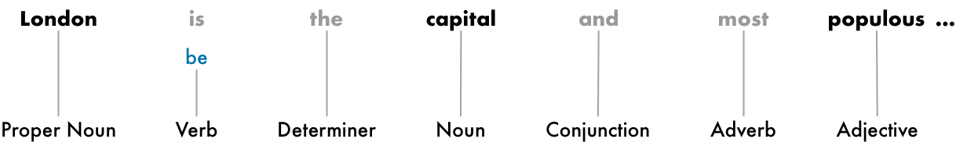
Step 1. Lexical Analysis/ Text Preprocessing
Step 1.3: StopWord Removal
Stop words - Common words that are just used to support construction of sentences
Do not impact meaning of sentence and can add noise
Remove the most commonly occurring words that don’t add much information to the text. For example, “the,” “a,” “an,” and so on.
There’s no standard list of stop words that is appropriate for all applications
Stop words grayed out
Notes:
Some NLP pipelines will flag them as stop words —that is, words that you might want to filter out before doing any statistical analysis.

Slide 31
Lexical Analysis
London is the capital and most populous city of England and the United Kingdom. Standing on the River Thames in the south east of the island of Great Britain, London has been a major settlement for two millennia. It was founded by the Romans, who named it Londinium.
“London is the capital and most populous city of England and the United Kingdom.”
“Standing on the River Thames in the south east of the island of Great Britain, London has been a major settlement for two millennia.”
“It was founded by the Romans, who named it Londinium.”
Sentence Segmentation
Tokenization
“London”, “is”, “ the”, “capital”, “and”, “most”, “populous”, “city”, “of”, “England”, “and”, “the”, “United”, “Kingdom”, “.”

