Slide 1
PRODUCT EXPERIMENTATION CERTIFICATION
FinWise, A Product-Led Growth Strategy
Unlock the revenue hidden in an underperforming reverse-trial PLG motion — from a flat 2% activation ceiling to a validated growth, retention, and monetization strategy.
Nandini Kodali · August
View deliverables →
Live prototype →

Slide 2
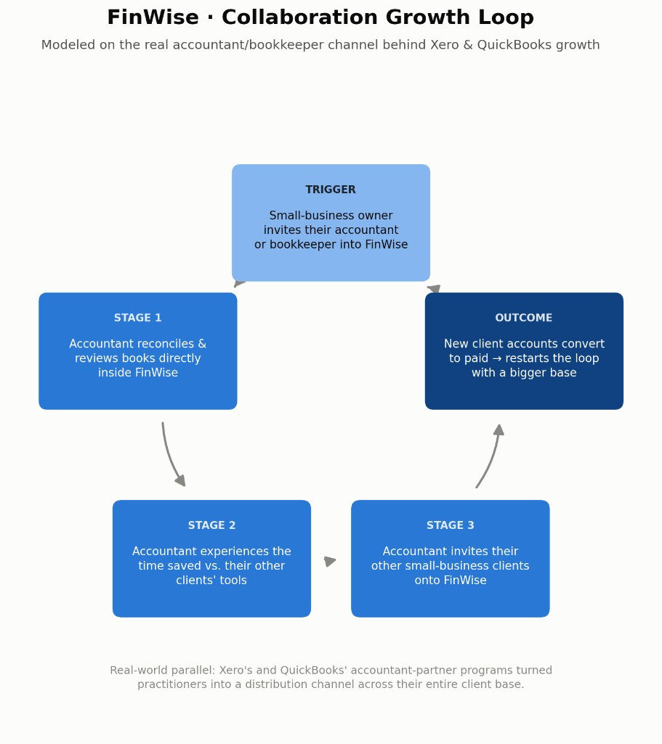
SLIDE 2 · THE BET
Growth hypothesis & the bet
GROWTH HYPOTHESIS
If we redesign FinWise's trial onboarding to guide new users to complete data import and their first financial model within their first session, trial-to-paid conversion will increase — because 13 months of flat ~2% conversion, regardless of traffic volume, shows activation, not acquisition, is the real blocker.
THE BET
Bet on activation, not acquisition — redesign onboarding around the Aha moment instead of buying more top-of-funnel traffic, backed by a Collaboration growth loop where accountants bring their client base onto FinWise.

Slide 3
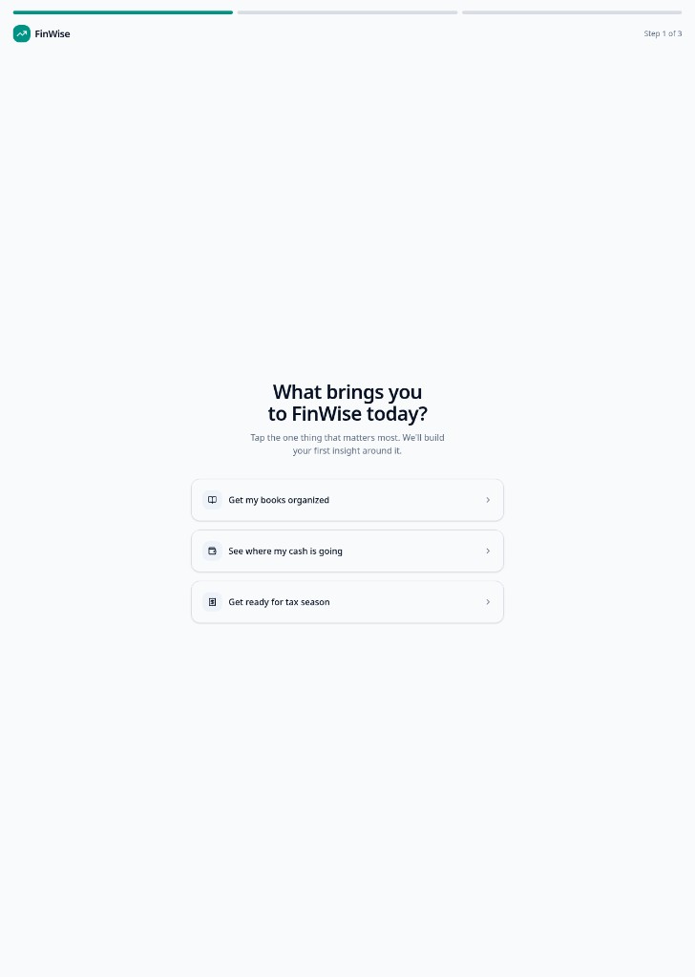
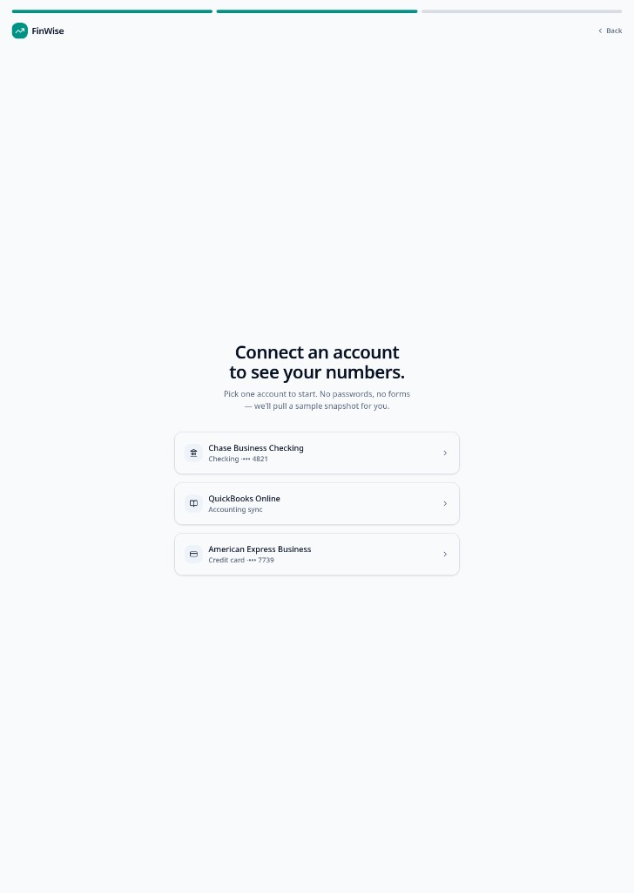
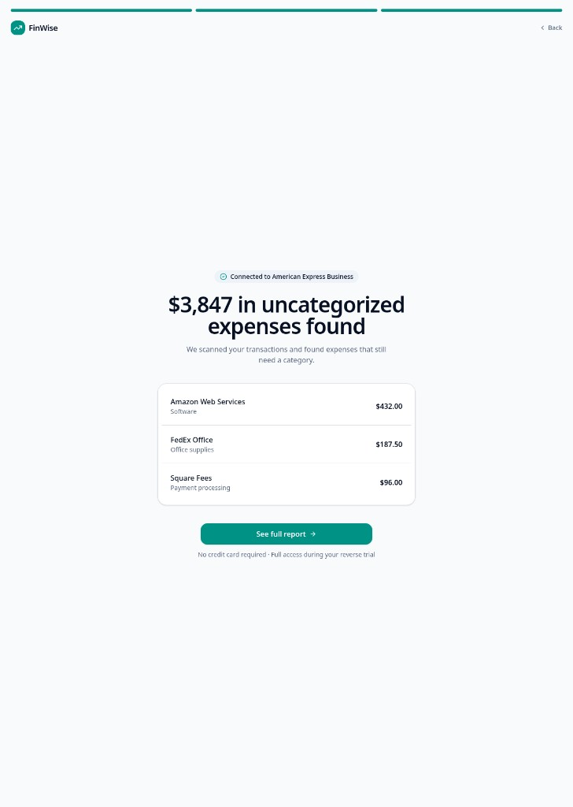
SLIDE 3 · THE SOLUTION
Onboarding & the Aha moment
AHA-MOMENT DEFINITION
"I didn't have to build this myself, and now I can actually see my business's numbers clearly."
The moment a new trial user connects their financial data and sees their first auto-generated report or financial snapshot. Builds on the growth bet — connecting data and generating a report as core value. Beats a pure insights/alerts moment (needs historical data) — more Habit-stage than Day-1 Aha.
Step 1 · Goal
Step 2 · Connect
Step 3 · Aha
Open onboarding prototype →

Slide 4
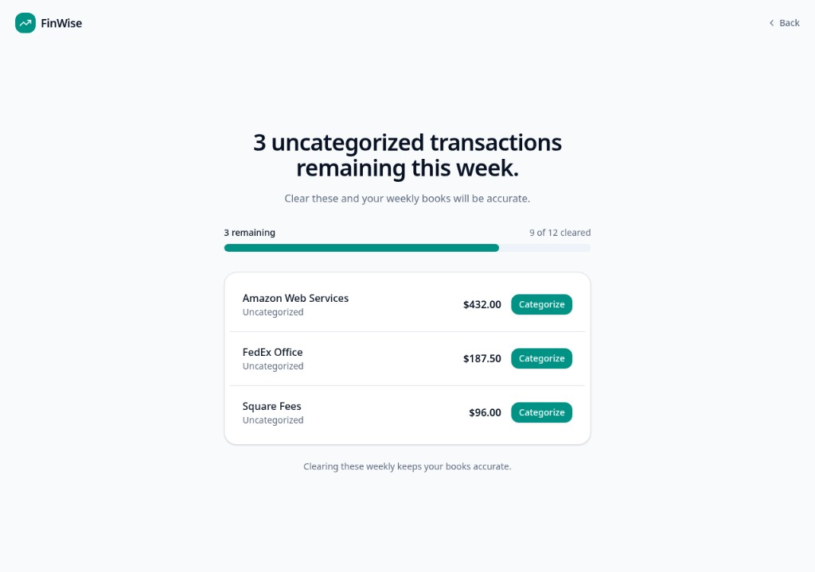
SLIDE 4 · THE MECHANIC
Weekly Clear-to-Zero
MECHANIC + RATIONALE
Weekly Clear-to-Zero — a countdown of uncategorized transactions remaining this week, tied to the same problem the Aha moment surfaced.
FinWise's 60% one-year churn is value churn: users get their one Aha moment during onboarding, then usage tapers off before it ever becomes a habit.
This mechanic builds that habit inside the reverse trial itself — before a paywall or renewal decision — so weekly categorization is already a habit by the time they evaluate paying.
Tied directly to real value (accurate books), not an arbitrary point system — keeps it out of the "reward loop without value" trap.
Open wireframe prototype →

Slide 5
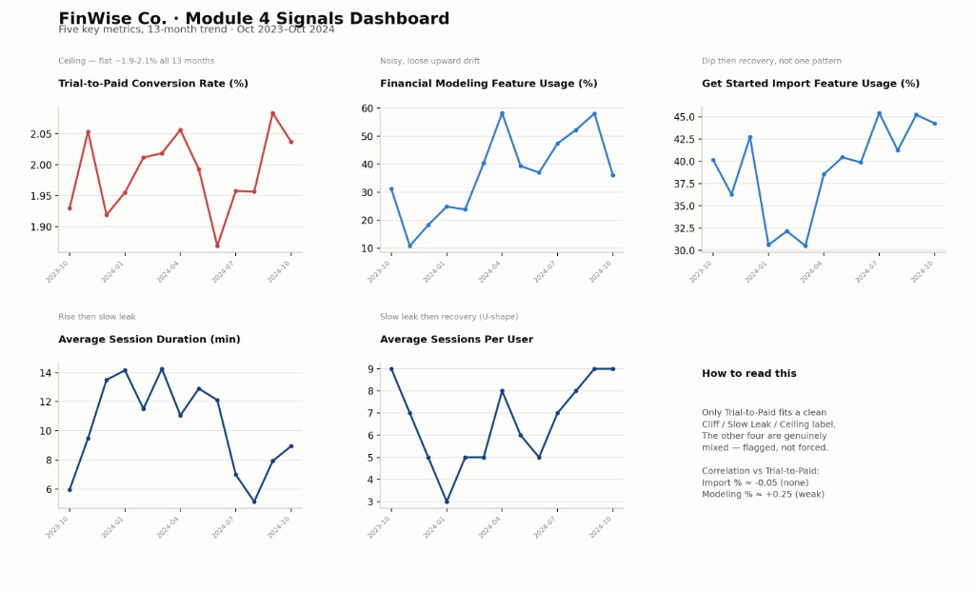
SLIDE 5 · THE SIGNALS
What we measure
LEADING
Get Started Import Feature Usage % — activation step the onboarding redesign targets.
Financial Modeling Feature Usage % — North Star behavior Weekly Clear-to-Zero reinforces; stronger (still weak) correlation with conversion.
LAGGING
Trial-to-Paid Conversion Rate — confirms whether leading indicators show up in the business result at scale.
DATA PATTERN
~2% ceiling · flat 1.87%–2.08% for 13 months
Not traffic — structural trial cap. Import % ≈ −0.05; Modeling % ≈ +0.25. Likely instrumentation gap: monthly aggregates across overlapping cohorts.

Slide 6
SLIDE 6 · THE VALIDATION
Experiment brief
Method: Standard A/B Test
Primary: Import Feature Usage %
Guardrail: Trial-to-Paid ≥ ~1.87%
Data Studio report →
METHOD + WHY
HYPOTHESIS + PRIMARY METRIC
GUARDRAIL + READ DATE
Standard A/B Test. Single, self-contained onboarding change on new trial sign-ups — no shared-environment contamination, no urgent per-user cost for a bandit. Cleanest signal without overcomplicating it.
If we replace FinWise's current onboarding with the import-first flow (intent tap → connect account → personalized headline finding), then Get Started Import Feature Usage % will increase.
Success threshold: 15% relative increase within the first 14 days of a trial (assumed target — no formal MDE calculated).
Guardrail: Trial-to-Paid Conversion Rate must not drop below its historical floor of ~1.87%.
Read date: Day 14 of each trial cohort's window. Decided before launch — no peeking early.

Slide 7
SLIDE 7 · THE MODEL
Pricing & packaging
Stage 2 — Revenue Expansion
Reverse-trial + Freemium hybrid
Packaging bet
RECOMMENDATION
STAGE + MODEL
Replace the hard trial-expiration cutoff with a real, usable free tier: reconciliation, transaction categorization, and the account-connection flow stay free indefinitely.
Financial Modeling — the forecasting/modeling output that represents FinWise's actual North Star ("reach first modeling output") — sits behind the paywall.
This is a packaging bet ("is packaging matched to value?"), not a price increase or a full model change: the price points don't move, the free/paid line does.
Goal: stop losing the 98% who don't convert in the trial window; let them build habit on free and convert later at the modeling wall.
Trade-off: some urgency from a hard cutoff is lost. Accepted cost so acquisition can compound instead of depending entirely on paid channels.
Stage 2 — Revenue Expansion. Value proven at $10M ARR. Evidence: only 2% convert; 40% one-year retention (60% churn). Pure reverse-trial proves value fast but fits poorly to recurring habit — pair with a free tier.
SUPPORTING SIGNAL
Financial Modeling Feature Usage % — only leading indicator with positive (weak) correlation to paid conversion. Success: conversions cluster at first Modeling attempts. Guardrail: free-tier reconciliation engagement must not collapse.

Slide 8
SLIDE 8 · THE STORY
Insights & submit
BIGGEST FRICTION
KEY AHA MOMENT
TAKEAWAYS
The instinct was to treat pricing as the fix — it's the most visible lever. Held off until the funnel data actually pointed there, which meant activation came first and pricing followed, as a packaging change, not a price hike.
The 2% conversion number stayed flat for 13 straight months no matter how much traffic changed. That's what turned this from an acquisition problem into an activation one.
Let the data gate each decision instead of jumping to the obvious lever. A correlation that's weak is still worth reporting honestly, not stretched into a bigger signal than it is.
SUBMIT ON THE LEARNING PLATFORM
View deliverables →
Live prototype →
Nandini Kodali · August · Product Experimentation Certification · Product School

