Slide 1
Traditional Paraguayan Snack Recognition using Deep Learning
Presenters : Octavio Santacruz, Juan Minardi, Jonathan González
Advisor : Prof. Shanq-Jang Ruan
Date : 01-06-2022

Slide 2
Outline
Introduction
Brief Introduction and Foundation about the project
Data Collection and Preparation
How data was collected
How data was preprocessed into model
Methodology
Results
Future Works
Ideas to Continue this project
Conclusion
Short summary of results and comments

Slide 3
Outline
Introduction
Data Collection and Preparation
Methodology
Results
Future Works
Conclusion

Slide 4
Introduction
Machine Learning is able to achieve incredible tasks.
Simply creating a machine learning model capable of identify food won’t solve any major problem right now, but is it a start
The process of identifying food from an image is an interesting field with various applications
4 Main Objectives
Notes:
The process of identifying food from an image is an interesting field with various applications. Since food controls our health. It takes a key role in health-related problems.

Slide 5
Outline
Introduction
Data Collection and Preparation
Methodology
Results
Future Works
Conclusion

Slide 6
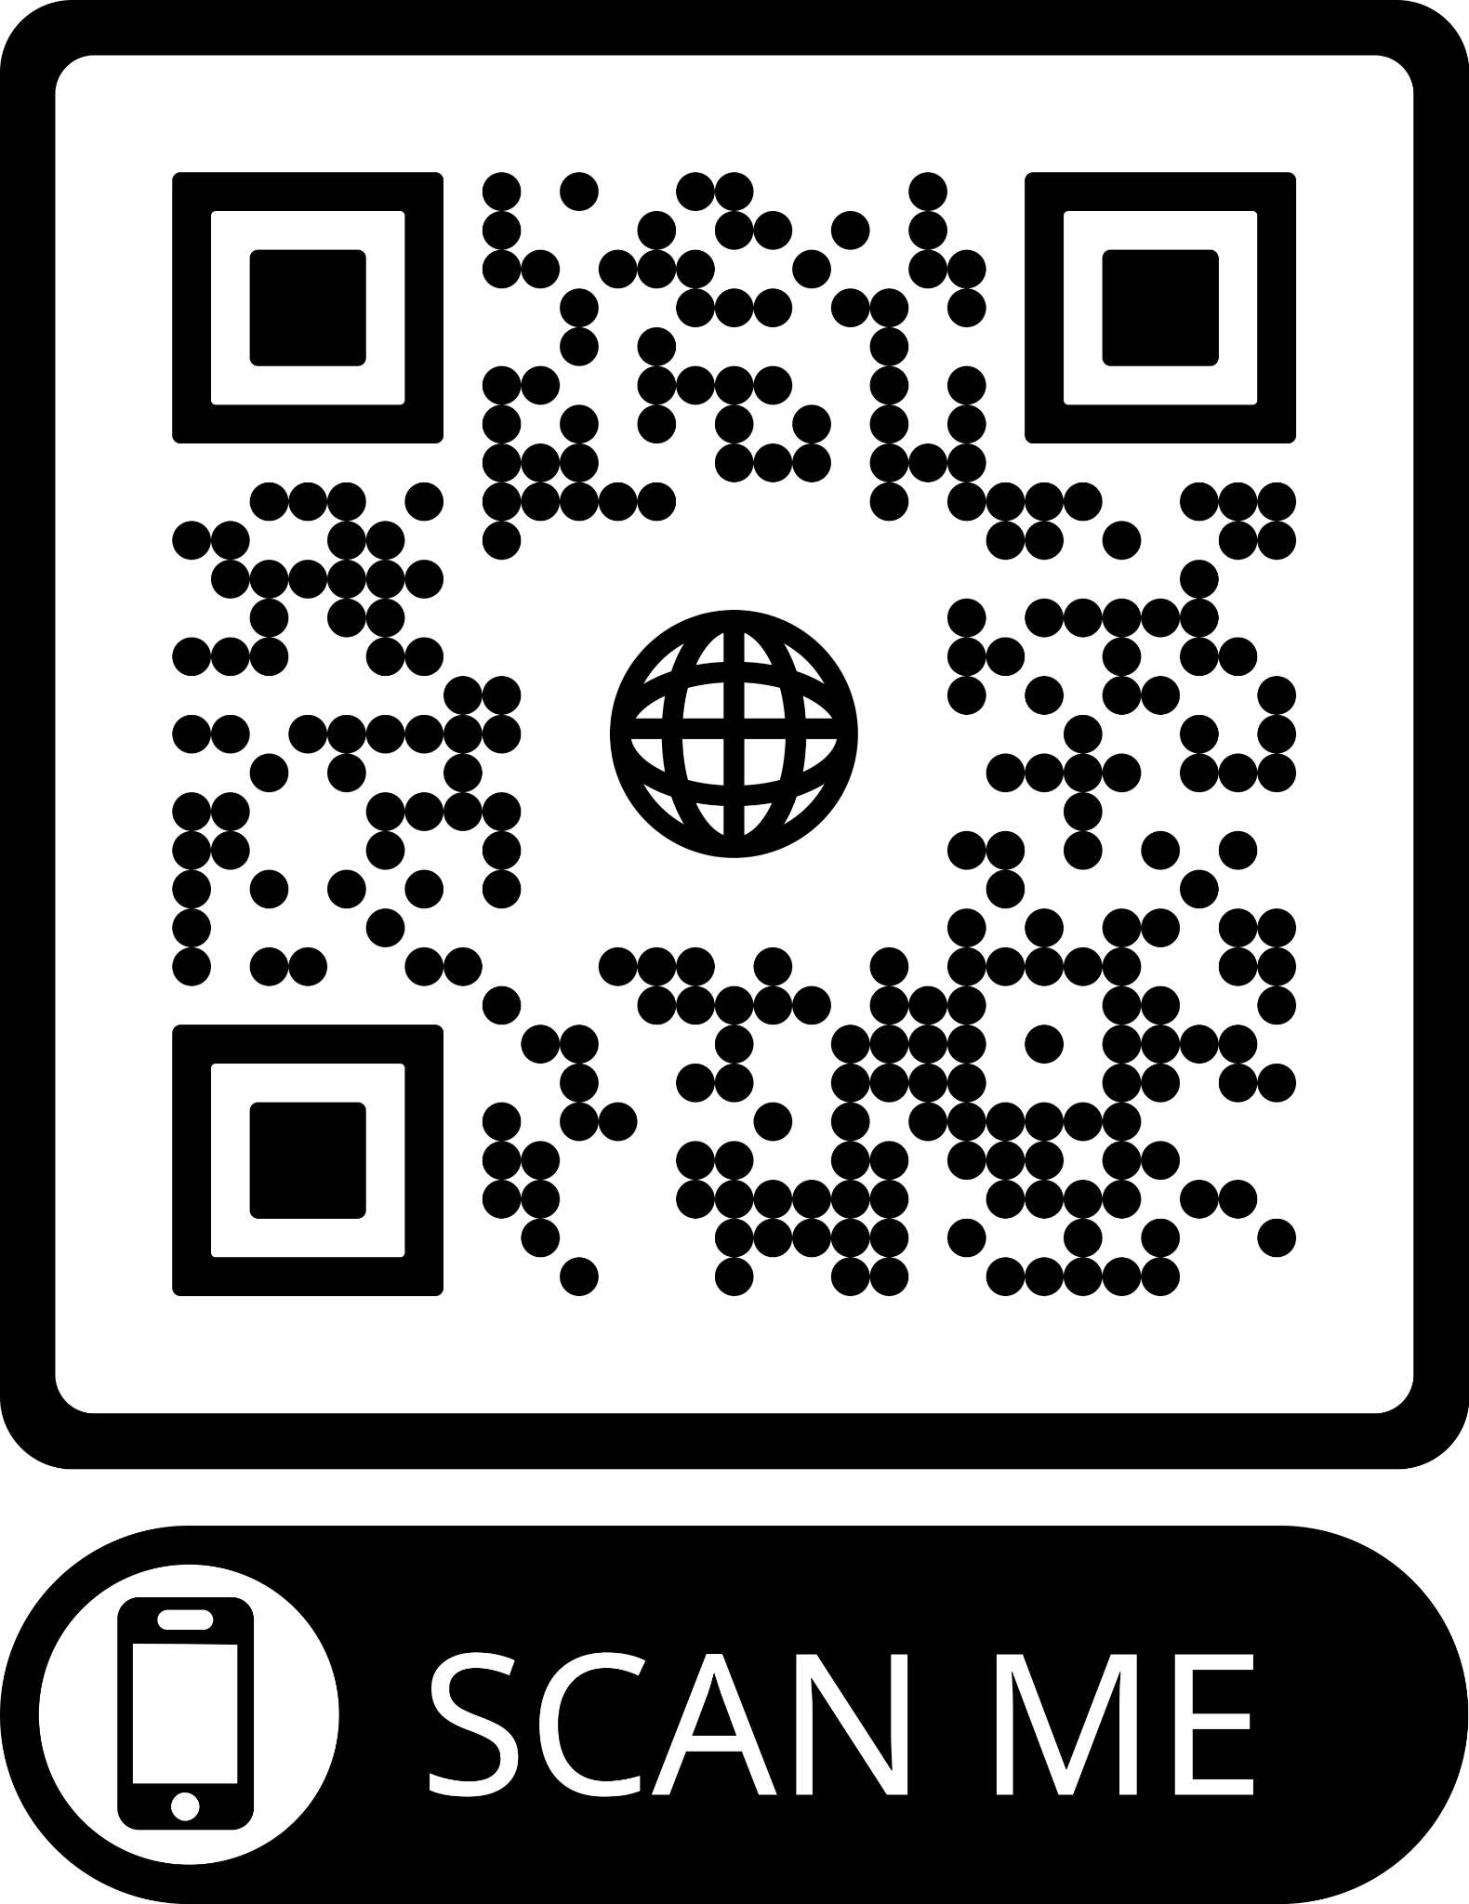
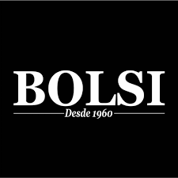
Data Collection and Preparation
All the photos come from a Paraguayan restaurant called “Bolsi”
Data Collection process involved taking photographs of the traditional snacks this restaurant sells with a white background
Those snacks include
Chipa, Chipa Guasu, Sopa Paraguaya/Paraguayan Soap, Pajagua, Pastel Mandi’o, Mbeju
Key Points from Data Preparation
Creation on Folders with respective name of each snack
Load the dataset from the directory, define image and batch size as well
Apply transformation to the images (using ImageDataGenerator method from keras)
Initialize an empty arrays x and y to hold image and
labels
Concatenate images and labels to arrays and break
t the loop when all images have been processed
Notes:
Dps de todo…
Finally split the data into training and test sets,
Training will be 80% and testing will be 20%

Slide 7
Outline
Introduction
Data Collection and Preparation
Methodology
Results
Future Works
Conclusion

Slide 8
Outline
Introduction
Data Collection and Preparation
Methodology
Results
Future Works
Conclusion

Slide 9
Outline
Introduction
Data Collection and Preparation
Methodology
Results
Future Works
Conclusion

Slide 10

Future Works
We come up with 4 paths to continue with this project
Create an Application or Website that is able to submit images voluntarily for revision and later addition to the dataset
Overfitting
Diversity of Data
Expand the dataset to cover “Bolsi”menu
Upload the dataset to Kaggle as open-source for further improvement from the community
Implement an Object Detection or Instance Segmentation
Both things could be done with YOLO
Notes:
Create an application that can predict and also submit images voluntarily for revision and later addition to the dataset in order to further diversify the data.
Expand the model to cover the whole menu of bolsi restaurant
Upload the dataset to kaggle as open-source for other to improve upon it
Implement an object detection model using YOLO

Slide 11
Outline
Introduction
Data Collection and Preparation
Methodology
Results
Future Works
Conclusion

