Slide 1
Development of a Diagonal Isometric Tensor Network Algorithm
Masters thesis
Benjamin Sappler

Slide 2
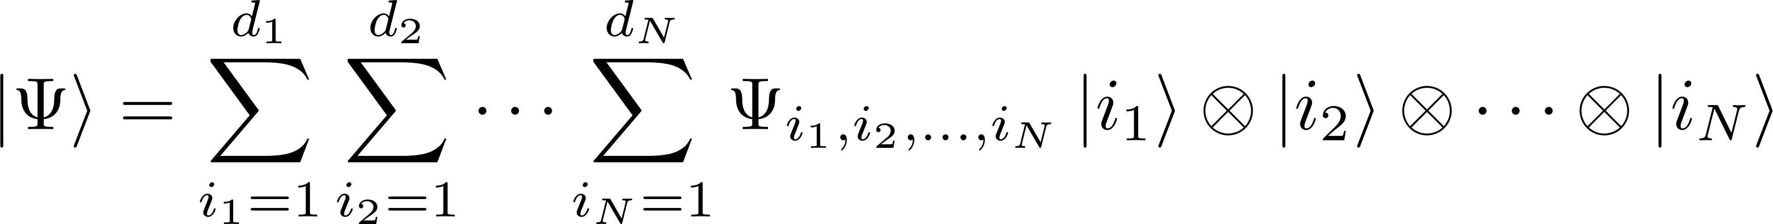
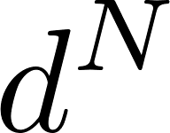
Simulation of QMB systems
parameters
Approximations are needed!

Slide 3
Contents
Matrix Product States (MPS)
Isometric Tensor Product States (isoTPS)
YB-isoTPS

Slide 4
Tensor Networks

