Slide 1
Development of a Diagonal Isometric Tensor Network Algorithm
Master‘s thesis
Benjamin Sappler

Slide 2
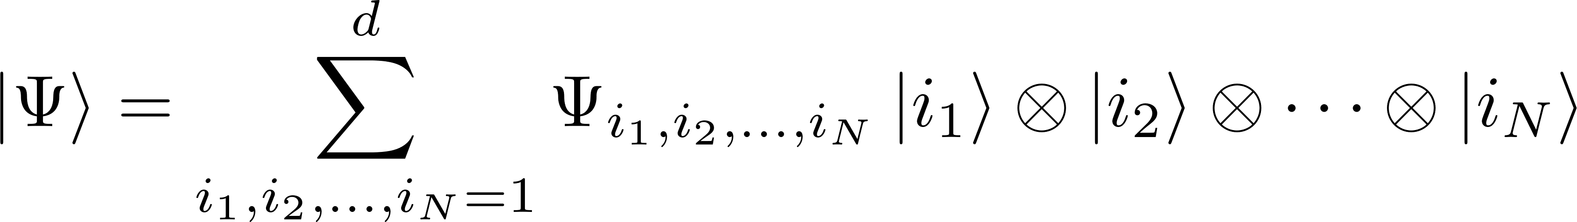
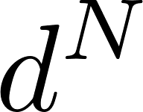
Simulation of QMB systems
Simulation of QMB systems is a hard problem
Fully describe wavefunction: parameters!
Approximations are needed!

Slide 3
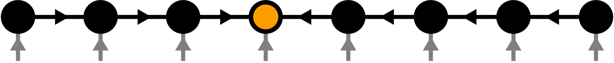
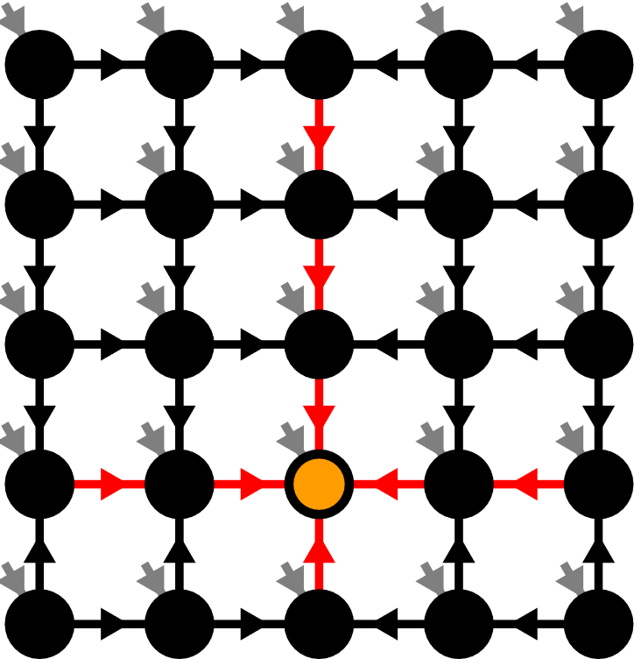
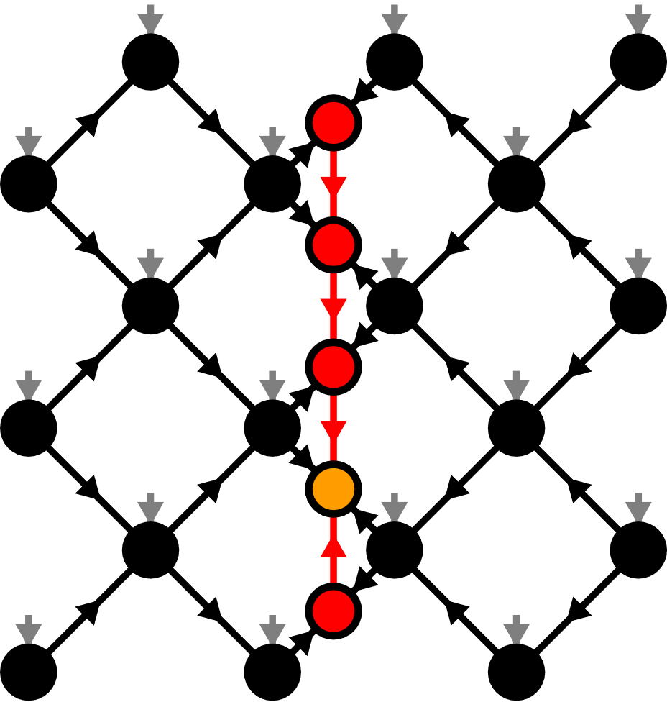
Contents
Matrix Product States (MPS)
Isometric Tensor Product States (isoTPS)
Alternative canonical form
[M. Fannes et al. 92]
[M.P. Zalatel, F. Pollmann, 2020]

Slide 4
Contents
Matrix Product States (MPS)
Isometric Tensor Product States (isoTPS)
Alternative canonical form
[M. Fannes et al. 92]
[M.P. Zalatel, F. Pollmann, 2020]

Slide 5

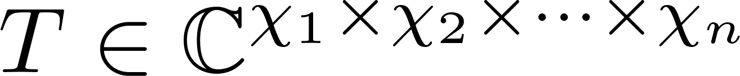
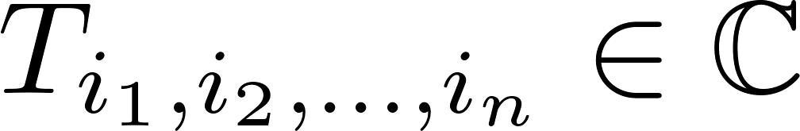
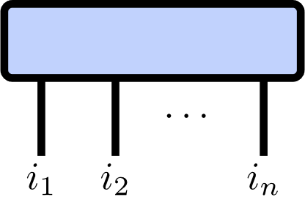
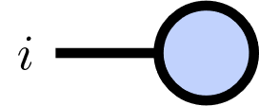
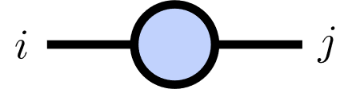
Tensor Networks
Tensor of rank :

Slide 6
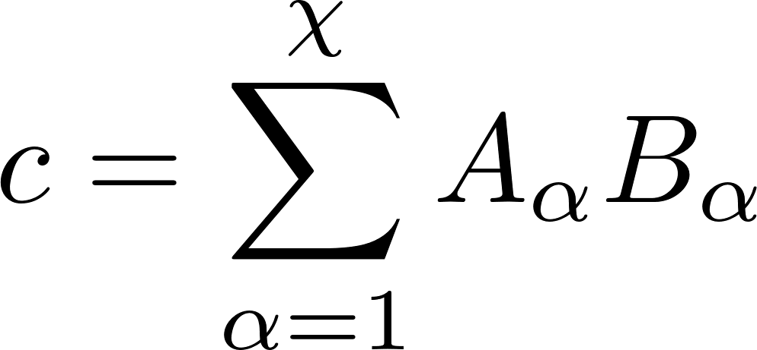
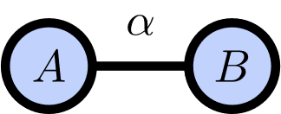
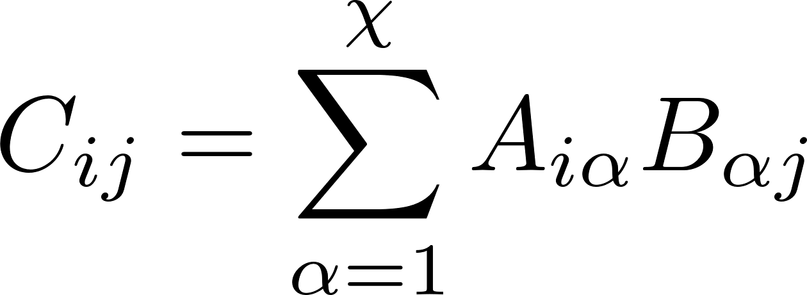
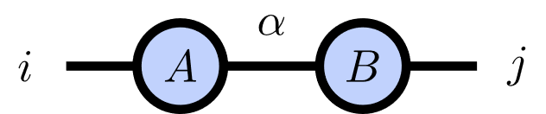
Index Contractions
Scalar product:
Matrix product:

Slide 7
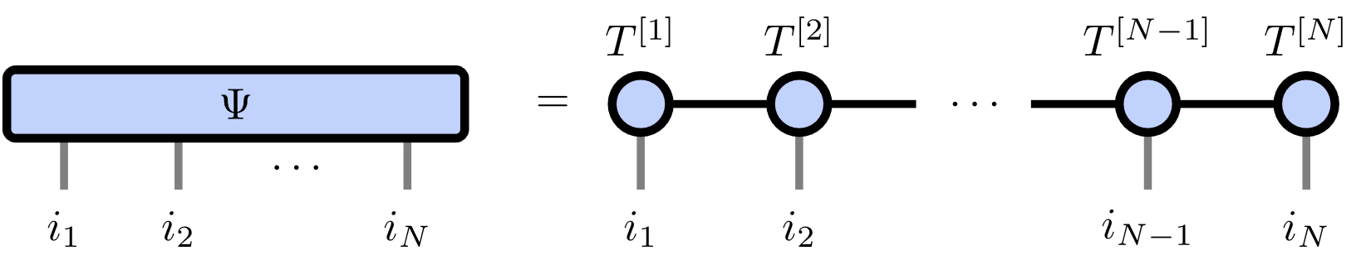
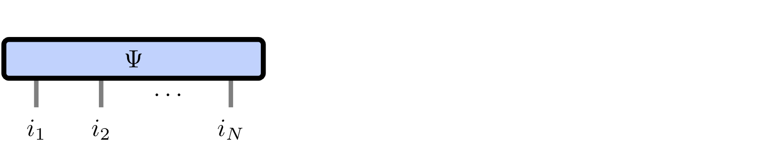
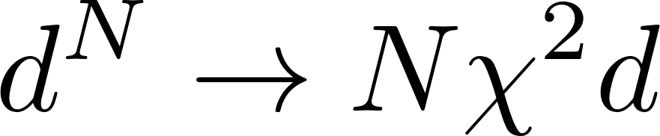

Matrix Product States
Number of parameters:
Represents area law states
[M. Fannes et al. 92]

Slide 8

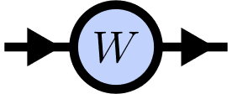
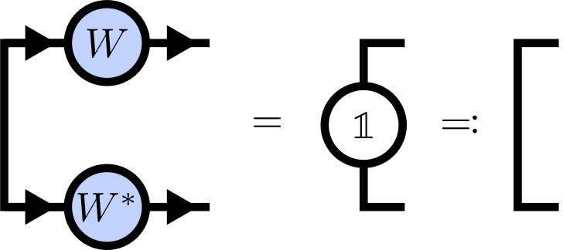
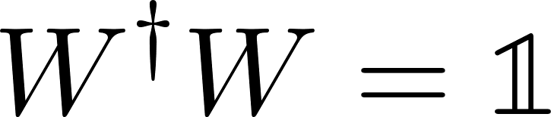
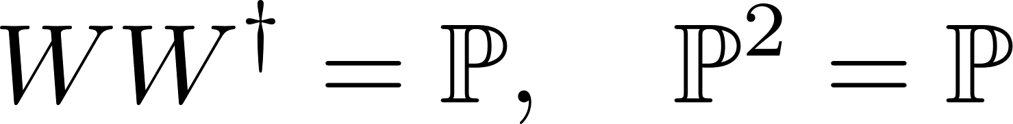
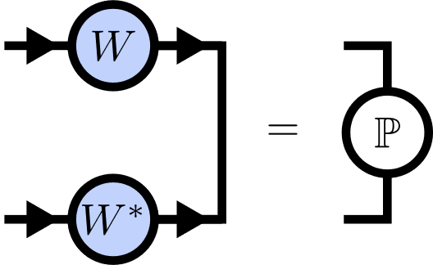
Isometries
Isometry:
Isometry condition:

Slide 9
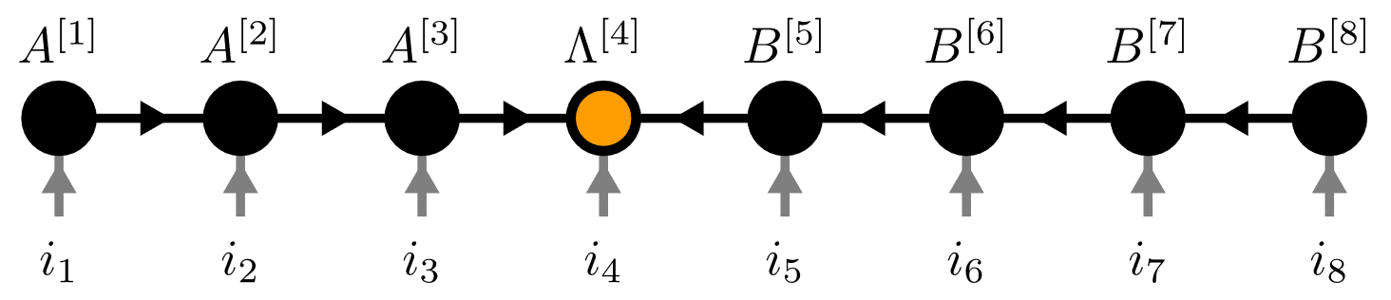
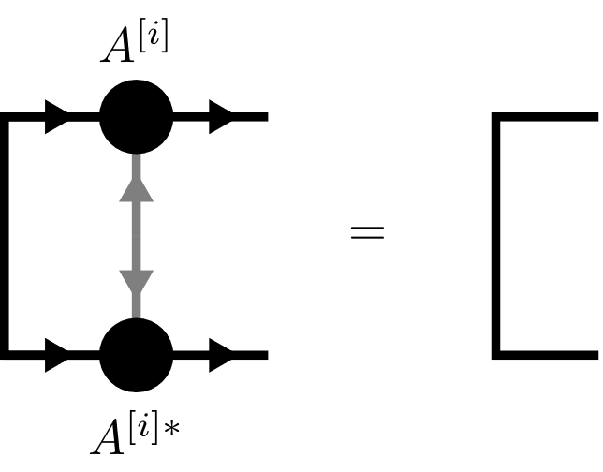
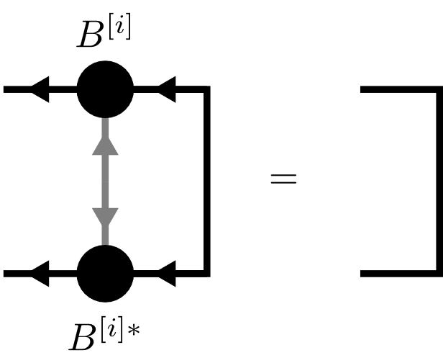
Canonical Form

Slide 10
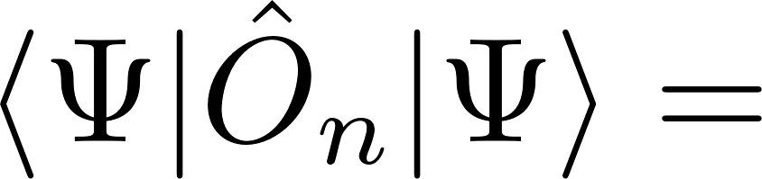
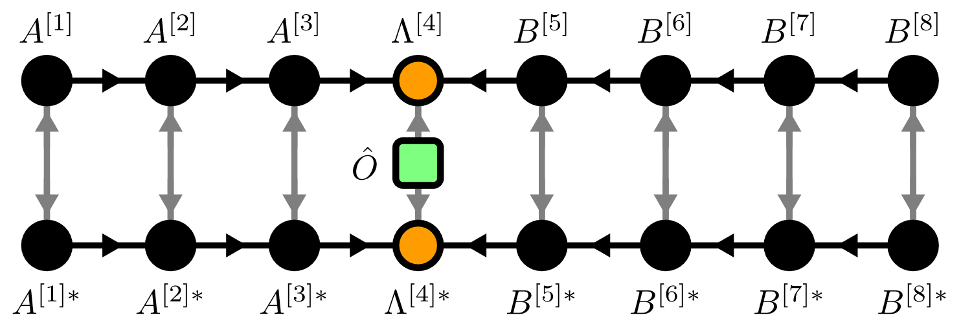

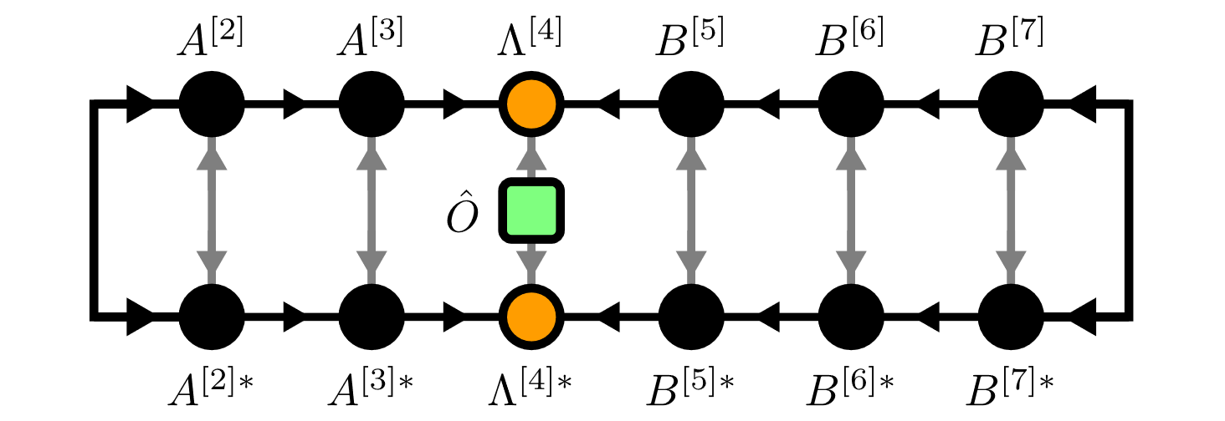
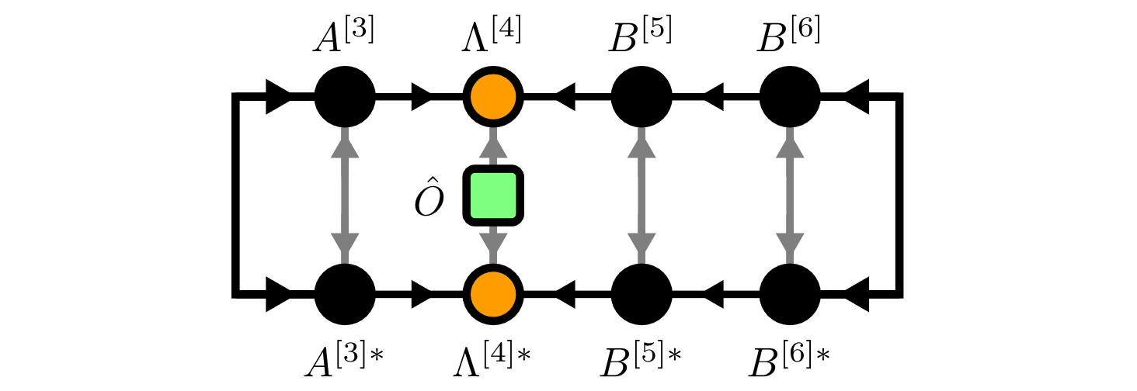

Local Expectation Values

Slide 11
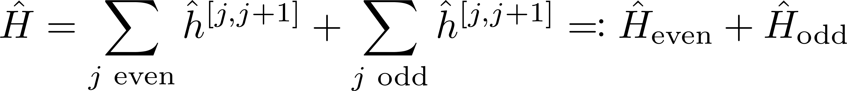
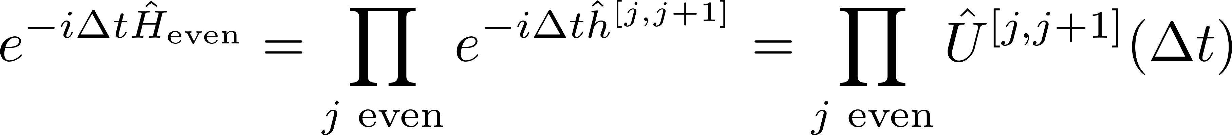
Time Evolving Block Decimation (TEBD)
Schrödinger equation:
Hamiltonian
Suzuki-Trotter decomposition:

Slide 12
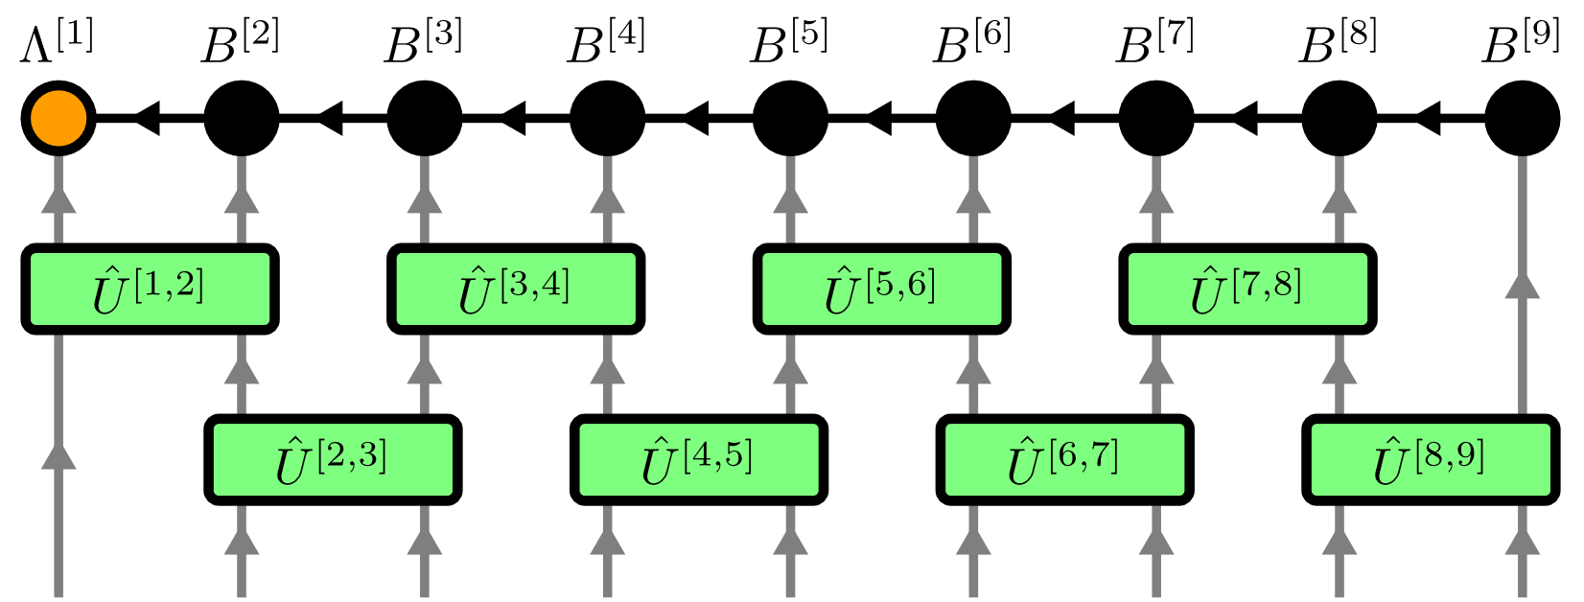
Time Evolving Block Decimation (TEBD)
[G. Vidal, 2004]

Slide 13
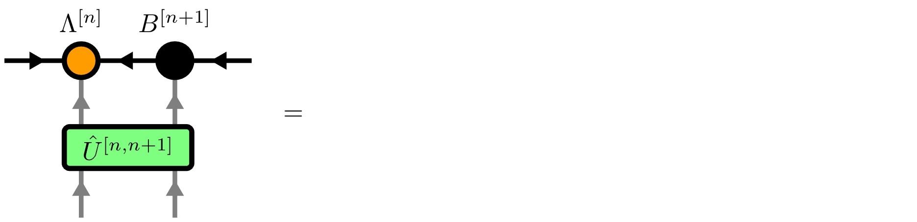
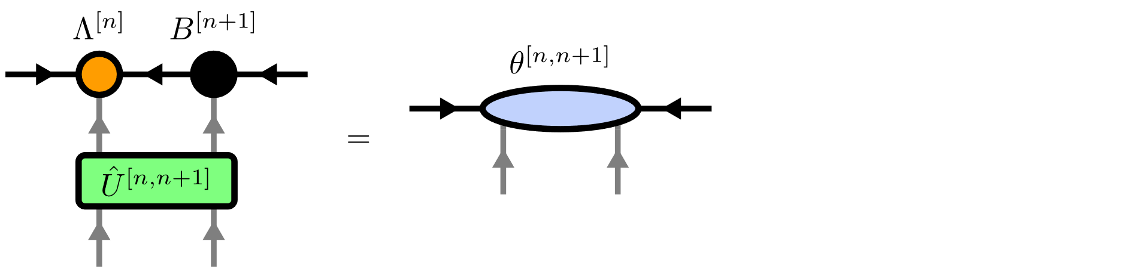
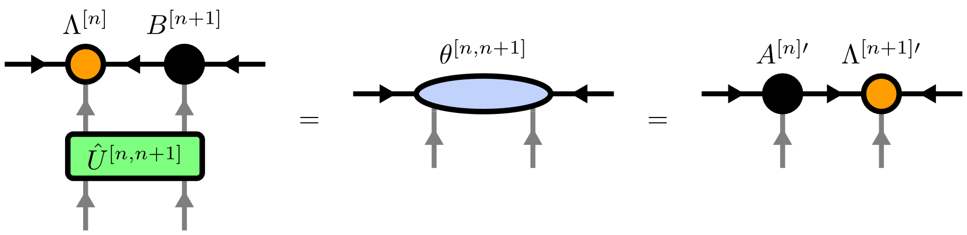
Time Evolving Block Decimation (TEBD)
[G. Vidal, 2004]

Slide 14
Contents
Matrix Product States (MPS)
Isometric Tensor Product States (isoTPS)
Alternative canonical form
[M. Fannes et al. 92]
[M.P. Zalatel, F. Pollmann, 2020]

Slide 15
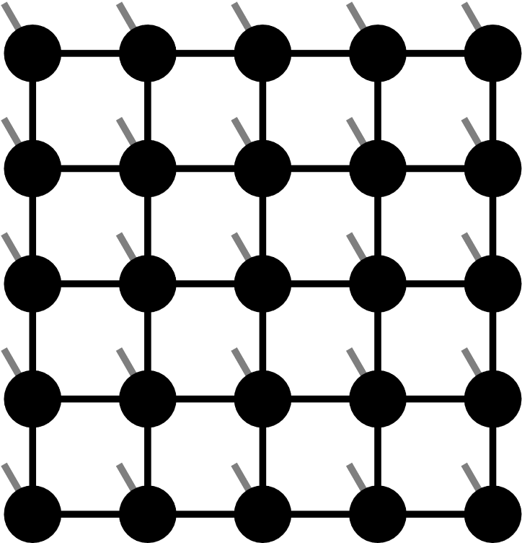

Projected Entangled Pair States (PEPS)

Slide 16
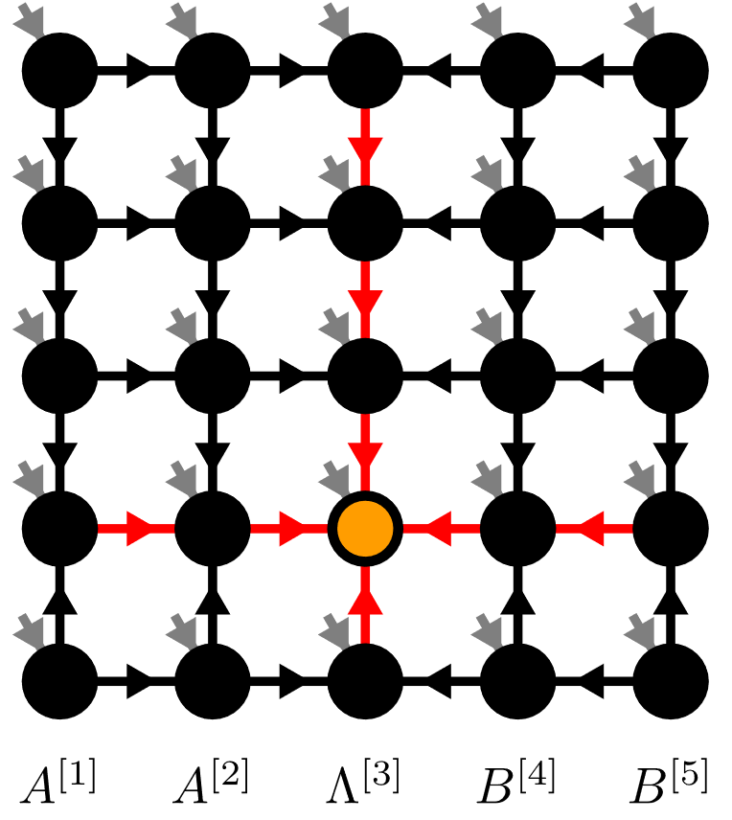
Isometric Tensor Product State
[M.P. Zalatel, F. Pollmann, 2020]

Slide 17
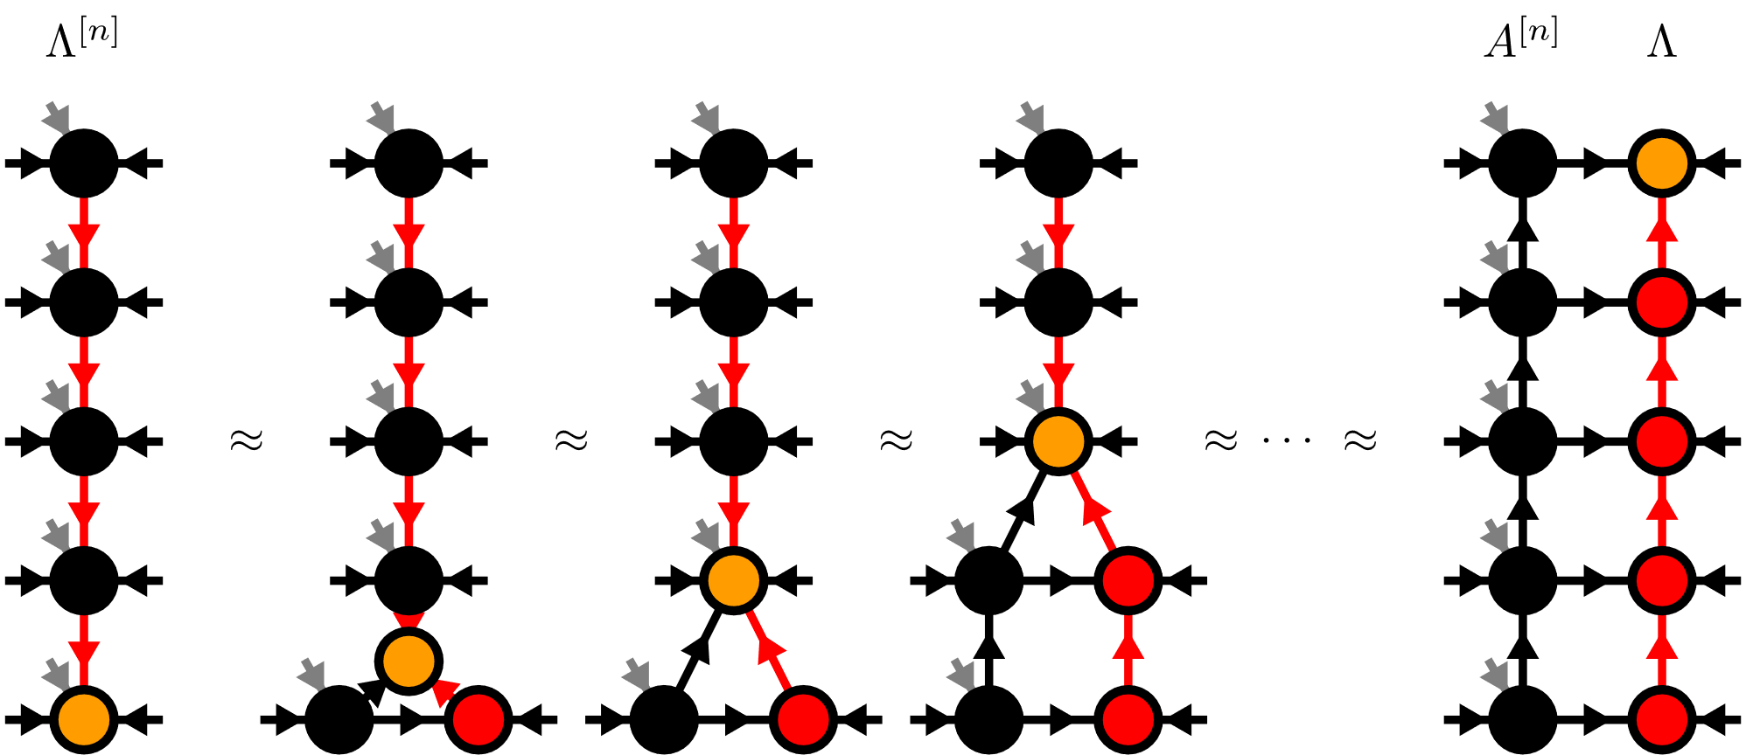
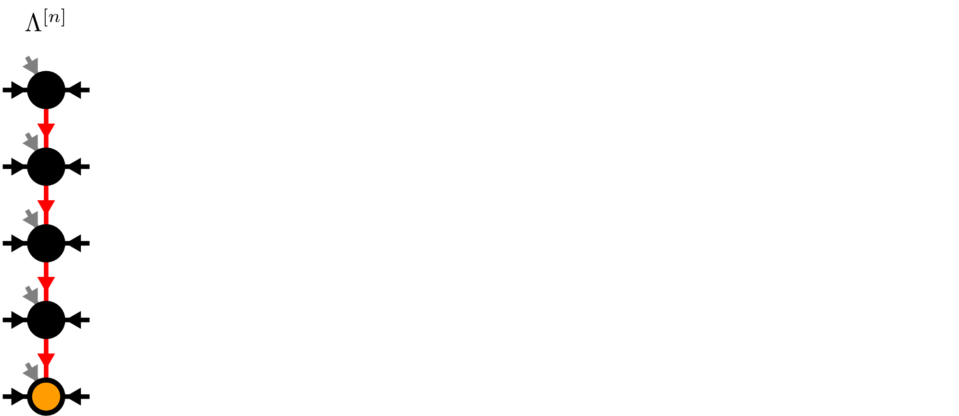
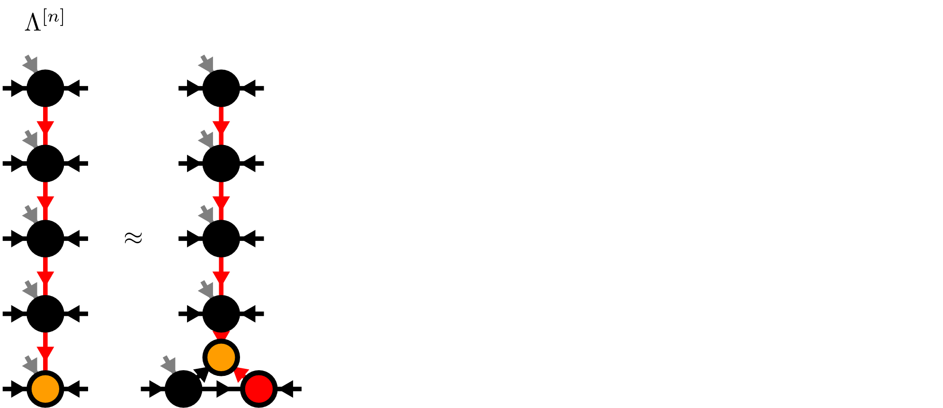
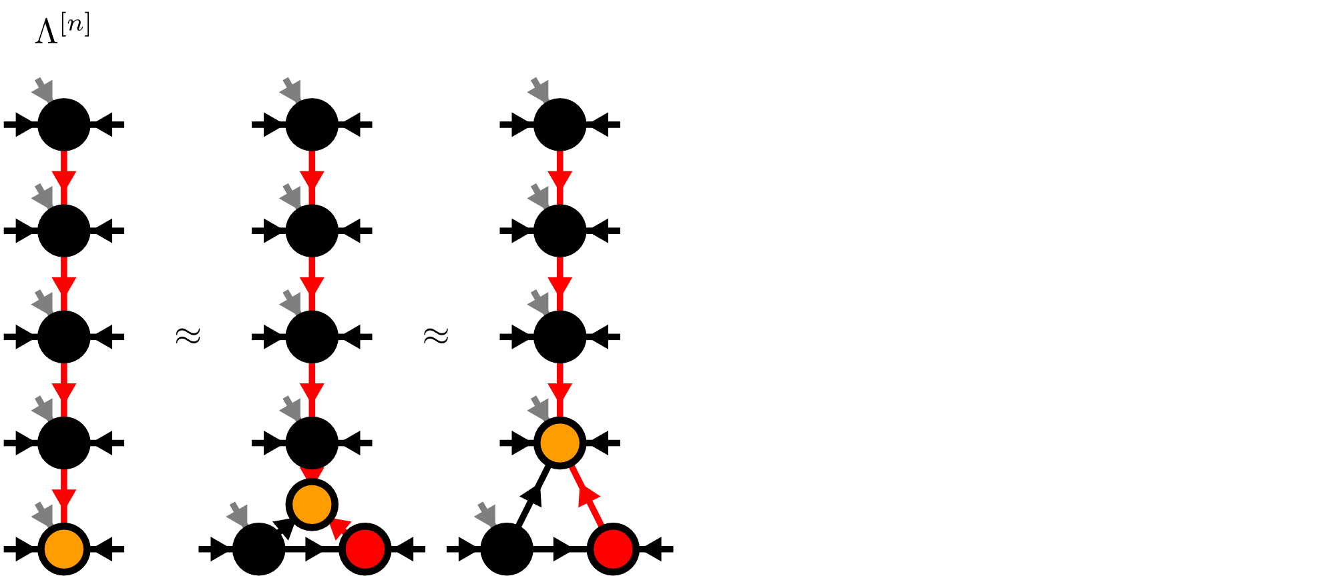
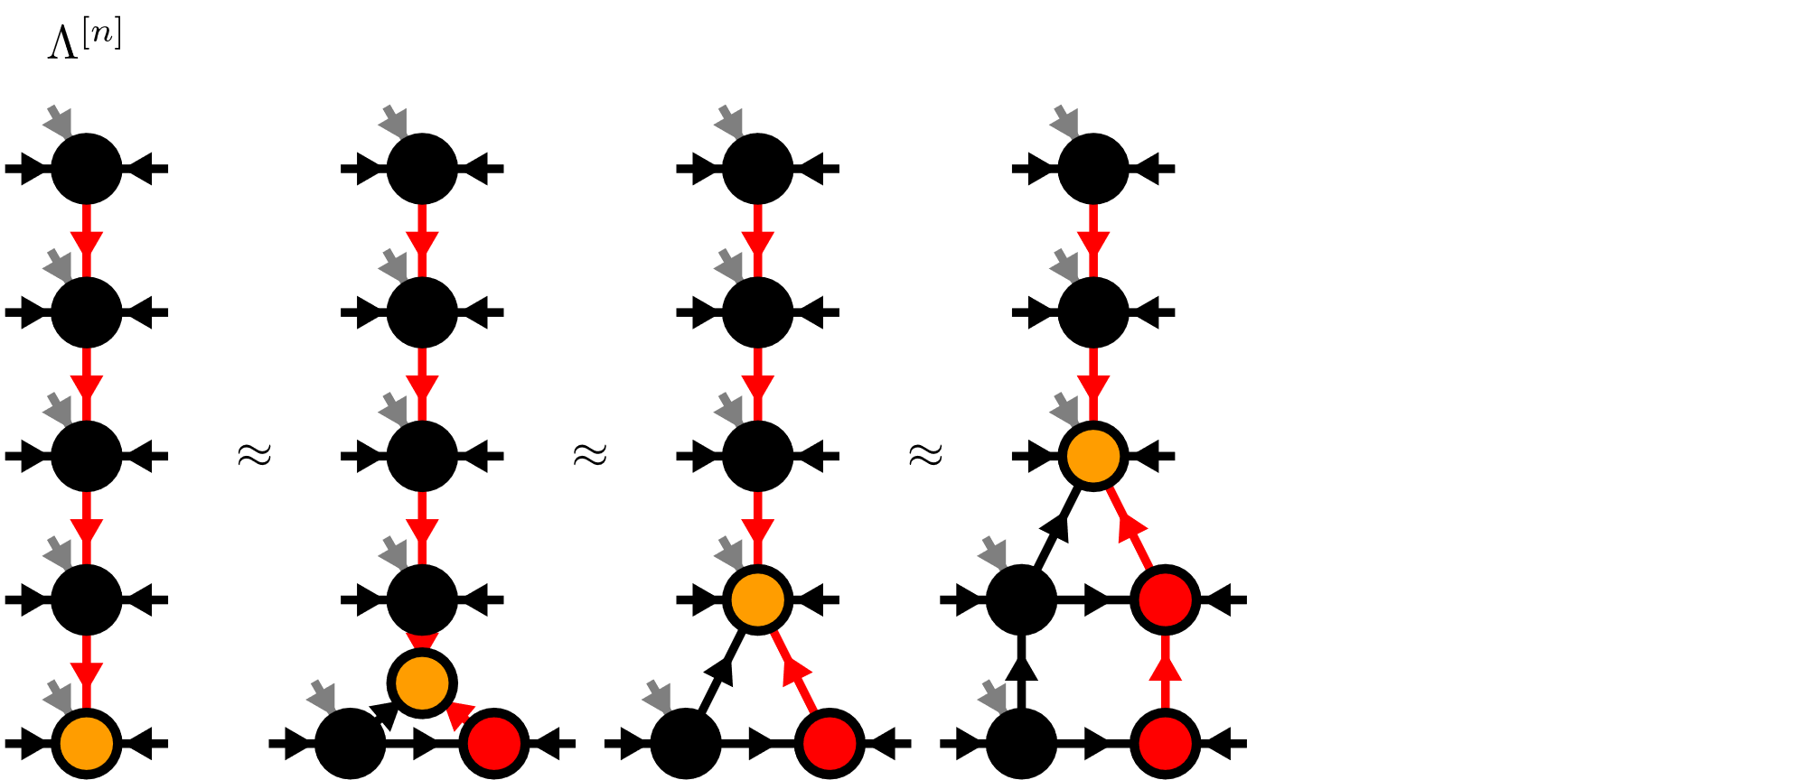
Moses-Move (MM)
[M.P. Zalatel, F. Pollmann, 2020]

Slide 18
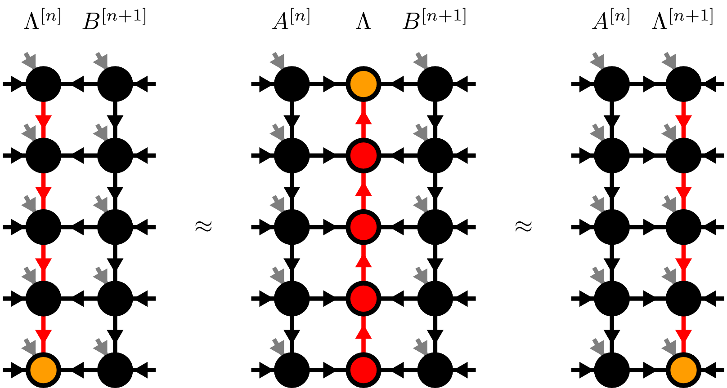
Moses-Move (MM)
[M.P. Zalatel, F. Pollmann, 2020]

Slide 19
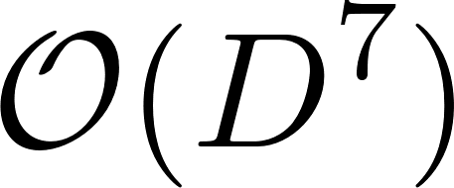
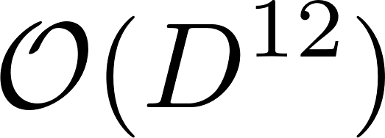
Algorithms on isoTPS
TEBD:
DMRG:
generalized eigenvalue problem -> standard eigenvalue problem
[M.P. Zalatel, F. Pollmann, 2020]
[S.-H. Lin M.P. Zalatel, F. Pollmann, 2022]

Slide 20
Contents
Matrix Product States (MPS)
Isometric Tensor Product States (isoTPS)
Alternative canonical form
[M. Fannes et al. 92]
[M.P. Zalatel, F. Pollmann, 2020]

Slide 21
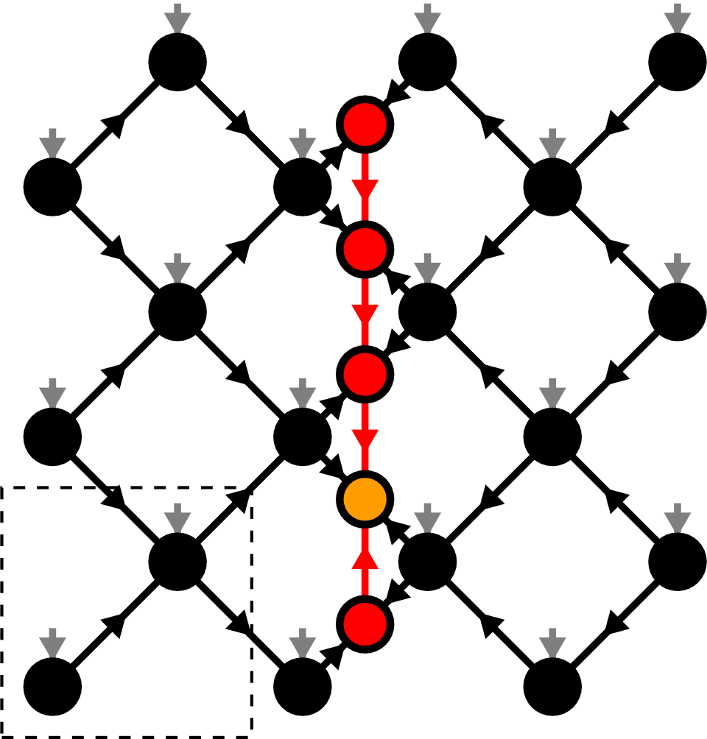
Alternative canonical form

Slide 22
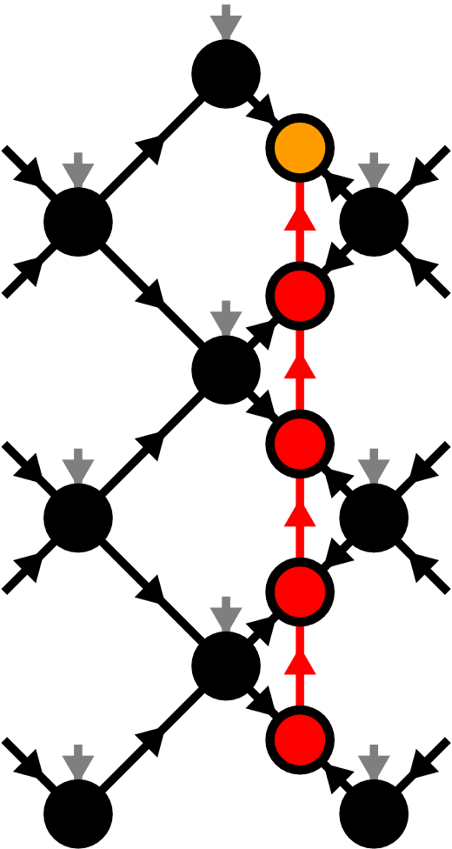
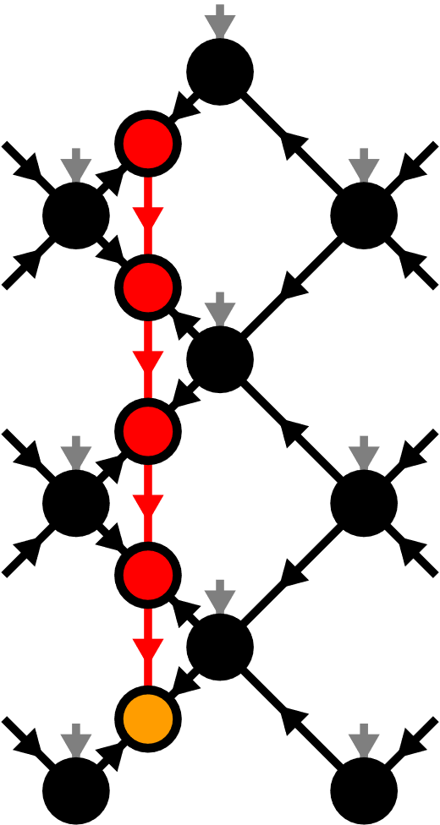
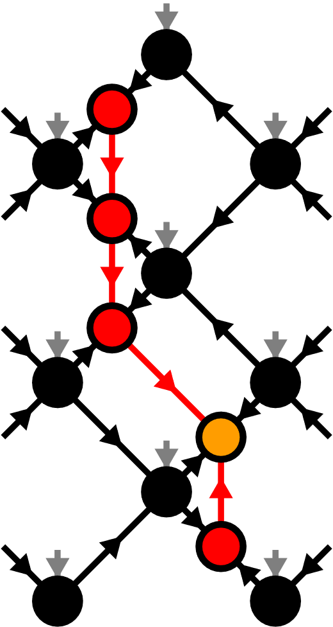
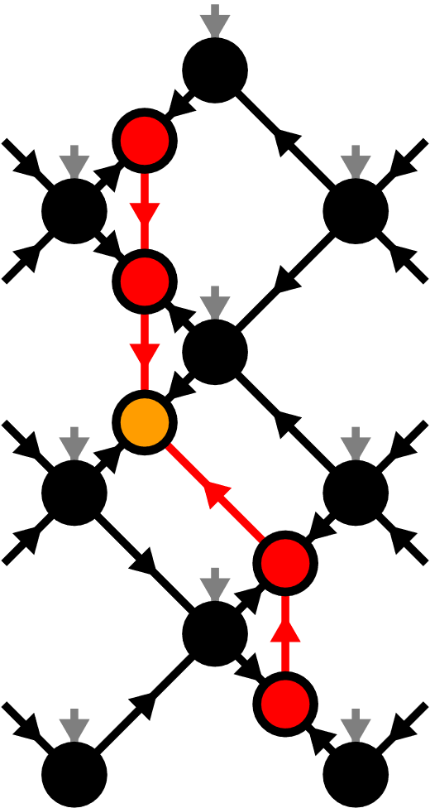


Moving the orthogonality hypersurface

Slide 23



Yang-Baxter (YB) Move
YB Error

Slide 24

Yang-Baxter (YB) Move
Constrained optimization problem
Two algorithms:
Variational optimization with local updates
Tripartite decomposition using SVD + disentangling

Slide 25


YB-move: Variational optimization

Slide 26

YB-move: Variational optimization

Slide 27






YB-move: Tripartite decomposition
[M.P. Zalatel, F. Pollmann, 2020]

Slide 28

Disentangling procedure

Slide 29





Disentangling procedure
Minimize the Rényi-entropy
Bounds truncation error for
In practice: Good results also for
[M.P. Zalatel, F. Pollmann, 2020]

Slide 30




Renyi-2 disentangling
Cost function:
Evenbly-Vidal algorithm:
maximize
[J. Hauschild et al. 2018]

Slide 31

Renyi-2 disentangling

Slide 32





Riemannian optimization
No easy tensor network form for
Use Riemannian optimization!
[S.T. Smith, 2014]

Slide 33


Riemannian optimization
Computing Gradient costs

Slide 34





Approximate Gradients
[J. Unfried, J. Hauschild, F. Pollmann, 2022]

Slide 35

Approximate Gradients

Slide 36



TEBD: Local updates
Apply local bond operator:
Optimization problem:

Slide 37


TEBD: Local updates

Slide 38







TEBD1

Slide 39
TEBD1 vs TEBD2
First order:
Second order:
with the same number of YB moves!

Slide 40


Transverse Field Ising (TFI) model
Critical field
[H.W. J. Blöte, Y. Deng, 2002]

Slide 41

Ground state search with imaginary TEBD
Imaginary TEBD can be used to find ground states
TEBD error:
Best results:
Reference Simulation: DMRG with tenpy
[J. Hauschild, F. Pollmann, 2018]

Slide 42





Comparing YB-move algorithms
4x4 diagonal square lattice, TFI model with

Slide 43


TEBD1 vs TEBD2
4x4 diagonal square lattice, TFI model with

Slide 44




Larger lattices
Diagonal square lattice, TFI model with

Slide 45



Larger lattices
Diagonal square lattice,
TFI model with

Slide 46


Real-time evolution: Global quench
8x8 diagonal square lattice,
TFI model with

Slide 47


Summary & Outlook
Alternative canonical form
YB-move:
Easily generalizable to other lattices
Toric Code ground state exactly representable
TEBD algorithm for time evolution
Numerical evidence for 2D area law states
Outlook:
DMRG
Thermodynamic limit
GPUs

Slide 49




Moses-Move (MM) – Tripartite Decomposition

Slide 50

Isometric Tensors

Slide 51

Moving the Orthogonality Center

Slide 52

DMRG extrapolation

Slide 53


Local Expectation Values

Slide 54






TEBD2

Slide 55


Slide 56

Ground state search logarithmic plot

