Slide 1
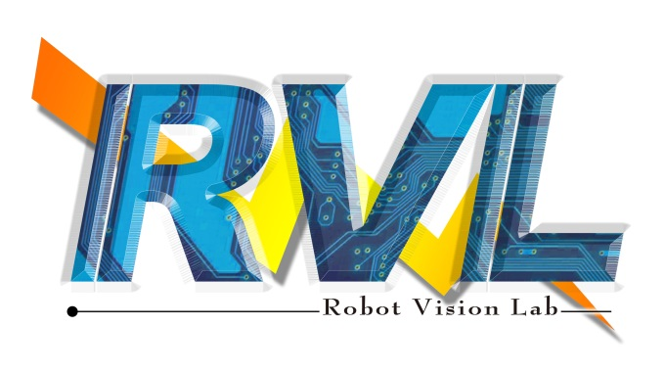
Computer Vision Homework1

Slide 2
Homework Assignment
Target:
Write the main functions by yourself to understand the theories of computer vision deeply.
Improve your skills about using Python

Slide 3
OpenCV
Import Library:
import numpy as np
import cv2
Read a image:
img = cv2.imread('image.jpg’)
Check image size:
height, width, channels = img.shape

Slide 4
OpenCV
Show image:
cv2.imshow('My Image', img)
cv2.waitKey(0)
cv2.destroyAllWindows()
Write image:
cv2.imwrite('output.jpg', img)

Slide 5
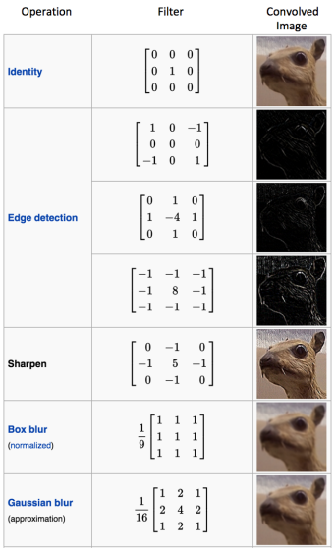
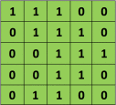

Convolution Operation
5 x 5 image
3 x 3 kernel

Slide 6
Padding
0 | 0 | 0 | 0 | 0 | 0 | 0
0 | 1 | 1 | 1 | 0 | 0 | 0
0 | 0 | 1 | 1 | 1 | 0 | 0
0 | 0 | 0 | 1 | 1 | 1 | 0
0 | 0 | 0 | 1 | 1 | 0 | 0
0 | 0 | 1 | 1 | 0 | 0 | 0
0 | 0 | 0 | 0 | 0 | 0 | 0
5 x 5 image without padding
3 x 3 kernel
5 x 5 image with padding

Slide 7
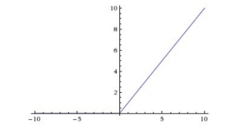
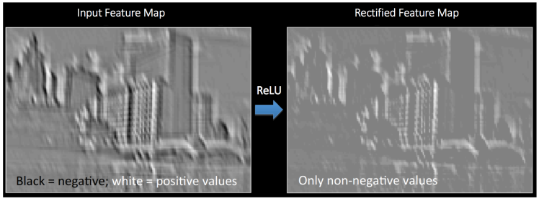

Activation function
ReLU operation (rectified linear unit )
An additional operation called ReLU has been used after every Convolution operation

Slide 8
Homework 1
Give two images (liberty.png and car.png) for testing:
1. Read a RGB image and write a function to convert the image to grayscale image.
2. Write a convolution operation with edge detection kernel
Then input to activation function (ReLU: Rectified Linear Unit)
3. Write a binarization operation (threshold = 128). (>=128) set 255 (<128) set 0

Slide 9
Rules
Allow to use
cv2.imread, cv2.imshow, cv2.imwrite, image.shape
Not Allow to use
Cannot use the function of Lib to do the main part of homework.
(ex: cv2.cvtColor、np.convolve)

Slide 10
Reports
Code Explanation
Experimental Results
Discussions

