Slide 1

Computer Vision Homework2

Slide 2
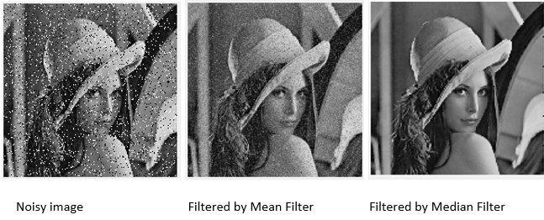
Mean Filter and Median Filter

Slide 3
Example of 3*3 Mean Filter
image
152 | 124 | 252 | 163 | 32 | 67
128 | 40 | 220 | 190 | 142 | 216
68 | 157 | 24 | 30 | 140 | 36
81 | 7 | 25 | 149 | 155 | 41
22 | 33 | 100 | 131 | 75 | 67
69 | 44 | 44 | 167 | 231 | 161
129
1/9 | 1/9 | 1/9
1/9 | 1/9 | 1/9
1/9 | 1/9 | 1/9
*
=
$$\left\lfloor \frac{1}{9}\left(152+124+252+128+40+220+68+157+24\right)\right\rfloor =129$$

Slide 4
Example of 3*3 Median Filter
image
152 | 124 | 252 | 163 | 32 | 67
128 | 40 | 220 | 190 | 142 | 216
68 | 157 | 24 | 30 | 140 | 36
81 | 7 | 25 | 149 | 155 | 41
22 | 33 | 100 | 131 | 75 | 67
69 | 44 | 44 | 167 | 231 | 161
128
Sorting：24, 40, 68, 124, 128, 152, 157, 220, 252
※ Please implement the sorting algorithm by yourself.

Slide 5
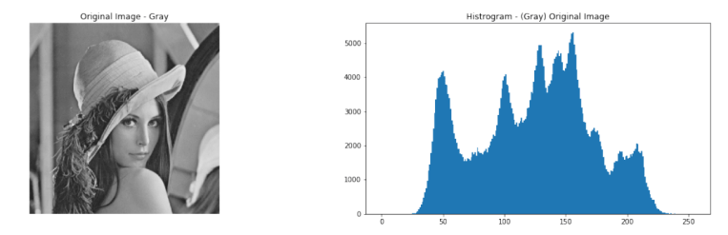
Example of 3*3 Median Filter
Count the number of each pixel’s intensity (0~255)
Create a table to record the number of each pixel’s intensity.
You can draw the histogram by using the functions of matplotlib.

Slide 6
Homework 2
Give one image with Salt & Pepper Noise (noise_image.png) for testing as follow:
1. Show the result after applying Mean Filter.
2. Show the result after applying Median Filter.
3. Accumulate the number of each pixel value, draw a histogram for each image, then
compare witch filter has a better results? Please describe what you observe on two
output images generated by two different filters in your report.

Slide 7
Rules
Allow to use
cv2.imread, cv2.imshow, cv2.imwrite, image.shape
Not Allow to use
Cannot use the function of Lib to do the main part of homework.
(ex: cv2.cvtColor、np.convolve)

Slide 8
Reports
Code Explanation
Experimental Results
Discussions

