Slide 1
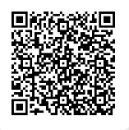
Mid-Term Project
Presentation on May 7, 2026
Online Instruction Folder
https://drive.google.com/drive/folders/19IyrpYWqp--ML058uZU0RD1K6-0VKQLq?usp=sharing

Slide 2
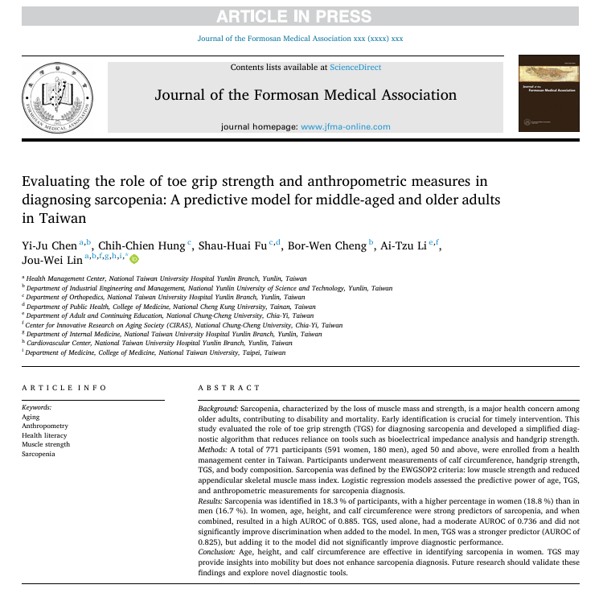
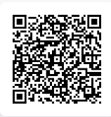
Screening for Sarcopenia
Refer to this article
https://drive.google.com/file/d/1gCJQBI0sSrmpK12pv4AFKOF2oF9gQQ6O/view?usp=drive_link

Slide 3
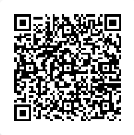
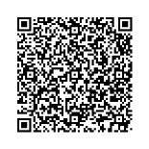
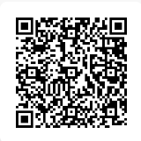
The dataset for midterm practice
Features
Age, calf circumference …
Targets
Muscle power (handgrip strength)
Muscle mass (ASML)
Sarcopenia
Low muscle strength: handgrip strength <28 kg for men and <18 kg for women.
Reduced skeletal muscle mass index: ASMI ≤7.0 kg/m² for men and ≤5.7 kg/m² for women, measured using bioelectrical impedance analysis (BIA)
Dataset here:
CSV
https://drive.google.com/file/d/1KFgNe3pBjZJvC9Uhn4DYORkP0DeGgTOU/view?usp=drive_link
Excel
https://docs.google.com/spreadsheets/d/16a39Y3Em1-rtNVaigpj7L5T8pSf8zXgL/edit?usp=drive_link&ouid=110407566279501444493&rtpof=true&sd=true
SPSS
https://drive.google.com/file/d/1LtQk6SgyrNnDvsOlseFjZp--jjp7lGGG/view?usp=drive_link
CSV Excel SPSS

Slide 4
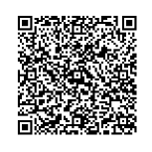
The dataset for practice
Women who participated in the sarcopenia screening program
591 subjects
10 predicting variables (features)
2 outcome variables (muscle power and muscle mass)
(Low) muscle power (classification or regression)
(Low) muscle mass (classification or regression)
Main Target: Sarcopenia
Binary classification
Codebook here:
https://docs.google.com/document/d/14mw0VpJWeR9zs7fd-p3NDu-TxSO1LSXY/edit?usp=drive_link&ouid=110407566279501444493&rtpof=true&sd=true

Slide 5
Variables | Label | Value | Role | Quote
seq_id | Individual id number | Numeric | No, just an id number | Not used in model
sex | Sex | 1: men 0: women | feature | Only women included in the study
age | Age (years) | Numeric | feature
dominant_hand | Dominant hand | 1: right 0, left | feature
dominant_leg | Dominant leg | 1: right 0, left | feature
calf_circ | Calf circumference (cm) of the dominant leg | Numeric | feature
weight | Weight (kg) | Numeric | feature
height | Height (cm) | Numeric | feature
BMI | Body mass index, defined as weight (kg) divided by square of height (kg/m²) | Numeric | feature | Probably no need to use this variable once weight and height are included
function_survey | A questionnaire survey about functional status | Numeric (ranging from 0 to 7) | feature | This variable is ordinal. But it is OK to treat it as continuous.
new_test | A new test that has not been evaluated yet and measured some kind of power (kg) | Numeric | feature | A new test that is not used in the diagnostic criteria for sarcopenia
muscle_power | Muscle power measured from dynamometer, indicating handgrip strength (kg)) | Numeric | Target (continuous) | A target for regression
muscle_mass | Muscle mass in terms of appendicular skeletal muscle power (ASML, kg/m²) measured by bioelectrical impedance analysis (BIA) | Numeric | Target (continuous) | A target for regression
sarcopenia | Sarcopenia was defined based on the criteria established by EWGSOP2. Participants were classified as having sarcopenia if they met both of the following conditions: 1. Low muscle strength: handgrip strength <28 kg for men and <18 kg for women. 2. Reduced skeletal muscle mass index: ASMI ≤7.0 kg/m² for men and ≤5.7 kg/m² for women, measured using BIA. | 1: Sarcopneia 0: No sarcopenia | Main Target (binary) | The main target, combining both low muscle power and low muscle mass, is a binary outcome for classification.

Slide 6
Analytic Issues
Descriptive statistics
Continuous data vs. categorical data
Missing data (very few):
Listwise deletion
Categorization
Imputation
Only the 433 women aged 65 years old and above
Two analytic strategies:
Selecting those who are aged (> 65 y/o)
Do twice:
All women (n = 592)
Those who are aged (n = 433)

Slide 7
Regression vs. Classification
Regression
Classification
To predict how much the muscle power and muscle power would be
Statistical methods
Linear regression
Machine learning
Ridge regression
Lasso regression
Tree-based ensemble methods …
To predict whether a woman would have sarcopenia
Statistical methods
Logistic regression
Machine learning
Multiple level neural networks
Support vector machine (SVM)
Bayesian analysis
Random forest
Xgboost …

Slide 8
Requirement
Statistical models
Build a linear regression model for predicting muscle power
Build a linear regression model for predicting muscle mass
Build a logistic regression model for predicting the presence of sarcopenia

Slide 9
Requirement
Machine learning models
Build a ML model for predicting muscle power and muscle mass
Choose one appropriate model, either ridge regression, Lasso regression, tree-based ensemble methods or others
Build a ML model for predicting the presence of sarcopenia
Choose one appropriate model, either NN, SVM, Bayesian analysis, Random forest , Xgboost, or others

Slide 10
Requirement
Evaluation
Regression model
Mean absolute error (RAE), root mean square error (RMSE), R²
Whatever appropriate
Classification model
Receiver operating characteristic (ROC) curve
Also work on
Feature relative importance
Developing parsimonious model

