Slide 1
Group 7
Student SCHOOL SAFETY SYSTEM (4S)

Slide 2
Introduction
STUDENT SCHOOL SAFETY system
Aim of this project include:
Develop an affordable low cost system for tracking and ensuring safety of children
Help ensure safe arrival and departure of students
Track real time status
Provide the school system to be reliable

Slide 3
Problem
STUDENT SCHOOL SAFETY system
Students often get on the wrong buses and get off at the wrong stop
Bus driver may not be able to identify all students and will not know in time if a student is missing
Working parents can’t know if their kids are safe until the bus returns in the evening
Young students aren’t allowed phones or parents can’t afford to buy smart phones for their kids
There is no reliable method for tracking delays which further annoy parents.

Slide 4
Proposed system
STUDENT SCHOOL SAFETY system
A reliable system that tracks the student’s information about school In/Out and inform their parent about it.
Each students can identify as they enter and leave the bus using Radio Frequency Identification card(RFID).
Parents using smarts phones to track their kids.

Slide 5
Benefits
STUDENT SCHOOL SAFETY system
Low cost - Uses ESP8266 microcontroller which is low-cost and provides efficient latency.
User friendly - Easy to use and provides a simple interface
Reliable and Secure - Updates are real time and hence reliable.

Slide 6

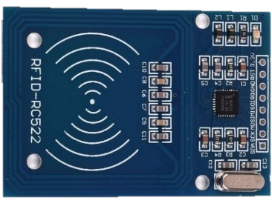



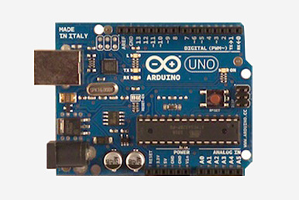

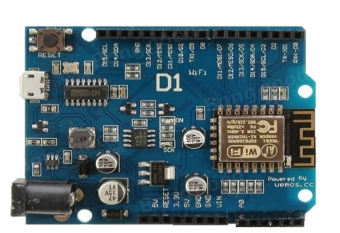
Setup of the system
STUDENT SCHOOL SAFETY system
Call
SPI
Wi-Fi Client Request
UART

Slide 7
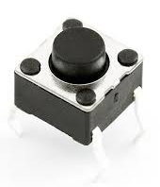
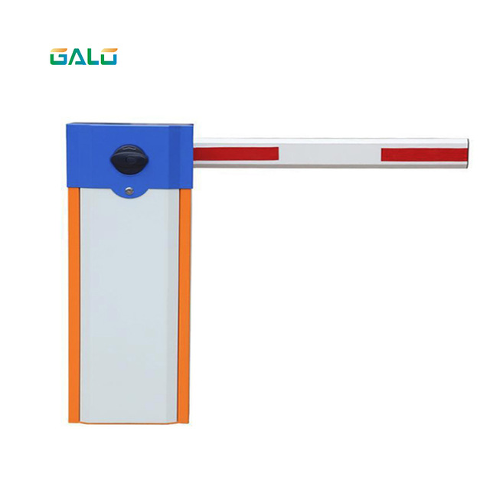
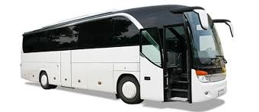
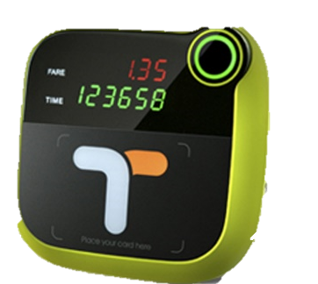
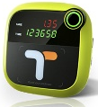
PROCESS
STUDENT SCHOOL SAFETY system
2
3
1

Slide 8
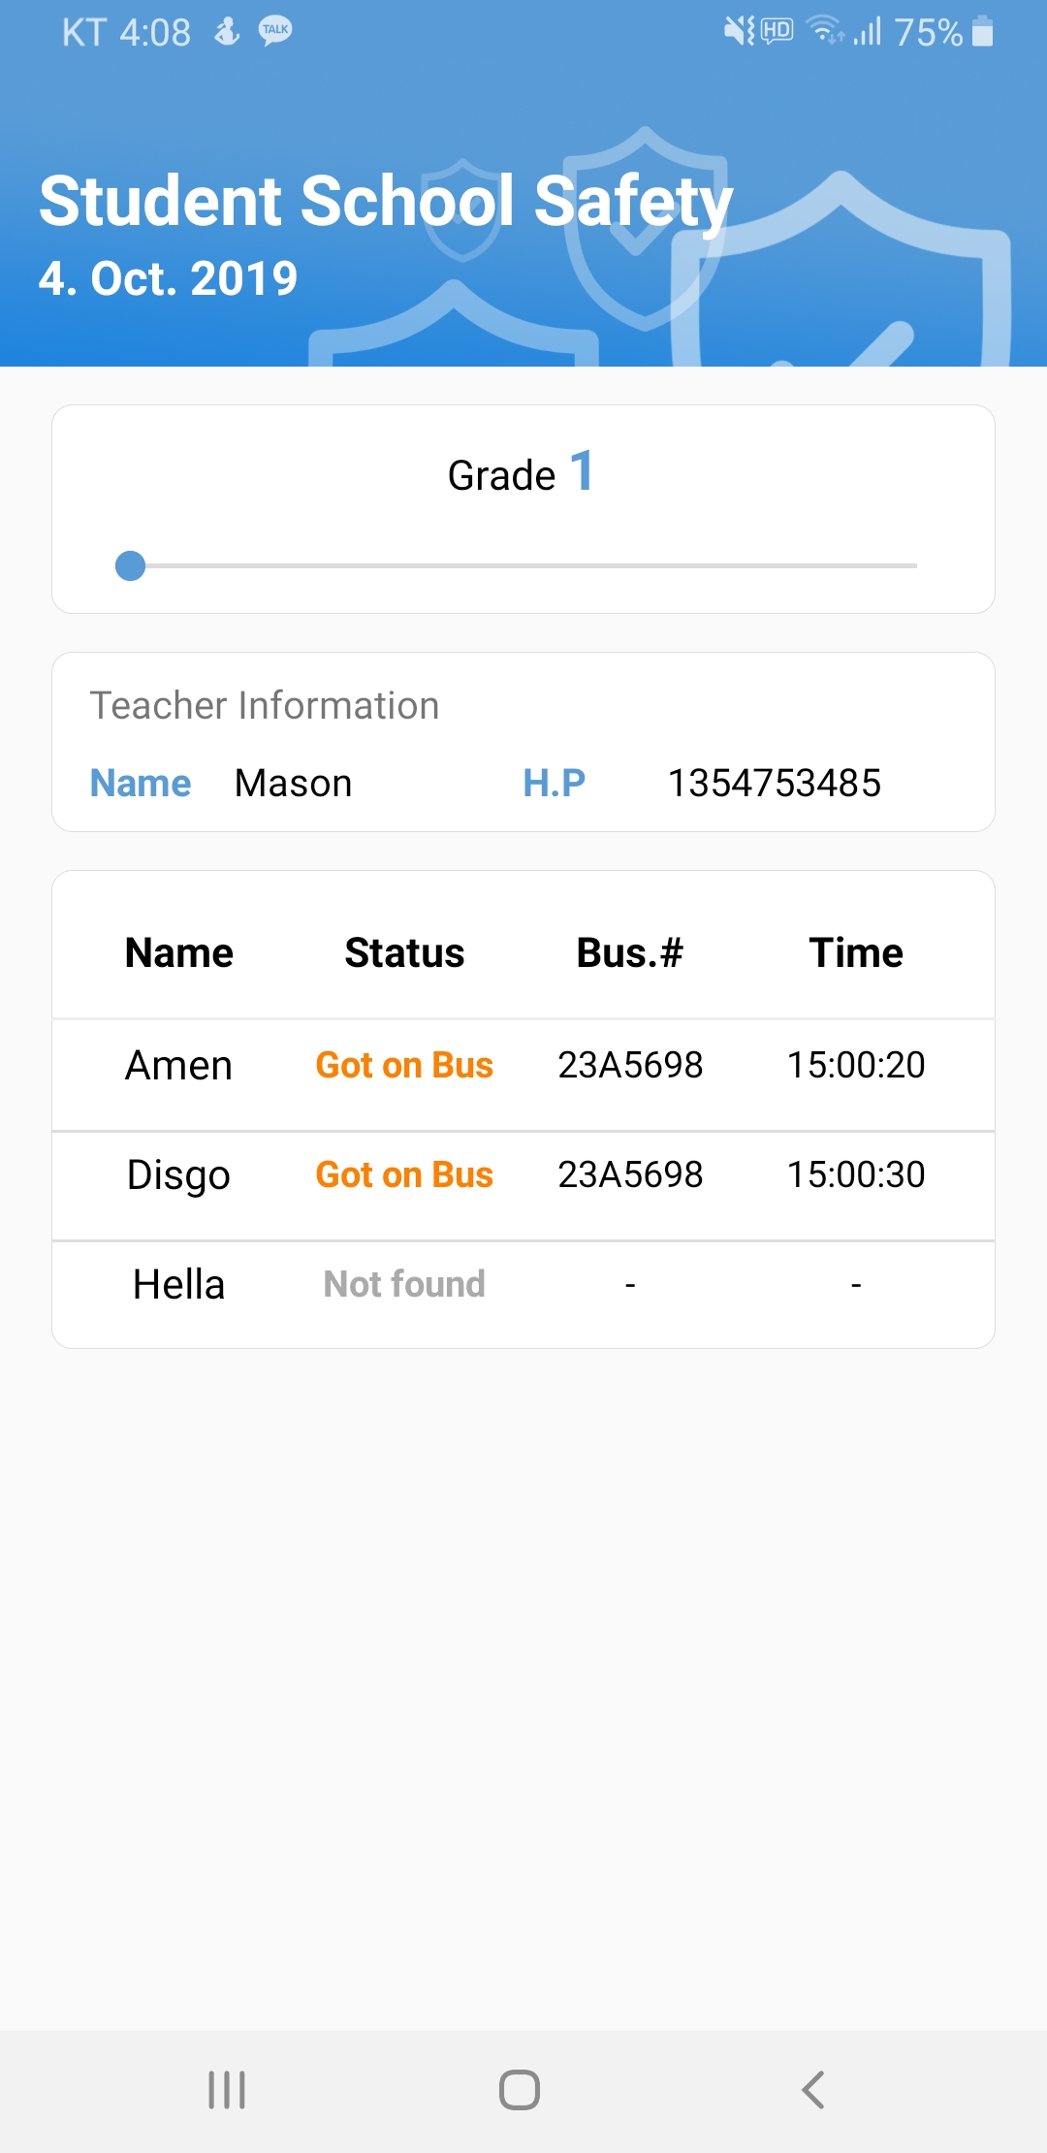
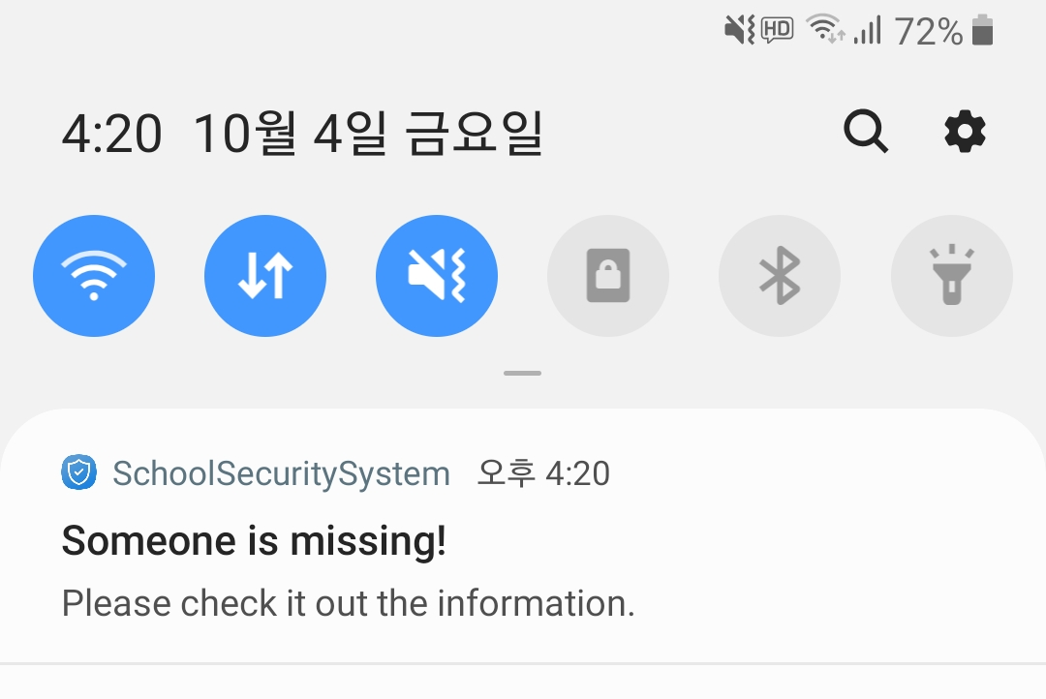
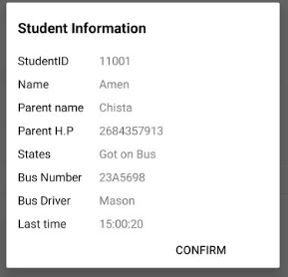
STUDENT SCHOOL SAFETY system

Slide 9
FUTHURE SCOPE
STUDENT SCHOOL SAFETY system
A provision to EMERGENCY CALL from the vehicle in case of issue in the vehicle.
A provision to unlock parking only upon id card can be added.
RFID can be replaced with more reliable methods like biometric/face identification.
Notification from School to the students, parents
Camera on the Bus, Contact driver

Slide 10
Thank You

