Slide 1
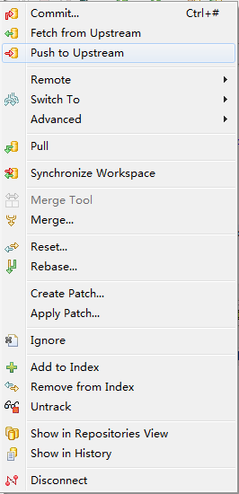
工程目录git菜单
Fetch from Upstream从上游取
push to upstream 推到上游
Untrack 卸载轨迹git

Slide 2
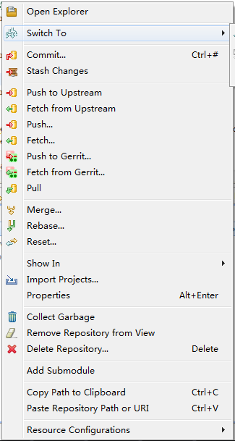
Git资源管理菜单

Slide 3
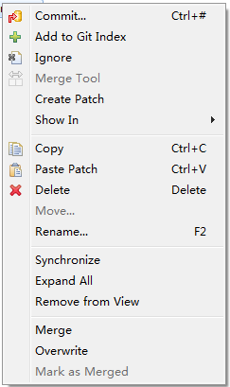
Eclipse工程同步中,菜单
Merge 合并
Overwrite 覆盖(服务器覆盖本地)

Slide 4
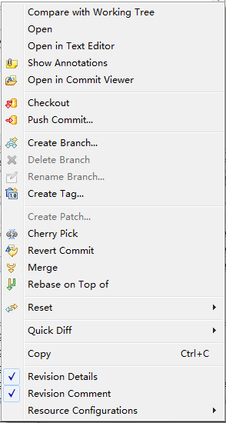
版本历史中菜单

