Slide 1
HTML Simplilearn

Slide 2
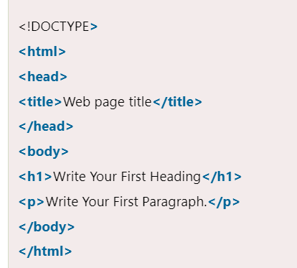
Html overview
The major points of HTML are given below:
HTML stands for HyperText Markup Language.
HTML is used to create web pages and web applications.
HTML is widely used language on the web.
We can create a static website by HTML only.
Technically, HTML is a Markup language rather than a programming language.

Slide 3
Html tags
HTML tags are like keywords which defines that how web browser will format and display the content. With the help of tags, a web browser can distinguish between an HTML content and a simple content. HTML tags contain three main parts: opening tag, content and closing tag. But some HTML tags are unclosed tags.
When a web browser reads an HTML document, browser reads it from top to bottom and left to right. HTML tags are used to create HTML documents and render their properties. Each HTML tags have different properties.
An HTML file must have some essential tags so that web browser can differentiate between a simple text and HTML text. You can use as many tags you want as per your code requirement.
All HTML tags must enclosed within < > these brackets.
Every tag in HTML perform different tasks.
If you have used an open tag <tag>, then you must use a close tag </tag> (except some tags)

Slide 4
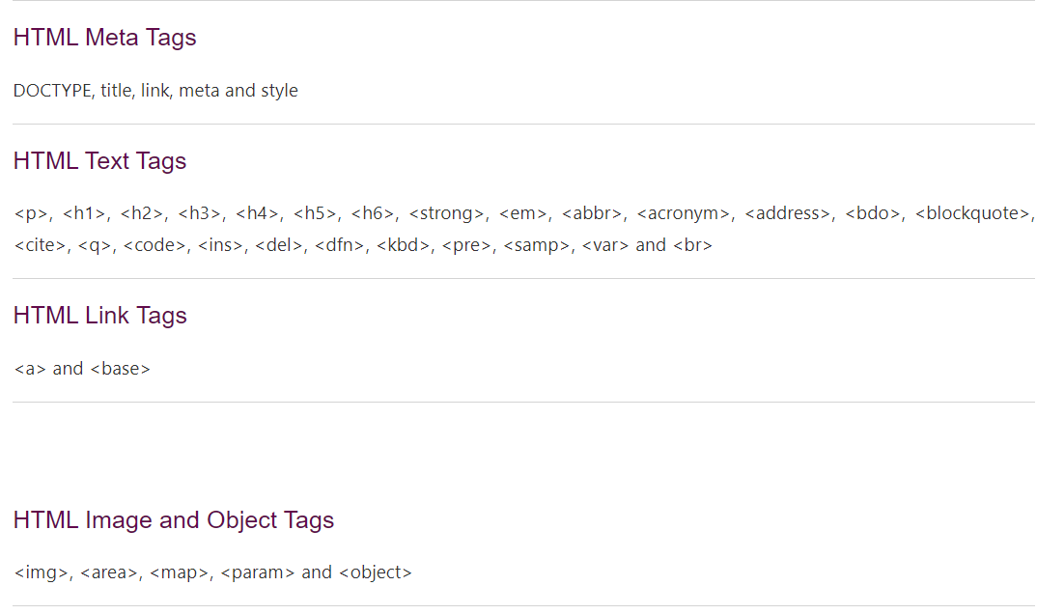
Html tags example

Slide 5
Html attribute
HTML attributes are special words which provide additional information about the elements or attributes are the modifier of the HTML element.
Each element or tag can have attributes, which defines the behaviour of that element.
Attributes should always be applied with start tag.
The Attribute should always be applied with its name and value pair.
The Attributes name and values are case sensitive, and it is recommended by W3C that it should be written in Lowercase only.
You can add multiple attributes in one HTML element, but need to give space between two attributes.

Slide 6
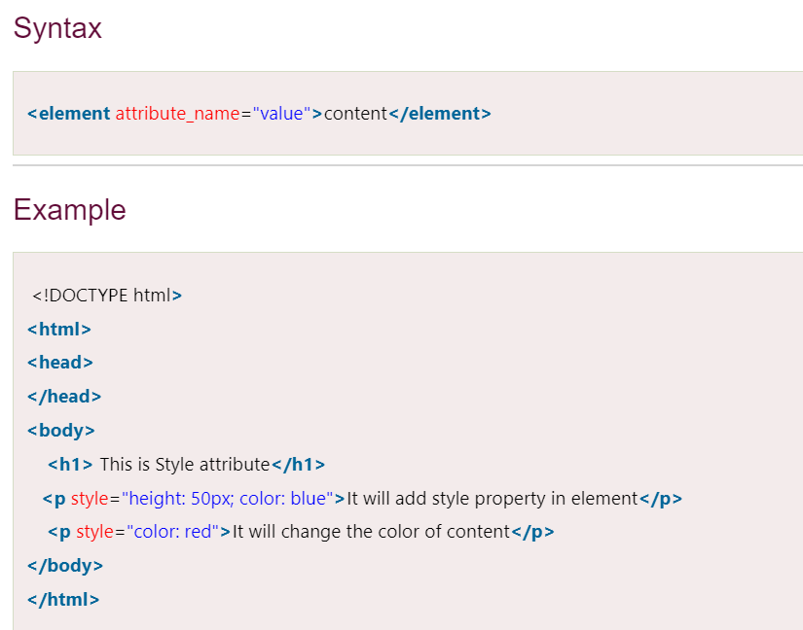
Syntax of html attribute

Slide 7
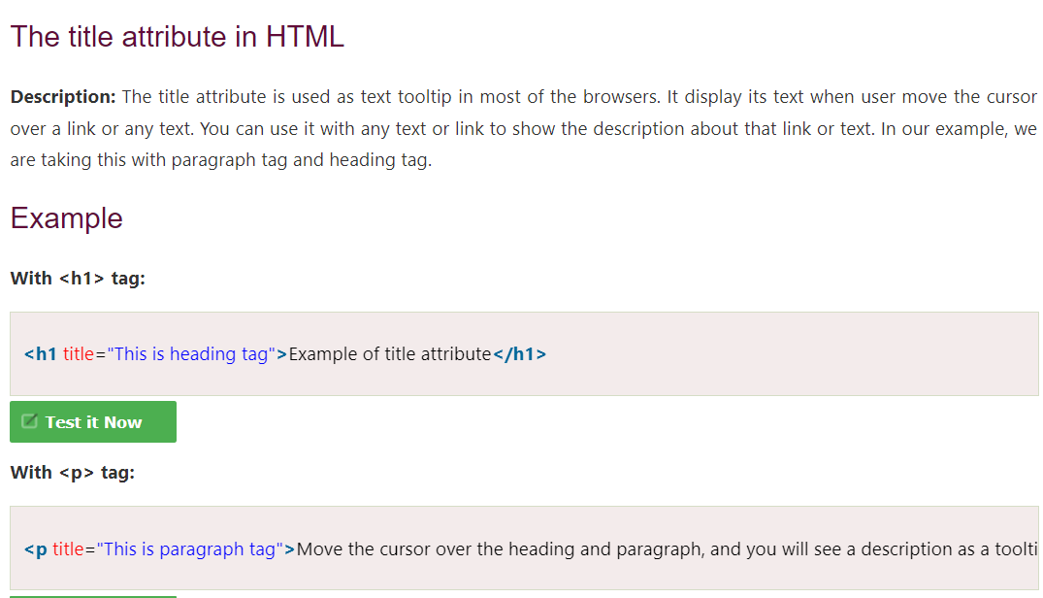
Html title attribute

Slide 8
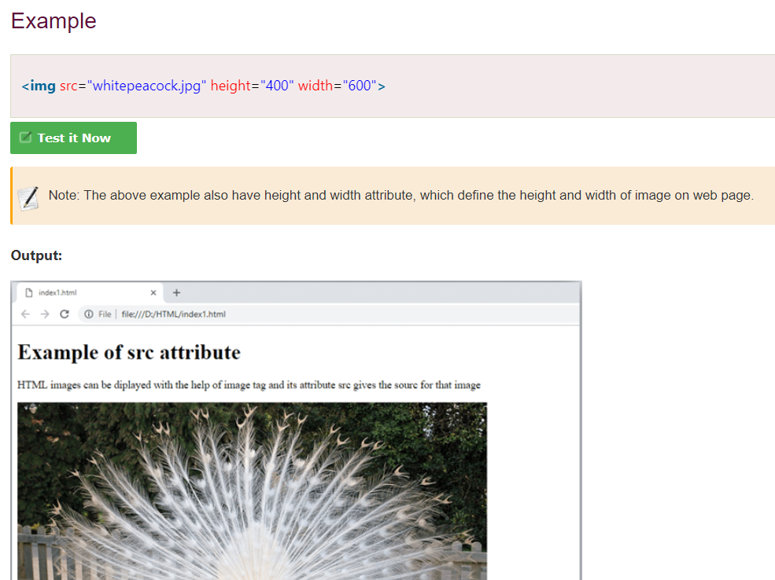
Src attribute
The src attribute is one of the important and required attribute of <img> element. It is source for the image which is required to display on browser. This attribute can contain image in same directory or another directory. The image name or source should be correct else browser will not display the image.

Slide 9
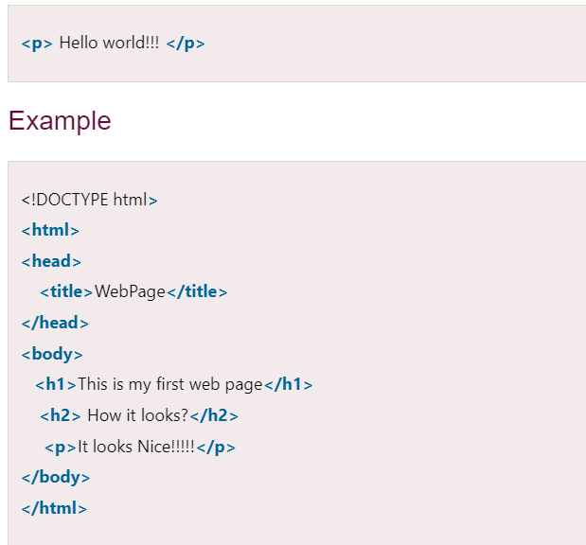
Html elements
An HTML file is made of elements. These elements are responsible for creating web pages and define content in that webpage. An element in HTML usually consist of a start tag <tag name>, close tag </tag name> and content inserted between them. Technically, an element is a collection of start tag, attributes, end tag, content between them.

Slide 10
Html formatting
HTML Formatting is a process of formatting text for better look and feel. HTML provides us ability to format text without using CSS. There are many formatting tags in HTML. These tags are used to make text bold, italicized, or underlined. There are almost 14 options available that how text appears in HTML and XHTML.
In HTML the formatting tags are divided into two categories:
Physical tag: These tags are used to provide the visual appearance to the text.
Logical tag: These tags are used to add some logical or semantic value to the text.

Slide 11
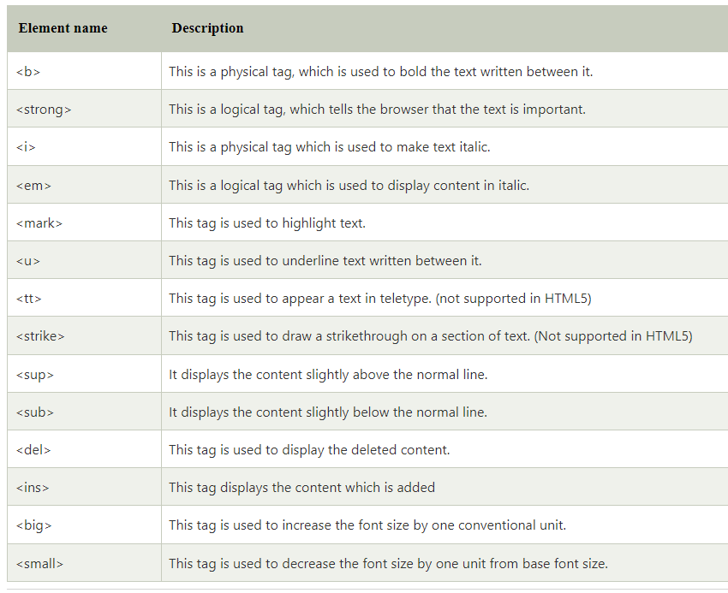
Html formatting tags

Slide 12
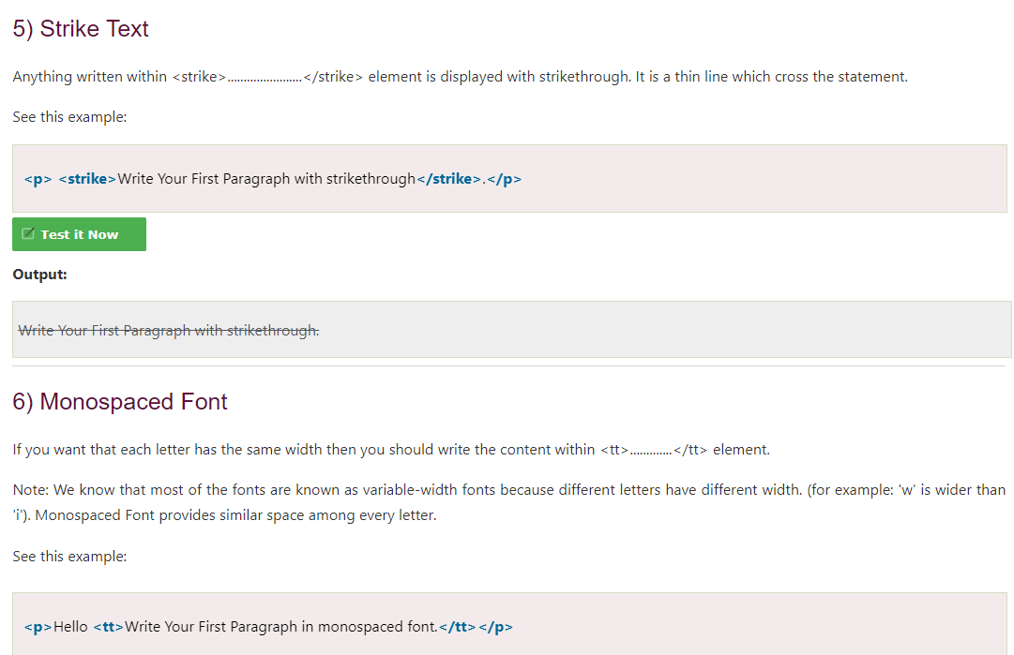
Striked text and monospaced font

Slide 13
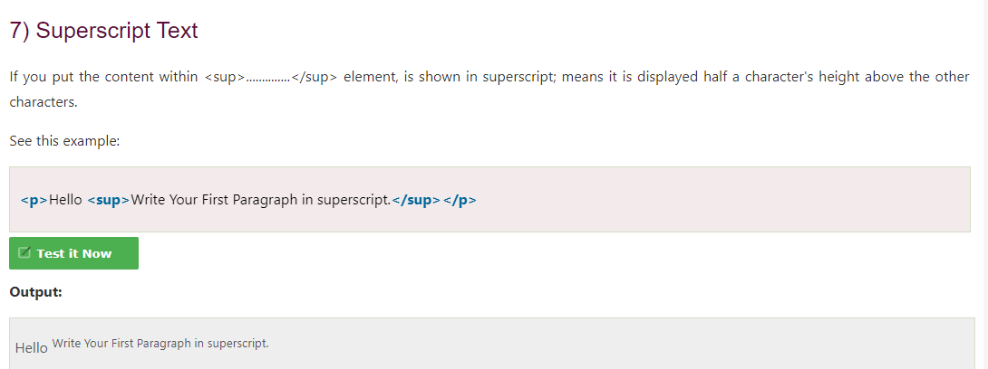
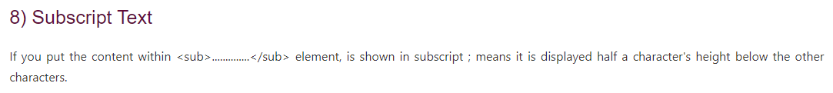
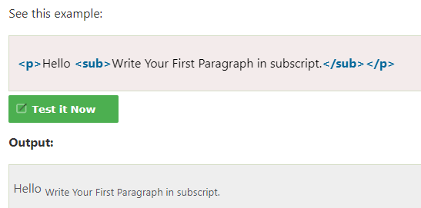
Superscript and subscript text

Slide 14
Html Heading
A HTML heading or HTML h tag can be defined as a title or a subtitle which you want to display on the webpage. When you place the text within the heading tags <h1>.........</h1>, it is displayed on the browser in the bold format and size of the text depends on the number of heading.
There are six different HTML headings which are defined with the <h1> to <h6> tags, from highest level h1 (main heading) to the least level h6 (least important heading).
h1 is the largest heading tag and h6 is the smallest one. So h1 is used for most important heading and h6 is used for least important.

Slide 15
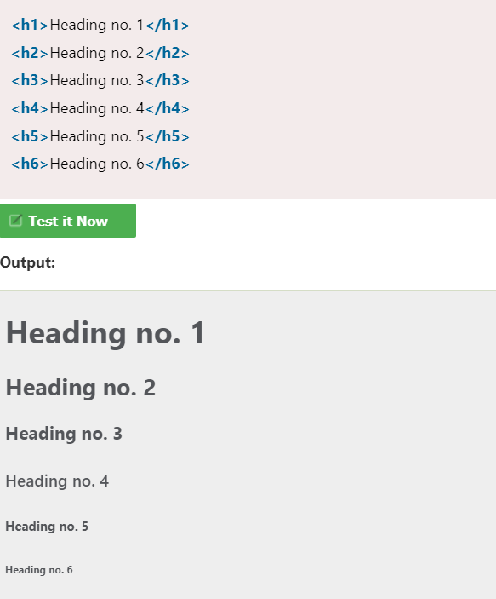
Types of heading tag

Slide 16
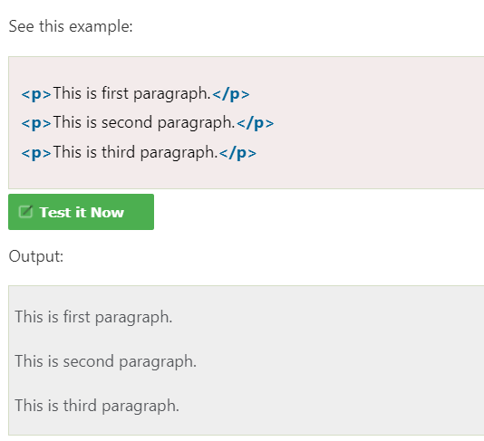
Html paragraph
HTML paragraph or HTML p tag is used to define a paragraph in a webpage. Let's take a simple example to see how it work. It is a notable point that a browser itself add an empty line before and after a paragraph. An HTML <p> tag indicates starting of new paragraph.

Slide 17
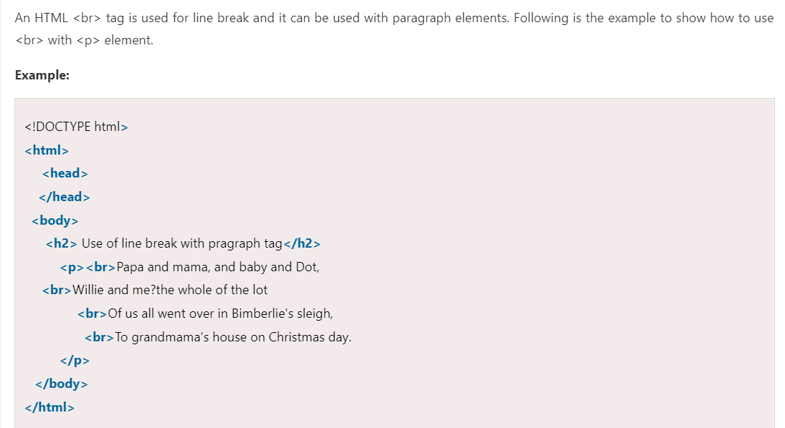
Using br tag in paragraph

Slide 18
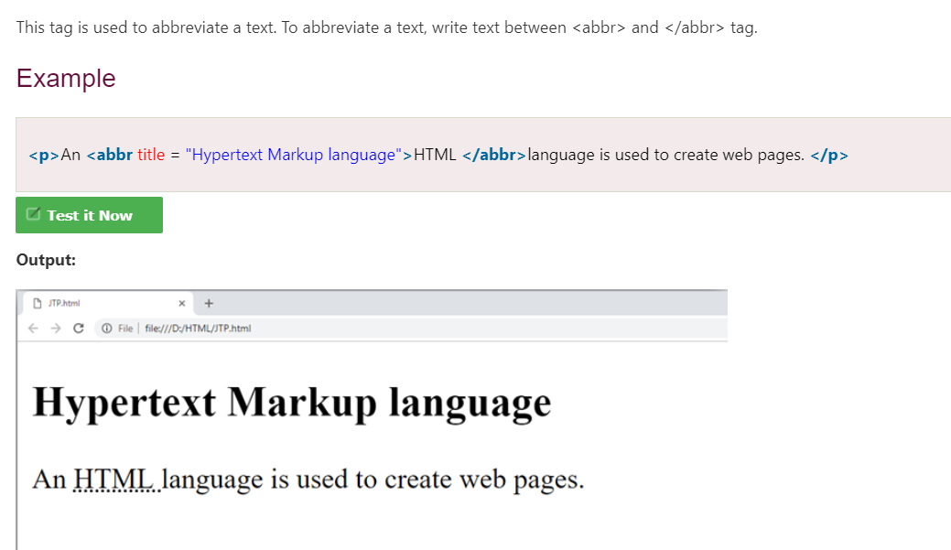
Text abbreviation tag

Slide 19
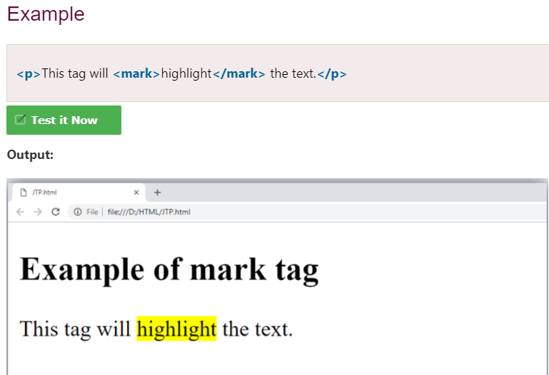
Marked tag
The content written between <mark> and </mark> tag will show as yellow mark on browser. This tag is used to highlight a particular text.

Slide 20
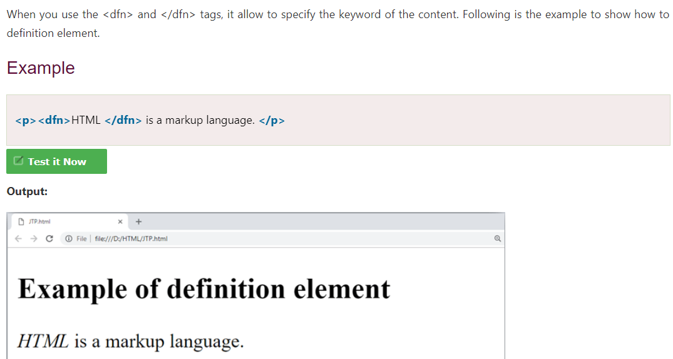
Definition tag

Slide 21
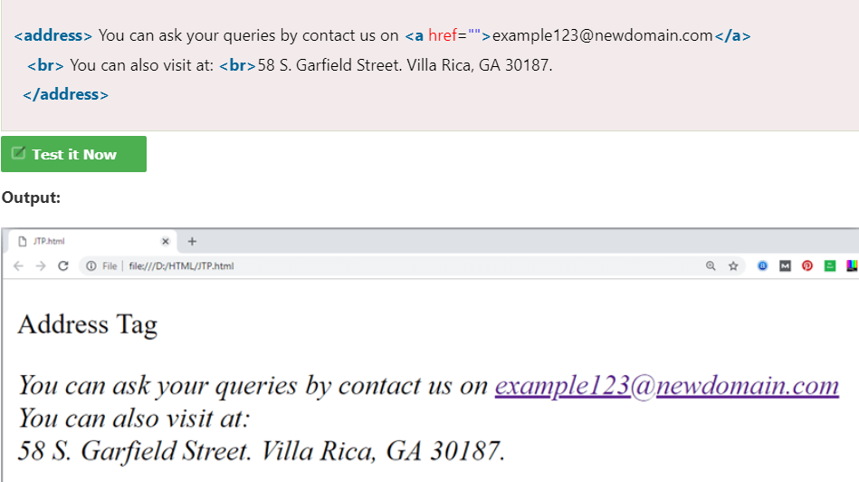
Address tag
An HTML <address> tag defines the contact information about the author of the content. The content written between <address> and </address> tag, then it will be displayed in italic font.

Slide 22

Html anchor tag
The HTML anchor tag defines a hyperlink that links one page to another page. It can create hyperlink to other web page as well as files, location, or any URL. The "href" attribute is the most important attribute of the HTML a tag. and which links to destination page or URL.
href attribute of HTML anchor tag
The href attribute is used to define the address of the file to be linked. In other words, it points out the destination page.

Slide 23
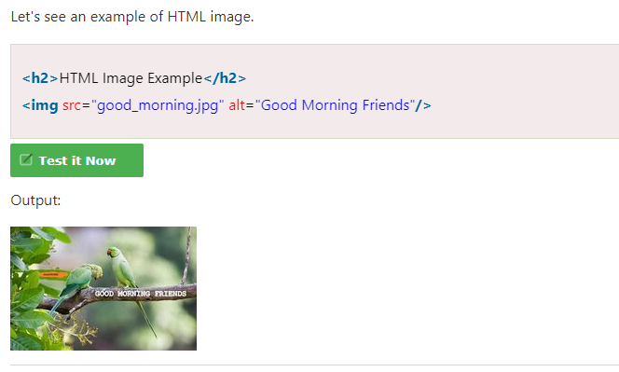
Html image tag
HTML img tag is used to display image on the web page. HTML img tag is an empty tag that contains attributes only, closing tags are not used in HTML image element.

Slide 24
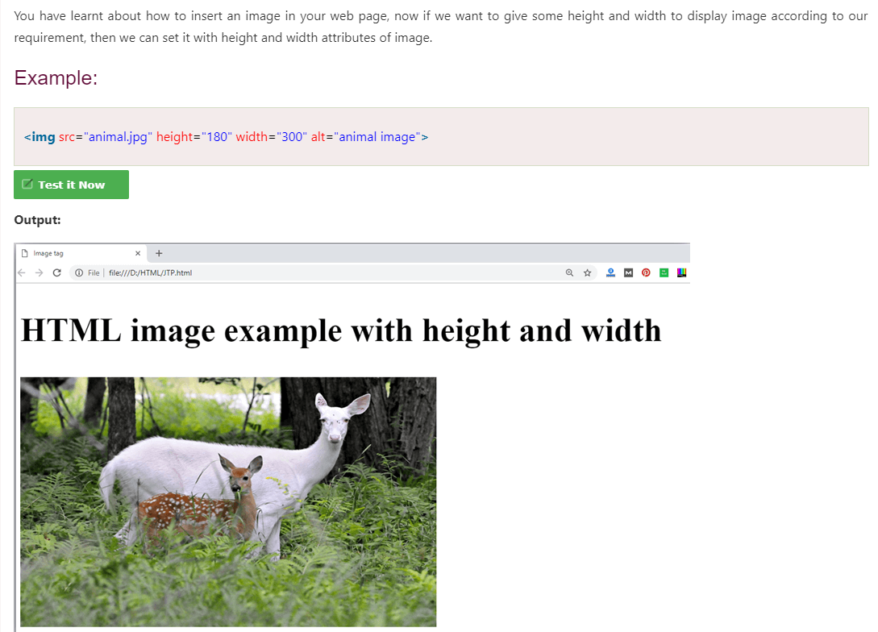
Using height and width in html image tag

Slide 25
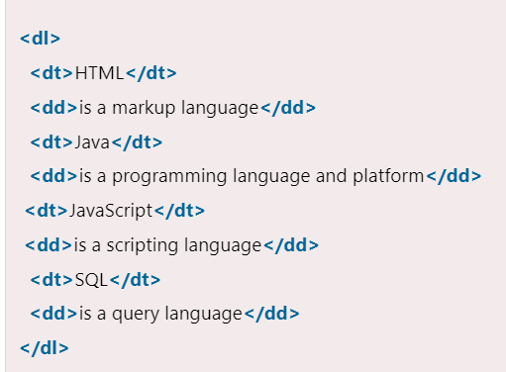
Html description list
HTML Description List or Definition List displays elements in definition form like in dictionary. The <dl>, <dt> and <dd> tags are used to define description list.
The 3 HTML description list tags are given below:
<dl> tag defines the description list.
<dt> tag defines data term.
<dd> tag defines data definition (description).

Slide 26
Html form
An HTML form is a section of a document which contains controls such as text fields, password fields, checkboxes, radio buttons, submit button, menus etc.
An HTML form facilitates the user to enter data that is to be sent to the server for processing such as name, email address, password, phone number, etc. .
Why use HTML Form
HTML forms are required if you want to collect some data from of the site visitor.
For example: If a user want to purchase some items on internet, he/she must fill the form such as shipping address and credit/debit card details so that item can be sent to the given address.

Slide 27
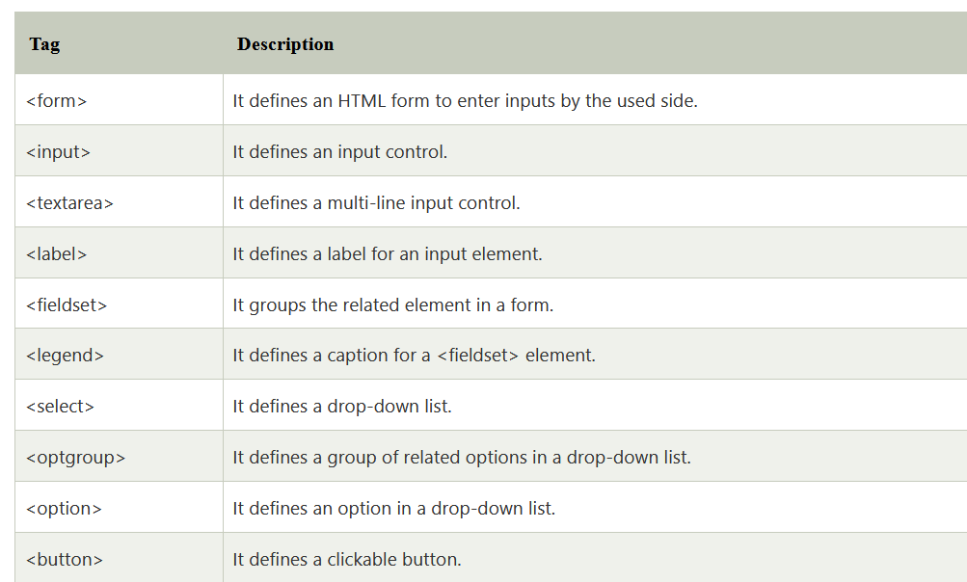
Html form syntax
<form action="server url" method="get|post">
//input controls e.g. textfield, textarea, radiobutton, button
</form>

Slide 28
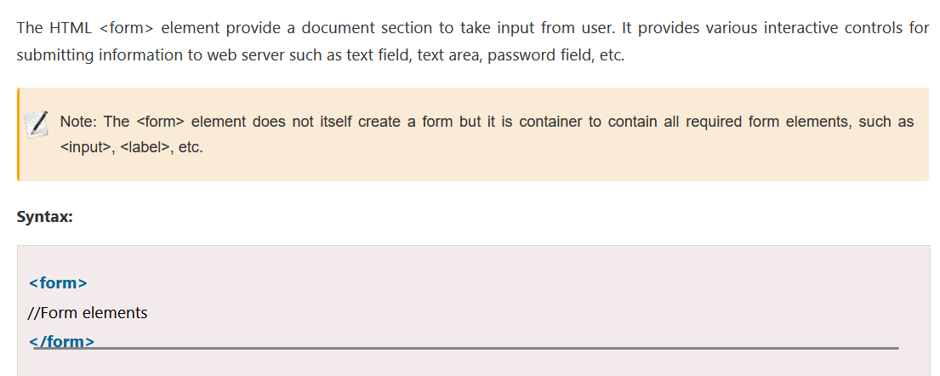
Html form element

Slide 29
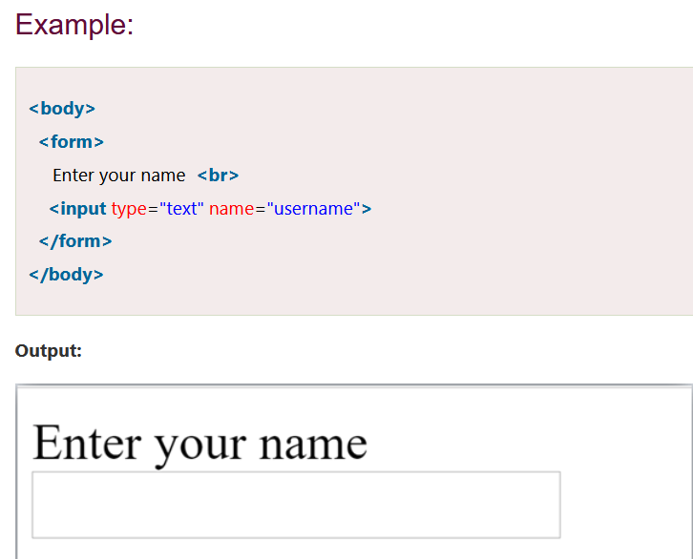
Html input element
The HTML <input> element is fundamental form element. It is used to create form fields, to take input from user. We can apply different input filed to gather different information form user. Following is the example to show the simple text input.

Slide 30
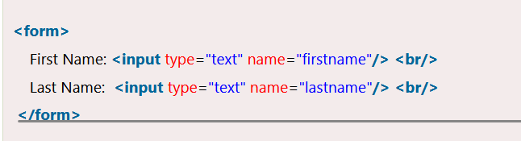
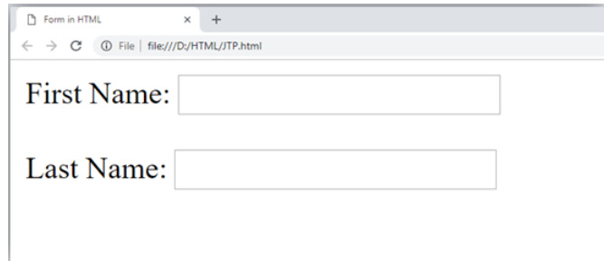
Html text field control
The type="text" attribute of input tag creates textfield control also known as single line textfield control. The name attribute is optional, but it is required for the server side component such as JSP, ASP, PHP etc

Slide 31
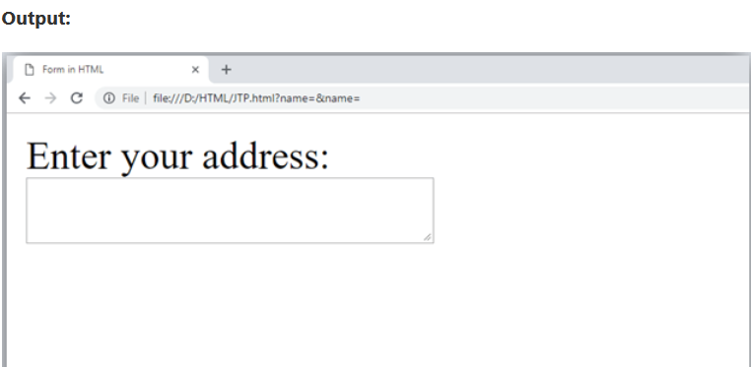
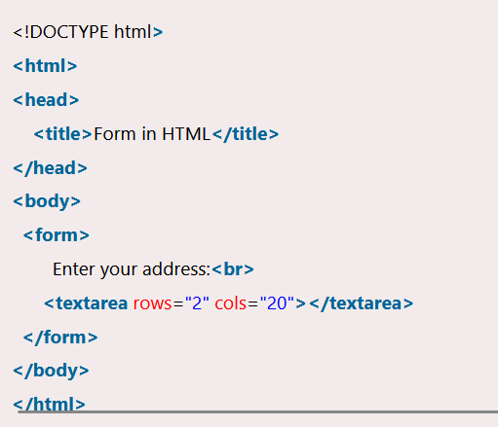
Html textarea tag
The <textarea> tag in HTML is used to insert multiple-line text in a form. The size of <textarea> can be specify either using "rows" or "cols" attribute or by CSS.

Slide 32
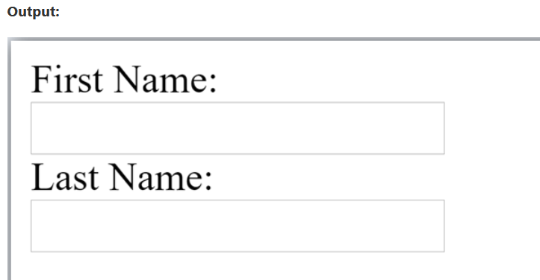
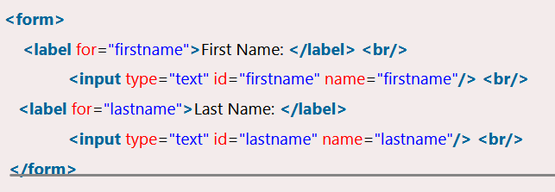
Label tag in form
It is considered better to have label in form. As it makes the code parser/browser/user friendly.
If you click on the label tag, it will focus on the text control. To do so, you need to have for attribute in label tag that must be same as id attribute of input tag.

Slide 33
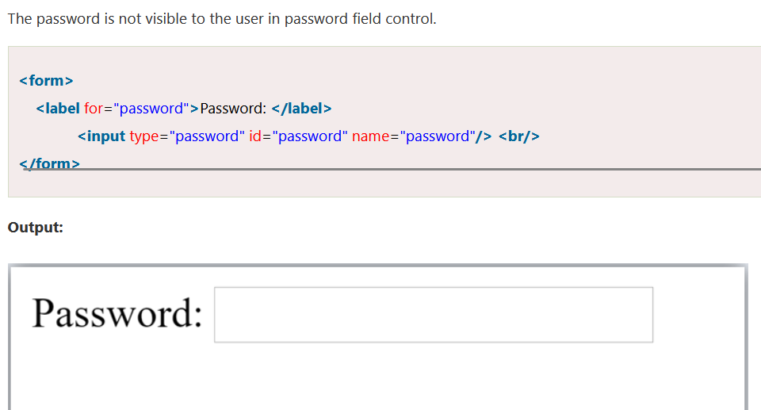
Html password field control

Slide 34
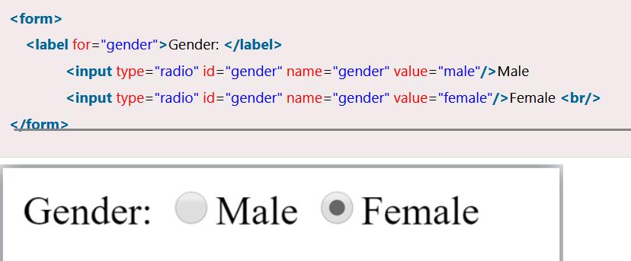
Radio button control
The radio button is used to select one option from multiple options. It is used for selection of gender, quiz questions etc.
If you use one name for all the radio buttons, only one radio button can be selected at a time.
Using radio buttons for multiple options, you can only choose a single option at a time.

Slide 35
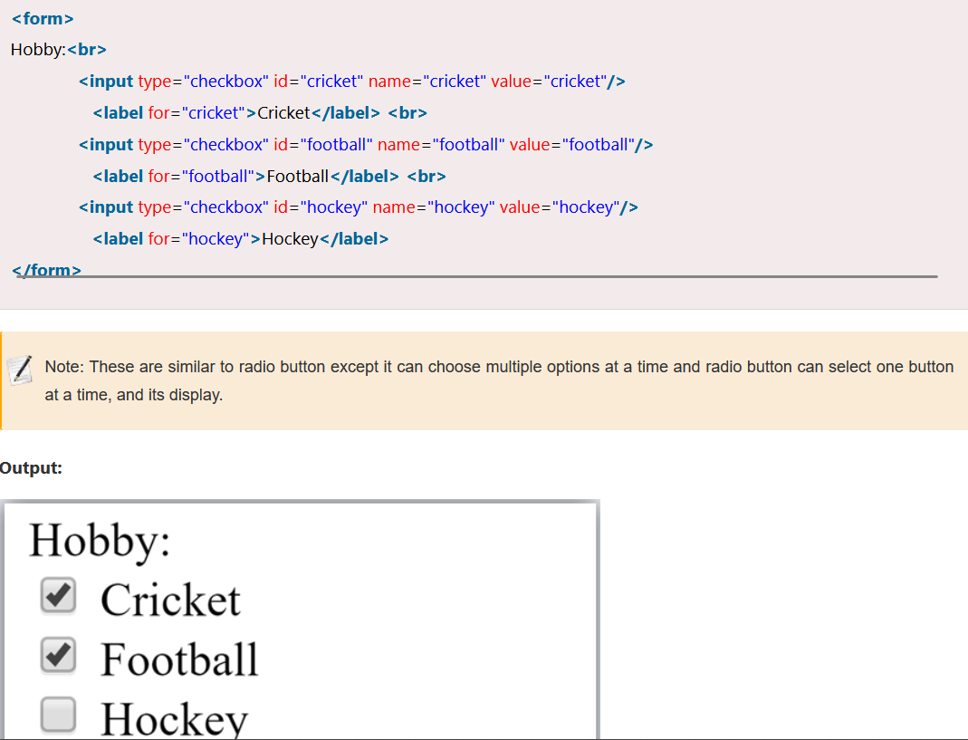
Checkbox control
The checkbox control is used to check multiple options from given checkboxes.

Slide 36
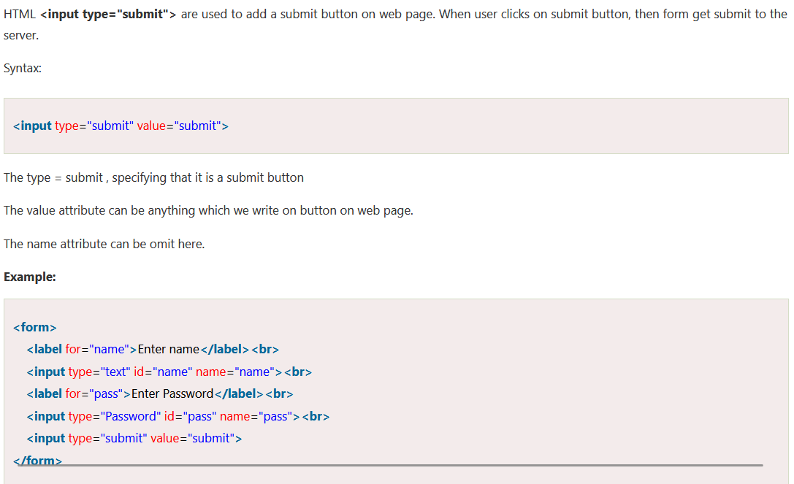
Submit button control

Slide 37
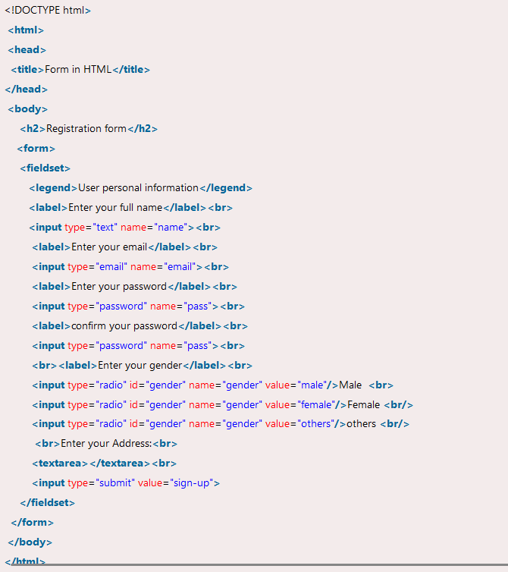
Html form example

Slide 38
Html lists
HTML Lists are used to specify lists of information. All lists may contain one or more list elements. There are three different types of HTML lists:
Ordered List or Numbered List (ol)
Unordered List or Bulleted List (ul)
Description List or Definition List (dl)
Note: We can create a list inside another list, which will be termed as nested List.

Slide 39
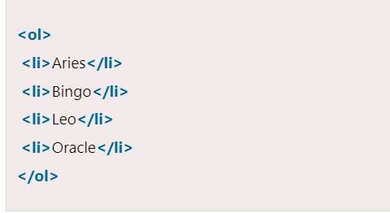
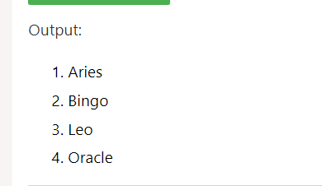
Html ordered list
In the ordered HTML lists, all the list items are marked with numbers by default. It is known as numbered list also. The ordered list starts with <ol> tag and the list items start with <li> tag.

Slide 40
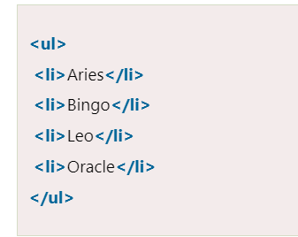
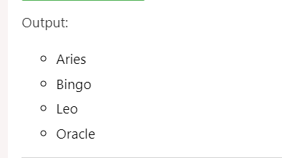
Html unordered list
In HTML Unordered list, all the list items are marked with bullets. It is also known as bulleted list also. The Unordered list starts with <ul> tag and list items start with the <li> tag.

Slide 41
Html description list
HTML Description list is also a list style which is supported by HTML and XHTML. It is also known as definition list where entries are listed like a dictionary or encyclopedia.
The definition list is very appropriate when you want to present glossary, list of terms or other name-value list.
The HTML definition list contains following three tags:
<dl> tag defines the start of the list.
<dt> tag defines a term.
<dd> tag defines the term definition (description).

Slide 42
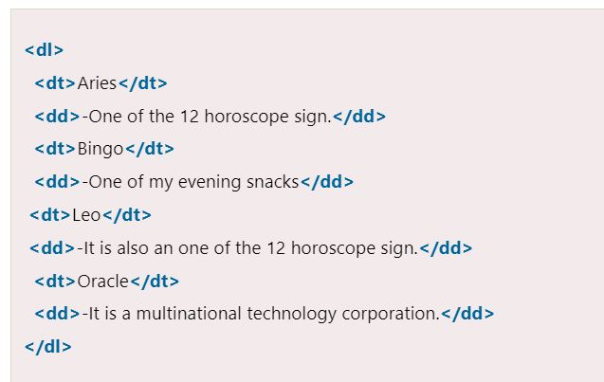
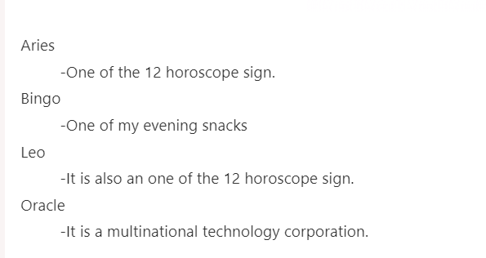
Html description list(continued)

Slide 43
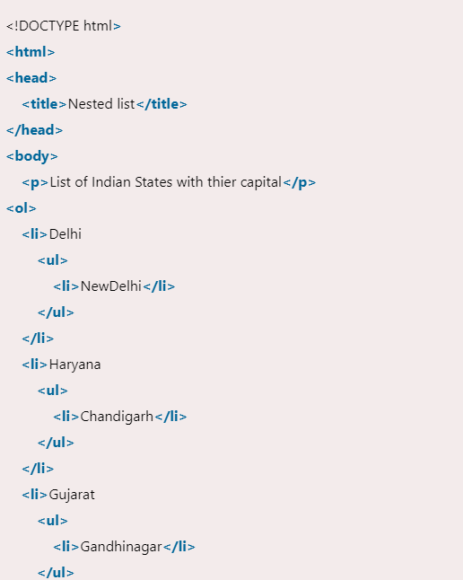
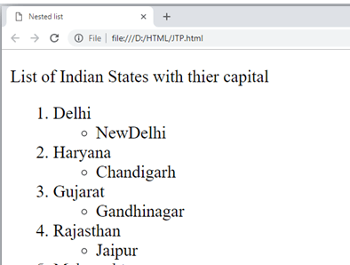
Html nested list
A list within another list is termed as nested list. If you want a bullet list inside a numbered list then such type of list will called as nested list.

Slide 44
Html form
An HTML form is a section of a document which contains controls such as text fields, password fields, checkboxes, radio buttons, submit button, menus etc.
An HTML form facilitates the user to enter data that is to be sent to the server for processing such as name, email address, password, phone number, etc. .
Why use HTML Form
HTML forms are required if you want to collect some data from of the site visitor.
For example: If a user want to purchase some items on internet, he/she must fill the form such as shipping address and credit/debit card details so that item can be sent to the given address.

Slide 45
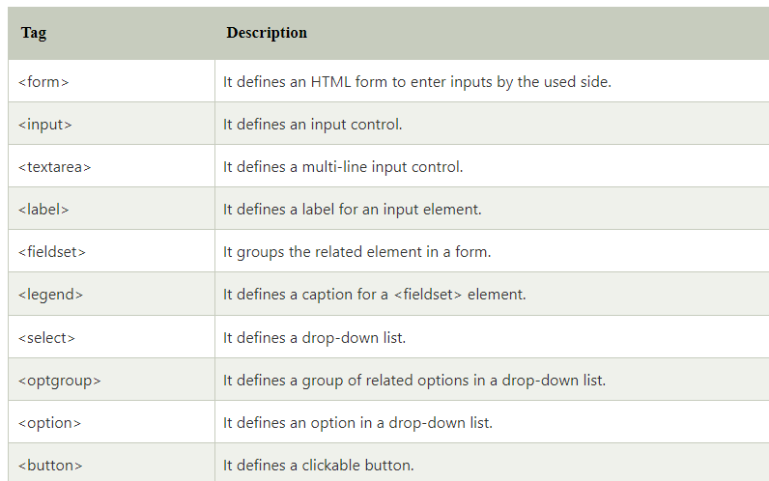
Html form tags

Slide 46
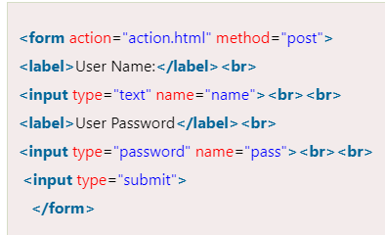
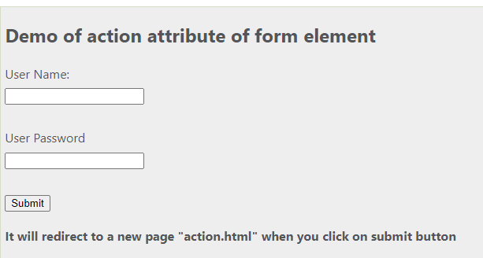
Html form attribute
In HTML there are various attributes available for <form> element which are given below:
HTML action attribute
The action attribute of <form> element defines the process to be performed on form when form is submitted, or it is a URI to process the form information.
The action attribute value defines the web page where information proceed. It can be .php, .jsp, .asp, etc. or any URL where you want to process your form.

Slide 47
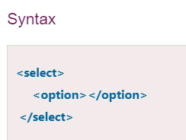
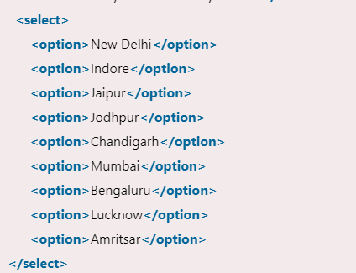
Html select tags
HTML <select> tag is used to create a drop down list with multiple options. The <option> element is nested within <select> tag for defining options in a list.
The <optgroup> element can be used for grouping related options in a list.
If you want to send data to server then use <select> tag within <form> element.

Slide 48
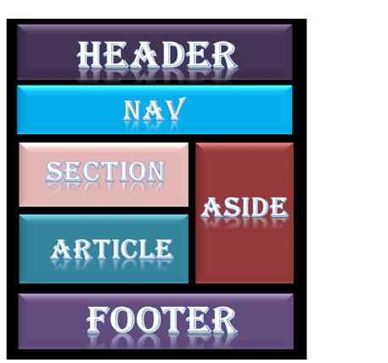
Html layouts
HTML layouts provide a way to arrange web pages in well-mannered, well-structured, and in responsive form or we can say that HTML layout specifies a way in which the web pages can be arranged. Web-page layout works with arrangement of visual elements of an HTML document.
Web page layout is the most important part to keep in mind while creating a website so that our website can appear professional with the great look. You can also use CSS and JAVASCRIPT based frameworks for creating layouts for responsive and dynamic website designing.

Slide 49
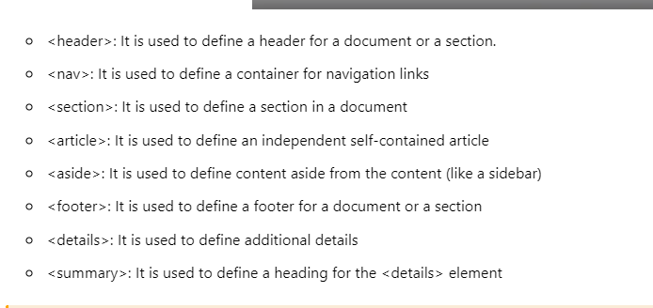
Types of html layouts

Slide 50

Html nav

Slide 51

Html section

Slide 52

Html footer

Slide 53

Html details tag

