Slide 1

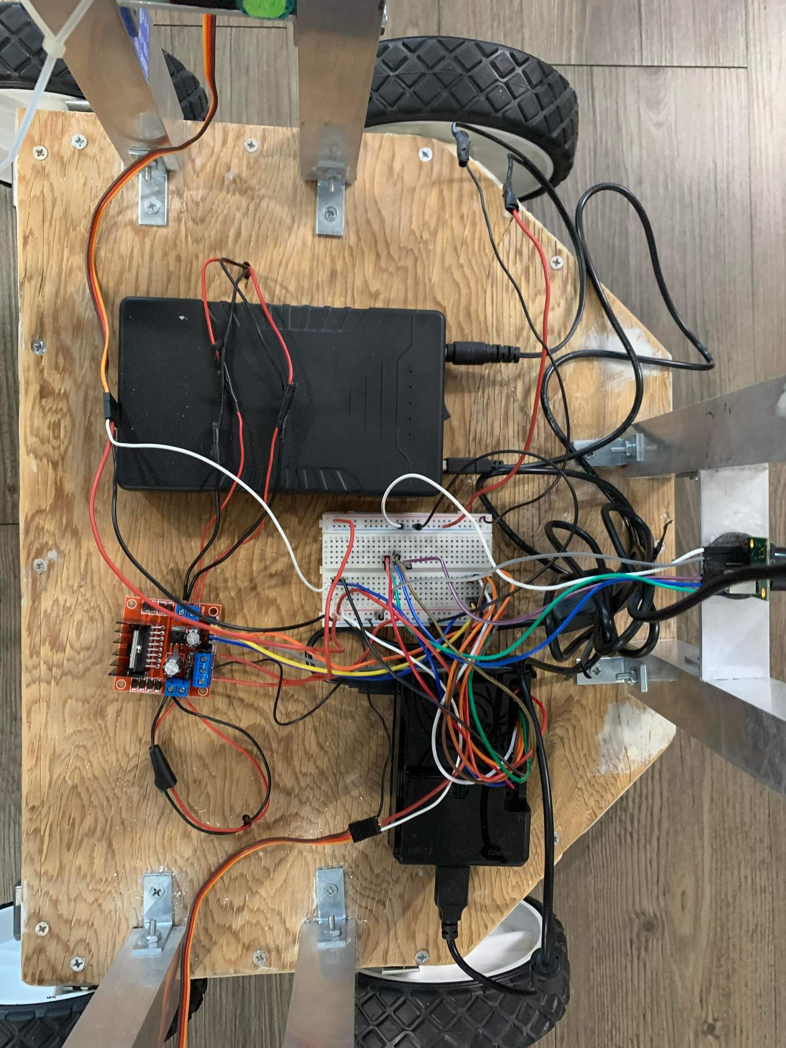
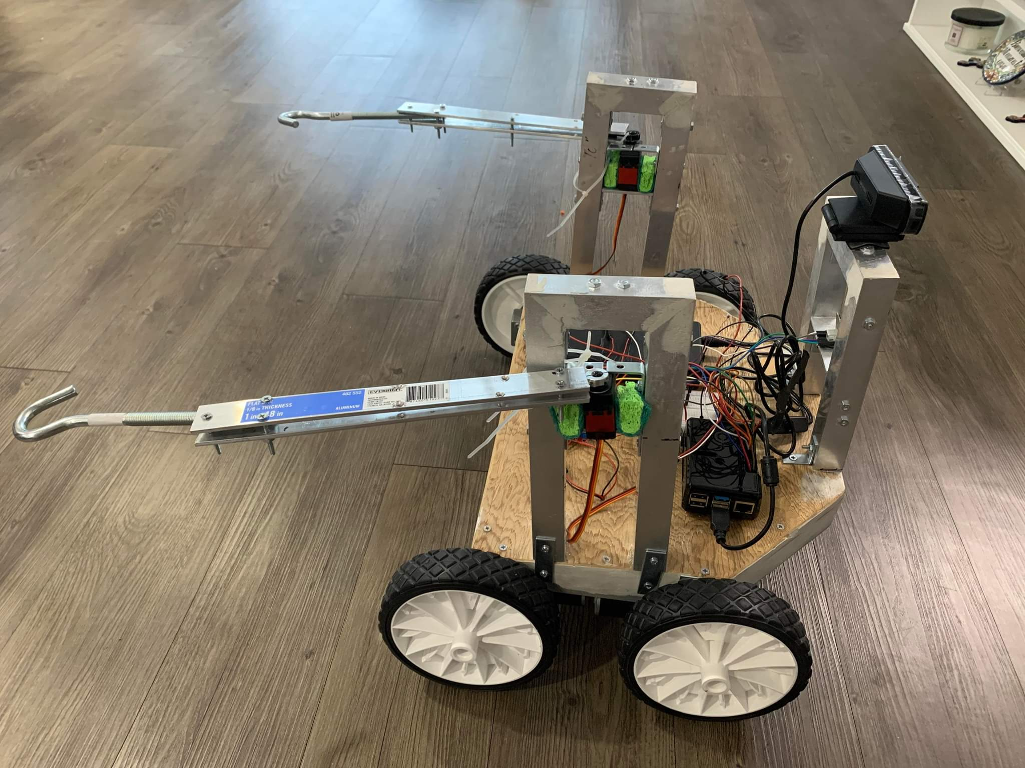
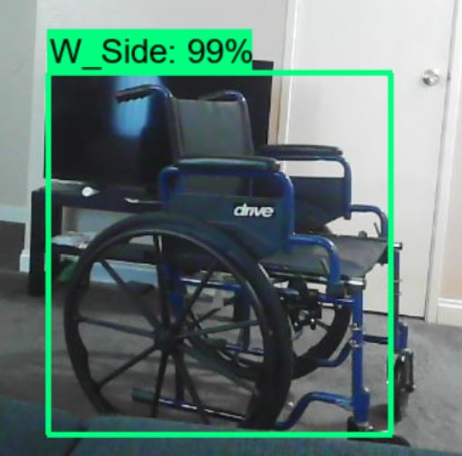
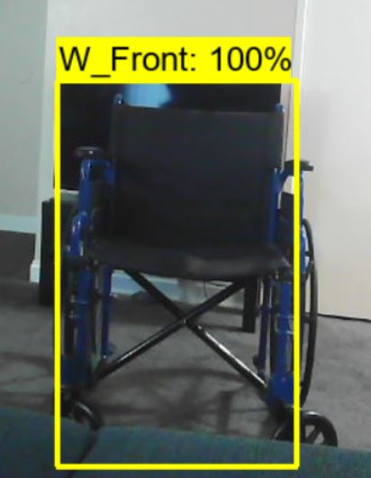
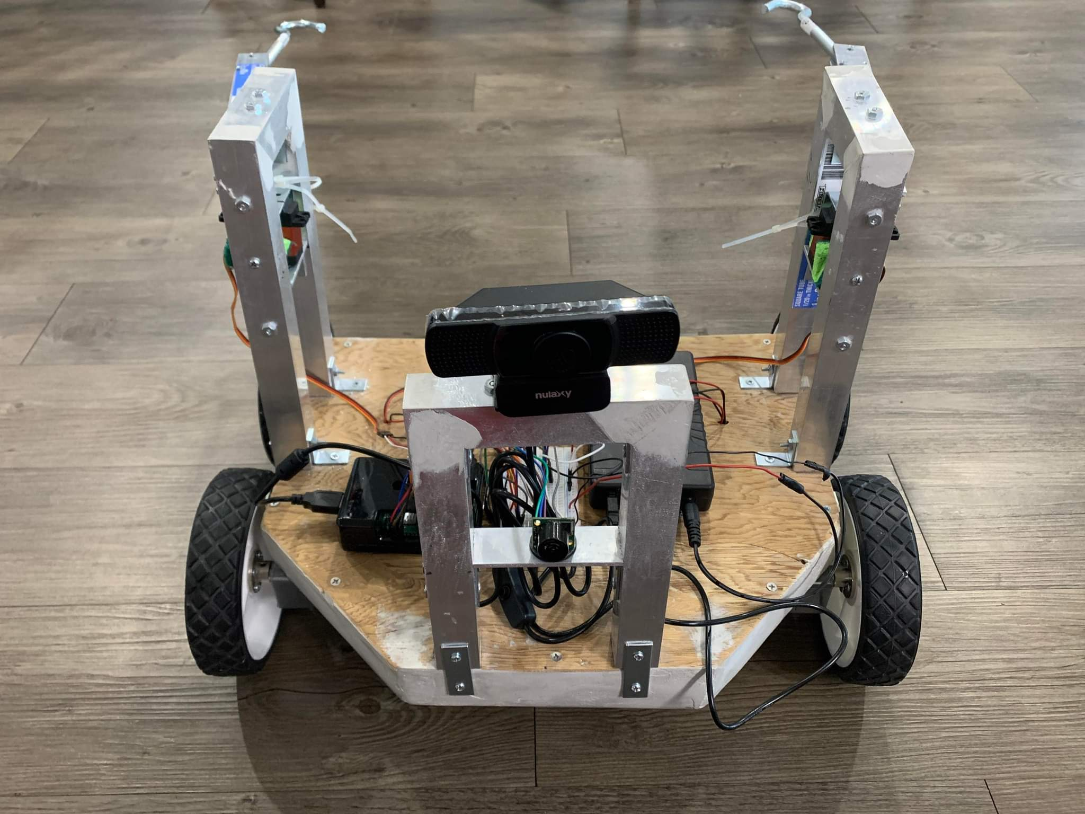
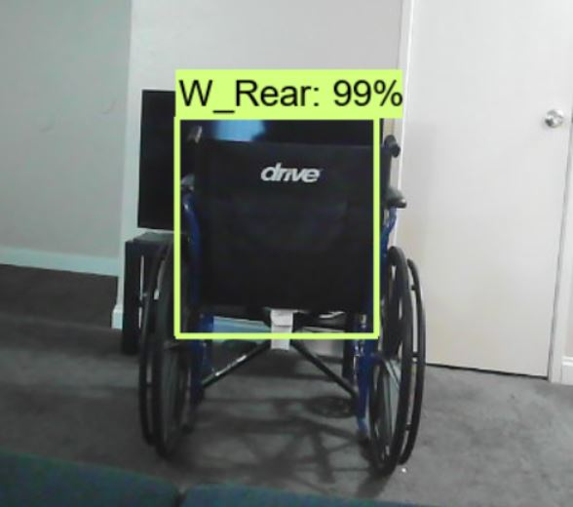
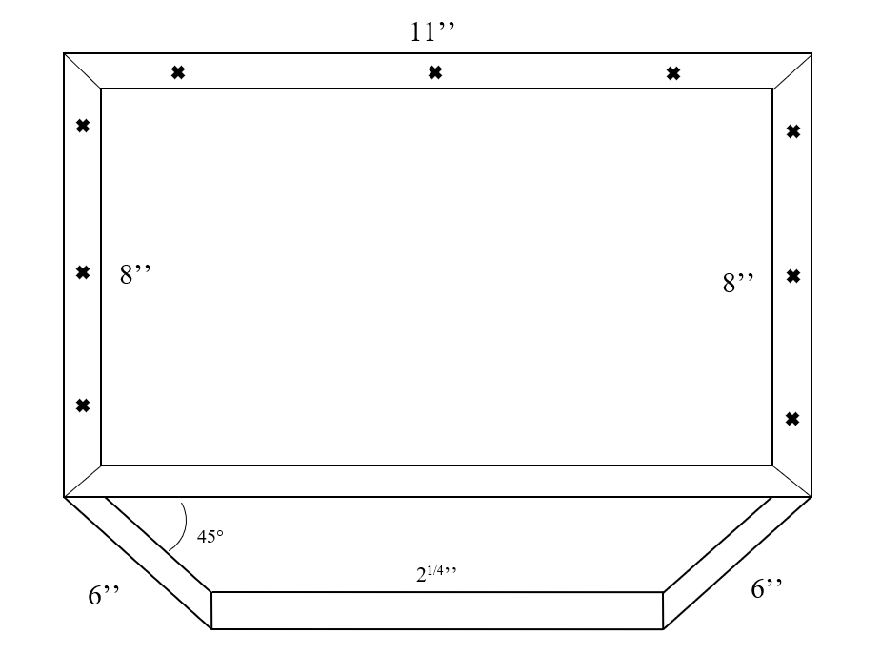
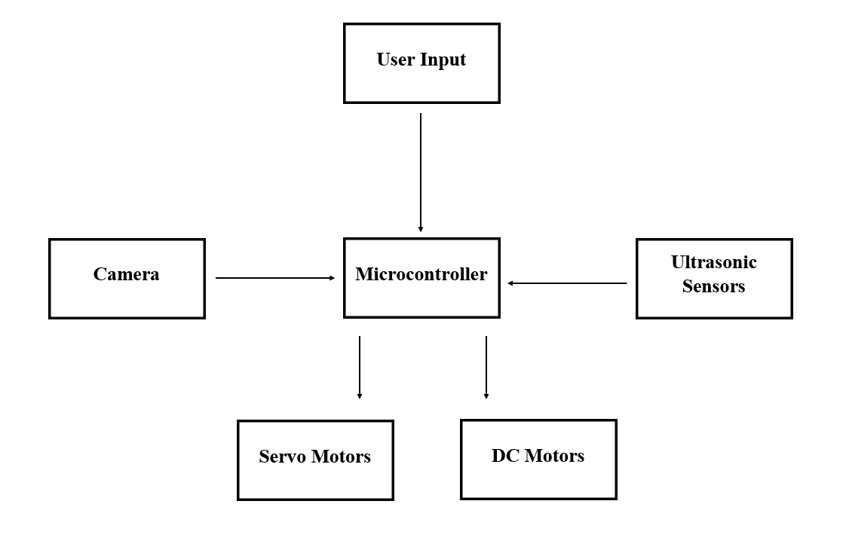
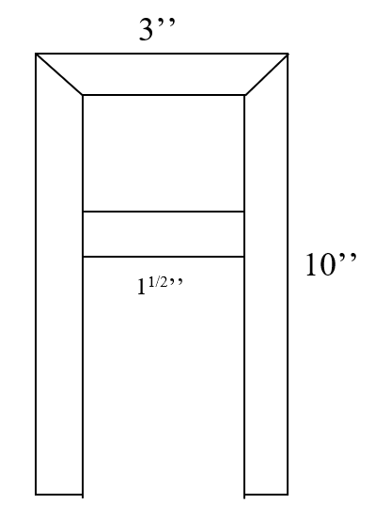
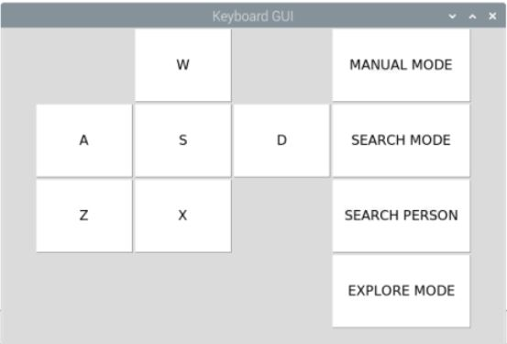
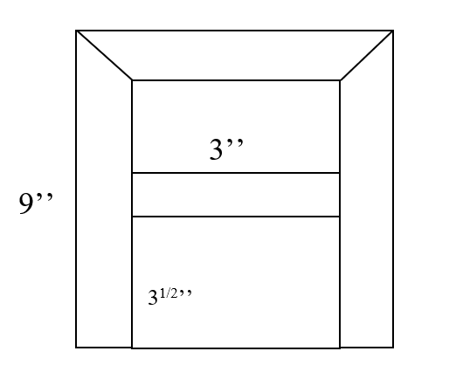
Handicap Helper
Anthony Torres, Gabriel Gabonia, and Nathan Pina
Instructor: Ming Zhu
Department of Electrical and Computer Engineering
Abstract
Theory of Operation
Testing
3. Final Prototype
The final iteration of testing was done with a full-scale version of the Handicap Helper.
Currently there are no automated or autonomous wheelchair retrieval products in the consumer market. All currently available solutions require a significant amount of money and material resources as well as the necessity of having a user be present during the entire retrieval process. The Handicap Helper was designed to assist those with difficulty obtaining their own wheelchair in a safe and hands-free way.
Situations where the Handicap Helper is needed.
Wheelchair is out of reach or in another room
The wheelchair is too heavy to lift/push for the user
The user is alone and are unable to move the wheelchair themselves
The basic process of the Handicap Helper can generally be broken down into these steps:
The robot is given a map of the user's room and will look for the wheelchair using its camera
The autonomous driving (or manual driving) will begin as the robot begins to search for the wheelchair
Once located, the robot will position itself under the wheelchair
A set of retractable slides extend out in between the railings of the wheelchair
The robot will then proceed to push and move the wheelchair back to the user
Several iterations of testing were done in order to test every component individually in addition to the combined testing of the final Handicap Helper build.
Object Detection
Camera mounted on robot needed to detect each of the different sides of the wheelchair.
2. Creating Different Functions
The robot can be set to different settings which can be toggle by the user.
Manual Mode
User takes manual control of the robot with button feedback
Search Mode and Search Person
Robot is set to search for the wheelchair and retrieve it to a person
Explore Mode
Robot will randomly explore the area
Product Features
The user can at any time enable a manual driving mode which allows for full user control using a keyboard and the included built in GUI.
Wheelchair Retrieval
Retractable aluminum slides help push the wheelchair to the user using high-torque gear motors
Manual Control
Fully controllable with a keyboard in addition to simple and easy to use GUI
Object Detection
Wheelchair is detected by the robot using a mounted camera
Autonomous Driving
Self-driving using ultrasonic sensors, camera, and python algorithms
Physical Implementation
The Handicap Helper was designed to fit under any standard sized wheelchair (between 45-60lb). Our electrical components like the Raspberry Pi, external power source, and drive control PCB will all be mounted on a wooden base placed on top of the robot.
Future Improvements
Stronger gear motors to improve retrieval speed and accuracy
Increased cam quality to improve object detection
Improved object detection accuracy by supplying algorithm with data from varying lighting conditions and camera angles
Develop a SLAM algorithm and self mapping functions for better efficiency
Finer movement controls allowing for precise turns and better obstacle avoidance
TOP VIEW
System Block Diagram
Conclusion
Although there are smart automatic wheelchairs, there are none that can be called to the user when the user is away from the chair. We seek to create a solution for the user to be able to call the wheelchair to themselves both manually and automatically. The bot we are making is separate from the chair. The cost of the bot will be significantly less than these smart automatic wheelchairs costing below $1,000. The bot will work with manual wheelchairs and will bring the chair to the user. If the user leaves their chair somewhere around the house the bot should be able to find and retrieve the chair. This is a better solution for people that can’t afford to buy an automatic chair or for people that already have a manual wheelchair and just need the functionality of calling their chair to themselves.
SIDE VIEW
FRONT VIEW

