Slide 1
Handwritten digits detection mini project presented to : Dr. Mohammad Aoude
Done by :Raneem Jaafar 5602
Hassan jawad 5264
Lebanese university - ULFG III
Electrical and electronics department

Slide 2
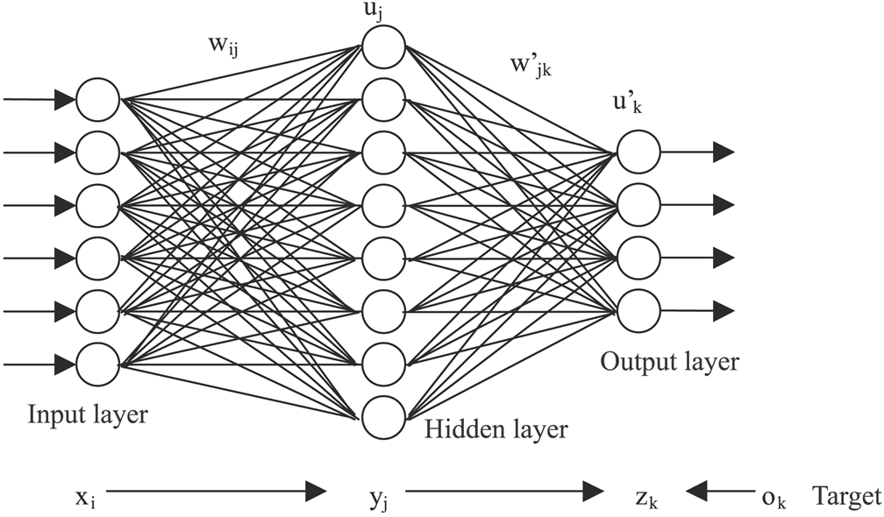
Neural network Definition
Formed of two or more layers : input layer, hidden layers(optional), and output layer
Each layer consists of one or more nodes
Lines indicate the flow of information from one node to the next.

Slide 3
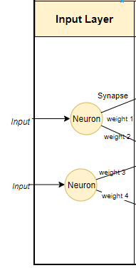
Input layer
responsible for receiving the inputs
inputs can be loaded from an external source
must always be one input layer in a neural network

Slide 4
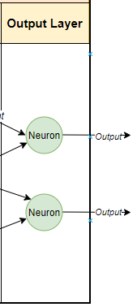
Output layer
responsible for producing the final result
must always be one output layer

Slide 5
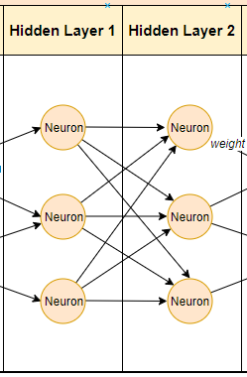
Hidden layer
reside in-between input and output layers
“hidden” implies that they are not visible to the external systems and are “private” to the neural network.
could be zero or more hidden layers in a neural network.

Slide 6

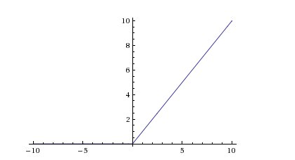
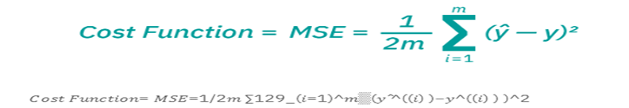
How does neural network works?
a=
Output = RelU(a)= max(0,a)
output = f(x) = 1 if ∑w1x1 + b<= 0; a if ∑w1x1 + b > 0

Slide 7
Thank you !

