Slide 1
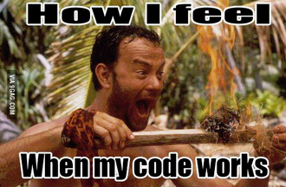

Monitoring Drought in Sugar Cane growing areas in Kwazulu Natal province of South Africa using SPI
Course: Geo-Scripting GRS-51806
Team: Snake Aka Python Authors: Andronikos Gyrichidis, Bongani Ngwenyama

Slide 2
Outline
Background
Methodology
Results (Interpolation, Graphs)
Conclusion
Key Lessons

Slide 3
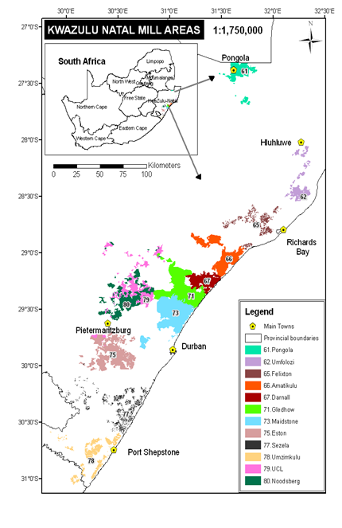
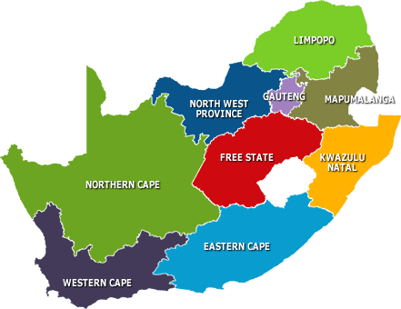
Background

Slide 4
Standard Precipitation Index
The Standard Precipitation Index (SPI) is once of the widely used drought indices globally. The level of drought is determined but the SPI value.
Positive SPI values indicate greater than median precipitation and negative values indicate less than median precipitation. Drought periods are represented by relatively high negative deviations. Normally, the 'drought' part of the SPI range is arbitrary split into:
moderately dry (-1.0 > SPI > -1.49),
severely dry (-1.5 > SPI > -1.99) and
extremely dry conditions (SPI < -2.0).
A drought event starts when SPI value reaches -1.0 and ends when SPI becomes positive again (McKee et al., 1993).

Slide 5
Methodology
Data downloading from SASRI(http://portal.sasa.org.za/weatherweb/weatherweb.ww_menus.menu_frame?menuid=1)
Pre-processing of the data (https://github.com/SnakeAkaPython/FinalReportGeo-ScriptingGRS-51806.git)
Calculation of SPI using the library (spi)
Interpolation between points using the library (spatstat)
Created raster bricks
Raster brick animation for every month in the period considered
Created graphs for all the station
Created the animation for each month for all the stations
Final markdown report (https://cdn.rawgit.com/SnakeAkaPython/FinalReportGeo-ScriptingGRS-51806/master/FinalProjectReporttest.html)

Slide 6
Interpolation Results

Slide 7
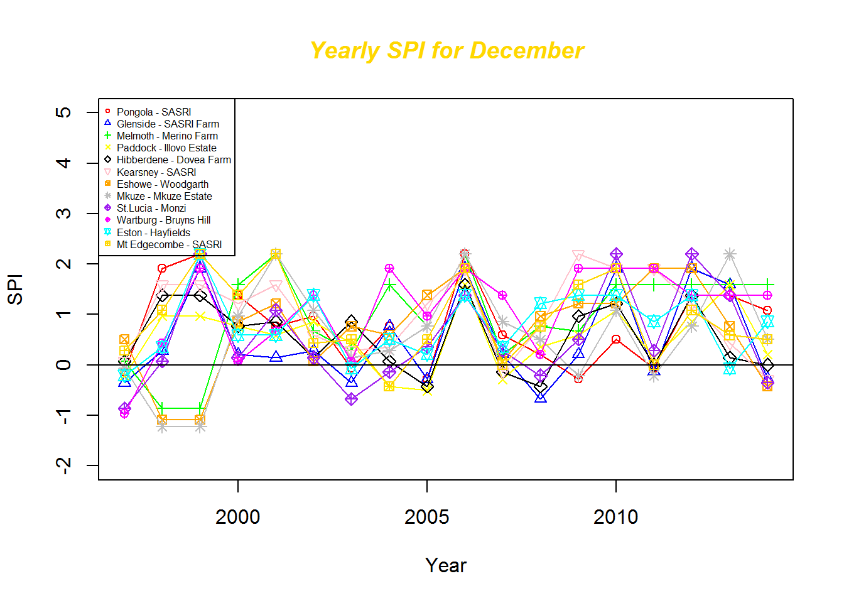
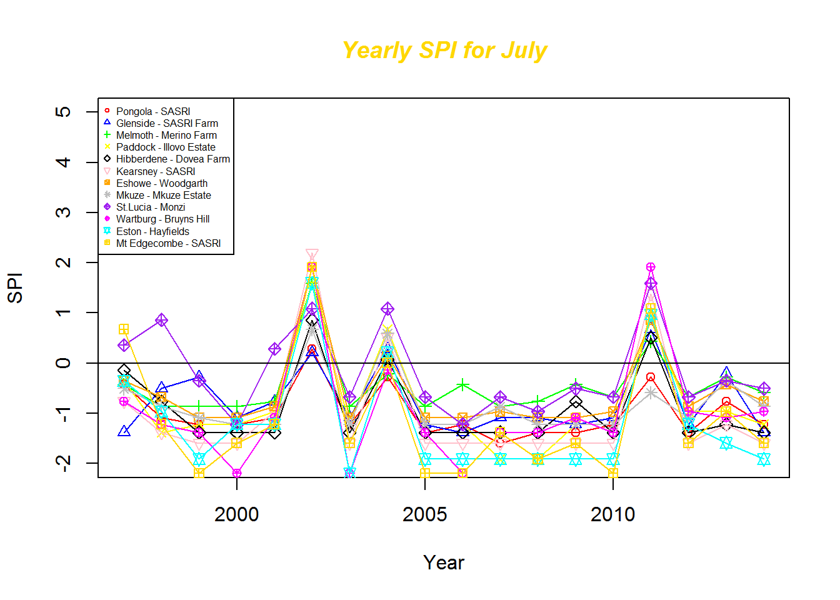

Slide 8
Graph Presentation

Slide 9
Conclusion
As Expected, the winter months are more drier than the Summer months are this area is a summer rainfall area.
As seen in the Yearly SPI for June, there are periods when all the areas were exceptionally wet than normal. This however not conclusive that once in ten every the areas would have wet conditions during this month because of the period considered in the analysis(i.e. 1997 - 2014 is not long enough for such conclusion).
The assessment also shows that the summer months experience dry conditions every after ten years, i.e. 2004 and 2014. As read from the article: (http://www.iol.co.za/news/south-africa/kwazulu-natal/kzn-to-declare-drought-emergency-1.1762934#.VMogo2jF8qk) The Province of KwaZulu Natal has declared a state of drought disaster.

Slide 10
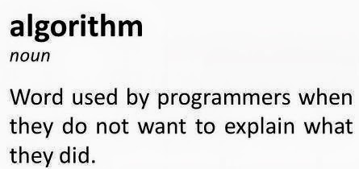

Key Lessons
New libraries (spi, spatstat, reshape, animation)
Google is our best friend
Advantages working on Linux (animation)
The importance of using scripting when handling data
Team work

