Slide 1

Snap for Windows Capstone
Jesse Millar, Mat Kuhn, Phillip Anderson, Devin Durtschi, McKade Clements
Professor Ekstrom

Slide 2

What is it?
Snap is an open source project started by Intel in July of 2015
Written in Go, but recently made expandable to encompass the usage of other languages
A single API for collecting telemetry data in Unix-based systems

Slide 3
What is Telemetry?
Telemetry is the gathering of system metrics from a distance
Used mainly for monitoring and troubleshooting purposes
Telemetry feedback can lead to system improvements

Slide 4
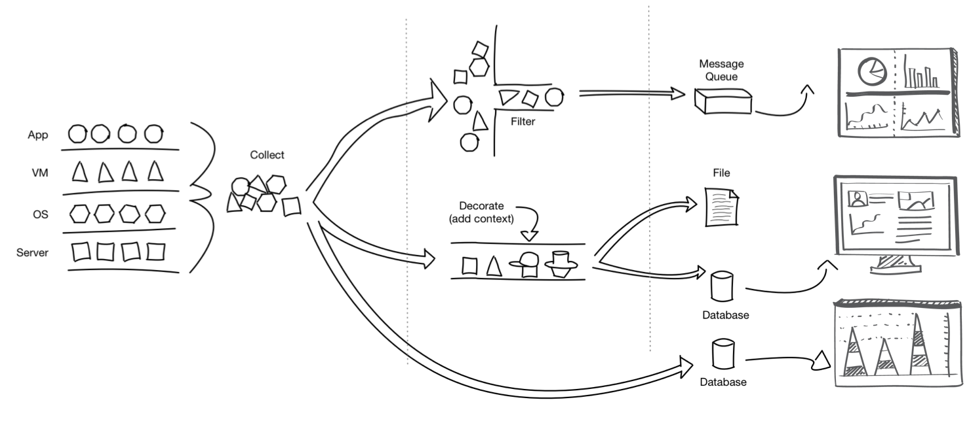
Notes:
Snap provides a unified way of gathering data from any layer of your system. It is made to be modular, so the collection aspect is completely separate from the processing and publishing, etc. Explain difference between collector, processor, publisher. Allows you to define “workflows”. Talk about Snap’s ability to scale with Tribes?

Slide 5


Stakeholders
Intel
Companies with Windows Systems
Operators of Windows Systems
Open-source Maintainers of the Snap Project
Members of the Snap Community
Notes:
Open Source image at: https://gongos.com/tl/data-scientists-converting-big-business-to-open-source/

Slide 6
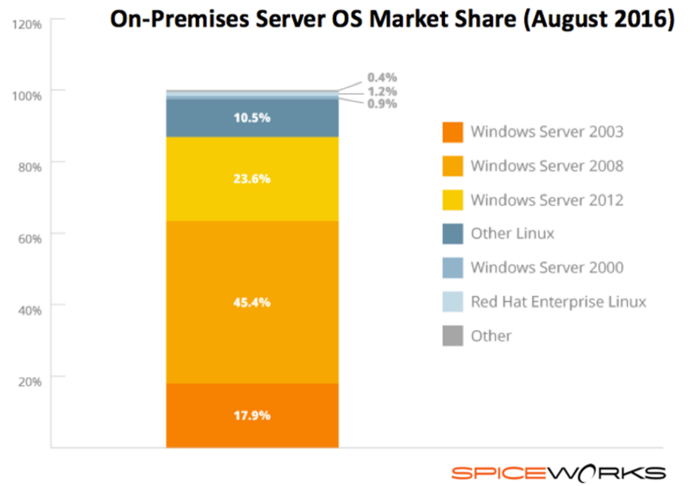
How does this impact stakeholders?
Windows servers/devices large percentage of enterprise environments
Windows runs on Intel processors
Greater ease in system management
Greater sales for Intel
Reduced cost for companies
By porting this to Windows, benefits are greatly increased
https://community.spiceworks.com/networking/articles/2462-server-virtualization-and-os-trends
Notes:
Rubric: We need to make sure and explain why we’re doing this. What are the benefits to customers and users?
In terms of web servers, Linux takes the lead, but both are around 30 percent (according to Wikipedia)
For graphic of Windows desktop environment percentage: https://www.netmarketshare.com/operating-system-market-share.aspx?qprid=10&qpcustomd=0

Slide 7
Objective Statement
Automate the Snap build process and port at least three Snap data collection plugins for Windows, including Perfmon, Sysinternals, and Active Directory by March 20th.
Notes:
Need to present a clear and accurate summary of the project here.
What are our goals with this project? What do we plan to accomplish/have already accomplished?

Slide 8
Project Management
Tie into existing system
GitHub
Weekly Standup Meetings
Zoom (with sponsor)
Google Hangouts
Slack
Notes:
We can change the title of slide, but rubric has: “The project management approach is appropriate for the design, and is completely and clearly presented (scheduling, changes, budget).”

Slide 9

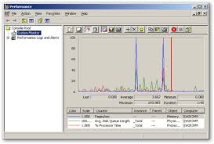
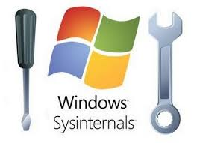



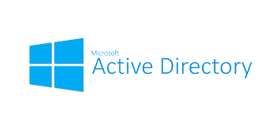


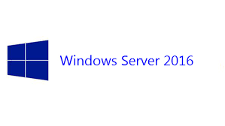
Technologies Involved
Notes:
Tech groups:
Main - snap
Supporting - Active Directory, Sysinternals, Perfmon, Windows Server 2016
Organization - github, go
Communication - slack, google hangouts, zoom

Slide 10
Snap Build Process
Currently created for Linux operatings systems
Built in Go which cross compiles
Makefiles don’t work natively on Windows Server
Notes:
We should mention that we’ve been able to build and run Snap on Windows, now we’re just trying to find the best/most maintainable way to automate the process.

Slide 11
Snap Build Process (cont’d)
Looking into CMake as a maintainable solution
Currently operational using a manual process
Will potentially make a Windows batch script in the meantime for easier development

Slide 12
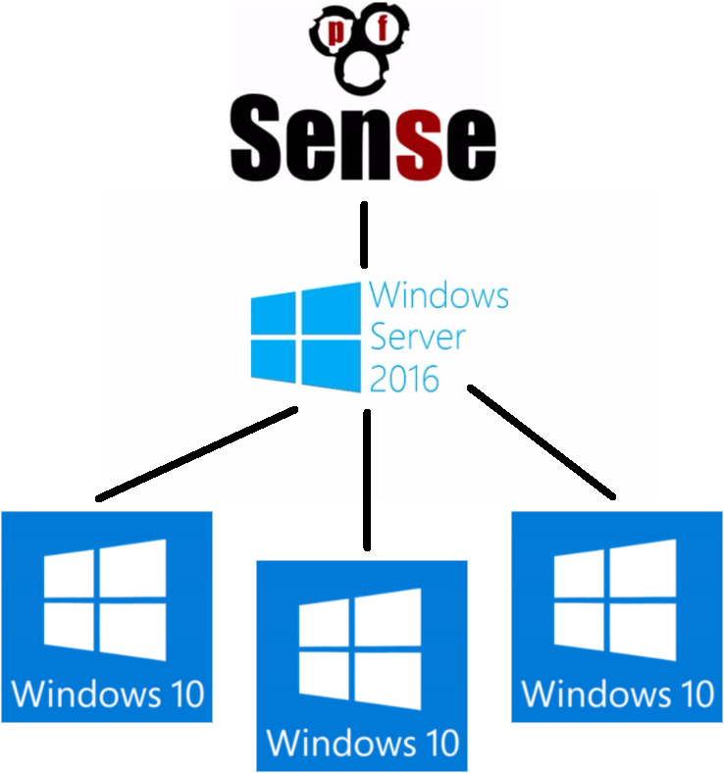
Development Environment
Set up firewall with PFSense
Contains domain inside
With domain controller
With several Windows 10 nodes

Slide 13
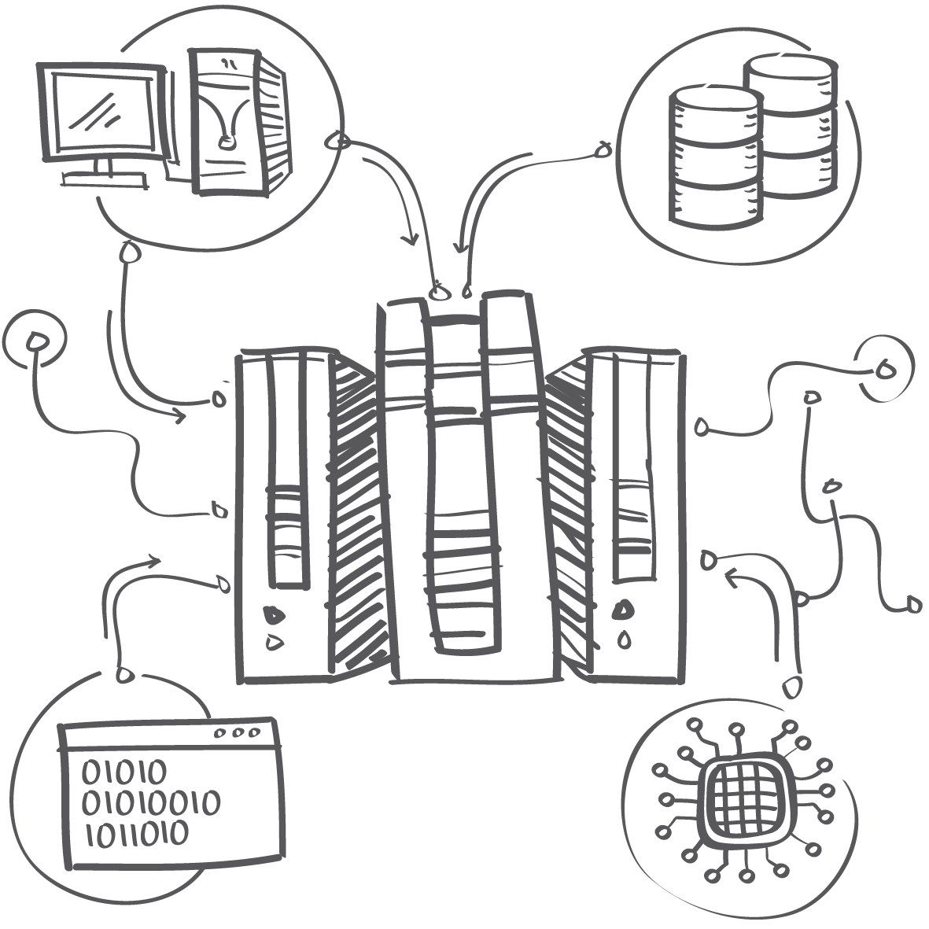
Plugins
Perfmon
SysInternals
Active Directory

Slide 14
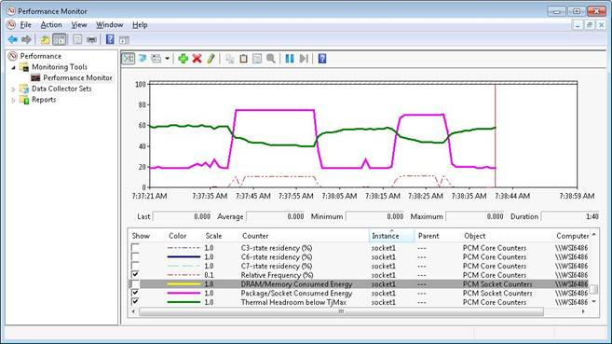
Perfmon
Used to display Windows metrics
Obtains data from “counters”
Plugin implements PowerShell script
Outputs to CSV file which will be parsed
Outlined basic pseudo-code to build
File structure set up
Dealing with recent library deprecation
Notes:
Idea for Perfmon plugin came from message on Slack by a Snap user (maybe from Intel).
Perfmon application interfaces with the Performance Counters API to provide and consume counter data.
Counters are used to provide information as to how well the operating system or an application, service, or driver is performing. The counter data can help determine system bottlenecks and fine-tune system and application performance. The operating system, network, and devices provide counter data that an application can consume to provide users with a graphical view of how well the system is performing.
https://msdn.microsoft.com/en-us/library/windows/desktop/aa371643(v=vs.85).aspx

Slide 15
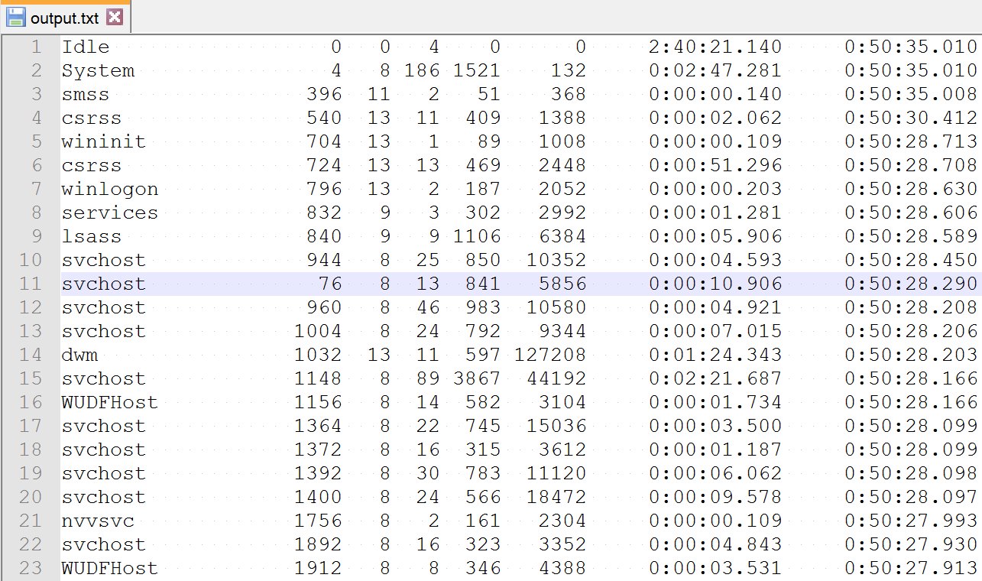
SysInternals - PsList
Show information about each running process
Use Powershell script to download/update the PsList executable

Slide 16

Active Directory

Slide 17
Lessons Learned
Documentation
Snap Community
Deprecated plugin library
Understanding pre-built framework and requirements
Learning Go, Git
Notes:
We can opt to take this slide out, but it could fill time if needed and may be good to explain why we aren’t farther along in the project/don’t have a demo.

Slide 18
Goals
December 20
Fully functional build automation script
January
Begin Active Directory Plugin
March
Complete functionality of plugins
Perform testing of all plugins (Perfmon, Sysinternals, Active Directory)
Stretch Goal
Research machine learning algorithms and Implementation
Notes:
We may want to change this to “Milestones” and then put actual dates next to each item.

Slide 19
Questions?

