Slide 1

Media Management Solution
Cloud based solution that simplifies
and drives incremental sales from
your media assets and in-store advertising.
Screenshot Demonstration

Slide 2
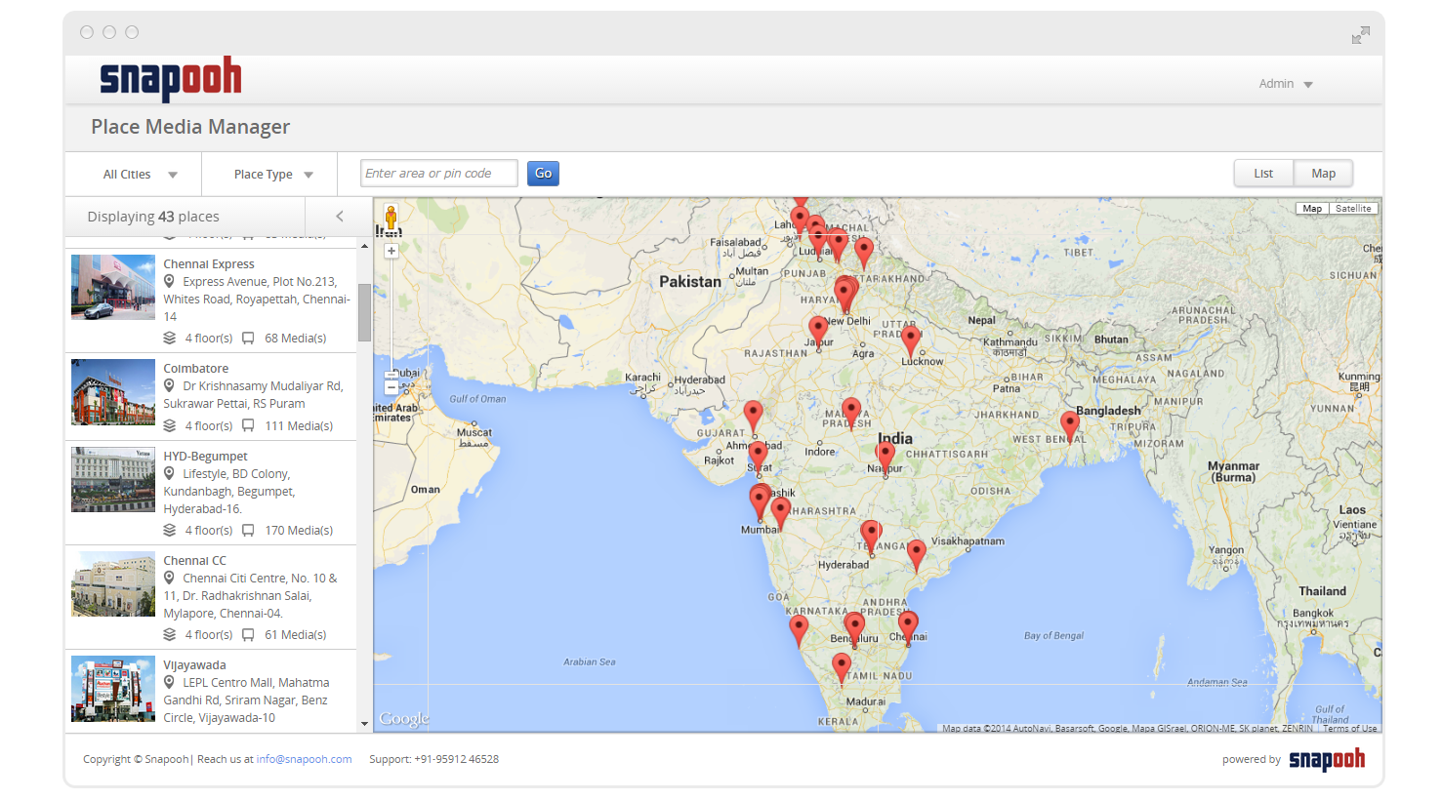
Manage your entire geographically spread places.

Slide 3
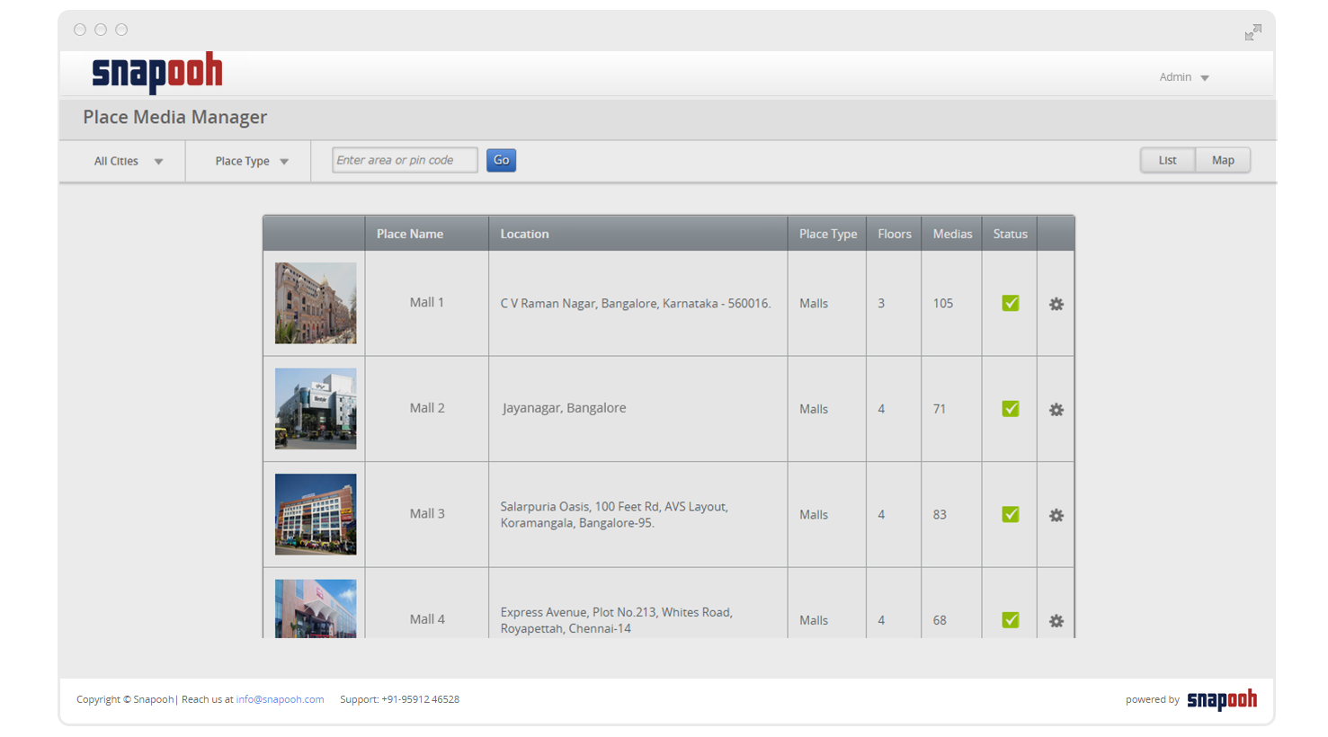
Manage your entire geographically spread places.

Slide 4
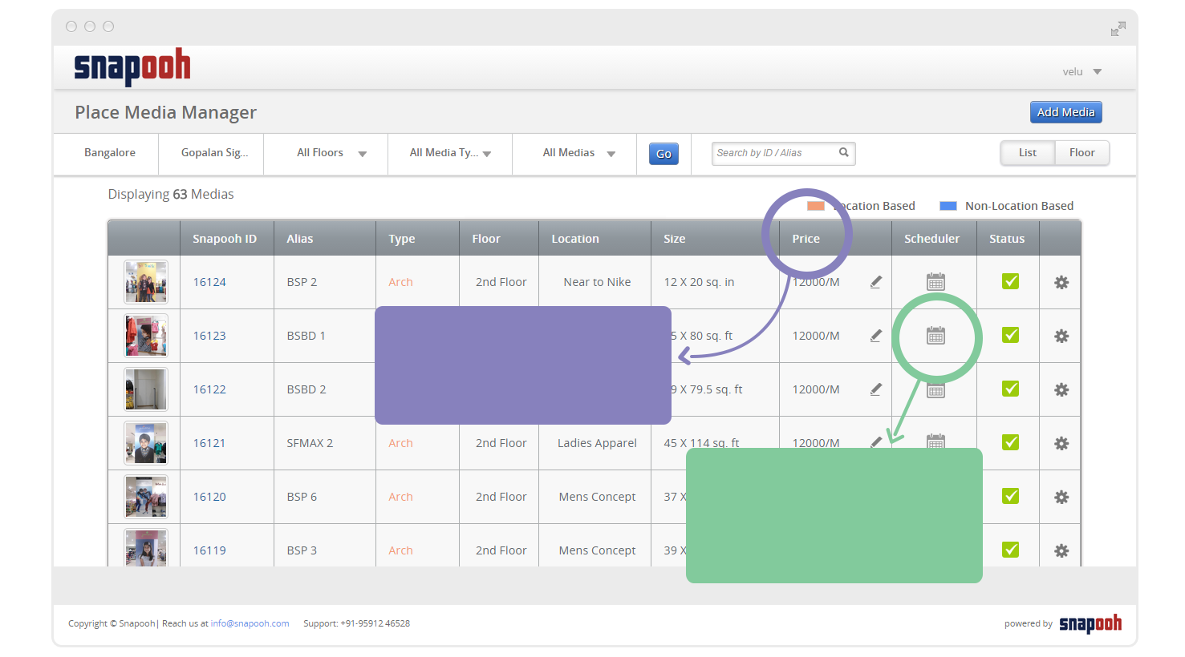
Manage any number of medias with complete specification. Supports all kinds of media.
Edit Price / Media details
View and Edit Calendar of
Every media

Slide 5
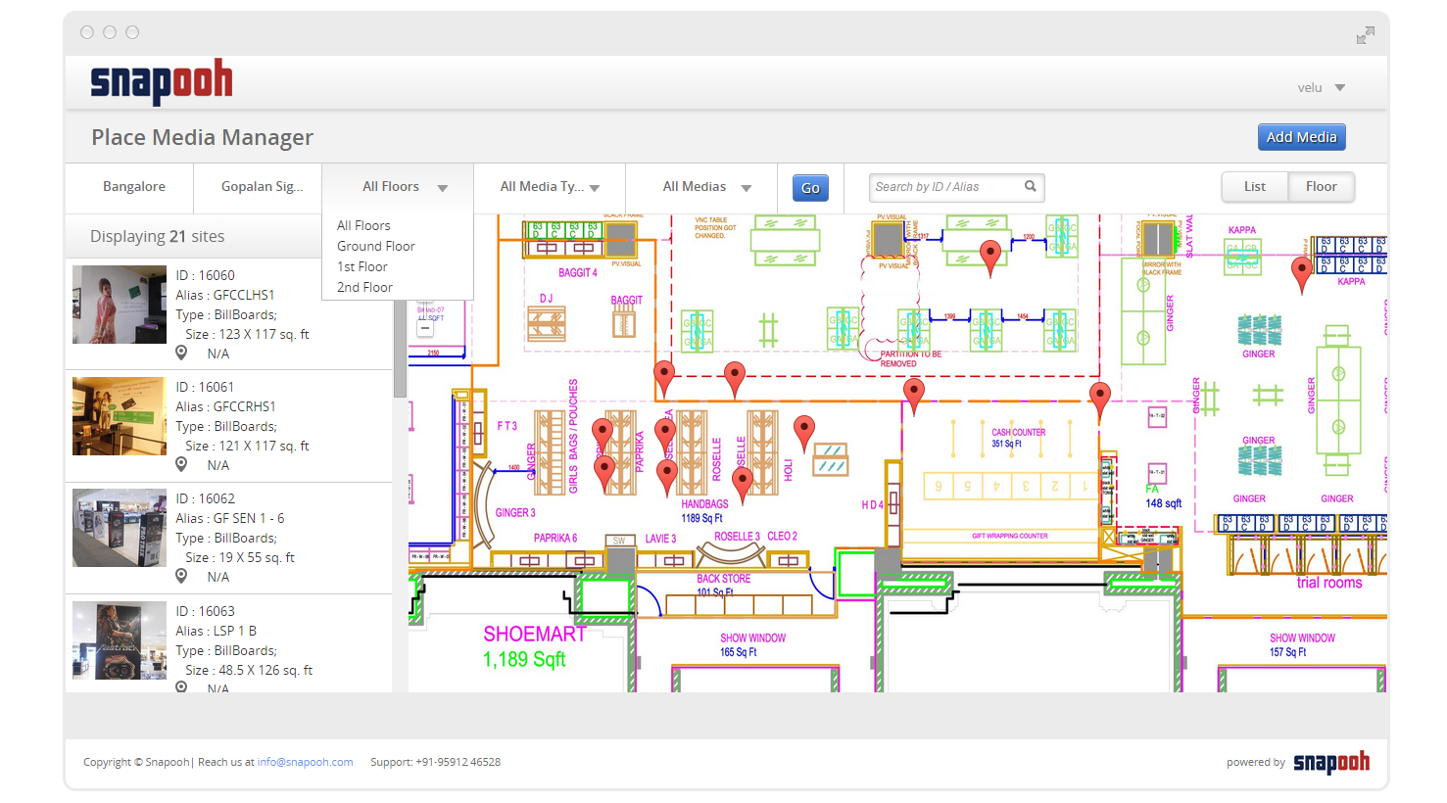
Add floors to places and load floor plans to indicate the location of every media.

Slide 6
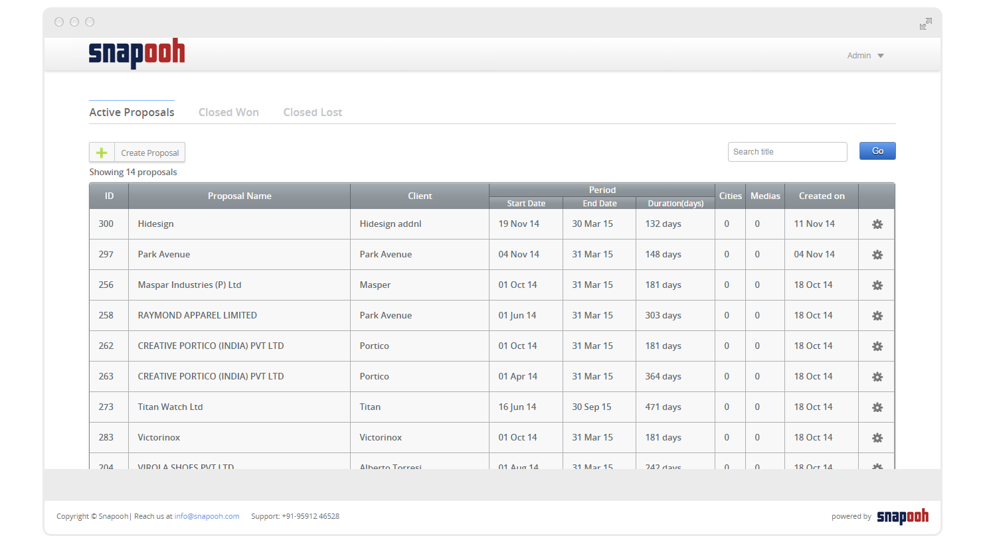
Create Proposals, Generate Presentations.

Slide 7
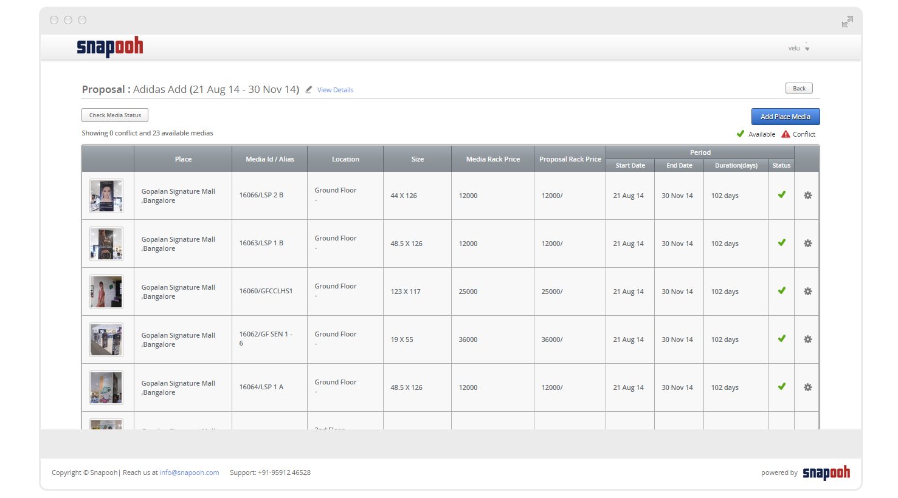
Add medias to proposals. Check for conflicts to avoid double booking.

Slide 8
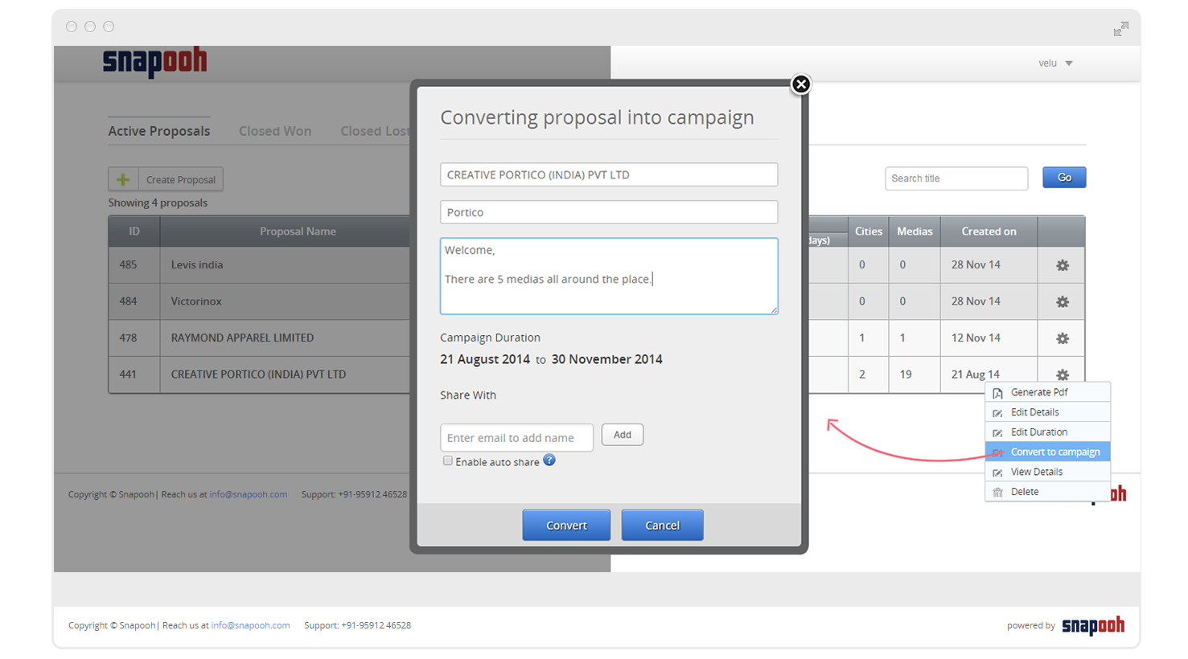
On confirmation, convert proposals to campaigns to book medias with a click

Slide 9
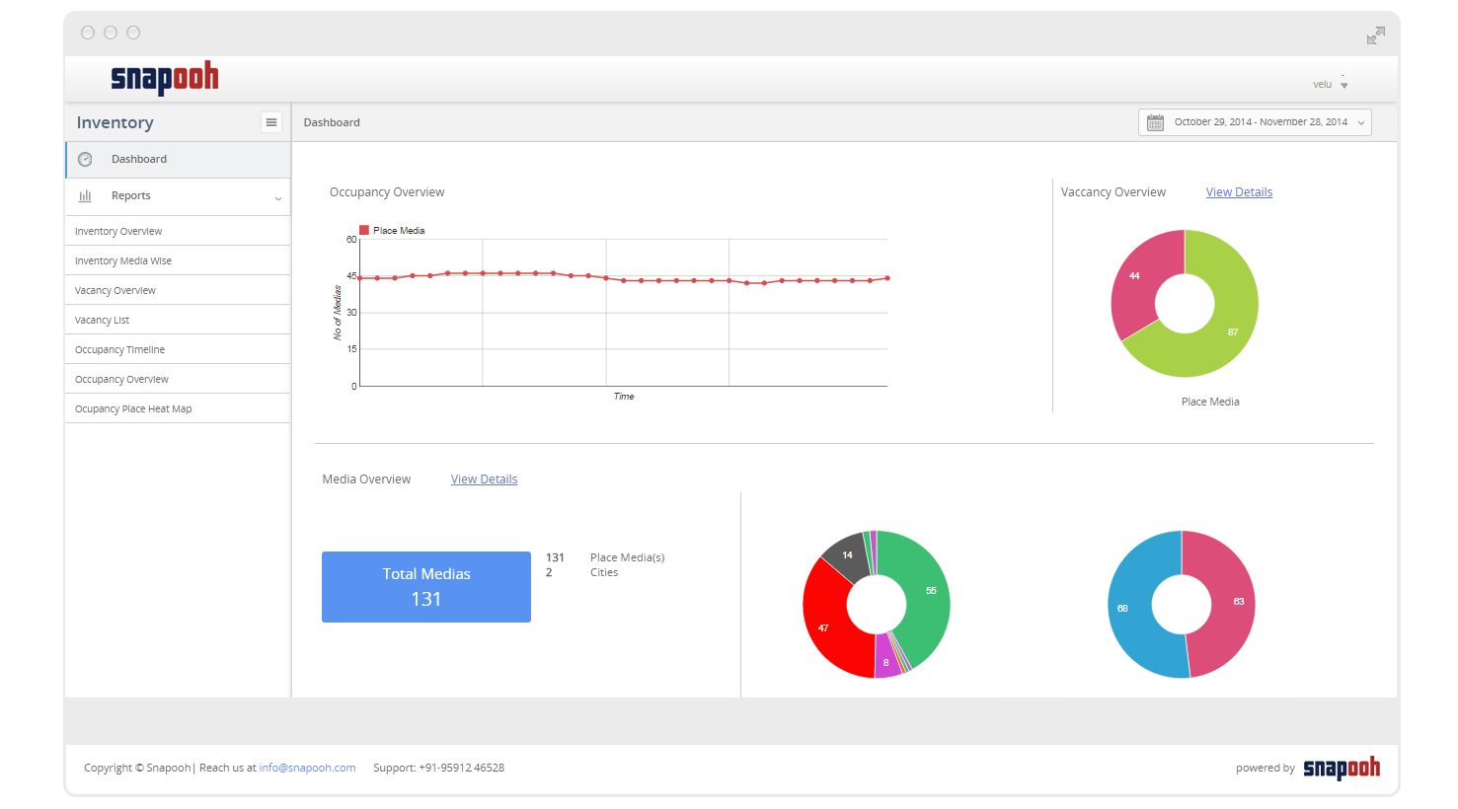
Dashboard : View inventory, occupancy and performance

Slide 10
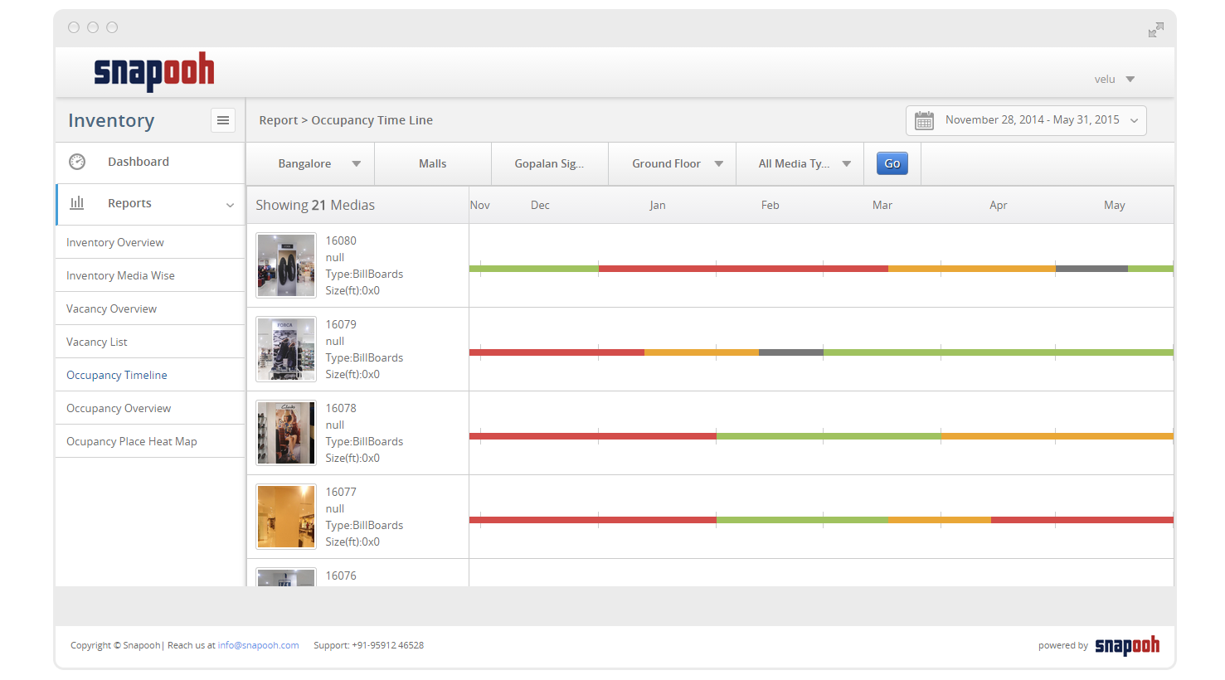
View booking timeline for every media.

Slide 11
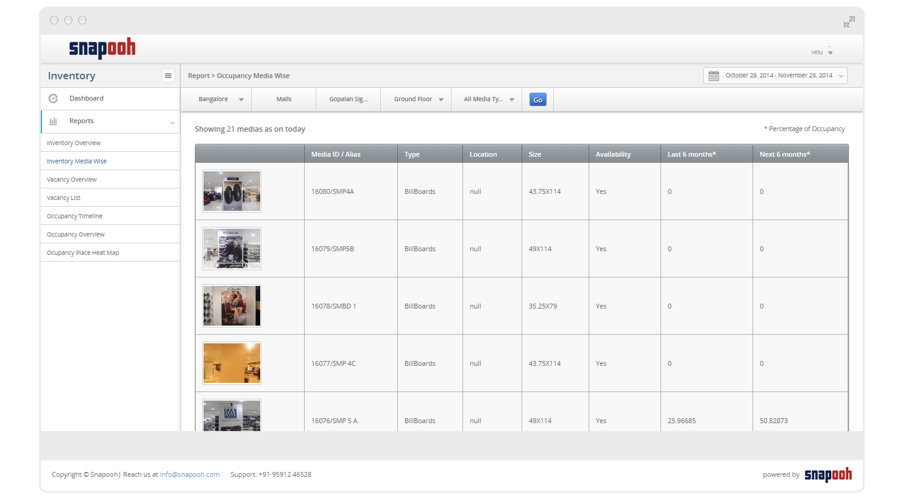
Reports and Analysis

Slide 12
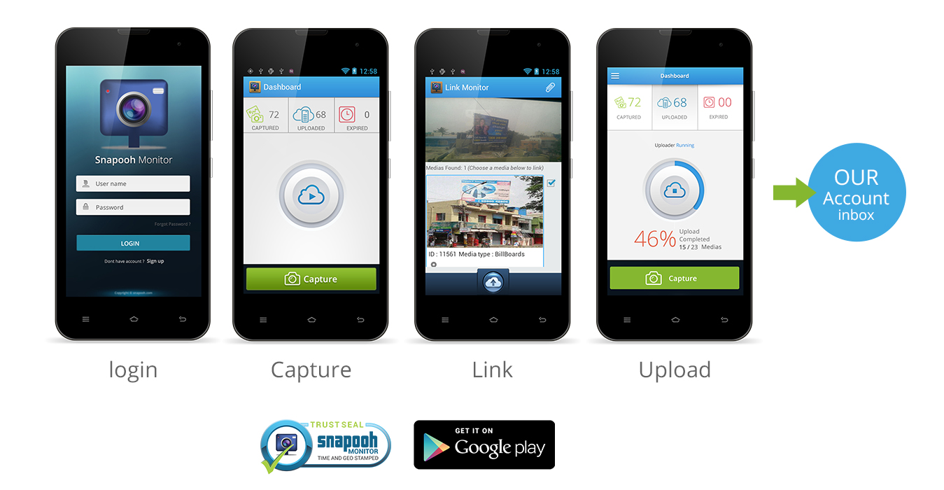
View booking timeline for every media.
Monitor your inventory with simple snapooh monitoring app. Pictures taken from the app are time stamped, linked to the media & campaign and uploaded to your centralized account.
Delight your clients by sharing certified photos of their campaigns.

Slide 13
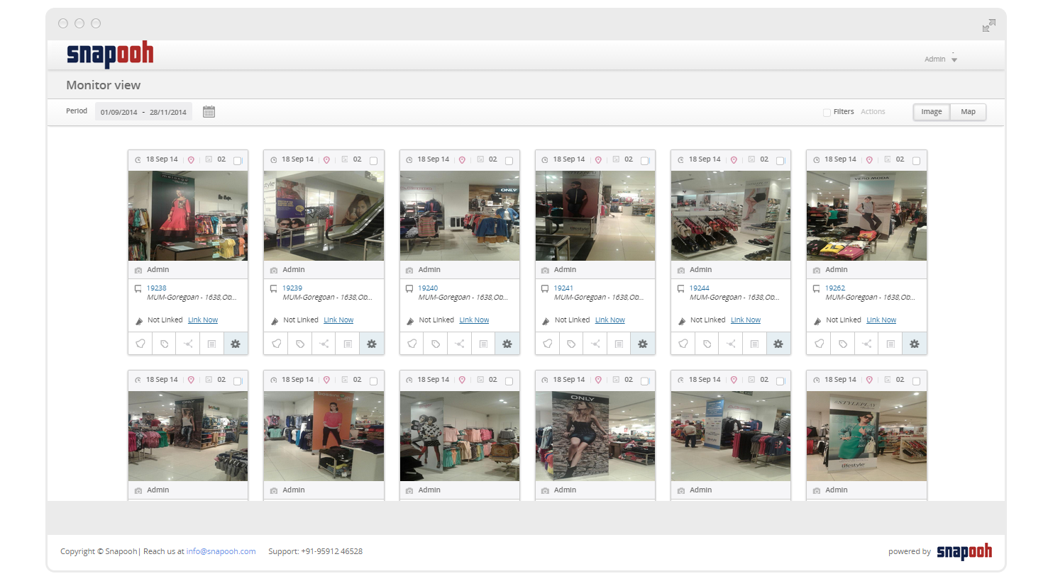
View all the monitored images and track all your media and campaigns

Slide 14
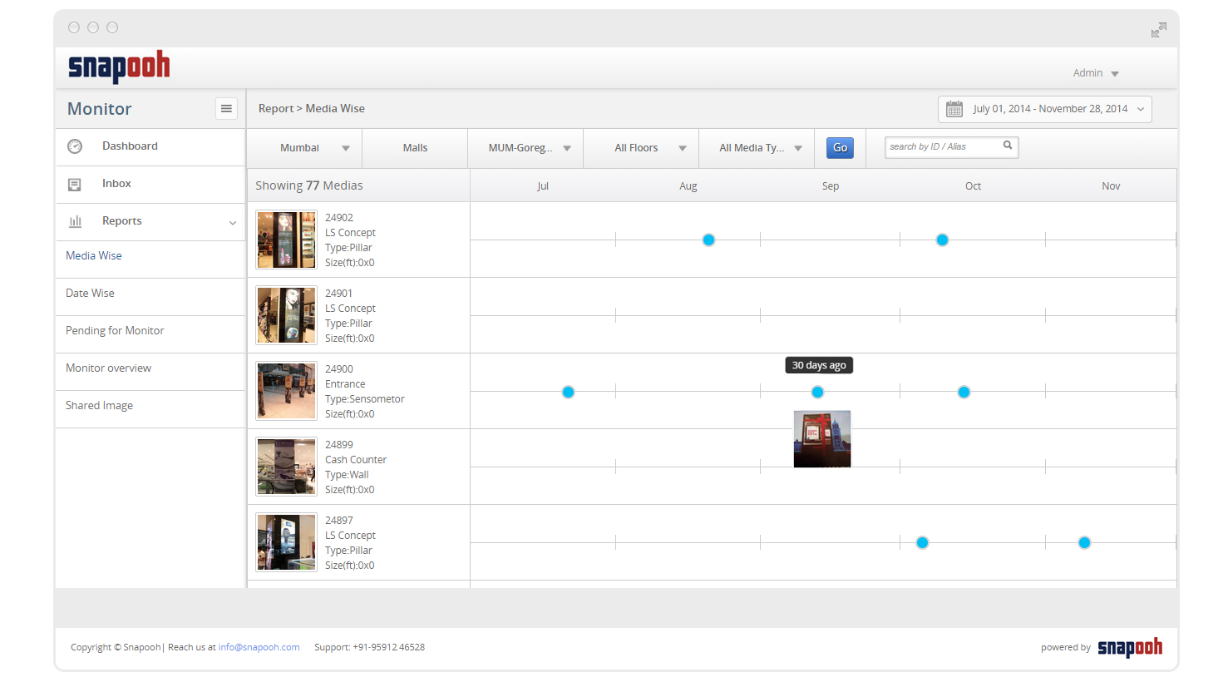
Visual timeline for the entire inventory – audit your inventory any time.

Slide 15
we believe in partnering with you to maximise the potential of your media assets.
For more information contact Manish Gulechha 9740097890 | manish@snapooh.com
Visit www.snapooh.com/mms

