Slide 1

Electricity Prices Prediction
Phase 2:Innovation

Slide 2
INTRODUCTION:
Prophet:
Is an open-source forecasting tool developed by Facebook's Core Data Science team. It is designed for time series forecasting and is particularly well-suited for datasets that exhibit strong seasonal patterns, holiday effects, and other non-linear trends. Prophet is widely used for forecasting tasks in various domains, including finance, retail, and energy.
Additive Decomposition: Prophet decomposes a time series into three main components: trend, seasonality, and holidays. This additive decomposition approach makes it easy to understand and model time series data with multiple components.
Customizable Seasonality: Prophet allows you to specify custom seasonalities, including daily, weekly, and yearly seasonality patterns. This flexibility is crucial for capturing various repeating patterns in your data.
Holiday Effects: You can provide information about holidays and special events that can affect the time series. Prophet incorporates these holiday effects into the forecasting model.
Automatic Changepoint Detection: Prophet automatically detects changepoints in the time series, which are points where the underlying data generating process may change. This helps the model adapt to structural changes in the data.

Slide 3
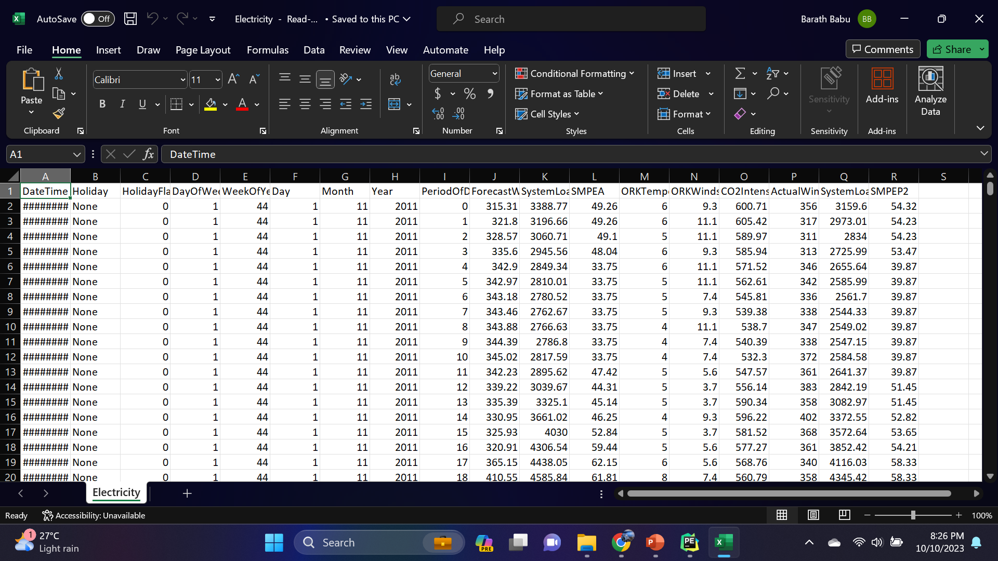
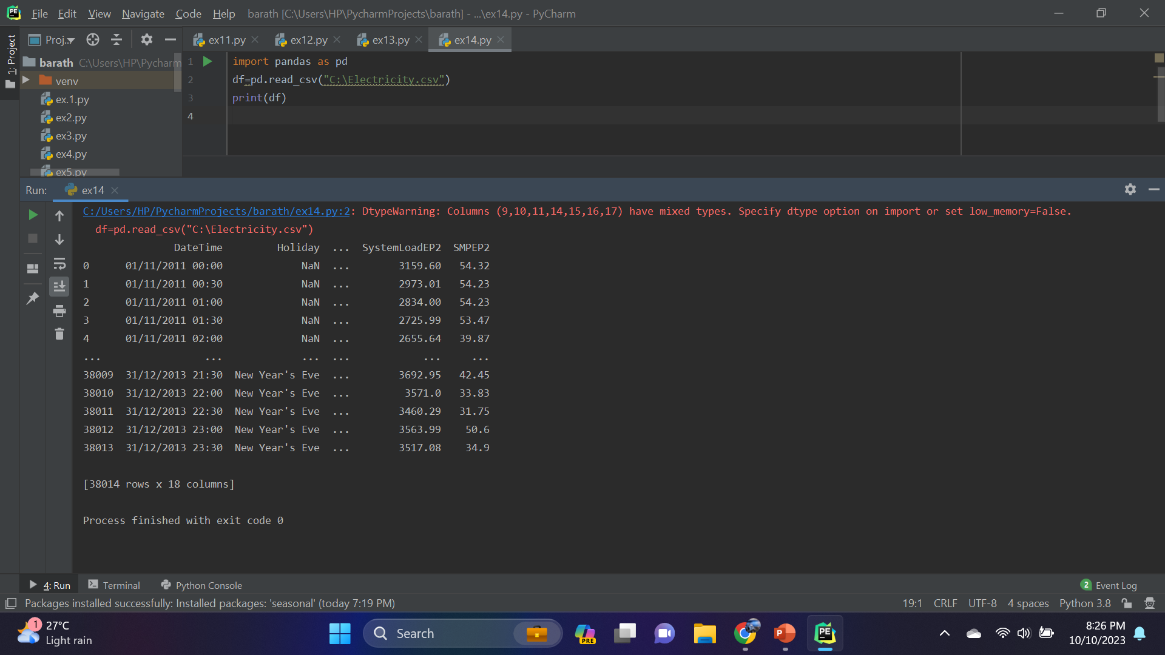
CONTENT FOR PHASE 2:
Consider exploring more advanced time series forecasting techniques like Prophet or deep learning models for improved accuracy in predicting future electricity prices.
Data Source:
A Good data source for forecasting techniques like prophet or deep learning models for improved accuracy in predicting future electricity prices.
Dataset Link:(https://www.kaggle.com/datasets/chakradharmattapalli/electricity-price-prediction)

Slide 4
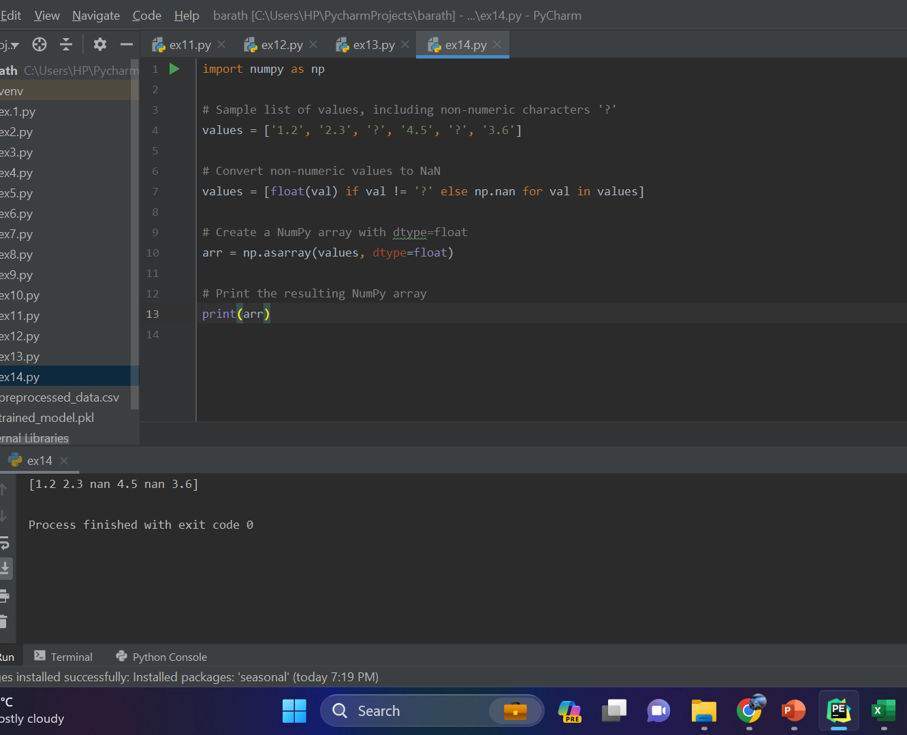
PROPHET:
Facebook Prophet is an open-source forecasting tool designed for time series data. It is particularly useful when dealing with time series that exhibit strong seasonal patterns, holiday effects, and other non-linear trends. Prophet is easy to use and provides good forecasting results with minimal tuning.

Slide 5
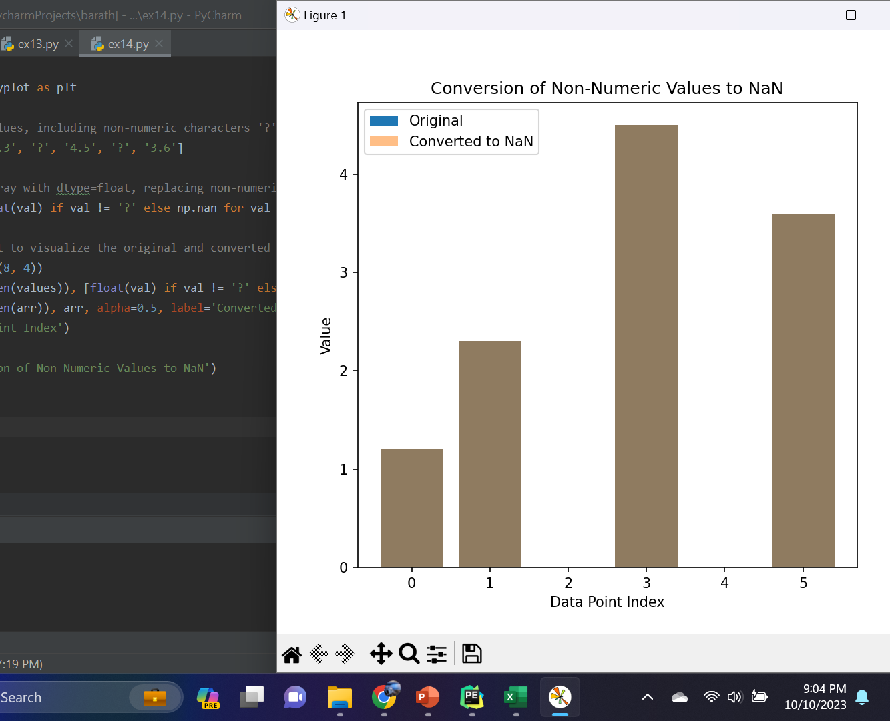
DEEP LEARNING MODELS:
Recurrent Neural Networks (RNNs): RNNs are designed to handle sequential data. They have a feedback loop that allows information to persist over time, making them suitable for time series data. Long Short-Term Memory (LSTM) and Gated Recurrent Unit (GRU) are popular variants of RNNs that address the vanishing gradient problem.
Convolutional Neural Networks (CNNs): While CNNs are typically associated with image processing, they can also be applied to time series data. 1D CNNs, in particular, can capture local patterns and features within your time series.
Hybrid Models: Some models combine elements of both RNNs and CNNs to capture both sequential and local patterns in the data.

Slide 6

CONCLUSION:
predicting electricity bills involves gathering historical consumption data, preprocessing and engineering features, selecting and training a suitable model, evaluating its performance, and making future consumption and cost predictions. It's crucial to monitor and update the model as conditions change for accurate forecasts.

