Slide 1
American Express Campus Analyze This 2017
Team – Pheonix

Slide 2
Team Details
Team Name :
Name | Campus | Roll No. | Mobile No. | Email Id
Sandesh Deshmukh | IIT Guwahati | 150103026 | 9950409115 | Sandesh.nitin.Deshmukh@gmai.com

Slide 3
Estimation Technique Used
Please provide the estimation/modeling technique(s) used to arrive at the solution/equation
Technique used for estimating Naïve Bayes classifier.
Accuracy of classifier =.7167

Slide 4
Strategy to decide final list
Please provide the strategy employed to decide the final list for submission
To decide final list, Firstly we studied the variables highly affecting the customers to choose Supplementary , credit, Elite or none of these.
From past years extension and acceptance of cards data is giving insight that there is more chance to accept the card if customer had extended or accepted card before several times.
Family size matters as high tendency towards supplementary cards if family is large. As for more members in family customer need to buy more supplementary cards.
Internal probability score for affinity towards business expenditure affecting customers choice of cards.
More the customer uses the card, more his/her probability to accept the card.

Slide 5
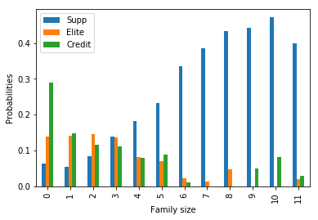
Details of each Variable used in the logic/mode/strategy
Please provide details of each variable used in the final logic
Family Size:
As we can see clearly increasing family size increases probabilities of supplementary cards.

Slide 6
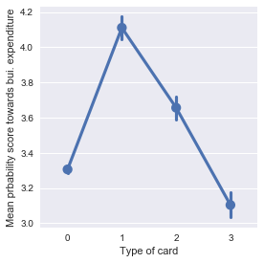
Continued….
2) Internal probability score for affinity towards business expenditure :
As we can see for supplementary card , mean internal probability score is higher than others.
Also for credit card this fall down to below 3.2.

Slide 7
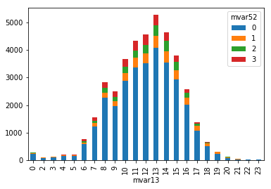
Continued….
Number of times the customer has made payments against the card in the last 1 year
For no. of transactions between 8 and 17 acceptance rate is higher than
customers in other range.

Slide 8
Reasons for Technique(s) Used
Why do you think this is the best technique(s) for this particular problem?
Naïve Bayes classifier technique used because it has better accuracy on training dataset as compared to others like Logistic regression , SVM’s, Multi-layer Perceptron.
Variables we used in logic are best fitted on Naïve Bayes algorithm.
Also evaluation score is highest using Naïve Bayes.

