Slide 1

Simulating Cognitive Flexibility in LLM
Data engineering capstone project
Sandeep Rupakheti (Y00848844)

Slide 2
Introduction
Cognitive flexibility refers to the ability to move between different tasks at the same time, using concepts from one context toward solving problems in another unrelated context
Large language models (LLMs) are models trained on vast data sets making them capable of understanding and generating natural language
Human-like text typically generated by computing a probability distribution over the possible completions of a given sequence of tokens

Slide 3
Introduction
LLMs have become a household name thanks to their role in bringing generative AI to the forefront
This raises various questions about the capabilities of LLMs and how they relate to human capability
We tested one such model (Gemini) by employing a prompt-based approach to simulate the flexibility of responding of human children in the dimensional change card sort (DCCS)

Slide 4
Background
Dimensional Change Card Sort (DCCS) measures executive function easily and widely
Most 3-year-olds persevere during the post-switch phase. By 5 years of age, most children switch when instructed to do so
The performance on the Dimensional Change Card Sort (DCCS) provides an index of the development of executive function
Suitable for participants across all ages
In a standard version, children are required to sort series of bivalent test cards, first according to one dimension(e.g. color), and then second dimension(e.g. shape)

Slide 5
Background
LLMs are driving innovation in various fields due to their remarkable capabilities in language processing and generation
Limited context awareness as it does not consider broader context which may lead to biases
The understanding of these issues can lead to a development of LLMs with cognitive flexibility in level of humans
With cognitive flexibility it will be adaptive with changing environments, can approach problems from multiple perspective and can learn more efficiently by quickly adjusting their strategies in response to feedback
Struggles with task requiring shift in perspective
Unknown whether it can abstract dimensions from the prompt to be used as the basis for successful shift responding

Slide 6
Problem Statement
Cognitive flexibility in humans have been widely studied within cognitive psychology and the results well established
This work is aimed at simulating cognitive flexibility in Dimensional Change Card Sort (DCCS) using a prompt-based approach on LLM's
This work will try to find if the LLM is cognitively flexible like a human. If not, where does it fail, what were the issues and what can be done to address those issues will be discussed
Current LLMs lack the ability to dynamically adjust their responses based on context
Limited capacity to understand and adapt to diverse linguistic nuances or shifts in meaning

Slide 7
Methodology
Prompt-based approach with focus on Dimensional Change Card Sort (DCCS) utilized for simulation
The LLM used for this work is Gemini. Initially both ChatGPT 3.5 and Gemini were tested
Targets are provided followed by the test cards. LLM is then asked to sort the test cards first according to one dimension (color) and then second dimensions (shape)
The main objective here is to check whether LLM can match the test card with the targets provided in accordance with the dimension change
Gemini chosen because of its ability to take image as the input

Slide 8
Experiments
We tried and tested several different prompts for experimental variations to simulate in the LLM. For this work we have used 9 different experimental variations
In first experimental variation, we provided exact prompt as we would provide to a child. We explained targets, test card, color game and shape game. Also, we kept the number of trials to 6 as we would do to a child in DCCS. We also asked the LLM to behave/imagine itself as a child
“ It provided imaginative engagement with enthusiasm. It was able to correctly shift from color to card game”
In second experimental variation, we made the prompt shorter and direct. Reduced number of trials. We did not ask it to imagine itself as anyone/anything. Explained the color and shape game
“ The response was much shorter and correct in both color and shape game”
In third experimental variation, we used the exact prompt except we did not explain the color and the shape game
“As we did not explain the how we play color and shape game, both the response was incorrect”

Slide 9
Experiments
In fourth experimental variation, we provided the targets but did not explain the type of the game
“Both the responses were correct”
In fifth experimental variation, we made the prompt shorter and even more direct and did not explain anything
“Both the responses were correct”
In sixth experimental variation, we made the image as the target and asked it to match with color and then to shape
“The response for the first prompt(color game) was incorrect and interestingly the response for the second prompt was correct”
In seventh experimental variation, we tried the same prompt except the image was different
“The result was same as in sixth experimental variation”

Slide 10
Experiments
In eight variation, we provided the prompt in English language except the test card
“While providing the target name in English, it was able to correctly predict the required outcomes”
In the final variation, we changed the dimension of the target and test card. Instead of color and shape, we used big, small, hard and soft
“Provided correct response”

Slide 11
Evaluating the Experiments with a Machine Learning Approach
Used the prompt and responses to train a neural network to generate response based on input prompt
Tokenized the prompts and response we have so that it can be understood by neural network
Tokenized prompts are converted into input sequences which are padded to ensure uniform length
Sequential model consisting of an embedding layer followed by two LSTM model layers, and a dense output layer is defined
Model is compiled and trained on the input sequences and corresponding labels
Used to predict responses for the prompts

Slide 12
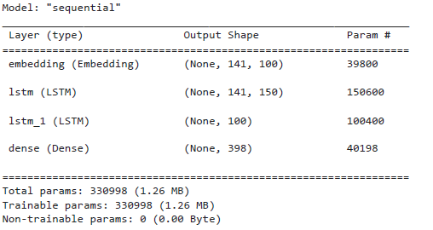
Evaluating the Experiments with a Machine Learning Approach
Neural Network Model Summary

Slide 13
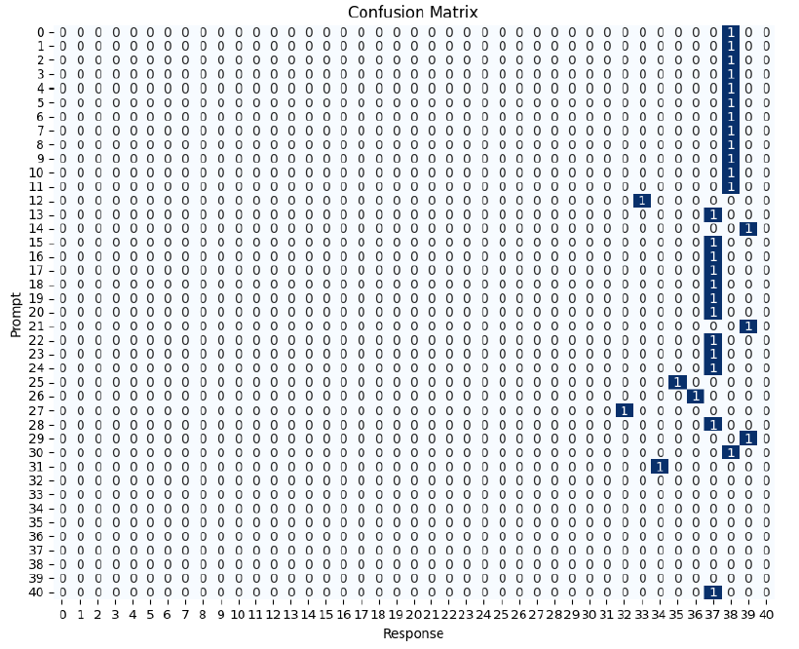
Evaluating the Experiments with a Machine Learning Approach
Shows the performance of the machine learning model
Model's performance varies depending on the specific prompt and the matching criteria (color vs. shape)
Model predicts the response when matching criteria is based on color of the object
Model struggles when matching criteria switches

Slide 14
Discussion
LLM's generally did not show evidence of cognitive flexibility; moreover, they had difficulty even during the learning or training phase
Upon reading the responses of the LLM, it appears to have abstracted the correct matching rule, but applied it incorrectly; more detailed prompts lead to performance more closely aligned to humans
This is the first comparison of human rule extraction and use to LLM's to our knowledge
Future studies should use an API to access and record responses systematically
The results generally did not conform to the performance of even the youngest children, a fact that was unexpected. More explicit prompts however did elicit better performance

Slide 15
Conclusion
Human-like flexibility performance was only attained with the most explicit prompts
This study gives insight that even though LLM's have been trained with massive amounts of data, they have not attained the human ability to extract, generalize, and apply higher-order dimensional rules, under the manipulations that were explored in this study.
LLMs have not yet attained artificial general intelligence in this context
Cognitive scientists and AI researchers needs to continue to systematically construct and deconstuct the limits of AI dimensional flexibity
The study indicates that for all their promise and discussion of the capabilities of LLM's, they are not smarter than a three-year-old

Slide 16
Thank you
Presented by:
Sandeep Rupakheti (Y00848844)
Faculty Coach: Dr. Jeffrey Coldren

Slide 17
Appendix
GitHub link
https://github.com/Sndpred/capstone_project

