Slide 1

SneakerHead
- An E-Commerce Website
A Cloud-Native Microservices E-Commerce Platform — built for scale, governed by code, deployed by automation.

Slide 2

Project Overview
STACK
MICROSERVICES
Frontend
React
Backend
FastAPI
Database
PostgreSQL
Microservices (4)
frontend • user-service
product-service • order-service
Databases (3)
Dedicated PostgreSQL per service
DEPLOYMENT
Docker • Kubernetes • GitOps CI/CD
Tools: Snyk • Trivy • SonarQube • ArgoCD • Prometheus • Grafana • Keycloak • Headlamp

Slide 3
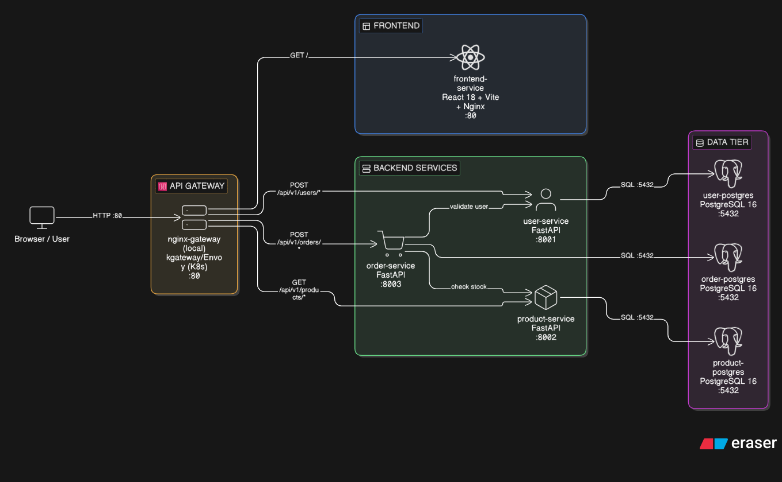
SneakerHead Architecture

Slide 4
Kubernetes Infrastructure
NAMESPACES (9)
CLUSTER TOPOLOGY
sneakerhead-dev — auto-sync enabled
sneakerhead-prod — manual sync (safe gate)
argocd • kgateway-system • monitoring • keycloak • headlamp • sealed-secrets • keycloak • nfs-provisioner
Control Plane (x1)
Worker Node 1
Worker Node 2
WORKLOADS
HAProxy load-balances across workers via NodePort
Helm umbrella chart (10 sub-charts)
NFS-backed PVCs (dev 2Gi / prod 4Gi per DB)
4 Deployments (per env): frontend, user, product, order service
Dev: 2–4 replicas via HPA (frontend) • CPU/Mem trigger: 60%/70%
Prod: 2–10 replicas via HPA (frontend) • CPU/Mem trigger: 60%/70%
3 dedicated PostgreSQL StatefulSets • NFS-backed PVCs
IN-CLUSTER TOOLS
ArgoCD GitOps CD • App-of-Apps pattern
Keycloak OIDC Identity Provider
Prometheus + Grafana Metrics + Dashboards
Headlamp K8s Dashboard • OIDC-gated
NETWORKING & SECURITY
kgateway (Gateway API) and 4 HTTPRoutes per env
NetworkPolicy • pods reachable only from gateway
Sealed Secrets for all credentials
RBAC: Role + ClusterRole per env • OIDC group-mapped

Slide 5

Security Layer — Sealed Secrets & Network Policies
SEALED SECRETS
NETWORK POLICIES
1 Encrypt kubeseal CLI encrypts using controller public key
Internet
▼
▼
2 Commit SealedSecret CRD stored safely in Git repository
kgateway (entry point)
▼
▼
Microservices (user / product / order)
3 Decrypt Sealed Secrets controller decrypts at runtime
▼
6 SealedSecrets per env — DATABASE_URL, JWT_SECRET, POSTGRES credentials
PostgreSQL (own DB only)
Private key lives in cluster only — ciphertext is safe in Git
Rules: gateway → services allowed
gateway → frontend
service → service
service → own DB only (no cross-service DB access)
5 policies per namespace • applied per env

Slide 6
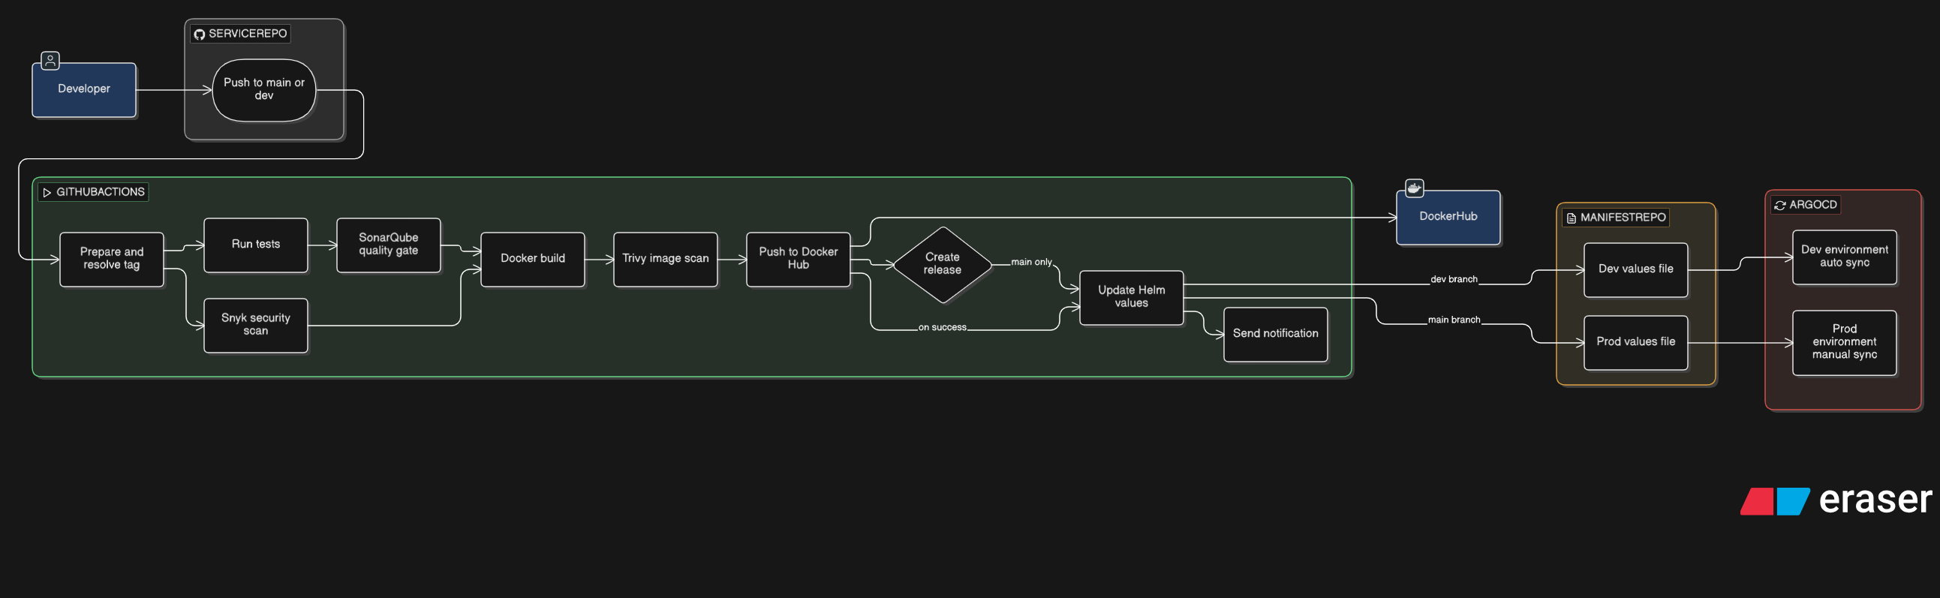

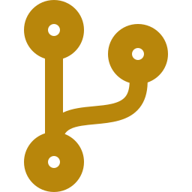
CI/CD Pipeline — GitHub Actions
Shift-Left Security
Branch → Environment
SonarQube (SAST)
Snyk SCA — requirements.txt + package.json
Trivy image scan — blocks on any critical CVE
Image BLOCKED if any scan fails
develop push → auto-deploy to sneakerhead-dev
main push → manual gate to sneakerhead-prod
ArgoCD dev: autoSync=true · selfHeal + prune enabled
ArgoCD prod: autoSync=false · safe manual promotion

Slide 7
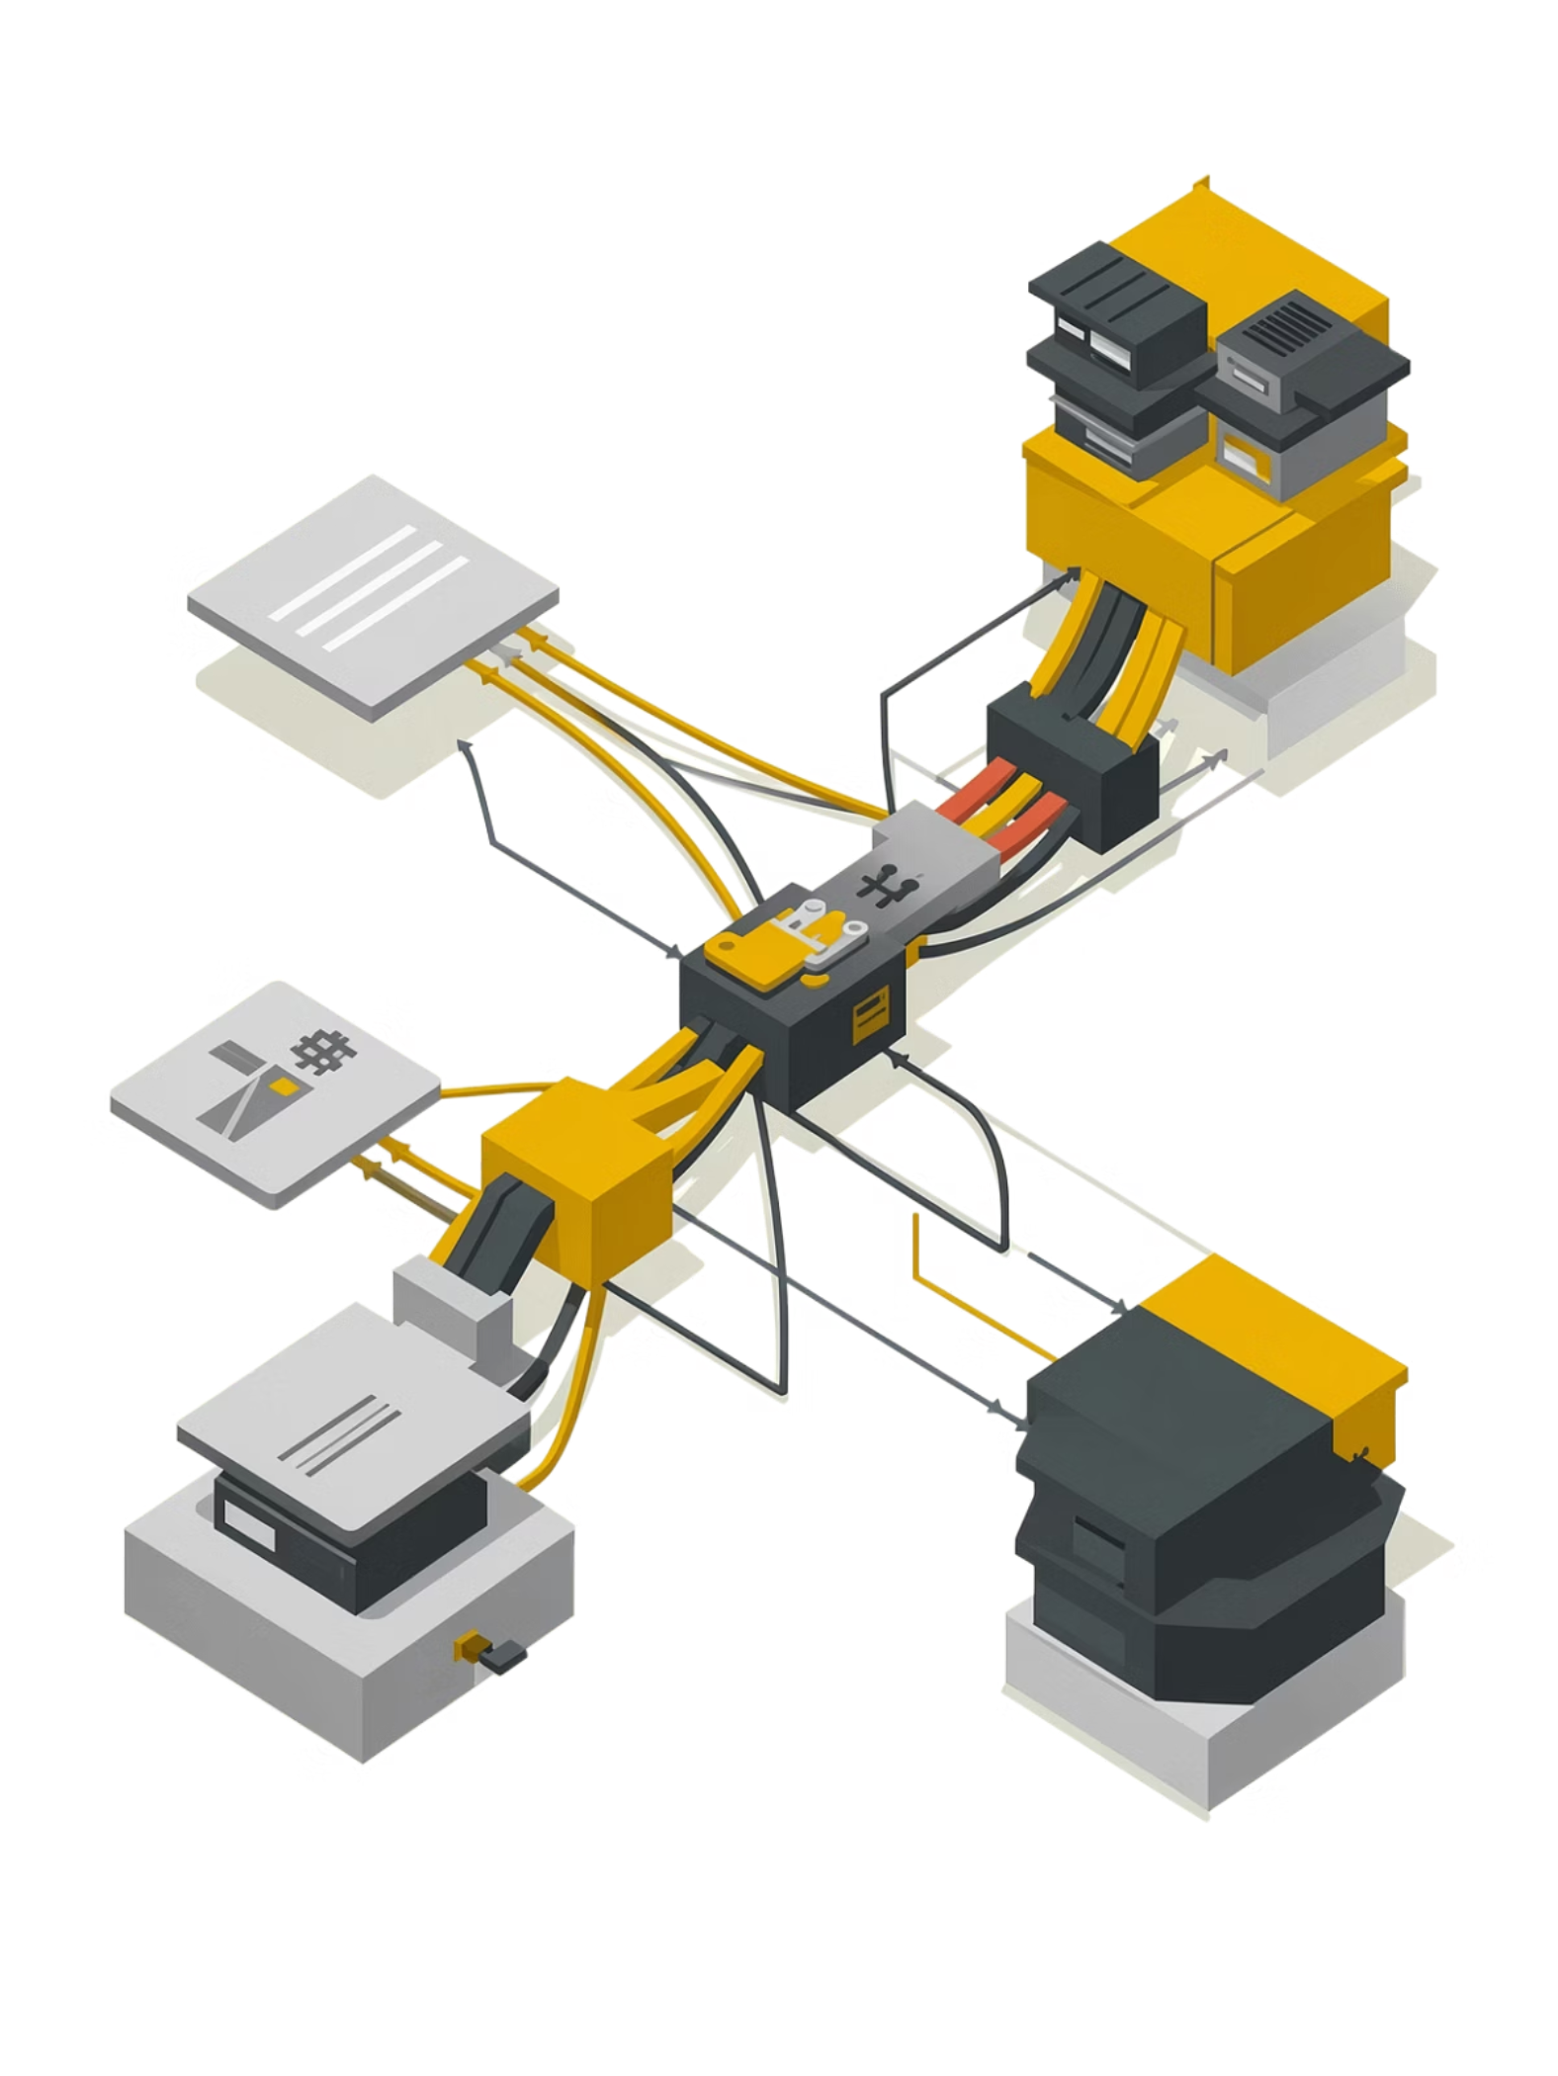



GitOps Continuous Deployment
CI Updates Manifests
The pipeline automatically commits updated Helm chart values to a dedicated Manifest Repository.
ArgoCD Reconciles
ArgoCD watches the Manifest Repo as the single source of truth, pulling desired state continuously from GitHub.
Zero Manual Deploys
Server access is never required. Manual deployment scripts are completely eliminated from the workflow.

Slide 8
GitOps Delivery
App-of-Apps + ApplicationSet
sneakerhead-root (root-app.yaml)
Single Entry Point
Auto Sync Flags
Source Repo
watches path: argocd/
recursively
autoSync: true
selfHeal: true · prune: true
github.com/SneakerHead-org/
SneakerHead-manifests
sneakerhead-infra
sneakerhead-data
sneakerhead-apps
AppProject
AppProject
AppProject
Wave 0
Wave 1
Wave 2
RBAC + Network Policies
PostgreSQL Databases
All Microservices
ApplicationSet (microservices-appset.yaml) — List Generator
5 services × 2 environments = 10 ArgoCD Applications
frontend
gateway
user-service
product-service
order-service
DEV
autoSync = true
selfHeal + prune enabled
PROD
autoSync = false
Manual promotion — safe production gate
"Git is the single source of truth — no kubectl apply manually"

Slide 9
Full GitOps Lifecycle
End-to-End Deployment Flow
1
Code Push
8
GitHub source repo
2
App Live
GitHub Actions CI
HAProxy → kgateway → services → DB
Build · Test · Push Docker image
7
GitOps
Lifecycle
3
Pods Scheduled
Update Image Tag
Readiness probes pass
SneakerHead-manifests repo
6
4
Secrets Decrypted
ArgoCD Detects
SealedSecret controller
Commit → triggers sync
5
Helm Release Sync
Applied to cluster
"Every commit is a deployment event — GitOps makes the cluster the source of truth"

Slide 10
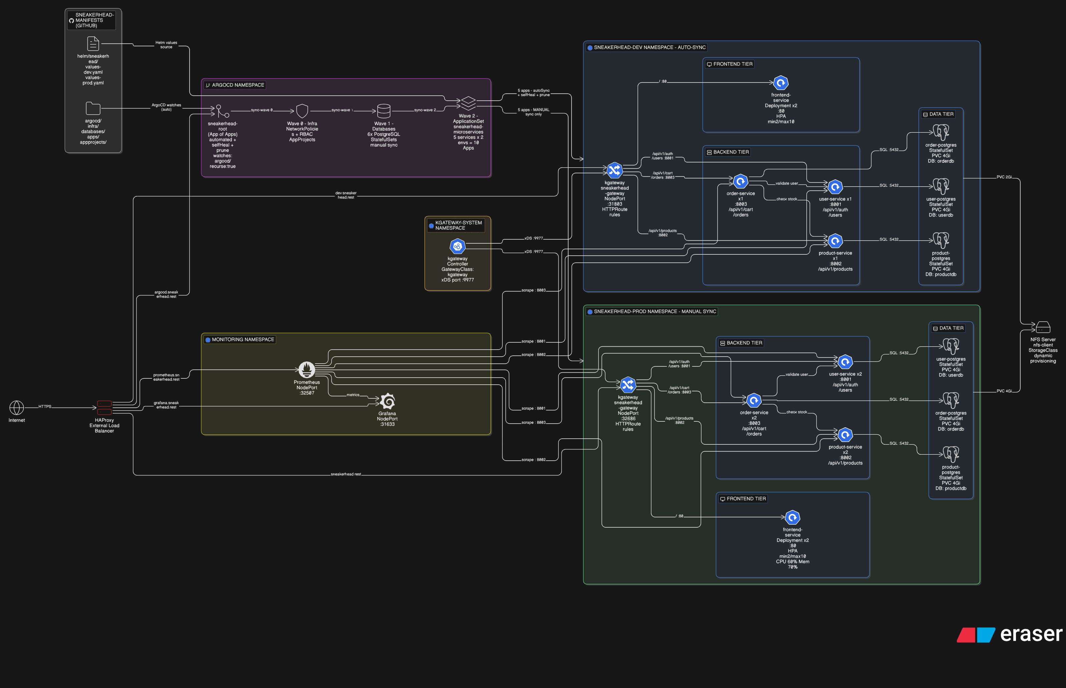

Slide 11
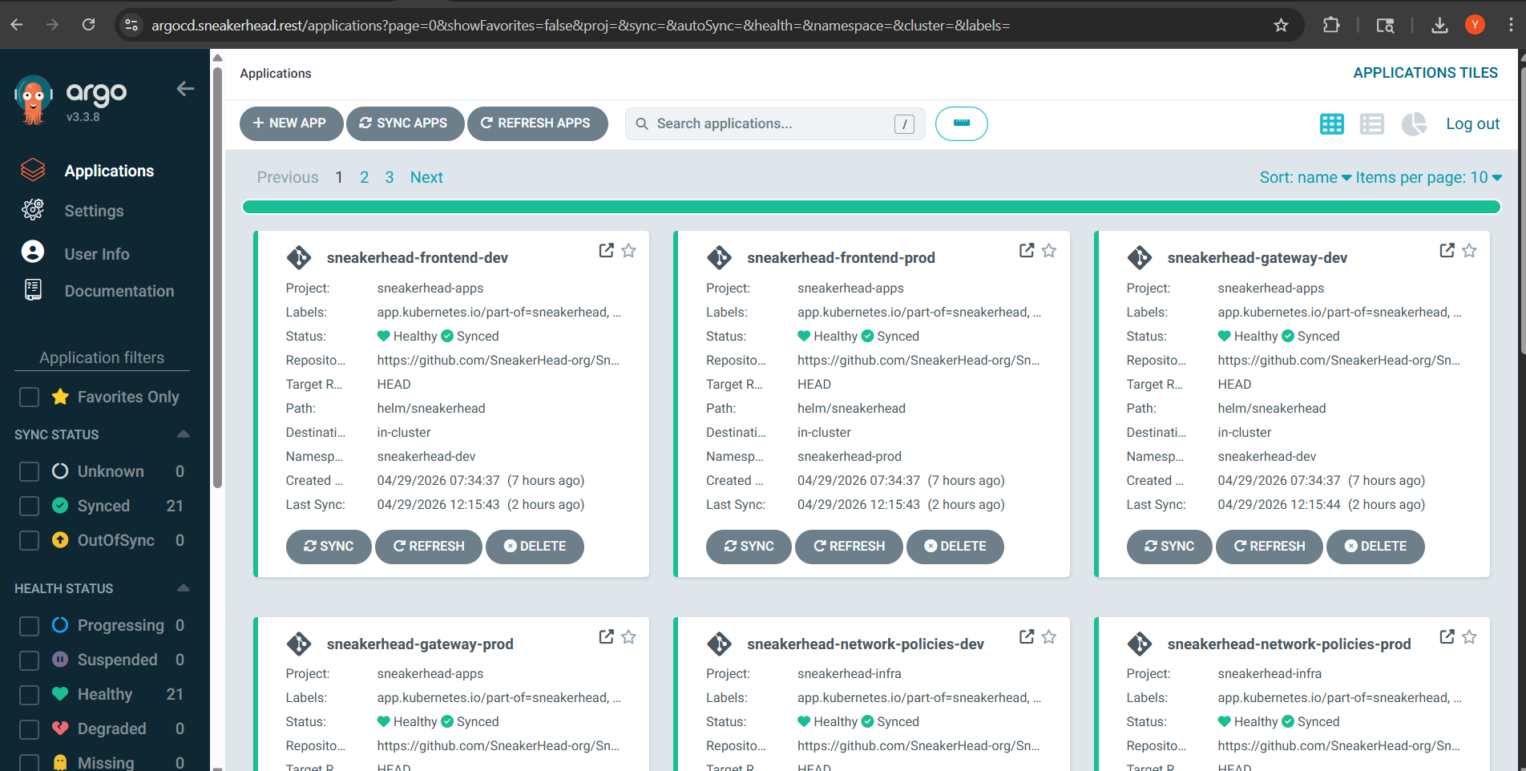

Slide 12
SecOps
Security Layers Across the Stack
01
Bitnami Sealed Secrets — RSA-encrypted, safe to commit to Git · SealedSecret bound to exact name + namespace
JWT_SECRET, DATABASE_URL, POSTGRES credentials always sealed · dev + prod (12 objects)
Secrets
Management
02
JWT (HS256) stateless auth — issued by user-service, verified by all services · bcrypt salted hashing via passlib
Token type guard: refresh ≠ access · Access: 30 min · Refresh: 7 days
Identity &
Authentication
03
Default-deny posture per namespace · Services accept traffic ONLY from kgateway — no direct pod-to-pod
PostgreSQL accepts connections ONLY from paired service · Cross-namespace blocked · Egress restricted
Network
Isolation
04
Dev namespace: Full CRUD — pods, deployments, secrets, PVCs, HPAs, gateways
Prod namespace: Read-only on all resources · update/patch on deployments + statefulsets only
RBAC
05
Non-root users · No privilege escalation · Secrets injected as env vars — never baked into images
Health probes (liveness + readiness) — unhealthy pods never receive traffic · Resource limits on all containers
Container &
Runtime Security
06
SonarQube (SAST) · Snyk (SCA: CVE scan on requirements.txt + package.json) · Trivy (container image scan)
All 3 run as GitHub Actions steps — image BLOCKED from pushing if any scan fails · Shift-left: caught at commit time
DevSecOps
Pipeline Scanning
"Security is not an afterthought — it is built into every layer of the deployment"

Slide 13
IDENTITY-DRIVEN ACCESS
OIDC Authentication Flow
Headlamp — Kubernetes Dashboard with OIDC
Browser
↓
HAProxy (TLS termination)
OIDC Login Flow
↓
User → headlamp.sneakerhead.rest → redirected to Keycloak (headlamp realm) → authenticates → ID token with group claims → Kubernetes RBAC enforced → user sees only permitted namespace
Headlamp Dashboard
↓
Keycloak (OIDC Provider)
RBAC Mapping
sneakerhead-dev-team
Full CRUD: pods, deployments, secrets, PVCs, HPAs, gateways (dev)
sneakerhead-prod-team
Read-only + update/patch on deployments (prod)
ClusterRole on both: list namespaces
Keycloak Integration
Realm: headlamp
Client: headlamp
Groups: sneakerhead-dev-team
sneakerhead-prod-team
Users: nandu (dev)
harsha (prod)
↓
Kubernetes API (RBAC enforced)
SneakerHead | Headlamp + OIDC Access Control

Slide 14
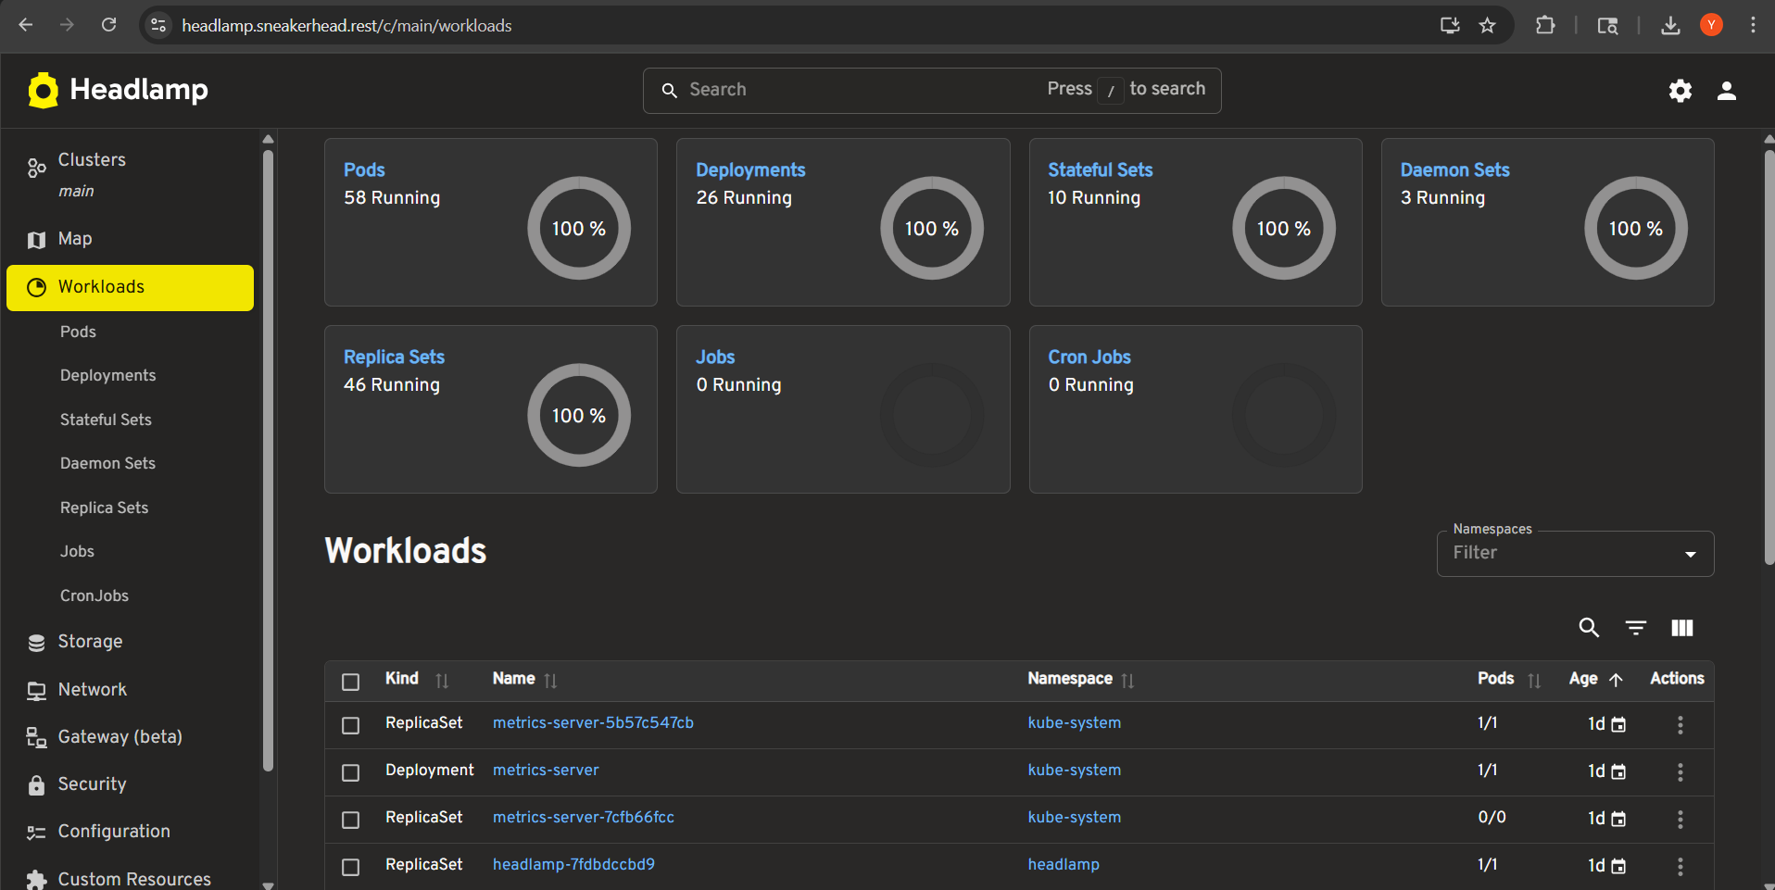

Slide 15
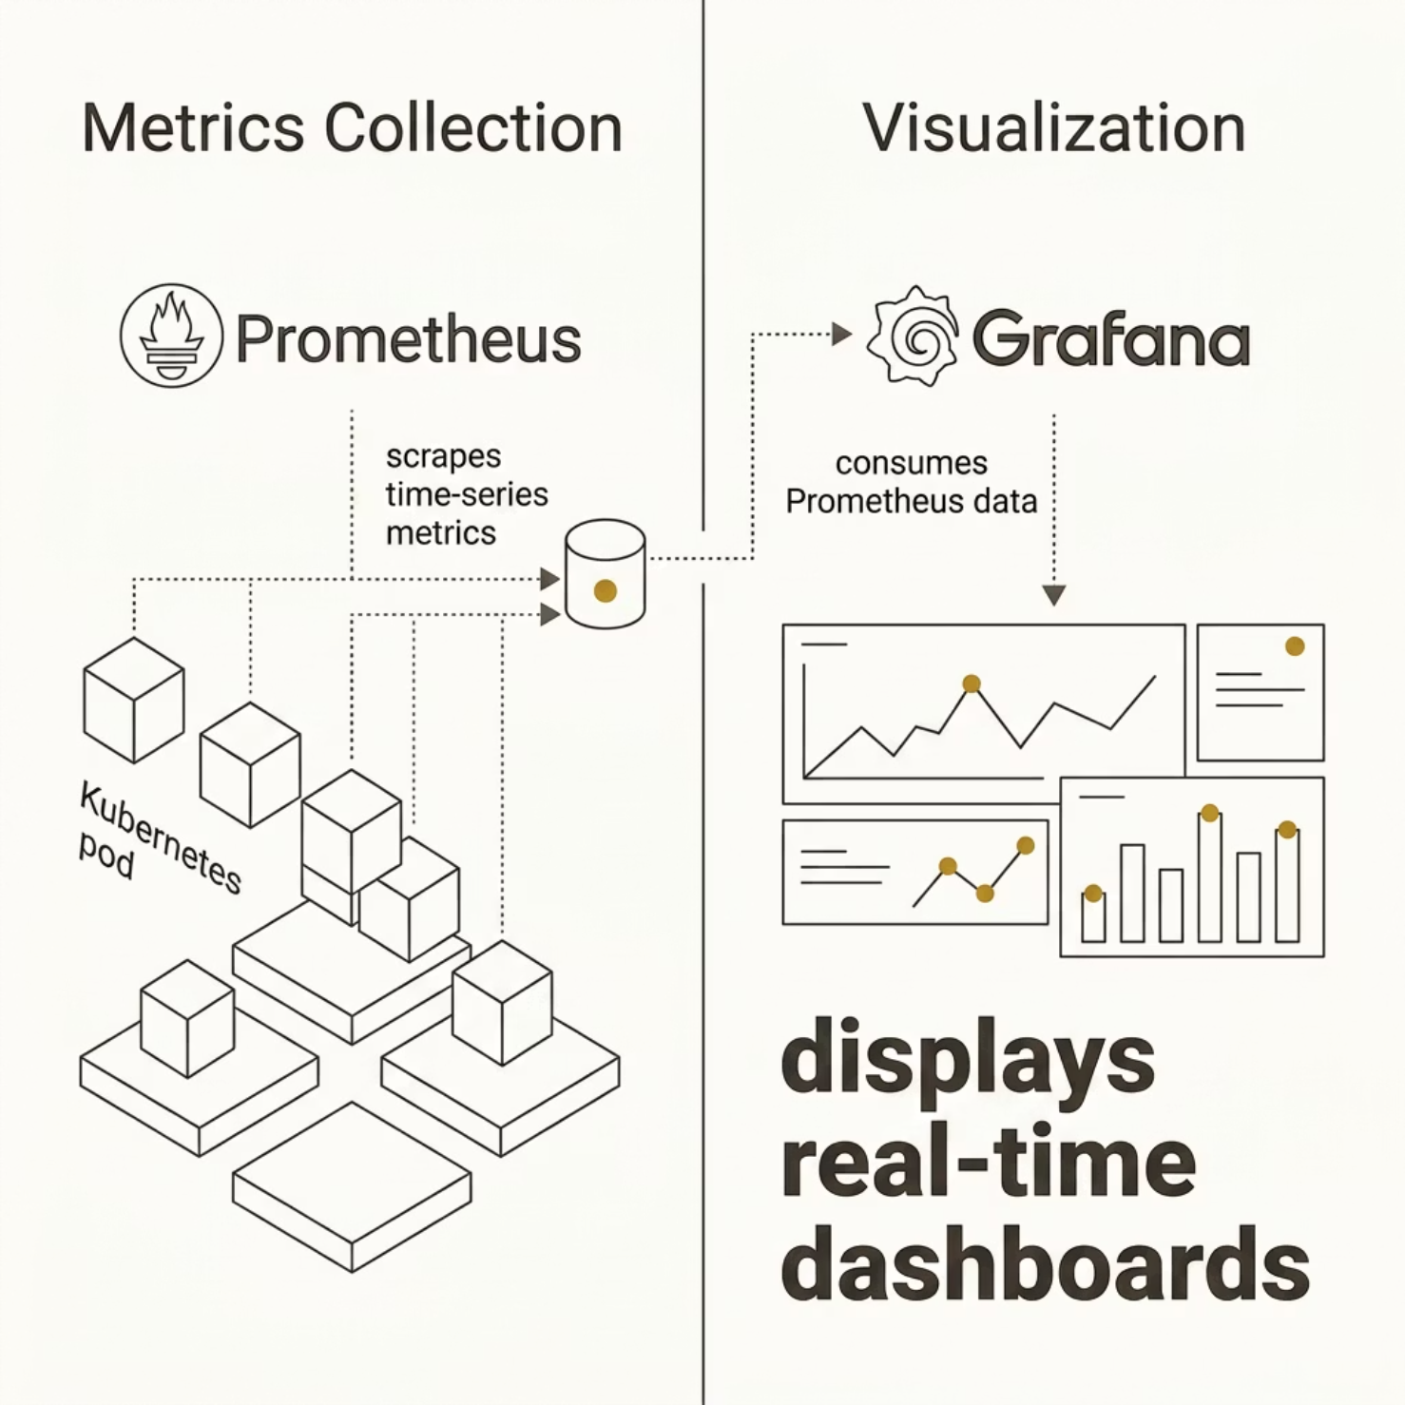


System Observability & Monitoring
PROACTIVE HEALTH MONITORING
Prometheus Metrics Collection
Continuously scrapes time-series metrics across every pod and node in the Kubernetes cluster — full-stack visibility with no blind spots.
Grafana Dashboards
Real-time, customizable dashboards surface actionable insights for developers and operators, enabling rapid incident response and performance tuning.
Maximum uptime is a design goal, not an afterthought.

Slide 16
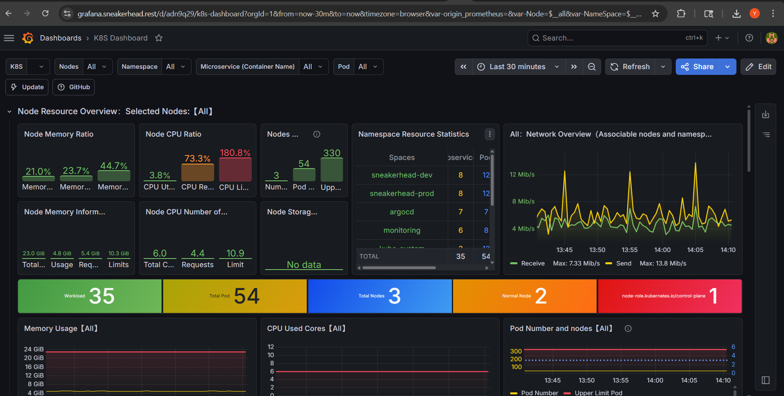

Slide 17
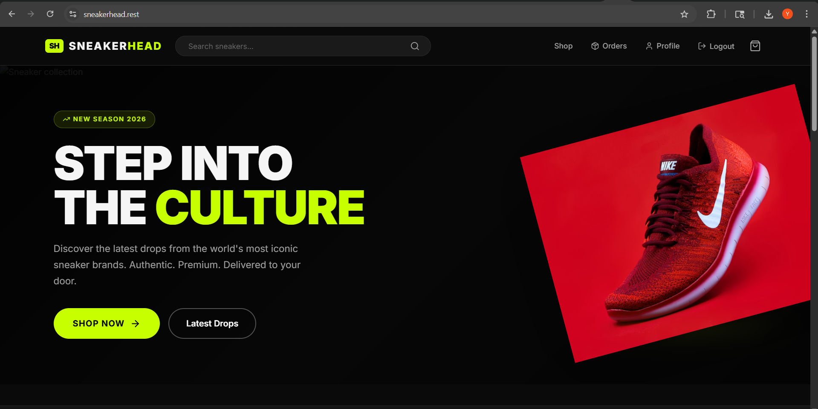

Slide 18
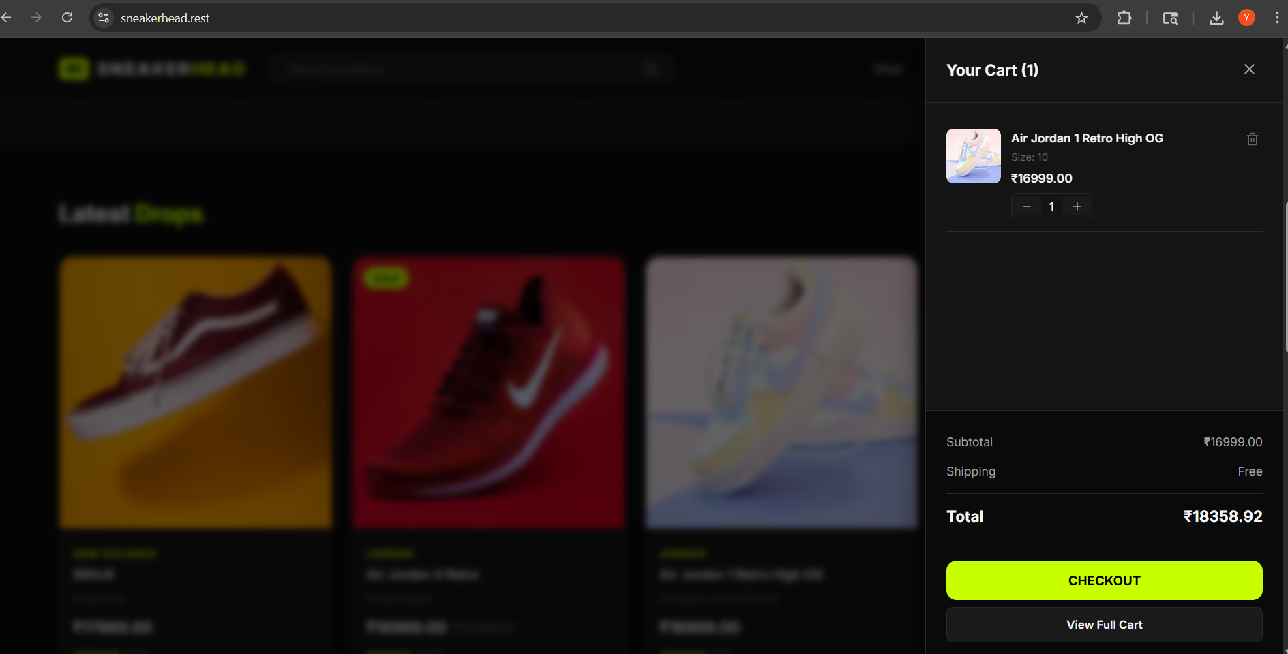

Slide 19
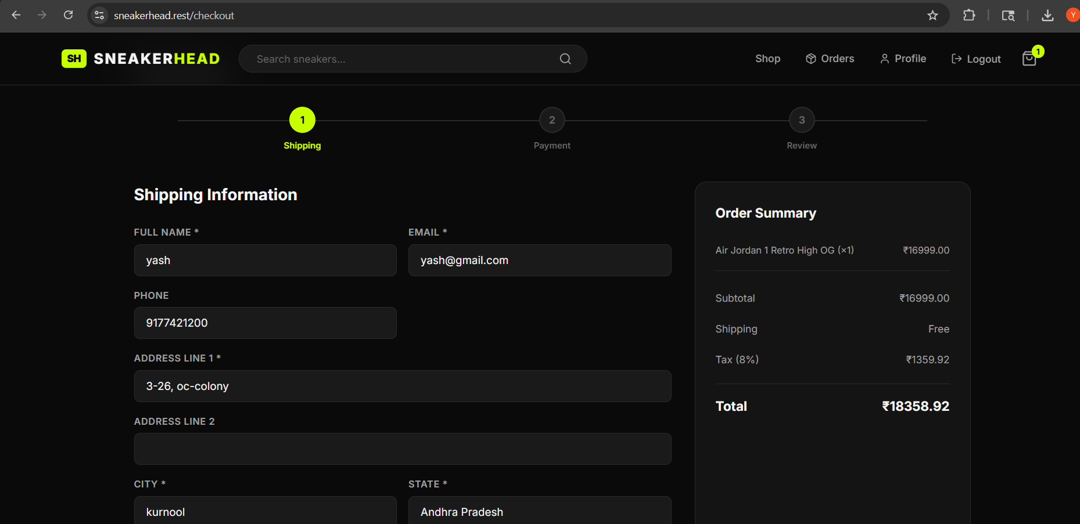

Slide 20
