Slide 1
Security-Detection
By: Jacob Yu

Slide 2
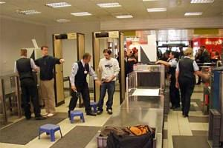
Overview
In many places such as airports, big events, and government complexes, seeing a professional security team and giant metal detectors are a common sight.
This is all done to ensure safety, however there is one problem…
This whole process relies on humans which would always give room for human error

Slide 3
My program
With my program, it utilizes both machine learning/artificial intelligence as well as cameras to detect objects
With the use of artificial intelligence, it can fully avoid human errors making it more efficient and accurate to find any dangerous objects
In my program, it ensures accurate results detecting objects such as phones, wallets, keys, and knives
When it detects a knife, the program would start alerting that it detects a weapon
With this streamlined process, security detection would never be made easier!

Slide 4
Process
First, I took around 120 images for each individual object in different positions and directions. This process is very long, but ensures the most accurate results
Next, I started the training process of neuro network (ssd-mobilenet), running around 5 epochs. Each epoch takes around 20 minutes. In the future, I would definitely run more epochs to improve the confidence.
Next, I exported my newly created network to onnx in order to run detectnet.
I then created a python code, that opens detectnet, but also alerts you if it detects any weapons.
After running “python3 my-detection.py” a live video feed should pop up, showing that the code is working

Slide 5
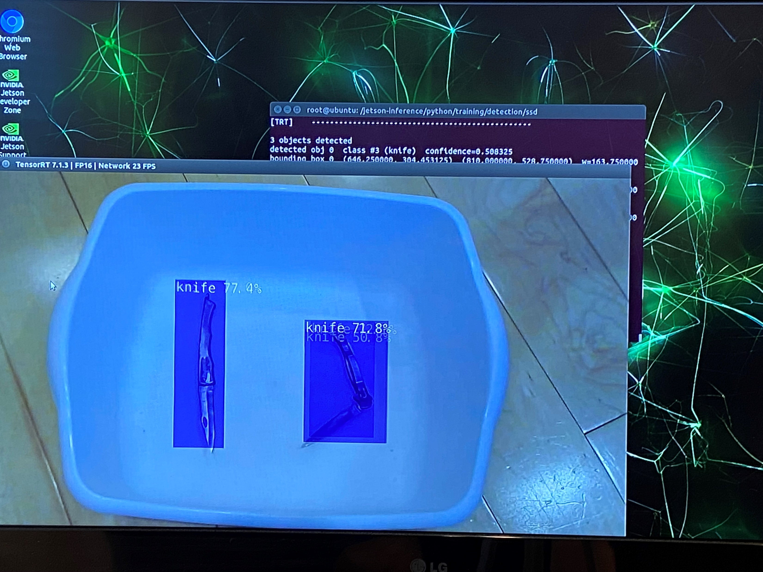
Photos
In this photo, two knives are being detected although, one of the knives have not been trained. This shows that the program could detect different shapes/sizes of knives.

Slide 6
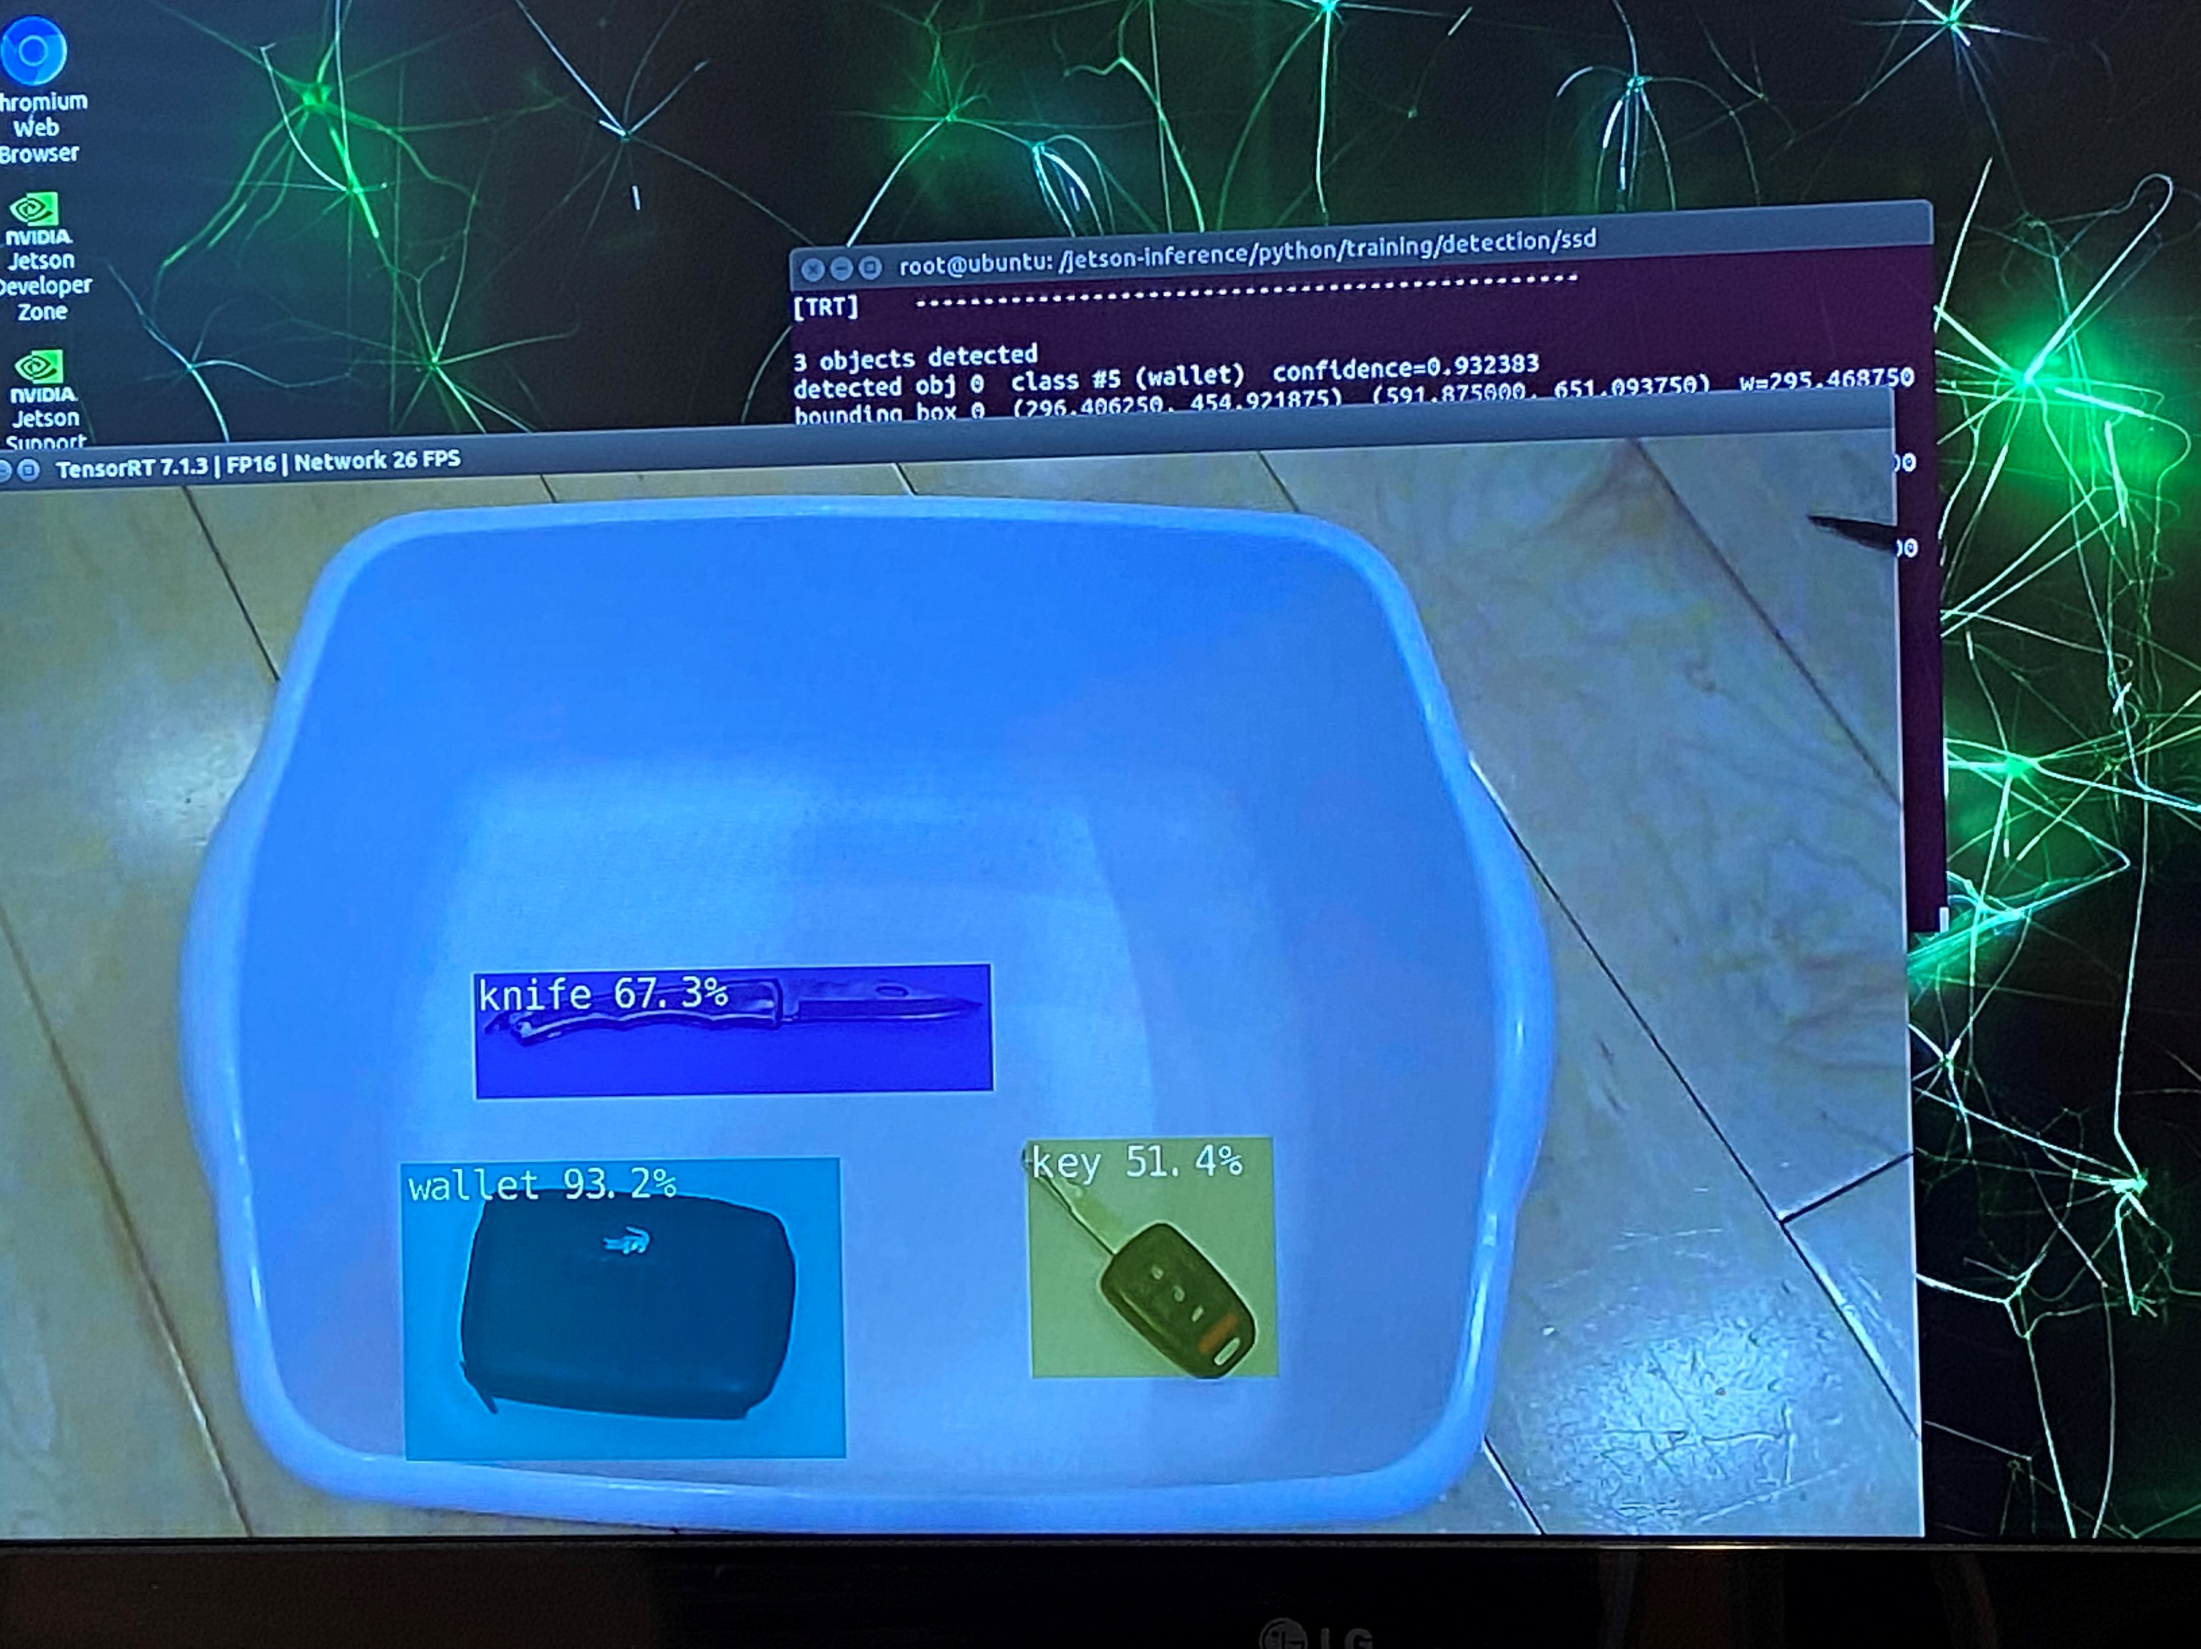
Photos continued…
This picture shows that it detects a knife among the many other objects. Behind in the black screen, you could barely make out the alert pop up.

Slide 7
Materials
Most importantly you would need a jetson nano kit consisting of:
Power supply
HDMI cable(optional if you run it on computer)
WIFI dongle
USB Mouse(optional if you run it on computer)
USB Keyboard(optional if you run it on computer)
Camera(IMPORTANT)

Slide 8
Video
Below is the link to my YouTube channel pages, where you can view my video demonstration, to help you get a better idea on how it works and the results of my program:
https://www.youtube.com/channel/UCoHZv72AstTldhWyz4Y-u_Q

Slide 9
Helpful links/materials
If you have any trouble setting up the project, I recommend you to watch the videos on Youtube as well as the jetson-inference github page. Link: https://github.com/dusty-nv/jetson-inference
If you have anymore doubts, you should also check out other types of projects that you can also do on your own in the jetson nano

