Slide 1
SYSTEM THESIS DEFENSE
ISU-GeoBot
A Campus Navigation and
Faculty Availability Assistant
ISU-GeoBot
Enhanced RAG
Random Forest availability
Status masking protocol
Interactive campus map
OCR announcement intake
Integrating a Random Forest classifier into a Retrieval-Augmented Generation pipeline, under an enforced disclosure limit.
Researchers: Simbulan, Christian Paul
Almario, Michael Allan
Institution / Department: College of Computing Studies,
Information and Communication Technology
Defense Date: September 16, 2026

Slide 2
Background of the Study
A student looking for a lecturer asks two questions. The campus answers neither well.
WHERE
WHETHER
THE RISK
A campus of thirty-odd buildings, no signage a newcomer can follow, and no searchable index of what is inside them.
Whether a lecturer is in right now is unanswerable without walking to the office and checking.
Answering the second question carelessly turns a navigation tool into a tracking tool.
THE DATA
THE GAP
THE RULE
425 real class blocks exist. Real attendance records do not — they were ruled out on privacy grounds.
Retrieval alone cannot answer availability. A timetable is not a document in the corpus.
An empty hour is not free time. It is the absence of a class, not the presence of a person.
The system must answer where a building is, and whether a lecturer is available — without ever disclosing where that person is.
ISU-GEOBOT · CAMPUS NAVIGATION AND FACULTY AVAILABILITY
1

Slide 3
Objectives
01
Integrate the classifier
02
Compare the architectures
Integrate a Random Forest classifier into the Retrieval-Augmented Generation pipeline so that faculty availability is estimated from temporal schedule data and behavioural attendance features.
Evaluate and compare the standard and Enhanced RAG architectures in terms of Response Time and the RAGAS metrics of Context Precision, Context Recall, Faithfulness and Answer Relevancy.
03
Deploy with a disclosure limit
04
Evaluate functional accuracy
Deploy the Enhanced RAG architecture within the web-based ISU-GeoBot system, enforcing a status masking protocol and an egress boundary so that no physical location of a person is disclosed.
Evaluate the functional accuracy of the system's availability estimates against direct field observation of classroom activity.
Evaluated on: Response Time • Context Precision • Context Recall • Faithfulness • Answer Relevancy • Macro F1
ISU-GEOBOT · CAMPUS NAVIGATION AND FACULTY AVAILABILITY
2

Slide 4
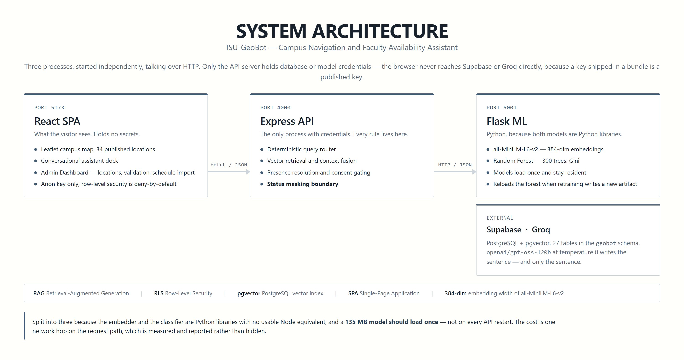
System Architecture
ISU-GEOBOT · CAMPUS NAVIGATION AND FACULTY AVAILABILITY
3

Slide 5
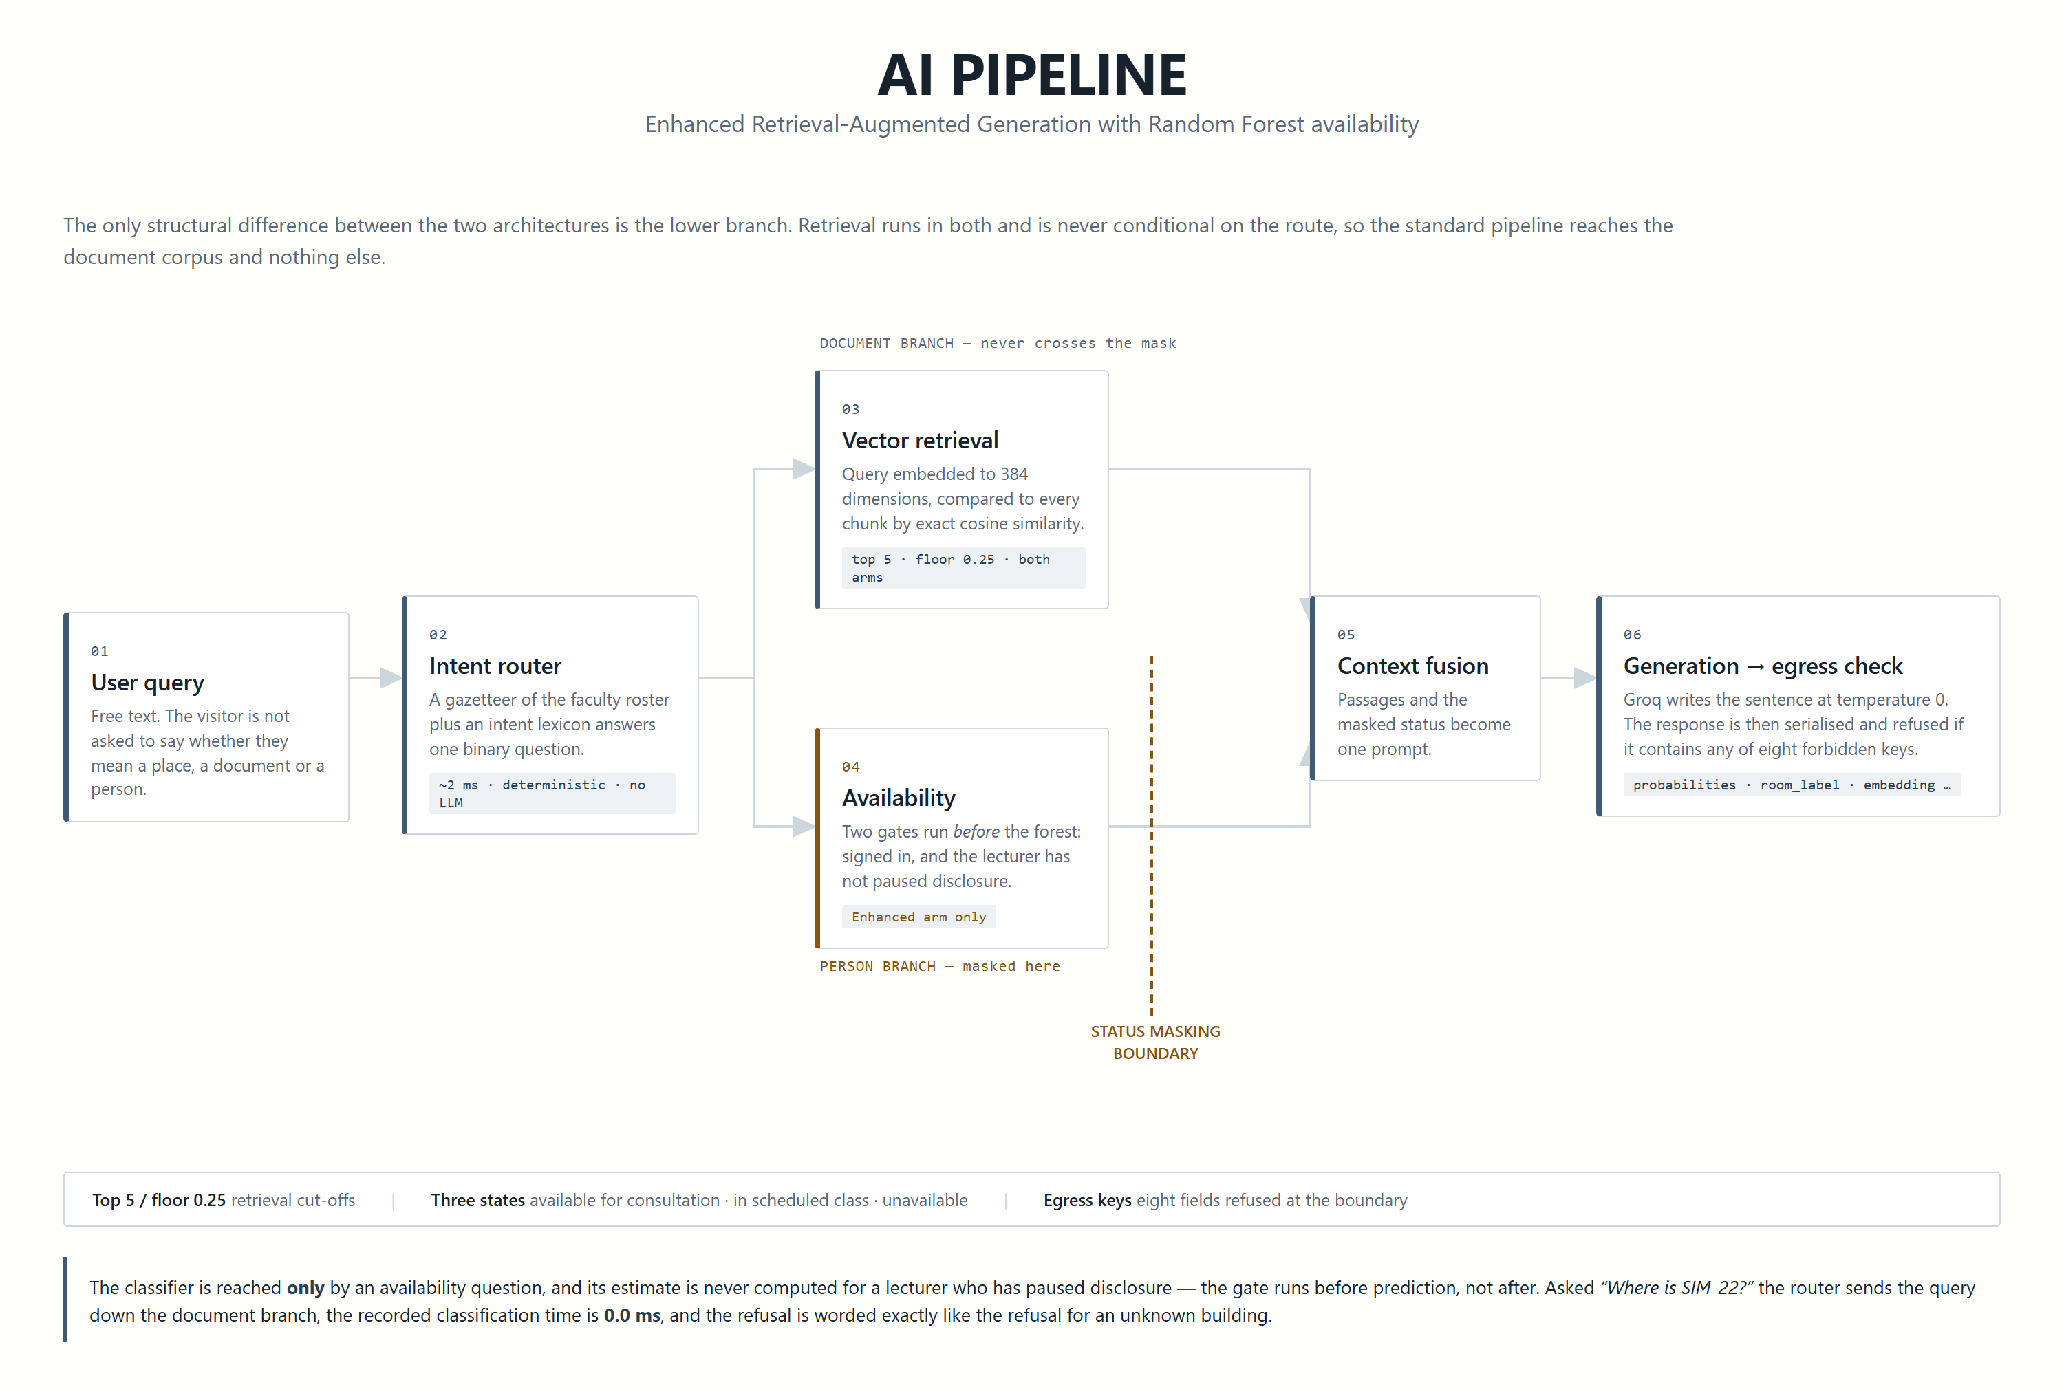
AI Pipeline
ISU-GEOBOT · CAMPUS NAVIGATION AND FACULTY AVAILABILITY
4

Slide 6
System Screenshots
01 OBJECTIVE
The classifier answering an availability question. One of three coarse states plus the next consultation window — and no location.
[ 05-chat-availability — not captured yet ]
ISU-GEOBOT · CAMPUS NAVIGATION AND FACULTY AVAILABILITY
5

Slide 7
Results — Response Time
02 OBJECTIVE
Pipeline stage
Standard
Enhanced
Δ
THE FINDING THAT MATTERS
Presence guard
0.0 ms
30.3 ms
+30.3
0 of 6
Random Forest
0.0 ms
9.1 ms
+9.1
availability questions answered by the standard architecture.
The Enhanced architecture answered 5.
Vector retrieval
168.1 ms
175.6 ms
+7.5
Answer generation
1,088.7 ms
1,147.8 ms
+59.1
End-to-end mean
1,315.6 ms
1,484.5 ms
+168.9
The Enhanced arm is slower, and that is the honest result. What the extra time buys is a class of question the baseline cannot answer at all.
ISU-GEOBOT · CAMPUS NAVIGATION AND FACULTY AVAILABILITY
6

Slide 8
Results — Retrieval Quality
02 OBJECTIVE
NOT REPORTED, AND WHY
The judge is capped at 8,000 tokens per minute and one grading prompt costs roughly 2,000, so a full four-metric sweep over both arms did not complete within the study period. This is a quota limit, not a design one.
The harness is implemented and every answer is recorded; only the scoring pass is outstanding.
ISU-GEOBOT · CAMPUS NAVIGATION AND FACULTY AVAILABILITY
7

Slide 9
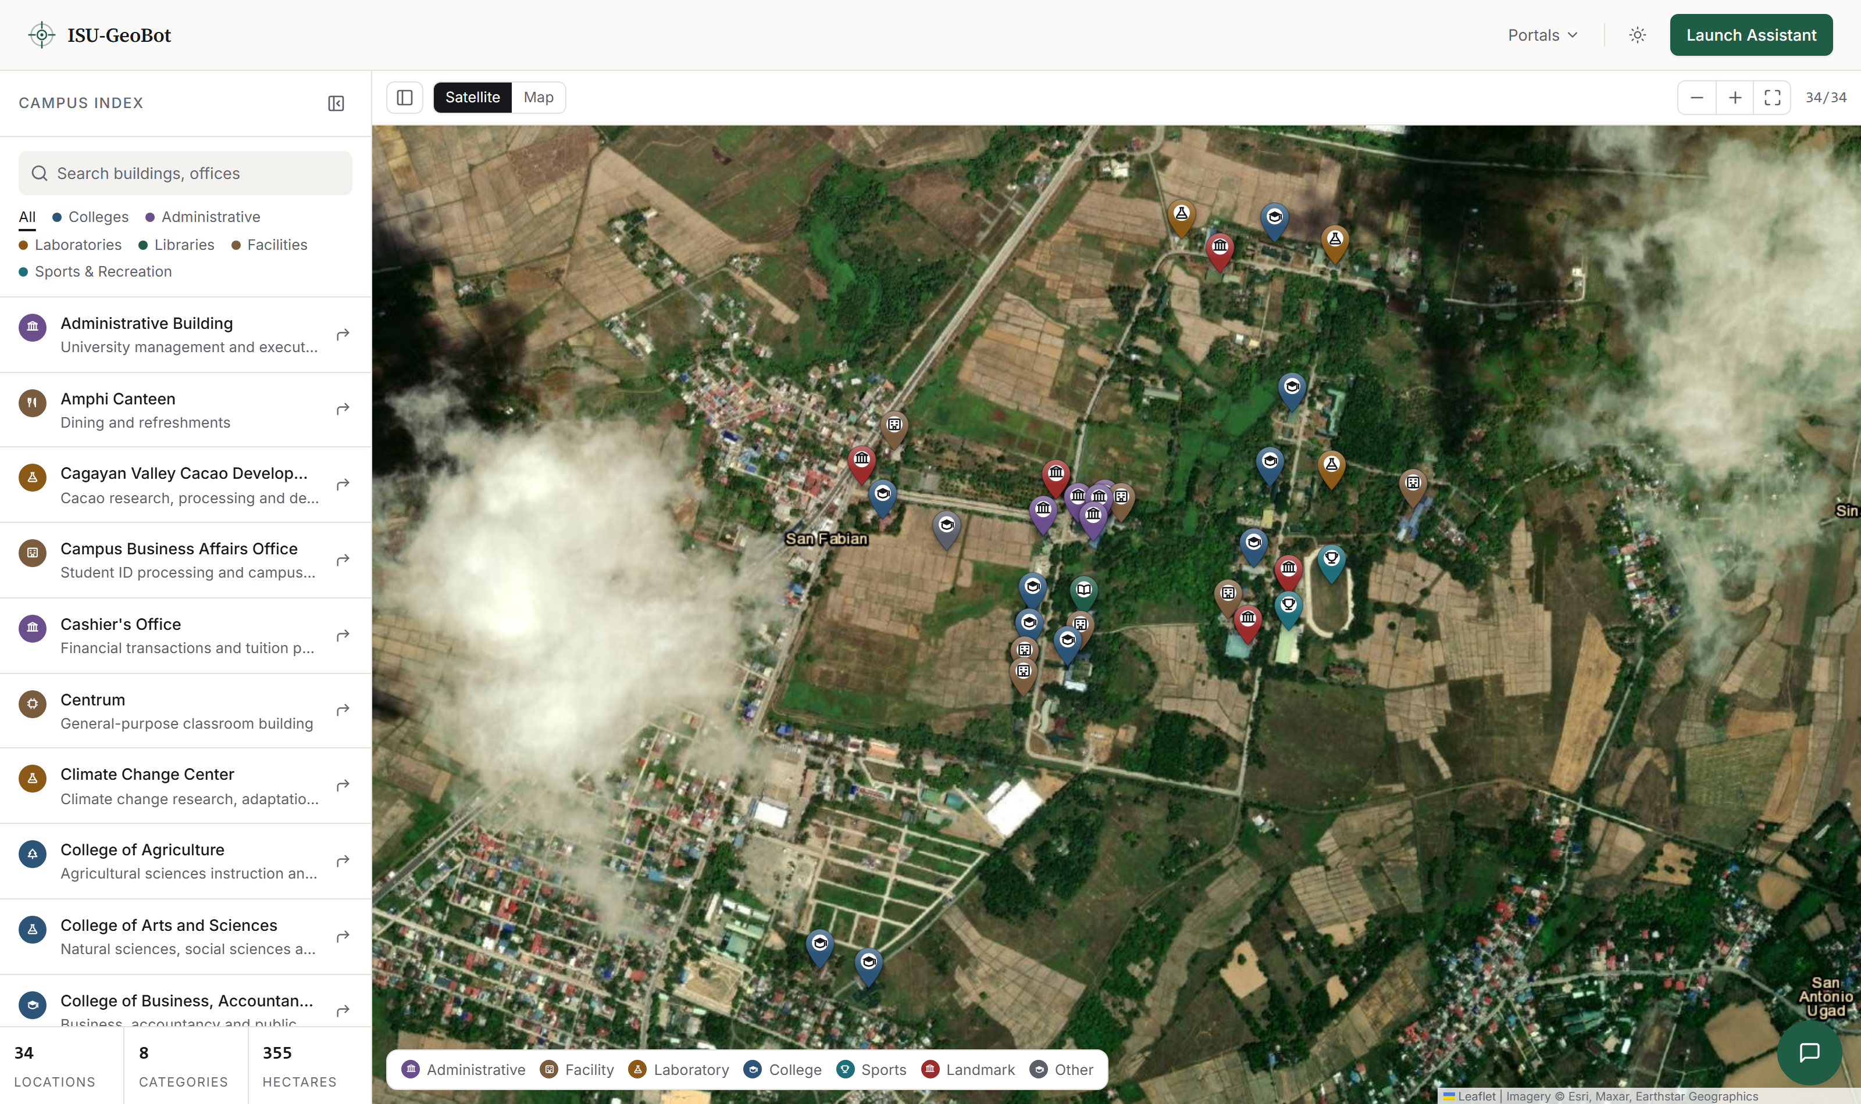
System Screenshots
03 OBJECTIVE
The deployed map. 34 published locations, drawn from the same records the assistant retrieves against.
ISU-GEOBOT · CAMPUS NAVIGATION AND FACULTY AVAILABILITY
8

Slide 10
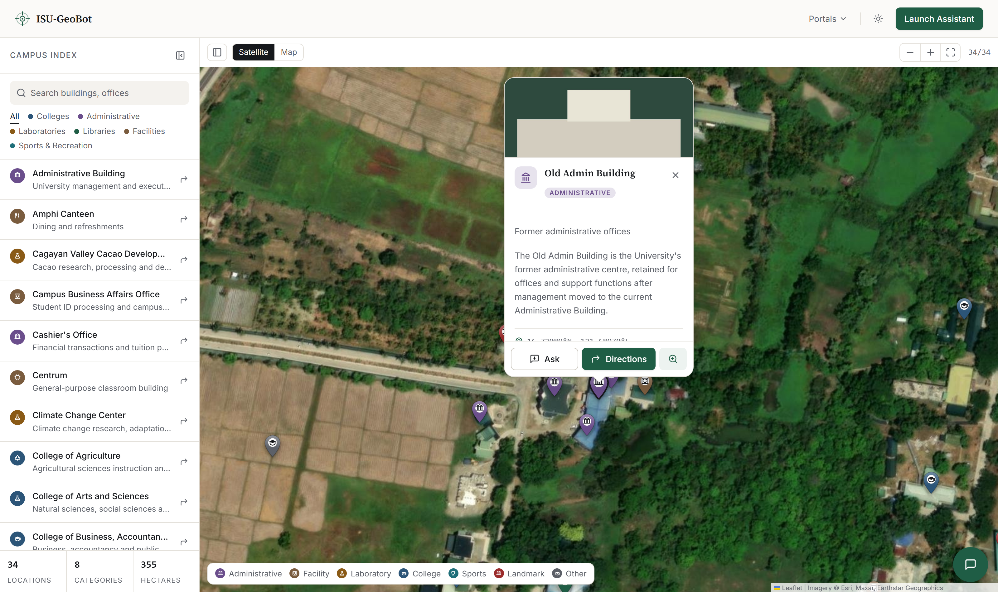
System Screenshots
03 OBJECTIVE
A place card. The photograph is interface only — it never enters the retrieval corpus.
ISU-GEOBOT · CAMPUS NAVIGATION AND FACULTY AVAILABILITY
9

Slide 11
The Refusal Is the Feature
03 OBJECTIVE
Asked: “Where is SIM-22?”
“I’m sorry, but I don’t have that information.”
—
Routed as navigation — the classifier never ran
[ 06-chat-refusal — not captured yet ]
—
Recorded classification time: 0.0 ms. Not computed, then hidden
—
Worded exactly like the refusal for an unknown building, so using the rule reveals nothing
Across all twelve availability responses, no answer named a room, building, floor or office — and the egress filter recorded zero interceptions.
ISU-GEOBOT · CAMPUS NAVIGATION AND FACULTY AVAILABILITY
10

Slide 12
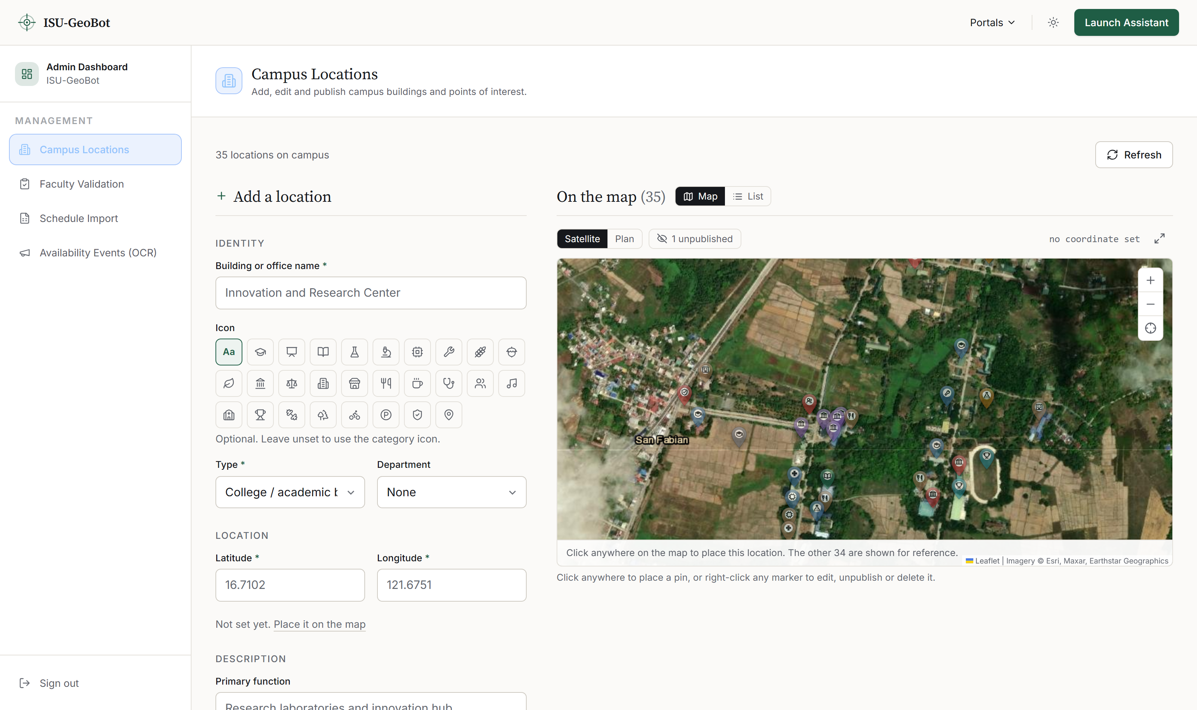
System Screenshots
03 OBJECTIVE
The Admin Dashboard. Adding a location writes the map pin and its embedded place card in one operation, so the two cannot drift apart.
ISU-GEOBOT · CAMPUS NAVIGATION AND FACULTY AVAILABILITY
11

Slide 13
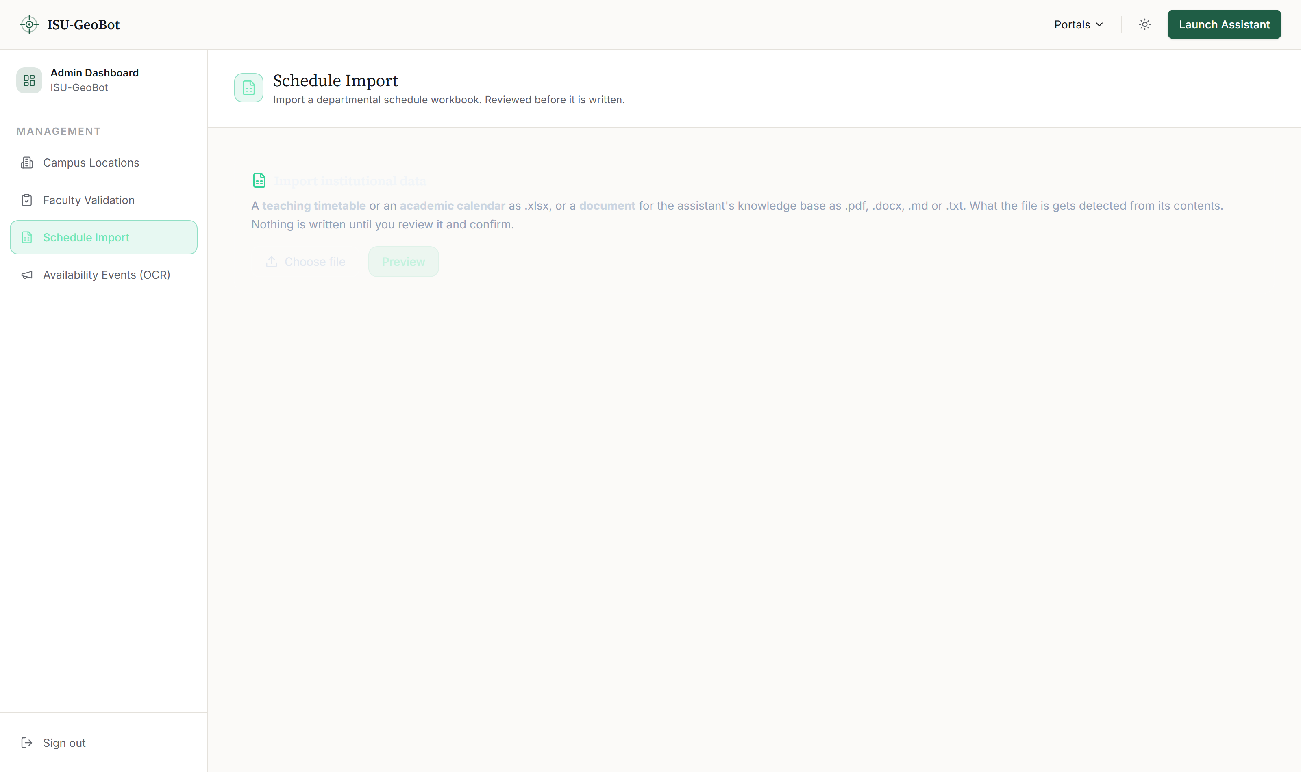
System Screenshots
03 OBJECTIVE
Schedule import. Two steps: the preview returns a checksum, and the apply is refused unless that checksum comes back.
ISU-GEOBOT · CAMPUS NAVIGATION AND FACULTY AVAILABILITY
12

Slide 14
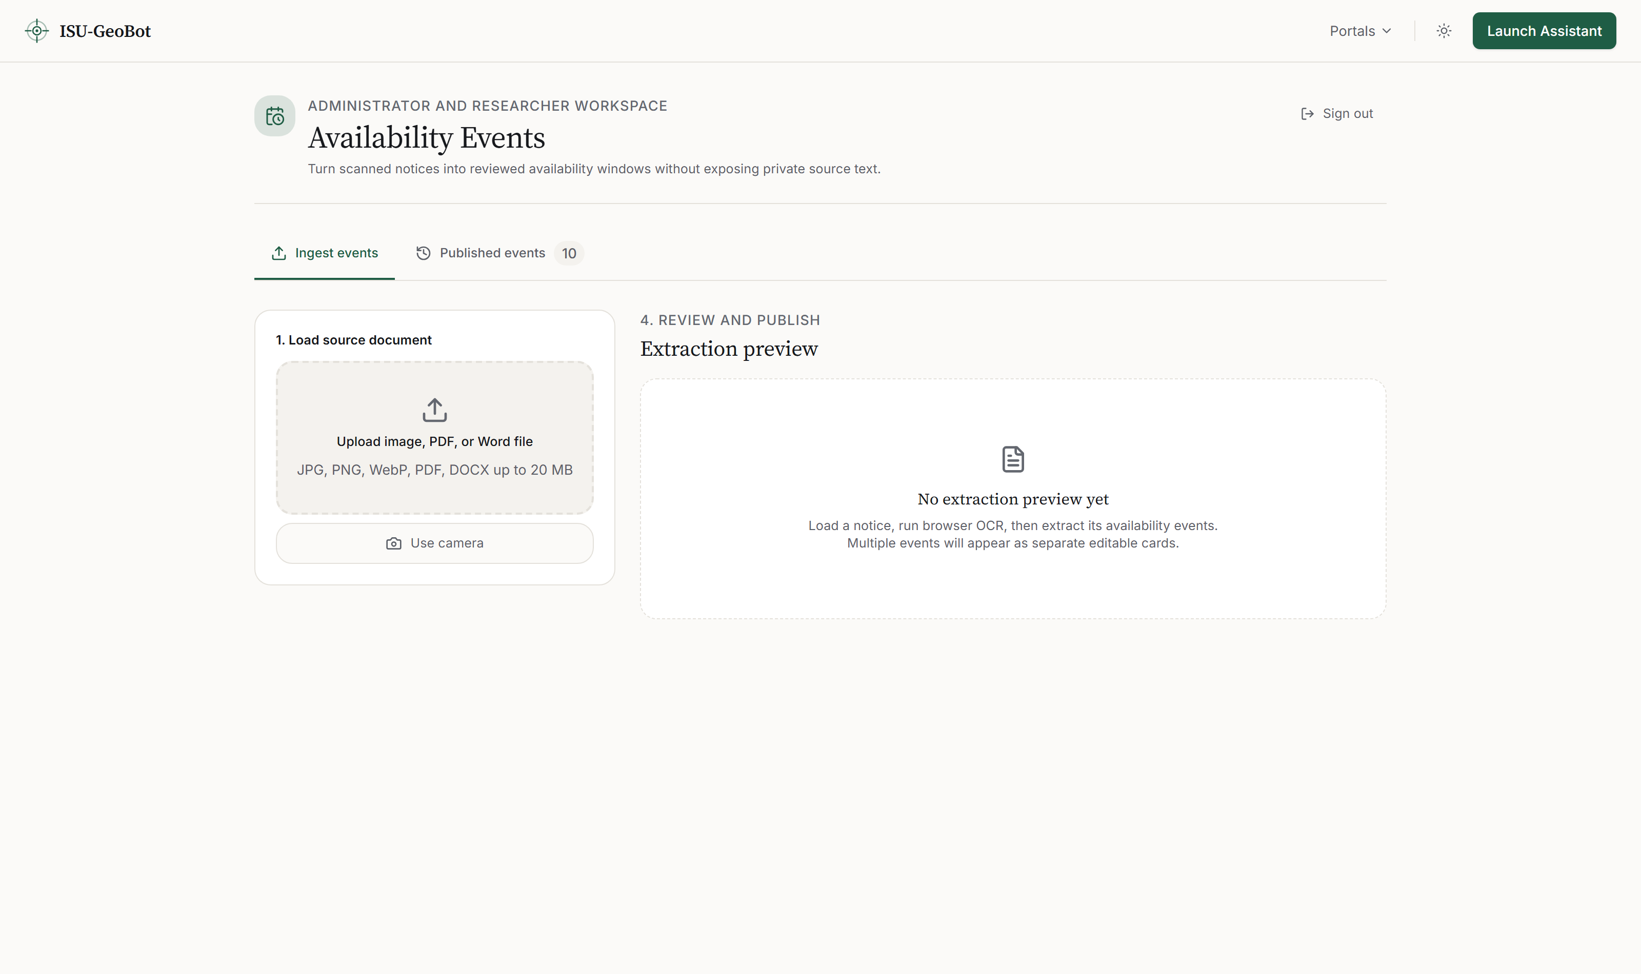
System Screenshots
03 OBJECTIVE
Announcement intake. OCR text is extracted in the browser and never stored; only the resolved event is written.
ISU-GEOBOT · CAMPUS NAVIGATION AND FACULTY AVAILABILITY
13

Slide 15
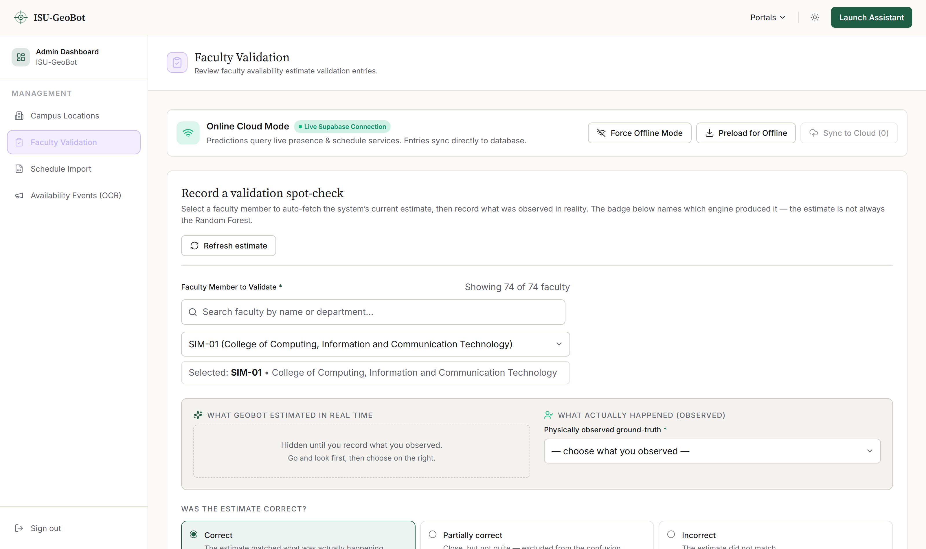
System Screenshots
04 OBJECTIVE
Field observation capture. The observed status starts empty and the system estimate stays hidden until the observer commits — the rebuilt form.
ISU-GEOBOT · CAMPUS NAVIGATION AND FACULTY AVAILABILITY
14

Slide 16
Expected Contribution / Conclusion
The contribution is not a faster assistant. It is an assistant that cannot disclose a person’s location, by construction.
01
Schedule-grounded availability
Availability is answered from a classifier over timetable and behavioural features, not inferred from retrieved prose.
02
Enforced disclosure limit
Three coarse states, never a room. The gates run before prediction, so a paused lecturer’s estimate is never computed at all.
03
Honest measurement
Generated data is stamped synthetic end to end, and the instruments refuse to score what the data cannot support.
04
Reproducible artifacts
Every figure in Chapter 4 is emitted by a script from the database rather than transcribed by hand.
A system that answered faster by guessing where someone is would not be an improvement.
ISU-GEOBOT · CAMPUS NAVIGATION AND FACULTY AVAILABILITY
15

Slide 17
Thank you
Questions are welcome.

