Slide 1
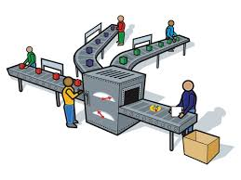

Production
The Marketing Mix
Product
Price
Promotion
Place
Marketing Mix Decisions
Marketing & Technology
Budgeting
Cash Flow Forecasts
The Income Statement
Business Finance
New Working Practices
Workforce Planning
Training & Appraisal
Workforce Performance
Organisational Design
Motivational Theory
Managmnt & Leadership
Staff-Employer Relations
Added Value
Production
Productivity
Technology
Lean Production
Quality
Stock Management
Research & Developmnt
Economies of Scale
INDEX
WJEC/Eduqas Business A Level
Component One:
Business Functions

Slide 2

Learning Objectives
The Marketing Mix
Product
Price
Promotion
Place
Marketing Mix Decisions
Marketing & Technology
Budgeting
Cash Flow Forecasts
The Income Statement
Business Finance
New Working Practices
Workforce Planning
Training & Appraisal
Workforce Performance
Organisational Design
Motivational Theory
Managmnt & Leadership
Staff-Employer Relations
Added Value
Production
Productivity
Technology
Lean Production
Quality
Stock Management
Research & Developmnt
Economies of Scale
INDEX
By the end of this topic you should be able to:
Understand the nature of operations management in different types of business organisation
Explain the different methods of production including job, batch and flow
Evaluate appropriate methods of production for businesses

Slide 3
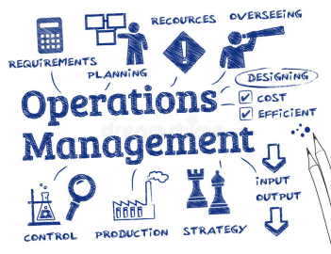
Operations Management
The Marketing Mix
Product
Price
Promotion
Place
Marketing Mix Decisions
Marketing & Technology
Budgeting
Cash Flow Forecasts
The Income Statement
Business Finance
New Working Practices
Workforce Planning
Training & Appraisal
Workforce Performance
Organisational Design
Motivational Theory
Managmnt & Leadership
Staff-Employer Relations
Added Value
Production
Productivity
Technology
Lean Production
Quality
Stock Management
Research & Developmnt
Economies of Scale
INDEX
Every firm has an operations function.
The goal of most firms involves the production of goods and/or services.
They need to purchase resources, convert them into outputs and distribute them to the end users.
Operations embraces all the activities required to create and deliver a firm’s goods or services to its customers or clients.

Slide 4

What is Production?
The Marketing Mix
Product
Price
Promotion
Place
Marketing Mix Decisions
Marketing & Technology
Budgeting
Cash Flow Forecasts
The Income Statement
Business Finance
New Working Practices
Workforce Planning
Training & Appraisal
Workforce Performance
Organisational Design
Motivational Theory
Managmnt & Leadership
Staff-Employer Relations
Added Value
Production
Productivity
Technology
Lean Production
Quality
Stock Management
Research & Developmnt
Economies of Scale
INDEX
Production is the process by which inputs (resources) are transformed into outputs in the form of a useful product or service.
Example
Hops
Barley
Yeast
Water
Malt
Beer
INPUTS
TRANSFORMATION PROCESS
OUTPUTS
Brewing Fermentation

Slide 5
Size and Nature of Firms
The Marketing Mix
Product
Price
Promotion
Place
Marketing Mix Decisions
Marketing & Technology
Budgeting
Cash Flow Forecasts
The Income Statement
Business Finance
New Working Practices
Workforce Planning
Training & Appraisal
Workforce Performance
Organisational Design
Motivational Theory
Managmnt & Leadership
Staff-Employer Relations
Added Value
Production
Productivity
Technology
Lean Production
Quality
Stock Management
Research & Developmnt
Economies of Scale
INDEX
The size of a business will often determine the manufacturing methods that they will employ.
The larger a business is, the more finance they have available to invest in capital and mass production techniques.
Bigger businesses also have a larger customer base that need products to be readily available.
Smaller firms are more likely to better understand the individual needs of their customers and are therefore more frequent users of small-scale manufacturing techniques such as job and batch production.

Slide 6
Impact of Technology
The Marketing Mix
Product
Price
Promotion
Place
Marketing Mix Decisions
Marketing & Technology
Budgeting
Cash Flow Forecasts
The Income Statement
Business Finance
New Working Practices
Workforce Planning
Training & Appraisal
Workforce Performance
Organisational Design
Motivational Theory
Managmnt & Leadership
Staff-Employer Relations
Added Value
Production
Productivity
Technology
Lean Production
Quality
Stock Management
Research & Developmnt
Economies of Scale
INDEX
The improvements in modern technology have meant that customers, retailers and manufacturers all have developed far closer relationships.
One of the main developments in operations has been the growth of mass customisation.
This is where mass produced goods are adapted to meet the individual needs of customers.

Slide 7
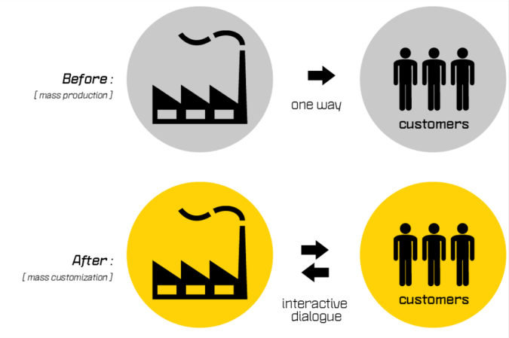
Mass Production v Customisation
The Marketing Mix
Product
Price
Promotion
Place
Marketing Mix Decisions
Marketing & Technology
Budgeting
Cash Flow Forecasts
The Income Statement
Business Finance
New Working Practices
Workforce Planning
Training & Appraisal
Workforce Performance
Organisational Design
Motivational Theory
Managmnt & Leadership
Staff-Employer Relations
Added Value
Production
Productivity
Technology
Lean Production
Quality
Stock Management
Research & Developmnt
Economies of Scale
INDEX
Source: twikblog.twikit.com

Slide 8

Mass Customisation
The Marketing Mix
Product
Price
Promotion
Place
Marketing Mix Decisions
Marketing & Technology
Budgeting
Cash Flow Forecasts
The Income Statement
Business Finance
New Working Practices
Workforce Planning
Training & Appraisal
Workforce Performance
Organisational Design
Motivational Theory
Managmnt & Leadership
Staff-Employer Relations
Added Value
Production
Productivity
Technology
Lean Production
Quality
Stock Management
Research & Developmnt
Economies of Scale
INDEX
Mass customisation makes use of flexible computer aided manufacturing technology.
This combines the benefits of low cost mass production with the customisation of products that better meet customer needs.
This can provide a business with a competitive advantage and adds value.
Dell Computers 0 mins 45 secs

Slide 9

Impact of Labour
The Marketing Mix
Product
Price
Promotion
Place
Marketing Mix Decisions
Marketing & Technology
Budgeting
Cash Flow Forecasts
The Income Statement
Business Finance
New Working Practices
Workforce Planning
Training & Appraisal
Workforce Performance
Organisational Design
Motivational Theory
Managmnt & Leadership
Staff-Employer Relations
Added Value
Production
Productivity
Technology
Lean Production
Quality
Stock Management
Research & Developmnt
Economies of Scale
INDEX
The skill set of a firm’s labour force is a key consideration in the methods of production used.
For a firm that produces small-scale, bespoke items that meet the individual needs of customers, higher skilled staff are employed.
Such skills are expensive to employ and develop further through training but firms are able to charge a premium price for the final product or service provided.

Slide 10
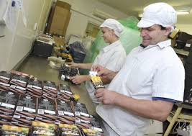
Impact of Labour
The Marketing Mix
Product
Price
Promotion
Place
Marketing Mix Decisions
Marketing & Technology
Budgeting
Cash Flow Forecasts
The Income Statement
Business Finance
New Working Practices
Workforce Planning
Training & Appraisal
Workforce Performance
Organisational Design
Motivational Theory
Managmnt & Leadership
Staff-Employer Relations
Added Value
Production
Productivity
Technology
Lean Production
Quality
Stock Management
Research & Developmnt
Economies of Scale
INDEX
Firms that utilise mass-production (flow production) techniques do not usually require highly skilled staff.
Operatives are needed to monitor and assist on the production lines but craft or specialist skills are far less necessary.
Employees working in mass production industries are often cheaper to employ.

Slide 11
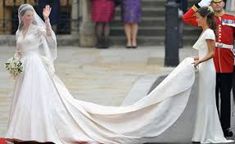
The Marketing Mix
Product
Price
Promotion
Place
Marketing Mix Decisions
Marketing & Technology
Budgeting
Cash Flow Forecasts
The Income Statement
Business Finance
New Working Practices
Workforce Planning
Training & Appraisal
Workforce Performance
Organisational Design
Motivational Theory
Managmnt & Leadership
Staff-Employer Relations
Added Value
Production
Productivity
Technology
Lean Production
Quality
Stock Management
Research & Developmnt
Economies of Scale
INDEX
Job Production
Job production involves the manufacture or delivery of one-off or a small number of items.
Customers are able to specify their exact requirements and it normally is a labour-intensive method.
Usually this is associated with small-scale businesses who specialise in a particular area and uses skilled employees.
Kate’s wedding dress was a one-off creation.

Slide 12



Job Production Examples
The Marketing Mix
Product
Price
Promotion
Place
Marketing Mix Decisions
Marketing & Technology
Budgeting
Cash Flow Forecasts
The Income Statement
Business Finance
New Working Practices
Workforce Planning
Training & Appraisal
Workforce Performance
Organisational Design
Motivational Theory
Managmnt & Leadership
Staff-Employer Relations
Added Value
Production
Productivity
Technology
Lean Production
Quality
Stock Management
Research & Developmnt
Economies of Scale
INDEX
Watch makers
Architects
Hair Stylists
Specialist staff with expertise in a particular skill set.
Some other examples include:
Surgeons
Artists
Sculptors
Tailors

Slide 13
Benefits and Drawbacks
The Marketing Mix
Product
Price
Promotion
Place
Marketing Mix Decisions
Marketing & Technology
Budgeting
Cash Flow Forecasts
The Income Statement
Business Finance
New Working Practices
Workforce Planning
Training & Appraisal
Workforce Performance
Organisational Design
Motivational Theory
Managmnt & Leadership
Staff-Employer Relations
Added Value
Production
Productivity
Technology
Lean Production
Quality
Stock Management
Research & Developmnt
Economies of Scale
INDEX
Benefits | Drawbacks
Exact customer requirements are met | Time consuming (long lead times)
Flexibility in meeting customer needs | Expensive – labour intensive
High employee motivation | No economies of scale
High quality and premium price | Low volume of production

Slide 14
Batch Production
The Marketing Mix
Product
Price
Promotion
Place
Marketing Mix Decisions
Marketing & Technology
Budgeting
Cash Flow Forecasts
The Income Statement
Business Finance
New Working Practices
Workforce Planning
Training & Appraisal
Workforce Performance
Organisational Design
Motivational Theory
Managmnt & Leadership
Staff-Employer Relations
Added Value
Production
Productivity
Technology
Lean Production
Quality
Stock Management
Research & Developmnt
Economies of Scale
INDEX
This involves the production of small quantities of identical products – a batch. Each batch goes through several stages.
Clothes manufacturers use batch production to produce a given item, such as a jacket, in batches of different sizes or colours.
All of the items in the batch are the same, so production is speeded up. This reduces the cost of labour and results in the final product being less expensive for the customer.

Slide 15
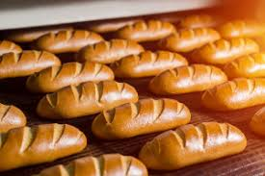
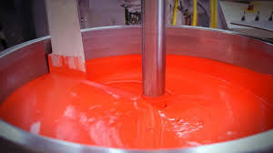
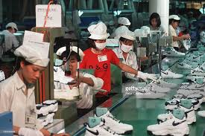
Batch Production Examples
The Marketing Mix
Product
Price
Promotion
Place
Marketing Mix Decisions
Marketing & Technology
Budgeting
Cash Flow Forecasts
The Income Statement
Business Finance
New Working Practices
Workforce Planning
Training & Appraisal
Workforce Performance
Organisational Design
Motivational Theory
Managmnt & Leadership
Staff-Employer Relations
Added Value
Production
Productivity
Technology
Lean Production
Quality
Stock Management
Research & Developmnt
Economies of Scale
INDEX
Bakeries
Paints
Sports Shoes
Semi-skilled staff and a greater reliance upon capital equipment.
Some other examples include:
Ink production
Adhesives
Water purification

Slide 16
Benefits and Drawbacks
The Marketing Mix
Product
Price
Promotion
Place
Marketing Mix Decisions
Marketing & Technology
Budgeting
Cash Flow Forecasts
The Income Statement
Business Finance
New Working Practices
Workforce Planning
Training & Appraisal
Workforce Performance
Organisational Design
Motivational Theory
Managmnt & Leadership
Staff-Employer Relations
Added Value
Production
Productivity
Technology
Lean Production
Quality
Stock Management
Research & Developmnt
Economies of Scale
INDEX
Benefits | Drawbacks
Lower labour and unit costs. | Repetitive tasks – low motivation
Faster production times. | Increased storage required
Some economies of scale. | Machines reset between batches
Employees able to specialise/use specialised equipment

Slide 17
Flow (Mass) Production
The Marketing Mix
Product
Price
Promotion
Place
Marketing Mix Decisions
Marketing & Technology
Budgeting
Cash Flow Forecasts
The Income Statement
Business Finance
New Working Practices
Workforce Planning
Training & Appraisal
Workforce Performance
Organisational Design
Motivational Theory
Managmnt & Leadership
Staff-Employer Relations
Added Value
Production
Productivity
Technology
Lean Production
Quality
Stock Management
Research & Developmnt
Economies of Scale
INDEX
This is a continuous process where products flow freely from one stage to the next without delay.
It enables large volumes of identical products to be manufactured.
Production is broken down into several smaller stages which enable the use of specialist robotics to speed up production and shorten lead-times.

Slide 18
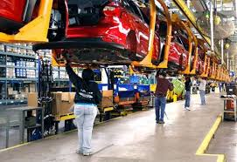
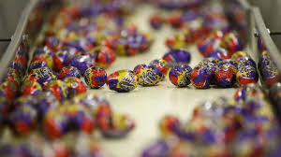
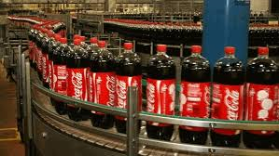
Flow Production Examples
The Marketing Mix
Product
Price
Promotion
Place
Marketing Mix Decisions
Marketing & Technology
Budgeting
Cash Flow Forecasts
The Income Statement
Business Finance
New Working Practices
Workforce Planning
Training & Appraisal
Workforce Performance
Organisational Design
Motivational Theory
Managmnt & Leadership
Staff-Employer Relations
Added Value
Production
Productivity
Technology
Lean Production
Quality
Stock Management
Research & Developmnt
Economies of Scale
INDEX
Car Assembly Plants
Chocolate Goods
Soft Drinks
A greater use of unskilled staff and a high reliance upon capital equipment.
Some other examples include:
Mobile phones
Electronic goods
Oil refineries

Slide 19
Benefits and Drawbacks
The Marketing Mix
Product
Price
Promotion
Place
Marketing Mix Decisions
Marketing & Technology
Budgeting
Cash Flow Forecasts
The Income Statement
Business Finance
New Working Practices
Workforce Planning
Training & Appraisal
Workforce Performance
Organisational Design
Motivational Theory
Managmnt & Leadership
Staff-Employer Relations
Added Value
Production
Productivity
Technology
Lean Production
Quality
Stock Management
Research & Developmnt
Economies of Scale
INDEX
Benefits | Drawbacks
Fast production speed | Initial expense to install equipment
Large economies of scale | Job losses – poor reputation
Consistent quality | Highly repetitive – poor motivation
High quality and premium price | Low volume of production
Higher volumes of production | Best suited to the production of identical products.

Slide 20
Final Evaluation
The Marketing Mix
Product
Price
Promotion
Place
Marketing Mix Decisions
Marketing & Technology
Budgeting
Cash Flow Forecasts
The Income Statement
Business Finance
New Working Practices
Workforce Planning
Training & Appraisal
Workforce Performance
Organisational Design
Motivational Theory
Managmnt & Leadership
Staff-Employer Relations
Added Value
Production
Productivity
Technology
Lean Production
Quality
Stock Management
Research & Developmnt
Economies of Scale
INDEX
The type of production method used by a business depends upon some of the following factors:
Cost/Skills of Labour
Cost of Capital
Nature of the Product
Available Technology
Market Size
Customer Requirements

Slide 21
Quick Fire Five
The Marketing Mix
Product
Price
Promotion
Place
Marketing Mix Decisions
Marketing & Technology
Budgeting
Cash Flow Forecasts
The Income Statement
Business Finance
New Working Practices
Workforce Planning
Training & Appraisal
Workforce Performance
Organisational Design
Motivational Theory
Managmnt & Leadership
Staff-Employer Relations
Added Value
Production
Productivity
Technology
Lean Production
Quality
Stock Management
Research & Developmnt
Economies of Scale
INDEX
Which manufacturing method is the most likely to benefit from economies of scale.
State the manufacturing method that is the most appropriate for the production of bespoke jewellery.
State the meaning of the term ‘mass customisation’.
State 2 drawbacks of using batch production techniques.
Examine the impact upon stakeholders of each of the different production methods.
Start
5 minutes
End

