Slide 1


Added Value
The Marketing Mix
Product
Price
Promotion
Place
Marketing Mix Decisions
Marketing & Technology
Budgeting
Cash Flow Forecasts
The Income Statement
Business Finance
New Working Practices
Workforce Planning
Training & Appraisal
Workforce Performance
Organisational Design
Motivational Theory
Managmnt & Leadership
Staff-Employer Relations
Added Value
Production
Productivity
Technology
Lean Production
Quality
Stock Management
Research & Developmnt
Economies of Scale
INDEX
WJEC/Eduqas Business A Level
Component One:
Business Functions

Slide 2

Learning Objectives
The Marketing Mix
Product
Price
Promotion
Place
Marketing Mix Decisions
Marketing & Technology
Budgeting
Cash Flow Forecasts
The Income Statement
Business Finance
New Working Practices
Workforce Planning
Training & Appraisal
Workforce Performance
Organisational Design
Motivational Theory
Managmnt & Leadership
Staff-Employer Relations
Added Value
Production
Productivity
Technology
Lean Production
Quality
Stock Management
Research & Developmnt
Economies of Scale
INDEX
By the end of this topic you should be able to:
Explain what is meant by added value
Calculate added value
Explain ways of increasing value added
Evaluate the importance of added value to a business and its stakeholders.

Slide 3

What is Added Value?
The Marketing Mix
Product
Price
Promotion
Place
Marketing Mix Decisions
Marketing & Technology
Budgeting
Cash Flow Forecasts
The Income Statement
Business Finance
New Working Practices
Workforce Planning
Training & Appraisal
Workforce Performance
Organisational Design
Motivational Theory
Managmnt & Leadership
Staff-Employer Relations
Added Value
Production
Productivity
Technology
Lean Production
Quality
Stock Management
Research & Developmnt
Economies of Scale
INDEX
Added value is the process of increasing the worth of a resource by modifying it in some way.
As a result the value of the final product is worth more than the sum of its individual parts.
Value can be added to both goods and services.

Slide 4
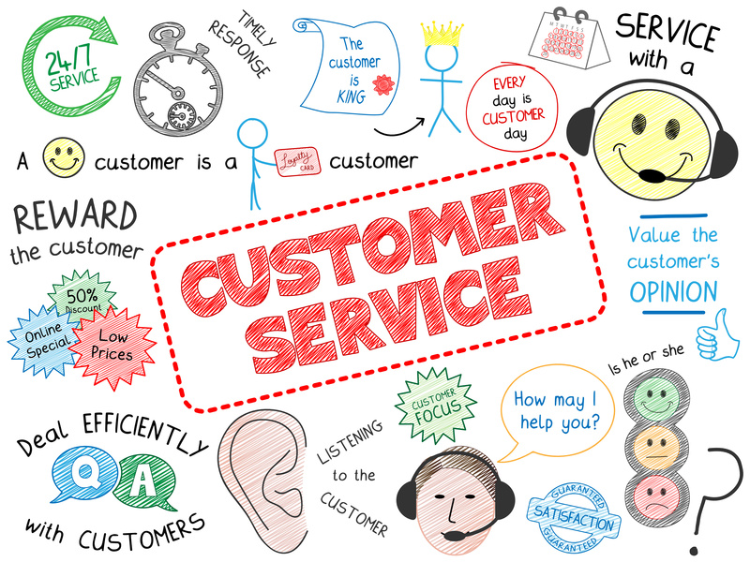
The Marketing Mix
Product
Price
Promotion
Place
Marketing Mix Decisions
Marketing & Technology
Budgeting
Cash Flow Forecasts
The Income Statement
Business Finance
New Working Practices
Workforce Planning
Training & Appraisal
Workforce Performance
Organisational Design
Motivational Theory
Managmnt & Leadership
Staff-Employer Relations
Added Value
Production
Productivity
Technology
Lean Production
Quality
Stock Management
Research & Developmnt
Economies of Scale
INDEX

Slide 5
Added Value Formula
The Marketing Mix
Product
Price
Promotion
Place
Marketing Mix Decisions
Marketing & Technology
Budgeting
Cash Flow Forecasts
The Income Statement
Business Finance
New Working Practices
Workforce Planning
Training & Appraisal
Workforce Performance
Organisational Design
Motivational Theory
Managmnt & Leadership
Staff-Employer Relations
Added Value
Production
Productivity
Technology
Lean Production
Quality
Stock Management
Research & Developmnt
Economies of Scale
INDEX
Added Value Calculation
Value of Output – Value (Cost) of Inputs
Exam Tip
Do not make the mistake of confusing added value with profit. Profit takes into account all of the costs involved in the process of adding value not simply the difference between raw material cost and selling price e.g. the price of a carpenter’s wages for sanding a table.

Slide 6

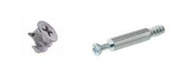





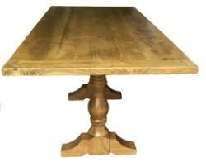
Worked Example
The Marketing Mix
Product
Price
Promotion
Place
Marketing Mix Decisions
Marketing & Technology
Budgeting
Cash Flow Forecasts
The Income Statement
Business Finance
New Working Practices
Workforce Planning
Training & Appraisal
Workforce Performance
Organisational Design
Motivational Theory
Managmnt & Leadership
Staff-Employer Relations
Added Value
Production
Productivity
Technology
Lean Production
Quality
Stock Management
Research & Developmnt
Economies of Scale
INDEX
Adding Value
Adding Value
INPUTS
Wood £150
Fixtures & Fittings £5
Glue £2
Varnish £10
PROCESSES
Labour
Sanding
Varnishing
Polishing
Construction
Value of Output – Value of Inputs
OUTPUTS £650
INPUTS £167
VALUE ADDED = £650-£167 =£483
OUTPUT
Finished Table £650

Slide 7
Ways of Increasing Added Value
The Marketing Mix
Product
Price
Promotion
Place
Marketing Mix Decisions
Marketing & Technology
Budgeting
Cash Flow Forecasts
The Income Statement
Business Finance
New Working Practices
Workforce Planning
Training & Appraisal
Workforce Performance
Organisational Design
Motivational Theory
Managmnt & Leadership
Staff-Employer Relations
Added Value
Production
Productivity
Technology
Lean Production
Quality
Stock Management
Research & Developmnt
Economies of Scale
INDEX
The Faster the Better
Raise Prices
Branding
Increase Convenience
Reduce Costs

Slide 8
Improving Lead Times
The Marketing Mix
Product
Price
Promotion
Place
Marketing Mix Decisions
Marketing & Technology
Budgeting
Cash Flow Forecasts
The Income Statement
Business Finance
New Working Practices
Workforce Planning
Training & Appraisal
Workforce Performance
Organisational Design
Motivational Theory
Managmnt & Leadership
Staff-Employer Relations
Added Value
Production
Productivity
Technology
Lean Production
Quality
Stock Management
Research & Developmnt
Economies of Scale
INDEX
Customers perceive a direct correlation between speed and the value of your product or service.
Customers are often willing to pay a premium price for faster delivery or manufacturing lead times.
The extra speed however, must not be delivered at the expense of product quality!
Firms who can rapidly fulfil orders fast are considered to be better and more competent offering a higher level of quality than a business who does it slowly, or whenever they get around to it.

Slide 9
Raise Selling Prices
The Marketing Mix
Product
Price
Promotion
Place
Marketing Mix Decisions
Marketing & Technology
Budgeting
Cash Flow Forecasts
The Income Statement
Business Finance
New Working Practices
Workforce Planning
Training & Appraisal
Workforce Performance
Organisational Design
Motivational Theory
Managmnt & Leadership
Staff-Employer Relations
Added Value
Production
Productivity
Technology
Lean Production
Quality
Stock Management
Research & Developmnt
Economies of Scale
INDEX
Even a small rise in price brings about a large drop in quantity sold for a price elastic good.
One option is to simply increase the selling price and so widen the monetary gap between the inputs and outputs.
However the success of this strategy depends upon the price elasticity value of a product or service.
An item with a highly price elastic value will see a substantial decline in sales if the selling price is raised and this will mean a fall in sales revenue.
Price
P1
P
Q1
Q
Quantity

Slide 10
Reduce Costs
The Marketing Mix
Product
Price
Promotion
Place
Marketing Mix Decisions
Marketing & Technology
Budgeting
Cash Flow Forecasts
The Income Statement
Business Finance
New Working Practices
Workforce Planning
Training & Appraisal
Workforce Performance
Organisational Design
Motivational Theory
Managmnt & Leadership
Staff-Employer Relations
Added Value
Production
Productivity
Technology
Lean Production
Quality
Stock Management
Research & Developmnt
Economies of Scale
INDEX
A business might try to add value by reducing the price paid for their inputs (raw materials).
Such as strategy must take into account the overall objectives of the business e.g. a business known for their quality is likely to face criticism and lost sales if they change to cheaper materials.
Changing suppliers is also a high risk strategy as it takes time to establish a new relationship with a supplier who understands the specific needs of your business.

Slide 11
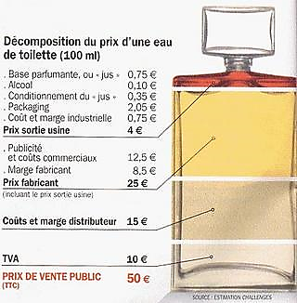
Branding
The Marketing Mix
Product
Price
Promotion
Place
Marketing Mix Decisions
Marketing & Technology
Budgeting
Cash Flow Forecasts
The Income Statement
Business Finance
New Working Practices
Workforce Planning
Training & Appraisal
Workforce Performance
Organisational Design
Motivational Theory
Managmnt & Leadership
Staff-Employer Relations
Added Value
Production
Productivity
Technology
Lean Production
Quality
Stock Management
Research & Developmnt
Economies of Scale
INDEX
Branding provides a business with a means of differentiating their good or service.
Premium brands are able to sell their goods for a significantly higher price.
Production costs of luxury perfumes are not very much higher than lower cost alternatives but the added value is a lot more.
Right out of the perfume factory, the scent in its packaging costs €4; the perfume itself = €0.75. With a selling price of €50 the added value is €46 per 100ml bottle. Profit is much lower at less than €15 a bottle after accounting for promotion and distribution.

Slide 12
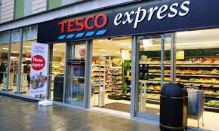

Convenience
The Marketing Mix
Product
Price
Promotion
Place
Marketing Mix Decisions
Marketing & Technology
Budgeting
Cash Flow Forecasts
The Income Statement
Business Finance
New Working Practices
Workforce Planning
Training & Appraisal
Workforce Performance
Organisational Design
Motivational Theory
Managmnt & Leadership
Staff-Employer Relations
Added Value
Production
Productivity
Technology
Lean Production
Quality
Stock Management
Research & Developmnt
Economies of Scale
INDEX
Increasing customer convenience can also help to add value with a good example being the fast food industry.
Fast food chains have numerous branches across towns, saving customers the inconvenience of driving about to find a store.
Supermarkets are also becoming more convenient.
Home delivery services are an extension of convenience strategies and add value as higher prices are able to be charged.

Slide 13
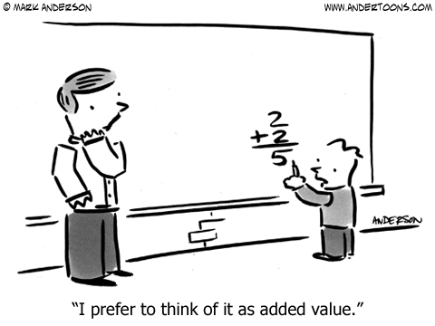
Final Evaluation
The Marketing Mix
Product
Price
Promotion
Place
Marketing Mix Decisions
Marketing & Technology
Budgeting
Cash Flow Forecasts
The Income Statement
Business Finance
New Working Practices
Workforce Planning
Training & Appraisal
Workforce Performance
Organisational Design
Motivational Theory
Managmnt & Leadership
Staff-Employer Relations
Added Value
Production
Productivity
Technology
Lean Production
Quality
Stock Management
Research & Developmnt
Economies of Scale
INDEX
Added value does not always guarantee a high enough level of profit to sustain a business.
The processes involved in the manufacturing (transformation phase) of production might be very high e.g. the need for highly skilled staff.
Added value helps a firm to differentiate their goods and services which can protect their market share from rival competitors.

Slide 14
Quick Fire Five
The Marketing Mix
Product
Price
Promotion
Place
Marketing Mix Decisions
Marketing & Technology
Budgeting
Cash Flow Forecasts
The Income Statement
Business Finance
New Working Practices
Workforce Planning
Training & Appraisal
Workforce Performance
Organisational Design
Motivational Theory
Managmnt & Leadership
Staff-Employer Relations
Added Value
Production
Productivity
Technology
Lean Production
Quality
Stock Management
Research & Developmnt
Economies of Scale
INDEX
What is the formula for calculating added value?
Explain the difference between added value and profit.
Analyse why raising the selling price might not be the best way to add value to a product or service.
Examine the potential benefits and drawbacks of reducing costs as a means of increasing added value.
How has convenience been used by fast food chains to improve the added value of their products?
Start
5 minutes
End

