Slide 1
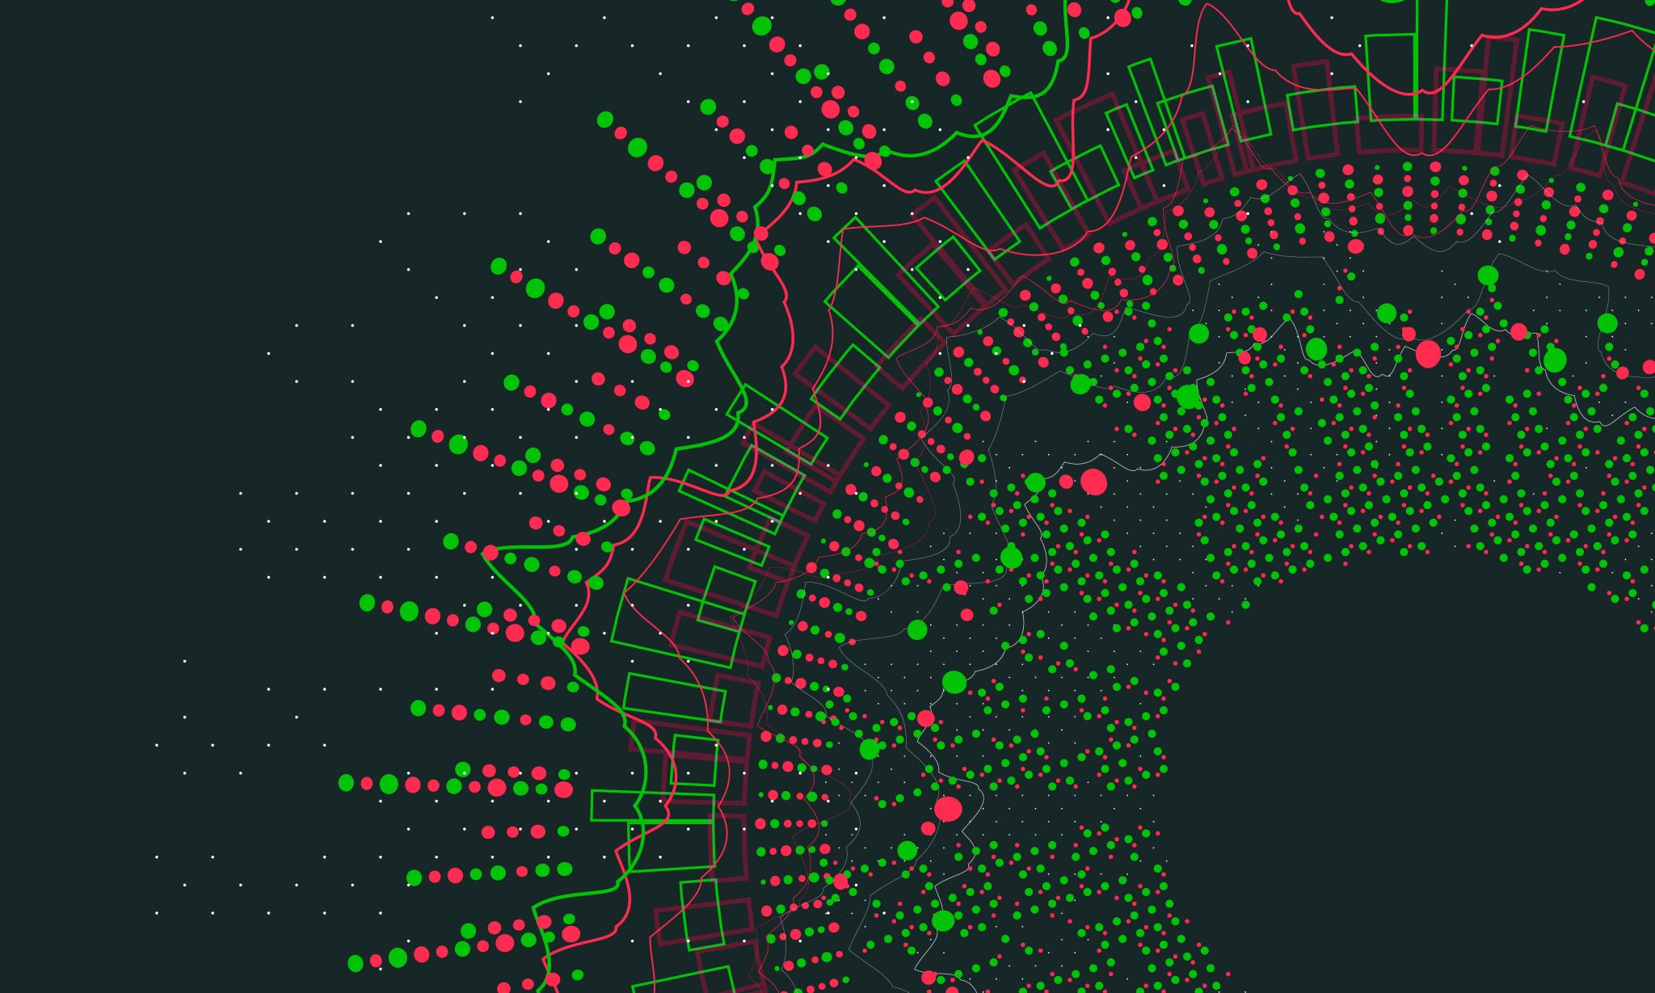
Caretech
By Gabriel Mureseanu

Slide 2
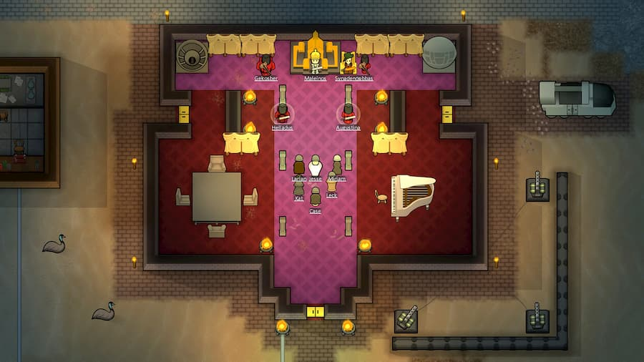

Project Pitch
A serious simulation game inspired by RimWorld/Dwarf Fortress in a First-Person perspective that will help teach Students of Health and Wellbeing (future caretakers) about using caretaker technology in a “normal day at the job” way.

Slide 3

Identity of the game
Type of game : Educational
Genre : Social Simulation
Target audience : Students of Health and Wellbeing
Platform : Desktop
Engine : Unity

Slide 4
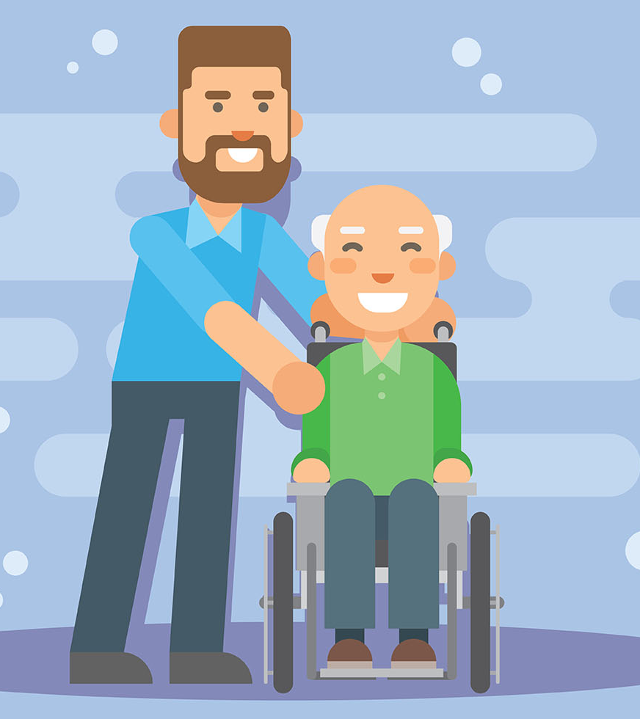
Gameplay
The player is going to take care of non-player characters in a retirement home semi-realistic simulation.
The player will need to react to their needs and use caretaker technologies in order to help them.
The goal of the game is to keep the non-player characters happy over the duration of the game.

Slide 5

eDUCATION
The player will learn about the technologies by using them in the game.
The player will learn when and how to use the technologies.
The player will train in how to react in certain specific situations.

Slide 6
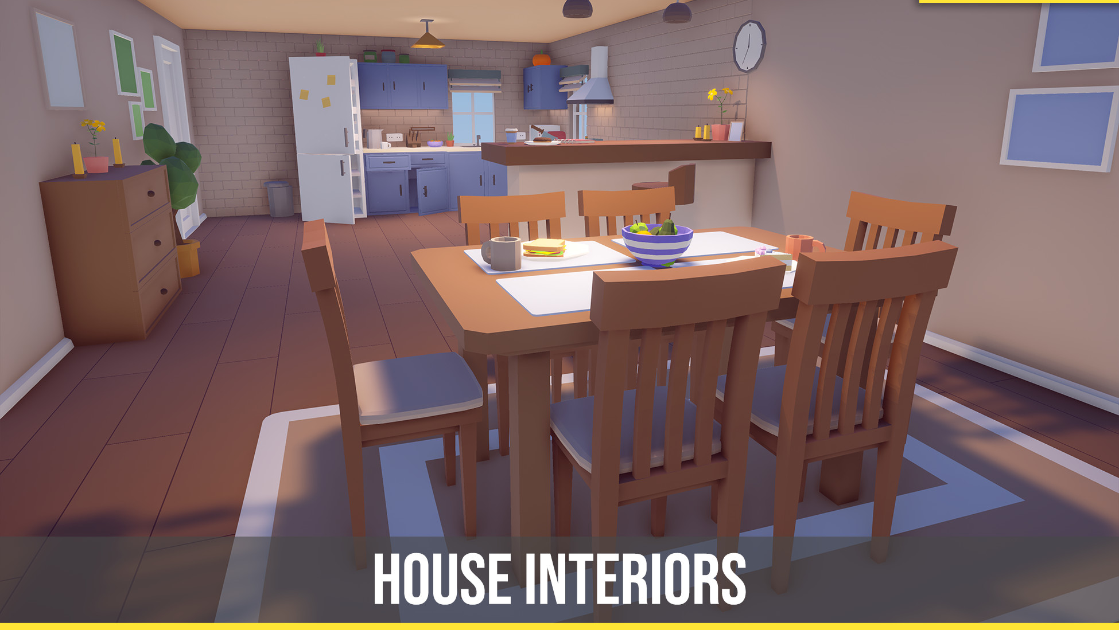
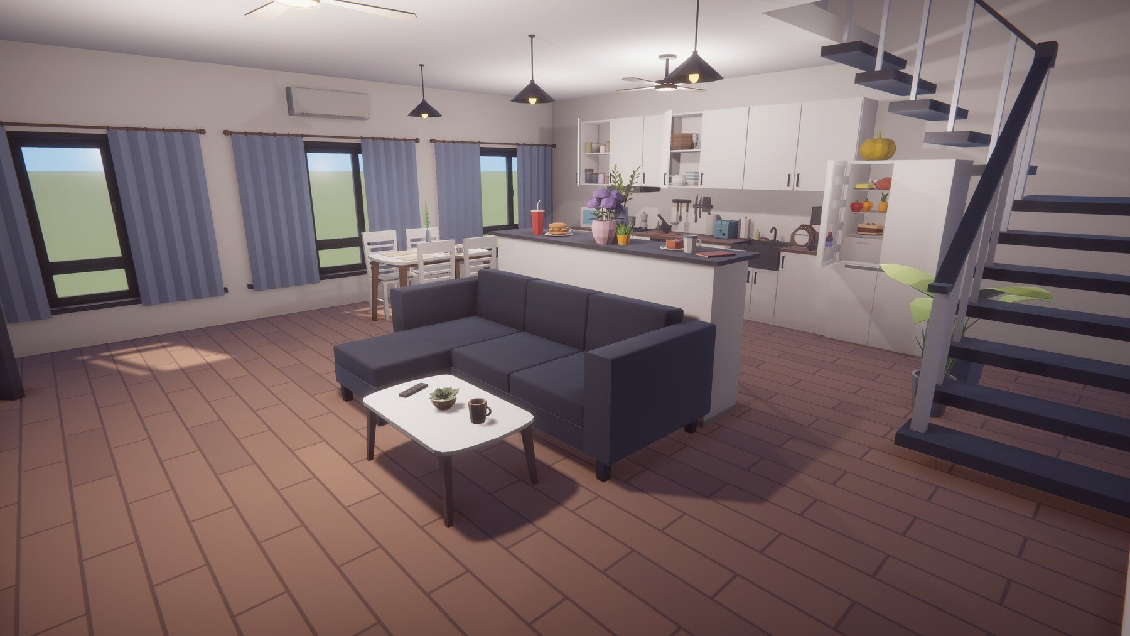
Visuals
Art is not the focus of the project; therefore, asset packs will be used.
The game will be based around a low-poly aesthetic, using pre-made assets from the Unity Asset Store

Slide 7

Scope
The prototype will showcase 5 caretaker specific technologies.
The target play time of the game is 70-100 minutes.

Slide 8
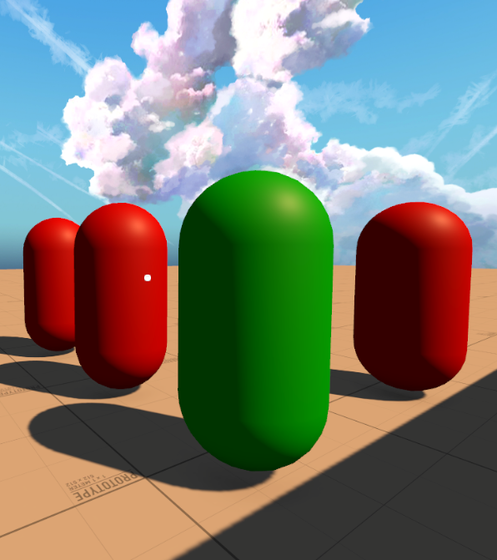
Prototype Demo

Slide 9

Questions?

