Slide 1
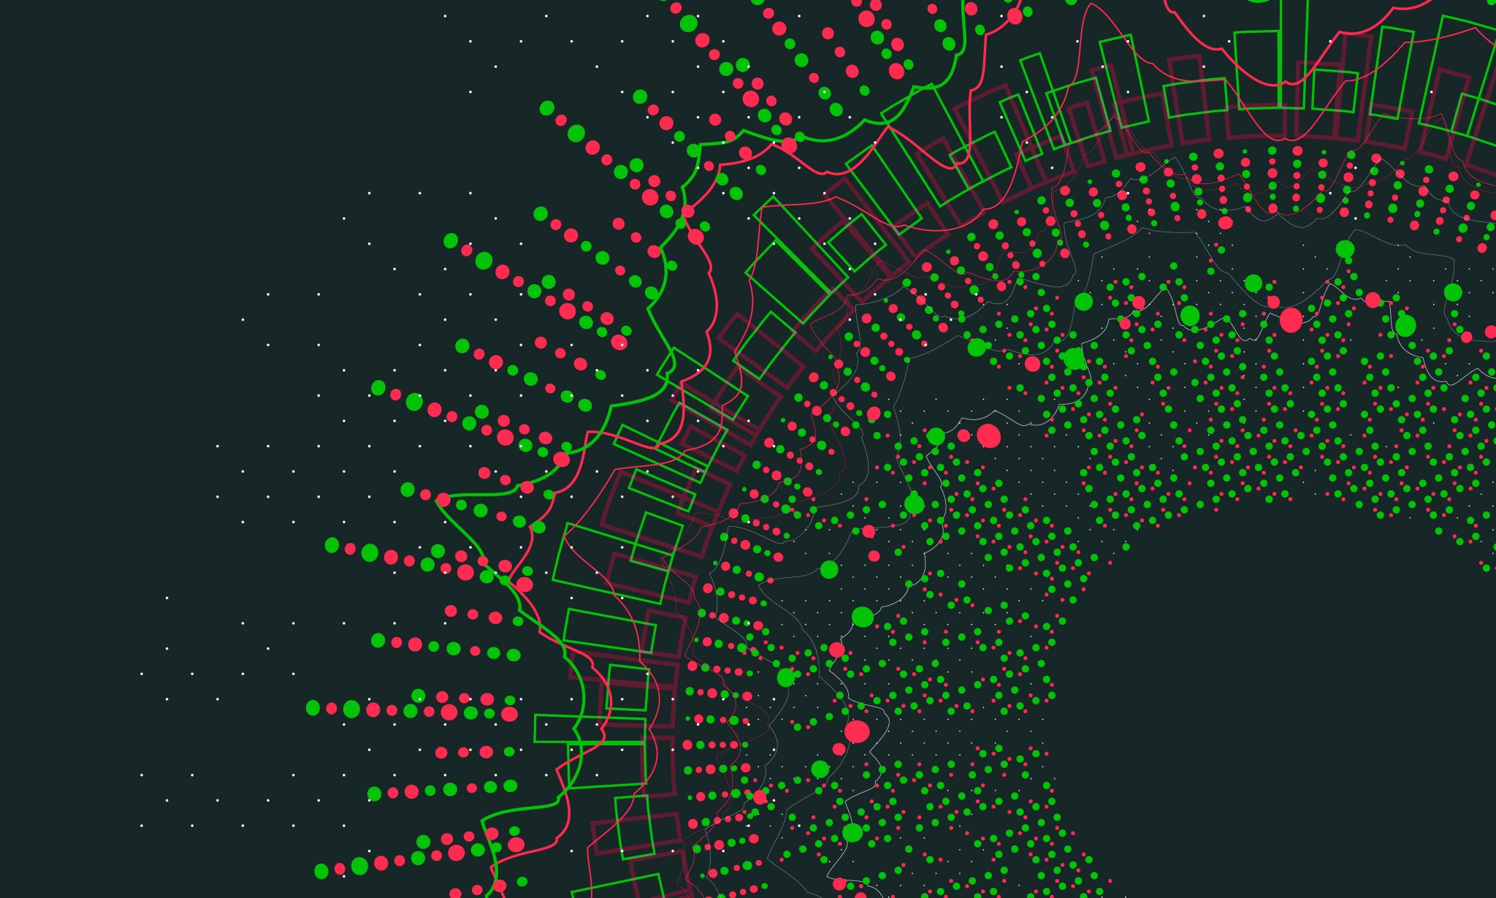
Caretaker Simulator
By Gabriel Mureseanu

Slide 2
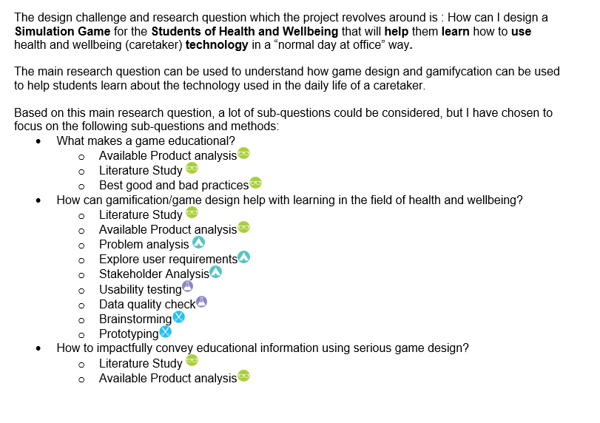
Project plan
Very good feedback.
Very close to completion.

Slide 3
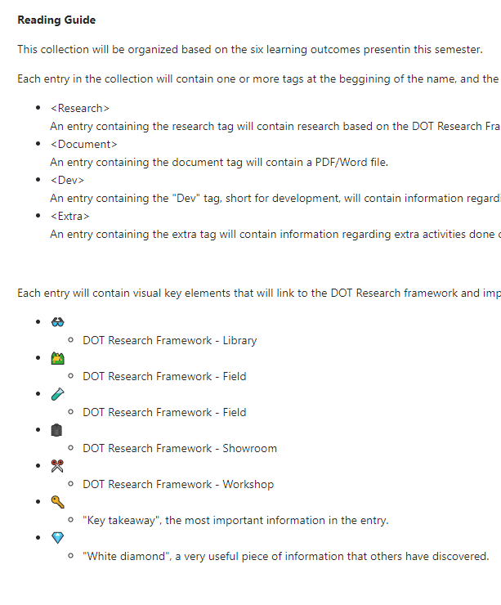
Portfolio
Reading guide complete.
Good feedback on organization.
Started working on first sub-question :”What makes a game educational?”.

Slide 4
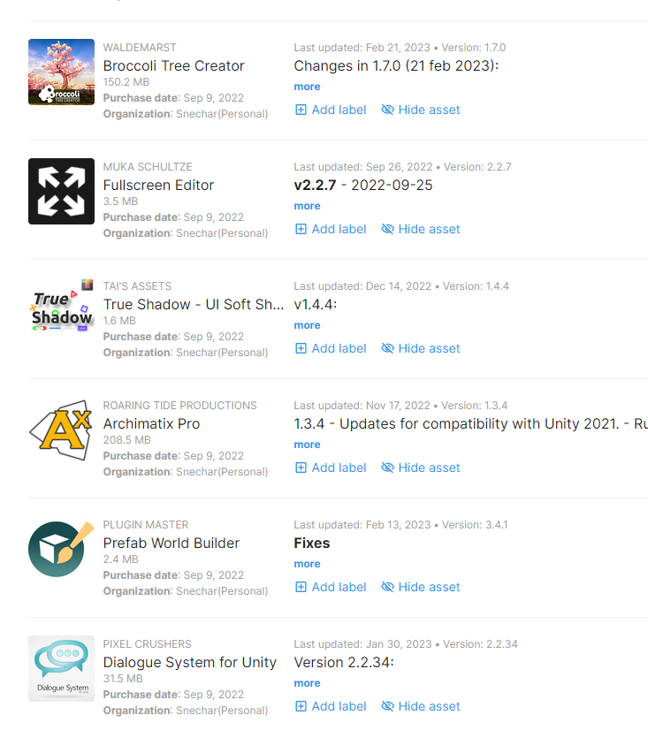
(already owned) Assets and a bit of research
Started researching about assets/packages that can help make the development faster/easier.
Prototyped multiple assets/packages, narrowed it down to a handful that can help me (not representative in the image)

Slide 5
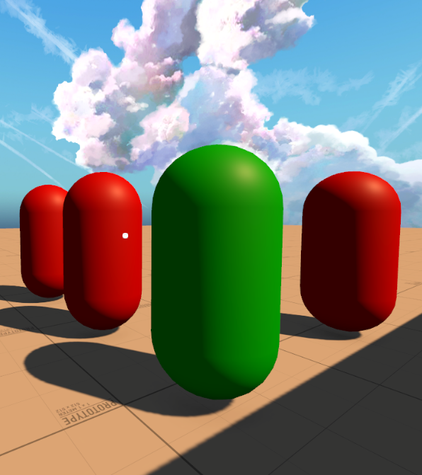
Development
Started working on AI
Implemented assets/packages that will help with development

Slide 6
Demo

Slide 7

Questions?

