Slide 1
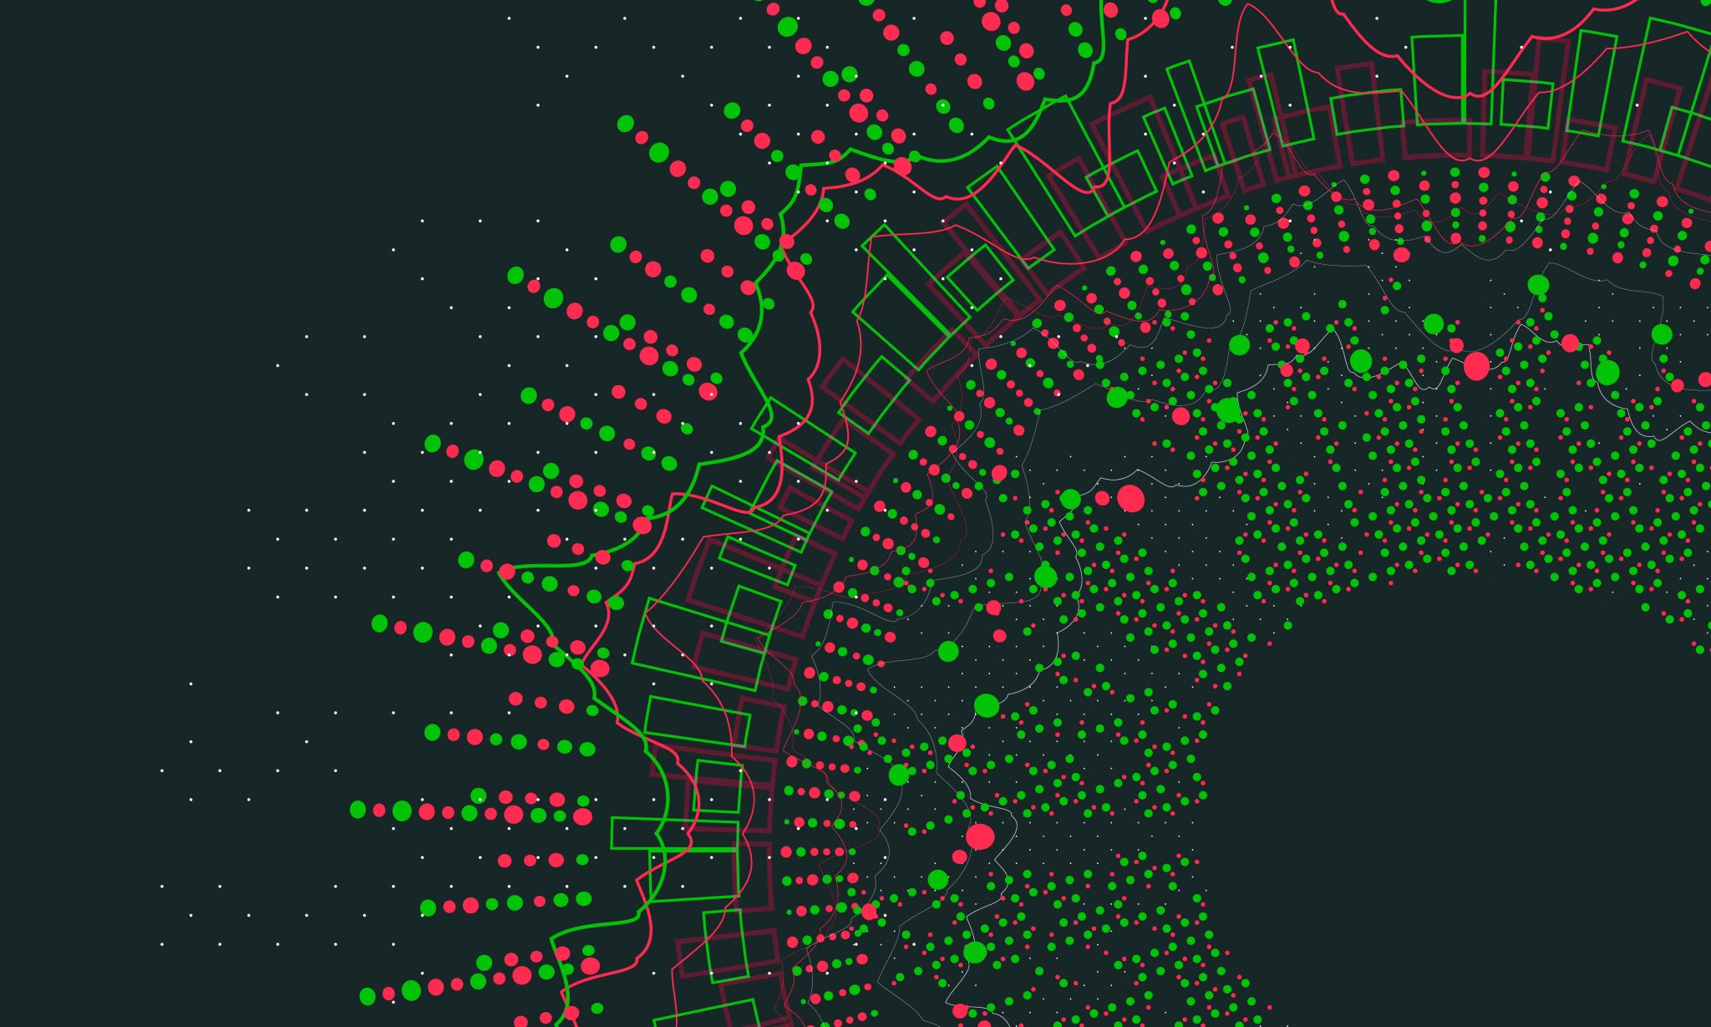
Caretaker Simulator
By Gabriel Mureseanu

Slide 2
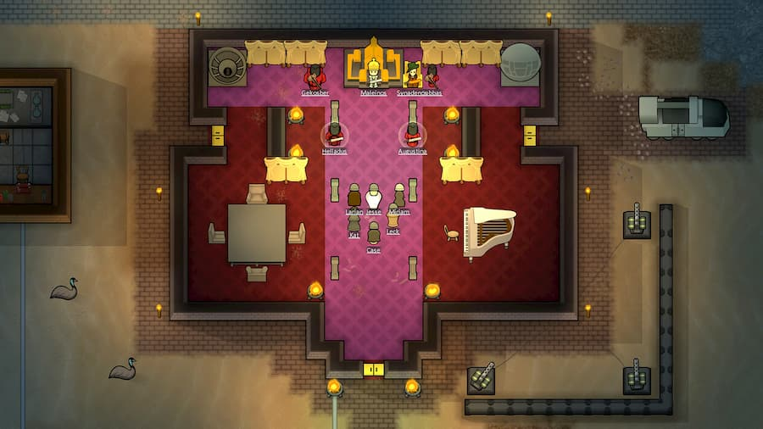

Project Pitch
A serious simulation game inspired by RimWorld/Dwarf Fortress in a First-Person perspective that will help teach Students of Health and Wellbeing (future caretakers) about using caretaker technology in a “normal day at the job” way.

Slide 3
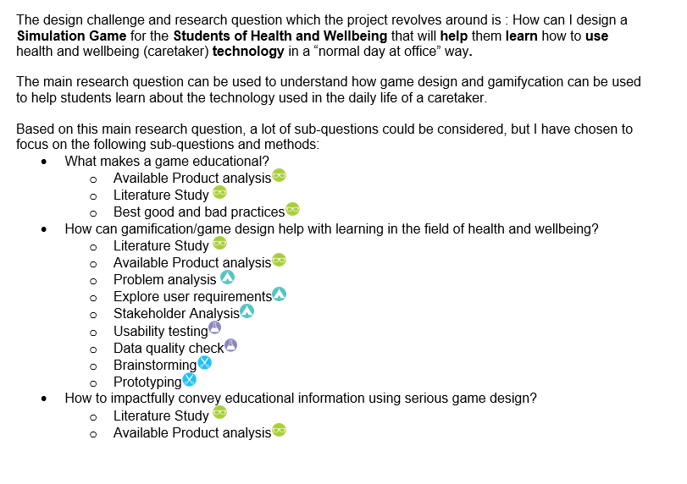
Project plan
Very good feedback.
Very close to completion.

Slide 4
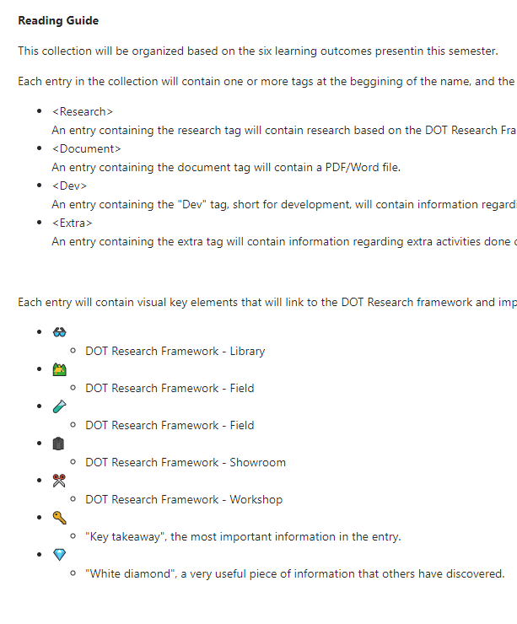
Portfolio
Reading guide complete.
Good feedback on organization.
Started working on first sub-question :”What makes a game educational?”.

Slide 5


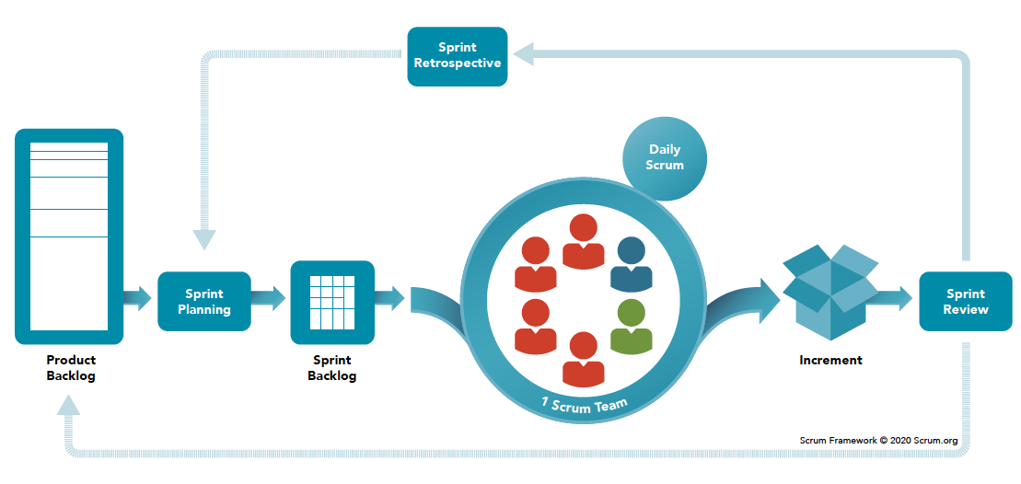
Pipeline
GitHub set up and running (already using)
Trello set up in SCRUM style.
Sprint definition complete.

Slide 6
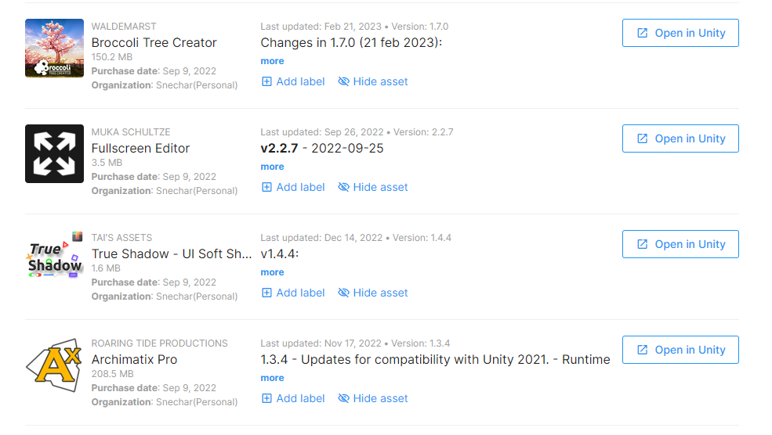
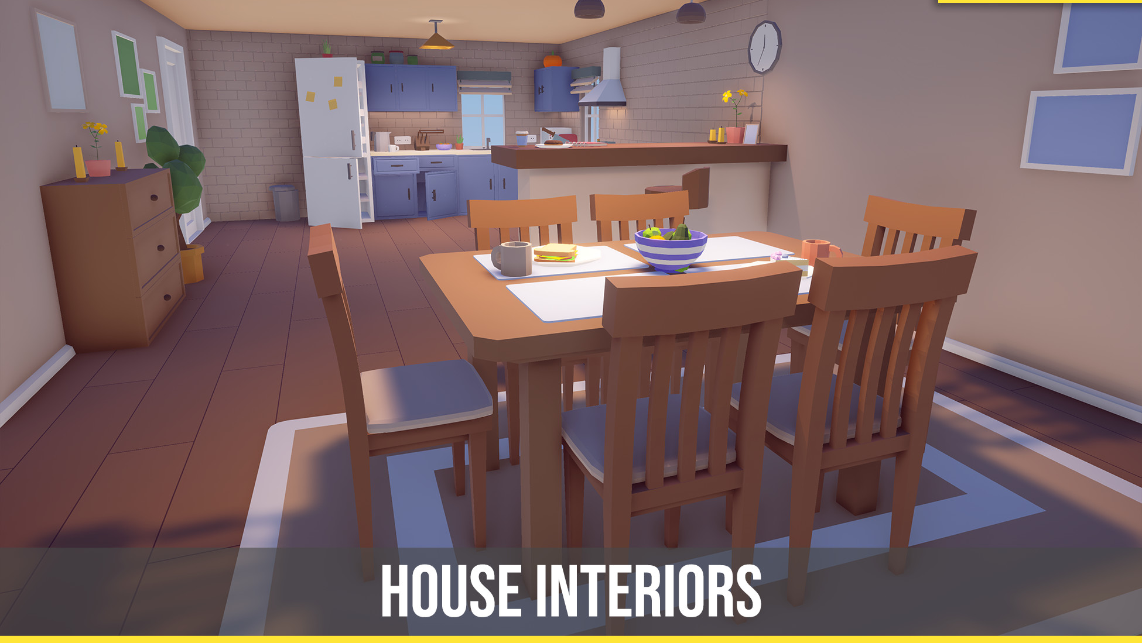
(already owned) Assets and a bit of research
Started researching about assets/packages that can help make the development faster/easier.
Prototyped multiple assets/packages, narrowed it down to a handful that can help me

Slide 7
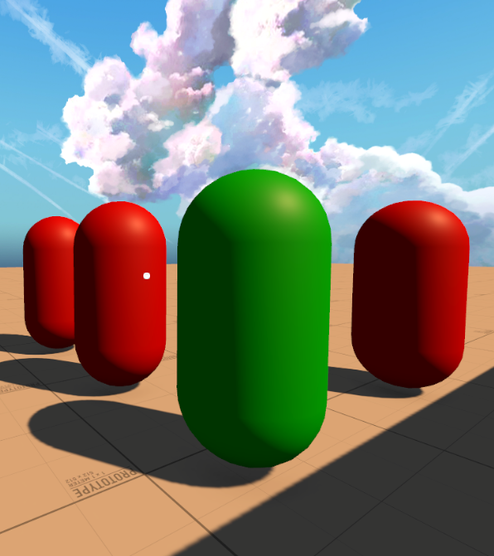
Development
Started working on AI
Implemented assets/packages that will help with development

Slide 8
Demo

Slide 9

Questions?

