Slide 1

NATS – Open-source messaging
Made By Gabriel Mureseanu

Slide 2
What is a messaging system?
Achieves the same results as a REST API, with a few extras.
The requests have a queue system, will be repeated if the message does not arrive.
Uses less threads than an API, therefore allowing microservices to run faster.
Less prone to failure.

Slide 3
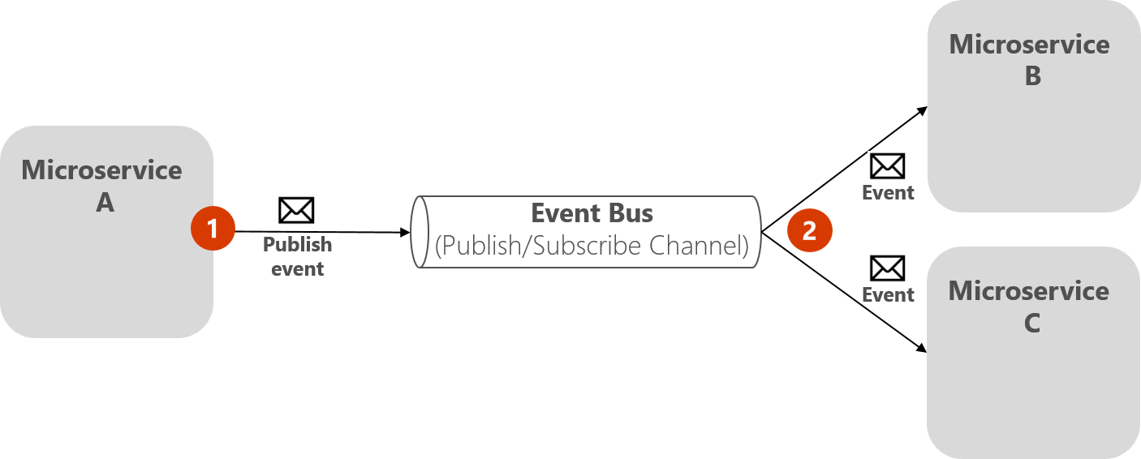
What is a messaging system used for?
Other than messaging, they are used for the following:
Messaging Bus
Event Bus

Slide 4
What confuses people
An Event Bus is a technology built upon a Messaging Bus.
A Messaging Bus takes a message from Component A to Component B
An Event Bus publishes the message on a channel, without knowing who will read them

Slide 5
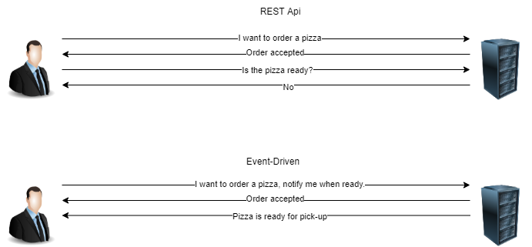
Differences between REST API and Event Bus

Slide 6

What does NATS do?
NATS is a server written in the GO programming language.
It’s main selling points are performance, scalability, and ease of use.
It consists of the server, client libraries and a connector framework.

Slide 7






Who uses NATS?

Slide 8

How to set up NATS Server
docker run -p 4444:4444 nats -p 4444

Slide 9

Demo
https://github.com/Snechar/NATSPresentation

Slide 10

Where to Find more information
Website
https://nats.io/
Documentation
https://docs.nats.io/
Official C# NATS github
https://github.com/nats-io/nats.net

Slide 11

Q&A

