Slide 1
Q
PULSE
Patient Urgency & Load Scheduling Engine · Quantum
Team - NEXUS (Team No. 14)
Members - Sriranjini | Anuraag
Real-time quantum-optimized triage for AQI-driven hospital surge emergencies
Addressing Problem Statement #18
Notes:
OPEN WITH ENERGY. Say the name clearly: 'We are PULSE-Q.' Pause. 'When Delhi's AQI hits 400 and 20 patients flood your emergency room in 30 minutes, a clipboard and gut feeling is not a triage system — it's a gamble. We built the alternative.' --- TIMING: 10 seconds. Do not explain the acronym yet. Just own the room and move.

Slide 2
Table of contents
Problem Statement
How we try to solve it?
Comparing with other routes
Current UI and functionality
Further Vision
Notes:
WHAT TO SAY: 'Picture Delhi in January. AQI 400. Your emergency room gets 20 patients in 30 minutes — all respiratory distress. What happens today? The nurse has a clipboard. She sorts by whoever grabbed her attention first. Two critical cases end up in general ward. An ICU nurse with eight years of experience is sent to someone with a mild cough. One ventilator goes to a stable patient. This is not a resource problem — it's an optimization problem.' --- Point at each stat card as you say it. Pause before the last line: 'That is the gap PULSE-Q fills.' TIMING: 25-30 seconds.

Slide 3
Problem Statement
Notes:
WHAT TO SAY: 'Picture Delhi in January. AQI 400. Your emergency room gets 20 patients in 30 minutes — all respiratory distress. What happens today? The nurse has a clipboard. She sorts by whoever grabbed her attention first. Two critical cases end up in general ward. An ICU nurse with eight years of experience is sent to someone with a mild cough. One ventilator goes to a stable patient. This is not a resource problem — it's an optimization problem.' --- Point at each stat card as you say it. Pause before the last line: 'That is the gap PULSE-Q fills.' TIMING: 25-30 seconds.

Slide 4
The System Fails During Surge
60%
+30%
2+hr
of Indian hospitals chronically understaffed during AQI surge
jump in respiratory admissions when AQI crosses 300 PM2.5
average ICU bed assignment delay under current manual triage
What hospitals do today:
A nurse ranks patients by gut feeling. Beds are assigned first-come-first-served. Staff is spread evenly across wards, regardless of who is critical. There is no system that simultaneously looks at a patient's SpO₂, blood pressure, the AQI outside, available ICU beds, and qualified nursing staff and produces an optimal allocation in real time. That is the gap PULSE-Q fills.
Notes:
WHAT TO SAY: 'Picture Delhi in January. AQI 400. Your emergency room gets 20 patients in 30 minutes — all respiratory distress. What happens today? The nurse has a clipboard. She sorts by whoever grabbed her attention first. Two critical cases end up in general ward. An ICU nurse with eight years of experience is sent to someone with a mild cough. One ventilator goes to a stable patient. This is not a resource problem — it's an optimization problem.' --- Point at each stat card as you say it. Pause before the last line: 'That is the gap PULSE-Q fills.' TIMING: 25-30 seconds.

Slide 5
PULSE-Q Solves It in 4 Stages
1
2
3
4
ENCRYPT
SCORE
OPTIMIZE
STAFF
Patient data secured with post-quantum cryptography
Quantum SVM rates each patient's urgency 0→1
QUBO assigns beds with a mathematical guarantee
Staff assigned based on acuity + skill (Phase 2)
→
→
→
Full pipeline runs in under 45 seconds on CPU (For hundred patients) · QPU-portable, same code, different sampler
Notes:
WHAT TO SAY: 'PULSE-Q has four stages. One — all patient data is encrypted with post-quantum cryptography. It's secure against classical and quantum attackers. Two — a Quantum SVM scores every patient's urgency. We'll explain how in a moment. Three — a QUBO optimizer assigns beds with a mathematical guarantee — no conflicts, ever. Four — in Phase 2, we extend the same framework to staff assignment. The whole thing runs in under 45 seconds. And the exact same code compiles to run on real quantum hardware.' --- TIMING: 25 seconds. High-level only — slides 4 and 5 have the depth.

Slide 6
How We Score Urgency –> The Quantum Kernel
The Intuition
The Equation
Classical ML compares patients on 8 features, one at a time. Our quantum kernel compares every pair of patients across 256 dimensions simultaneously. This catches the hidden link between AQI spikes and respiratory failure that linear models completely miss.
K(xᵢ, xⱼ) = |⟨Φ(xᵢ)|Φ(xⱼ)⟩|²
BP deviation
HR deviation
SpO₂ deficit
Respiratory rate
Temperature
GCS deficit
AQI PM2.5
Lactate
8 qubits → 2^8 = 256-dimensional comparison space
Notes:
WHAT TO SAY: 'The hardest part of triage is ranking patients when everything is wrong at once. A standard algorithm looks at blood pressure, then oxygen, then temperature — one by one. Our quantum kernel does something different. We take four patient features and encode each one into a qubit using a rotation gate. Now when we compare two patients, we're comparing them in a 16-dimensional space — simultaneously. The kernel value K-of-xi-xj is literally the probability of measuring the all-zero state after running the quantum circuit. That number tells us how similar two patients are. The output is a single urgency score between zero and one for every patient. That score is what feeds the optimizer.' --- If asked: 'Why not just use a classical RBF kernel?' Answer: 'RBF doesn't capture the correlated feature interactions between AQI and SpO2. Our kernel is specifically structured for the feature map of clinical + environmental data.' TIMING: 25 seconds. The analogy matters more than the equation.

Slide 7
How We Allocate Beds –> Optimization as Physics
The Concept
The Hamiltonian
We turn bed assignment into a physics energy problem. Every patient-bed combination has an 'energy cost'. The optimizer finds the arrangement with the lowest total energy, which means the right patients in the right beds, with no conflicts and no overflow.
H = −Σ urgency × resource utility + α × (uniqueness constant) + β × (respect capacity)
The issue We Found & Fixed:
Hardcoded α = 20 caused the optimizer to assign the same patient to both ICU and Ventilator simultaneously. We derived α analytically, it must be computed at runtime, not guessed. Today it's ≈ 161 in surge conditions. Double-assignment is now mathematically impossible.
Notes:
WHAT TO SAY: 'Once we have urgency scores, we solve the allocation as a physics problem. We write a function — called a Hamiltonian — where low energy means: critical patients in the best resources, every patient has exactly one bed, no ward is over capacity. We run Simulated Annealing to minimize that energy — it converges in under two seconds. --- Now here is where it gets interesting. When we first ran this system, there was a bug. The penalty term alpha was hardcoded at 20. The optimizer kept assigning the same patient to both ICU and the ventilator unit. Was the optimizer wrong? No. It found the actual lowest energy state — the formulation was wrong. We went back to the math and derived alpha from first principles. For surge conditions it comes out to around 161. With that value, double-assignment is not just unlikely — it is mathematically impossible.' --- That derivation is your strongest intellectual contribution. Pause on it. TIMING: 35 seconds. This is the densest slide — take your time.

Slide 8
Beds Are Half the Problem, Staff Is the Other Half
STAGE 1 - Already Built
STAGE 2 - Phase 2 Build
Staff → Patient
Patient → Bed
12 staff × 8 patients = 96 binary variables
8 patients × 3 resource types = 24 binary variables
→
ICU nurse / Vent specialist / General
ICU / Ventilator / General Ward
coupling constraint
Solved ✓
Solved ✓
Patient Manually
Solved ✓
The coupling rule:
If a patient lands in ICU (Stage 1), only ICU-qualified nurses can be assigned to them (Stage 2). The optimizer also weighs staff fatigue, a nurse at hour 7 of 8 has a reduced effective skill weight.
Notes:
WHAT TO SAY: 'A bed without the right nurse is useless. Stage 1 — which works today — assigns patients to beds. Stage 2, which we build in Phase 2, assigns staff to patients. But here's the critical constraint: the two stages are coupled. If a patient is assigned to ICU in Stage 1, only ICU-qualified nurses can be assigned to them in Stage 2. A general nurse floating to the ICU is penalized heavily in the optimizer. We go from 24 variables in Stage 1 to 96 in Stage 2. That fourfold increase in problem size is actually why quantum matters more at scale — classical solvers degrade badly as variable count grows. We also model nurse fatigue: a nurse seven hours into an eight-hour shift has a lower effective weight. No clipboard system accounts for any of this.' TIMING: 25 seconds.

Slide 9
Four Things No One Else Can Claim
Mathematical Guarantee
AQI-Coupled Triage
QPU-Portable
India-First
Dynamic α ≈ 161, derived at runtime. No double-assignment, proven, not tuned.
Environmental PM2.5 wired into urgency. AQI spike = automatic surge reallocation.
Same QUBO compiles to IBM / D-Wave / IonQ. Swap the sampler. No code changes.
NAQI tiers + Ayushman Bharat categories. National Quantum Mission grant-eligible.
Notes:
WHAT TO SAY: Four differentiators — one sentence each, move fast. 'First: mathematical guarantee. Alpha is computed, not guessed. Double-assignment is impossible by proof. Second: AQI coupling. When the air quality crashes, our urgency scores update automatically. No other triage system does this. Third: QPU portable. This is not a simulator project. The same code that runs on your laptop compiles to real quantum hardware. Fourth: India-first. We designed for Delhi surge reality, NAQI air quality tiers, and Ayushman Bharat categories. The National Quantum Mission has six thousand crore rupees looking for exactly this kind of applied quantum use case.' TIMING: 20 seconds. One breath per point.

Slide 10
Comparing different routes
Criterion | Manual | Greedy | Random Forest | Neural Net | ILP/Gurobi | QSVM + QUBO
Speed | 1 min/patient | Instant | Instant | Instant | Minutes–hours | Seconds (sim) / µs (QPU)
Features used | 2–3 | 2 | 8 | 8+ | 8 | 8 (Hilbert space)
Global optimization | No | No | No | No | Yes | Yes
Staff assignment | Manual | No | No | No | Possible | Yes (Stage 2 QUBO)
Needs training data | No | No | Yes | Yes (lots) | No | No
Explainability | High | High | Medium | Low | High | High (QUBO terms)
Scales to 1000 patients | No | Yes | Yes | Yes | No (NP-hard) | Yes (QPU)
Qualification constraints | Human memory | No | No | No | Yes | Yes (γ penalty)
Hardware ready today | Yes | Yes | Yes | Yes | Yes | Sim only (QPU soon)
Quantum advantage | None | None | None | None | None | Kernel + tunneling
Notes:
WHAT TO SAY: Four differentiators — one sentence each, move fast. 'First: mathematical guarantee. Alpha is computed, not guessed. Double-assignment is impossible by proof. Second: AQI coupling. When the air quality crashes, our urgency scores update automatically. No other triage system does this. Third: QPU portable. This is not a simulator project. The same code that runs on your laptop compiles to real quantum hardware. Fourth: India-first. We designed for Delhi surge reality, NAQI air quality tiers, and Ayushman Bharat categories. The National Quantum Mission has six thousand crore rupees looking for exactly this kind of applied quantum use case.' TIMING: 20 seconds. One breath per point.

Slide 11
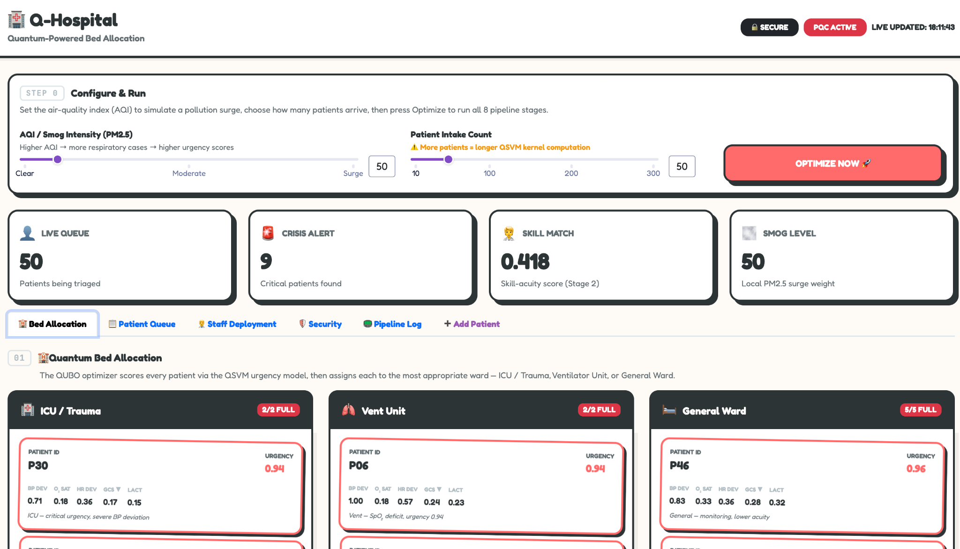
Current UI and functionality
Notes:
WHAT TO SAY: Four differentiators — one sentence each, move fast. 'First: mathematical guarantee. Alpha is computed, not guessed. Double-assignment is impossible by proof. Second: AQI coupling. When the air quality crashes, our urgency scores update automatically. No other triage system does this. Third: QPU portable. This is not a simulator project. The same code that runs on your laptop compiles to real quantum hardware. Fourth: India-first. We designed for Delhi surge reality, NAQI air quality tiers, and Ayushman Bharat categories. The National Quantum Mission has six thousand crore rupees looking for exactly this kind of applied quantum use case.' TIMING: 20 seconds. One breath per point.

Slide 12
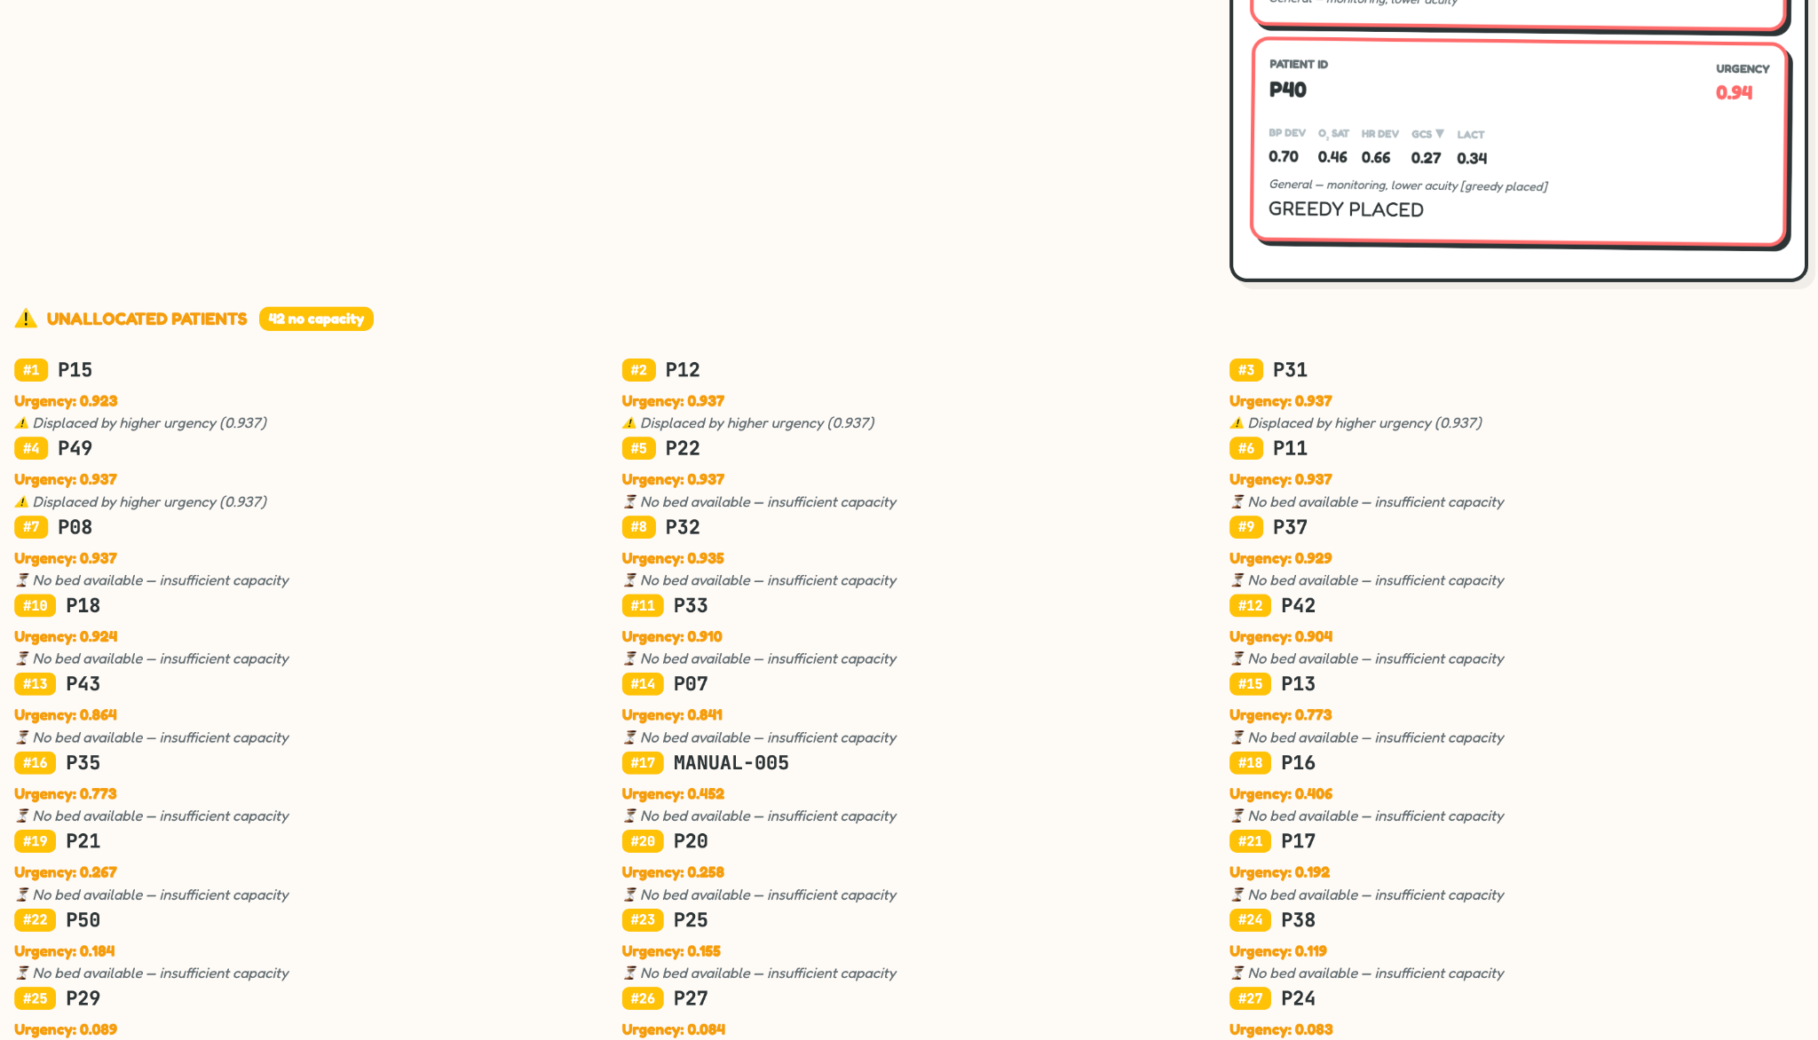
Current UI and functionality
Notes:
WHAT TO SAY: Four differentiators — one sentence each, move fast. 'First: mathematical guarantee. Alpha is computed, not guessed. Double-assignment is impossible by proof. Second: AQI coupling. When the air quality crashes, our urgency scores update automatically. No other triage system does this. Third: QPU portable. This is not a simulator project. The same code that runs on your laptop compiles to real quantum hardware. Fourth: India-first. We designed for Delhi surge reality, NAQI air quality tiers, and Ayushman Bharat categories. The National Quantum Mission has six thousand crore rupees looking for exactly this kind of applied quantum use case.' TIMING: 20 seconds. One breath per point.

Slide 13
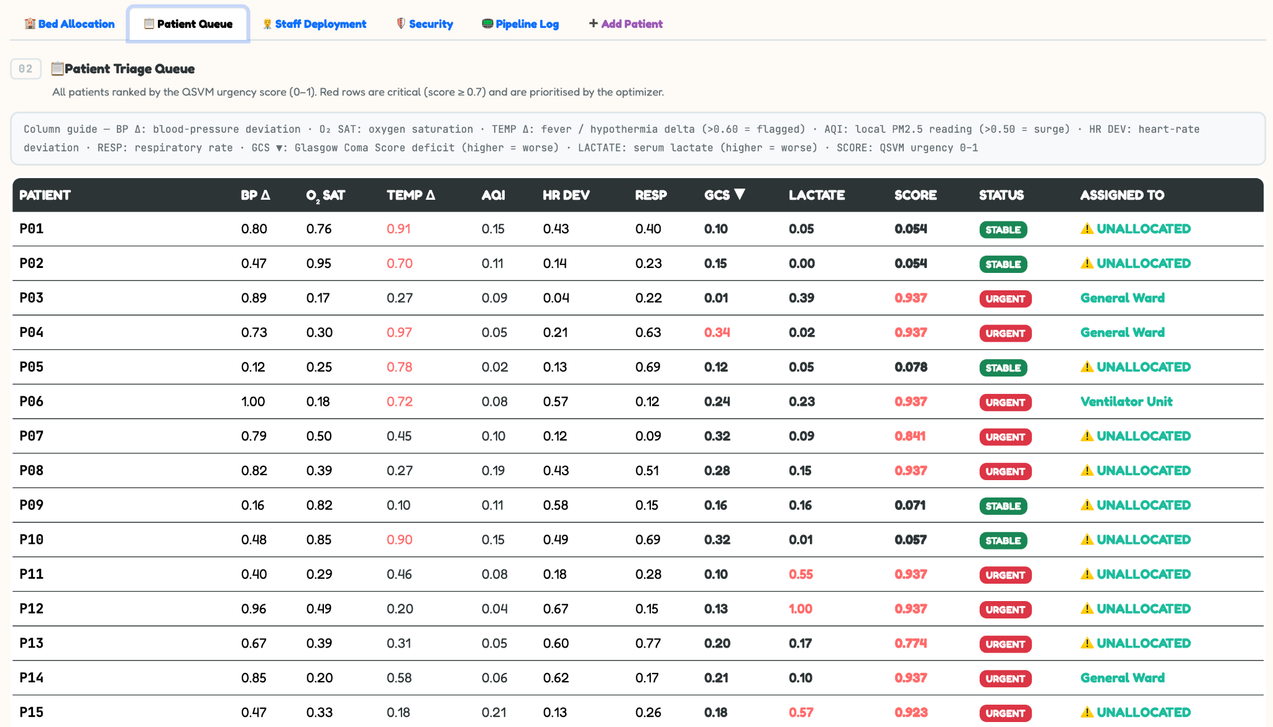
Current UI and functionality
Notes:
WHAT TO SAY: Four differentiators — one sentence each, move fast. 'First: mathematical guarantee. Alpha is computed, not guessed. Double-assignment is impossible by proof. Second: AQI coupling. When the air quality crashes, our urgency scores update automatically. No other triage system does this. Third: QPU portable. This is not a simulator project. The same code that runs on your laptop compiles to real quantum hardware. Fourth: India-first. We designed for Delhi surge reality, NAQI air quality tiers, and Ayushman Bharat categories. The National Quantum Mission has six thousand crore rupees looking for exactly this kind of applied quantum use case.' TIMING: 20 seconds. One breath per point.

Slide 14
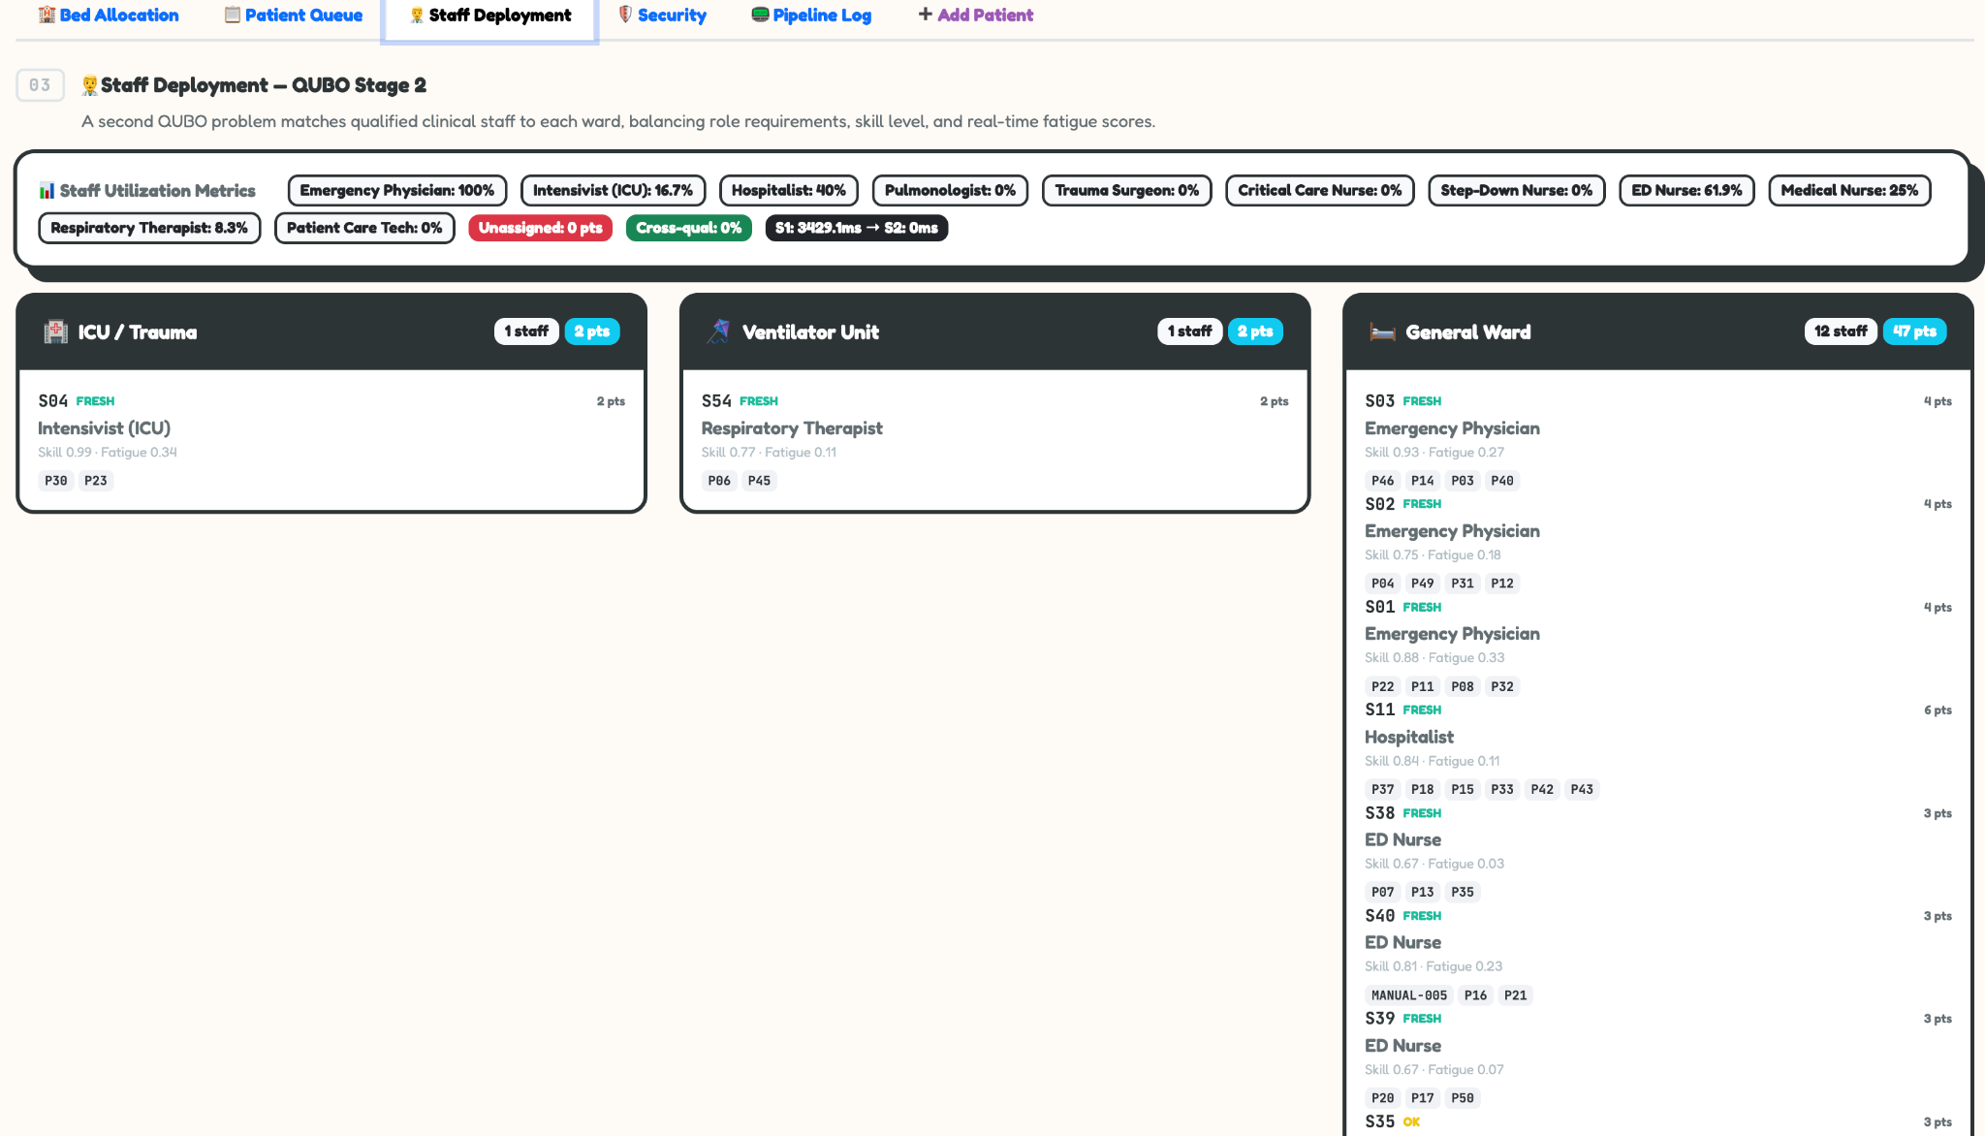
Current UI and functionality
Notes:
WHAT TO SAY: Four differentiators — one sentence each, move fast. 'First: mathematical guarantee. Alpha is computed, not guessed. Double-assignment is impossible by proof. Second: AQI coupling. When the air quality crashes, our urgency scores update automatically. No other triage system does this. Third: QPU portable. This is not a simulator project. The same code that runs on your laptop compiles to real quantum hardware. Fourth: India-first. We designed for Delhi surge reality, NAQI air quality tiers, and Ayushman Bharat categories. The National Quantum Mission has six thousand crore rupees looking for exactly this kind of applied quantum use case.' TIMING: 20 seconds. One breath per point.

Slide 15
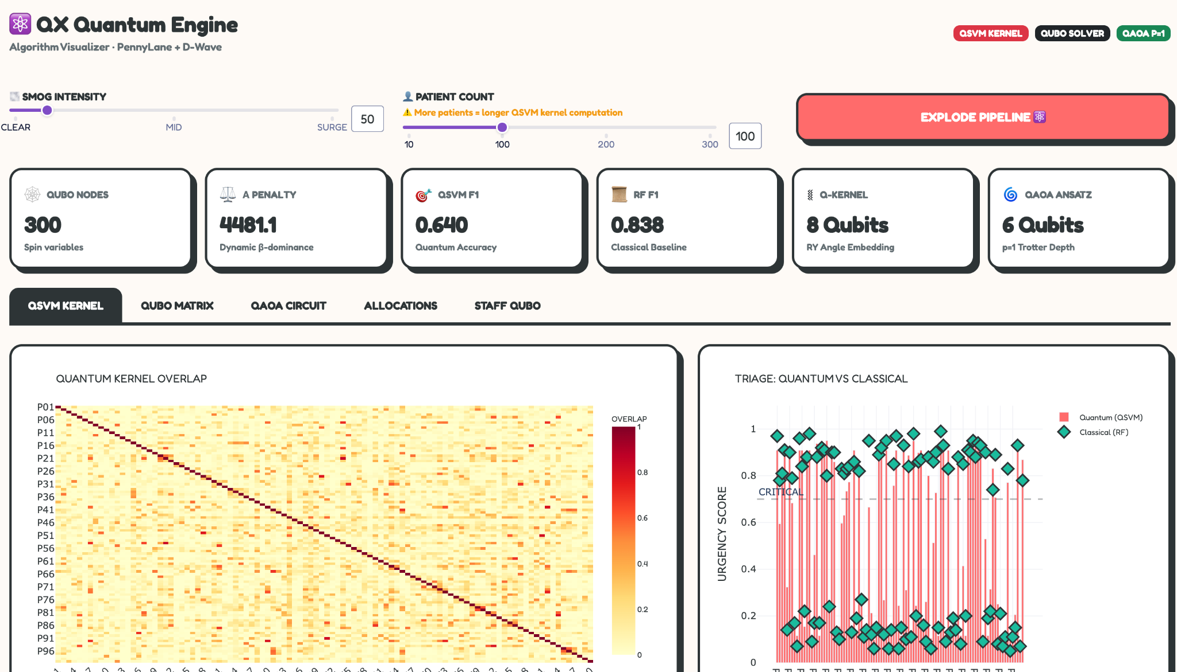
Current UI and functionality
Notes:
WHAT TO SAY: Four differentiators — one sentence each, move fast. 'First: mathematical guarantee. Alpha is computed, not guessed. Double-assignment is impossible by proof. Second: AQI coupling. When the air quality crashes, our urgency scores update automatically. No other triage system does this. Third: QPU portable. This is not a simulator project. The same code that runs on your laptop compiles to real quantum hardware. Fourth: India-first. We designed for Delhi surge reality, NAQI air quality tiers, and Ayushman Bharat categories. The National Quantum Mission has six thousand crore rupees looking for exactly this kind of applied quantum use case.' TIMING: 20 seconds. One breath per point.

Slide 16
The Vision
Quantum-hybrid SaaS for hospital command centers. The problem is real. The system runs. The market is India.
Phase 2 Hackathon
Q3 2026 Pilot
Q1 2027 SaaS
2028+ QPU
Full prototype: staff QUBO + live dual dashboard
2 tier-2 hospitals, Delhi NCR, clinical validation
Hospital command center product, subscription model
IBM Eagle integration + NQM grant
Built:
Running code today, QSVM, QUBO optimizer, dual dashboard.
Honest:
No quantum speedup claims. Better approximation + QPU portability.
Novel:
Dynamic alpha derivation + two-stage staff QUBO: unpublished at this scale.
Notes:
WHAT TO SAY: 'Here's what we're asking you to believe today. First — this system is built. Not a concept, not a mockup. The QSVM runs. The QUBO optimizer runs. The dashboards are live. Second — we're not overclaiming. We know we can't prove quantum speedup on a simulator. We're claiming better optimization quality under surge conditions, and a system that's ready for real hardware the moment it's available. Third — the dynamic alpha derivation and the two-stage staff QUBO are genuinely novel. We haven't seen this combination at any hackathon. Give us Phase 2. We'll show you the full system.' --- CLOSE STRONG. Make eye contact. Stop exactly on time. TIMING: 15 seconds.

Slide 17
THANK YOU
Notes:
WHAT TO SAY: 'Here's what we're asking you to believe today. First — this system is built. Not a concept, not a mockup. The QSVM runs. The QUBO optimizer runs. The dashboards are live. Second — we're not overclaiming. We know we can't prove quantum speedup on a simulator. We're claiming better optimization quality under surge conditions, and a system that's ready for real hardware the moment it's available. Third — the dynamic alpha derivation and the two-stage staff QUBO are genuinely novel. We haven't seen this combination at any hackathon. Give us Phase 2. We'll show you the full system.' --- CLOSE STRONG. Make eye contact. Stop exactly on time. TIMING: 15 seconds.

