Slide 1

DocEasy
Appointments
Made easy
Batch 18

Slide 2

PROBLEM STATEMENT
Appointment to doctors are not
Done in an efficient manner
Currently there is no online platform to book a Doctors appointment
All appointments are made through phone call and in person which is difficult for people who travel far away and people with accessibility issues
People also are inaccessible to the appointment data like past appointments to the doctor

Slide 3

EXISTING ALTERNATIVES
Appointments in person
Appointments through phone

Slide 4

OBJECTIVE
To Create a Web Application for Easily Managing Doctors Appointments
The Application Provides Facility to :
To Create and manage appointments for doctor
To book and manage appointment for user

Slide 5
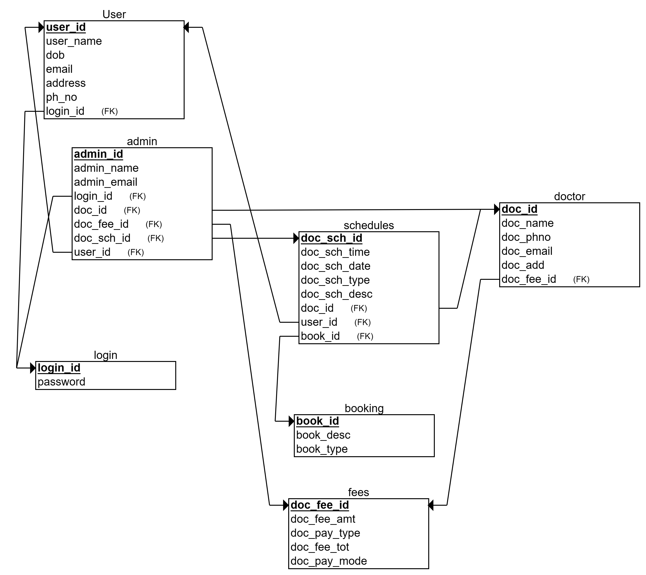
SCHEMA DIAGRAM

Slide 6
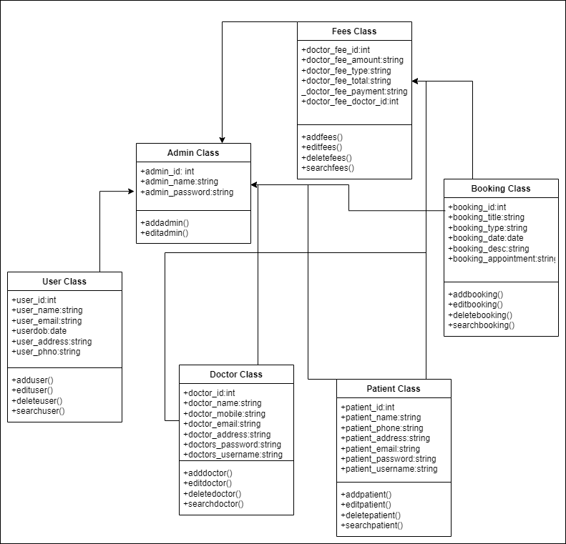
CLASS DIAGRAM

Slide 7

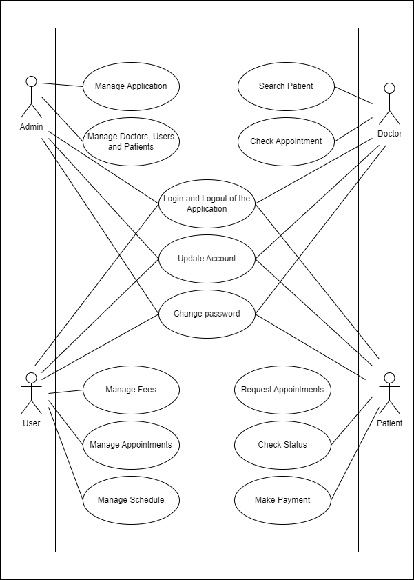
USE CASE DIAGRAM

Slide 8
TECHNOLOGY STACK
Frontend React.js
Backend Spring Boot
Database MySQL
ORM Mapping Hibernate

Slide 9

THANK YOU!
Snega M
Vimalan S
Yuvaraj D

