Slide 1

TEAM NAME: ResQharmony TEAM MEMBERS : SHANGARI C SREE SAHAANA N ROOPA SHREE S

Slide 2

Index
1
Problem Statement
2
Concept of the Solution
3
Novelty / Scope of Solution
4
Pros and Cons of the solution
5
Technical Description
6
Implementation Plan or Working Model (as the case may be)
7
Validation/Testing/Analysis
8
References

Slide 3
Problem Statement
In vehicular accidents, the timely detection and response to the deployment of airbags are critical for ensuring the safety and well-being of the occupants. However, conventional mechanisms for alerting emergency services and family members in the event of an accident may not always be efficient or reliable. There is a need for a proactive and automated system that can promptly notify relevant parties when an airbag deploys, along with the current location of the vehicle involved in the accident.

Slide 4
Concept of the solution
Introducing RES Q Harmony, our cutting-edge alert system utilizing SRS computing, EDR, and magnetic reed switches. Designed to enhance emergency response, it swiftly fetches real-time accident data and relays precise location information via GPS to nearby hospitals and police stations. This seamless integration ensures rapid and effective assistance, potentially saving lives. Stay ahead with RES Q Harmony, revolutionizing emergency alerts for a safer community.

Slide 5
Novelty / Scope of Solution
The novelty in this problem statement lies in its recognition and proposed solution for the deficiencies in current emergency response systems. It highlights the existing challenges, such as delayed assistance and ineffective communication, and introduces RES Q Harmony as an innovative approach. The integration of advanced technologies like SRS computing, EDR, and magnetic read switches sets this solution apart, offering a real-time and precise accident information system. This comprehensive and interconnected system aims to bridge the critical gap in timely response, revolutionizing emergency alerts and contributing to the creation of a safer and more responsive community. The novel aspect is the holistic and technologically advanced approach to emergency response.

Slide 6
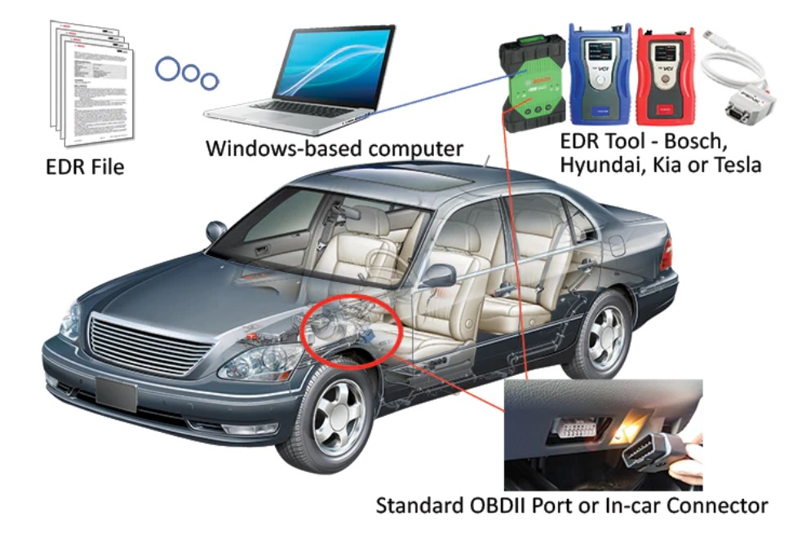

Slide 7
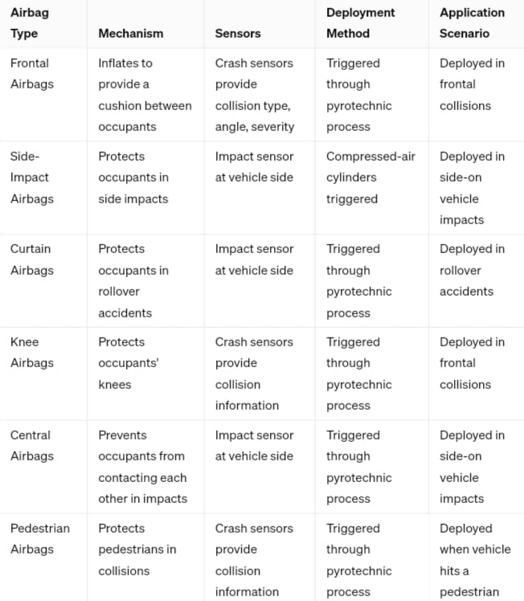

Slide 8


HARDWARE
RUIYI Magnetic Reed Switch
Set threshold value for a specific case depends on factors such as the
Size of the airbag compartment
the strength of the magnet
the sensitivity of the magnetic reed switch
Cost Estimate ₹ 205

Slide 9
Pros and Cons of the solution
Pros
Enhances automotive safety by providing timely emergency response.
Integrates advanced sensor technology for real-time monitoring.
Automates emergency calls to nearest hospitals, reducing response times.
Addresses critical gaps in emergency response systems.
Potentially saves lives in critical situations.
Revolutionizes vehicle safety standards.
Cons:
Reliance on sensor technology may lead to occasional false alarms
Requires regular maintenance and updates to ensure optimal performance.
Privacy concerns regarding the collection and transmission of real-time sensor data

Slide 10

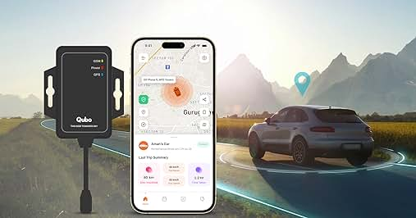



Technical Description
To obtain Live data of tilt angle values
GPS To send current location of user to the hospitals and to obtain information of nearest hospitals
Front-end

Slide 11
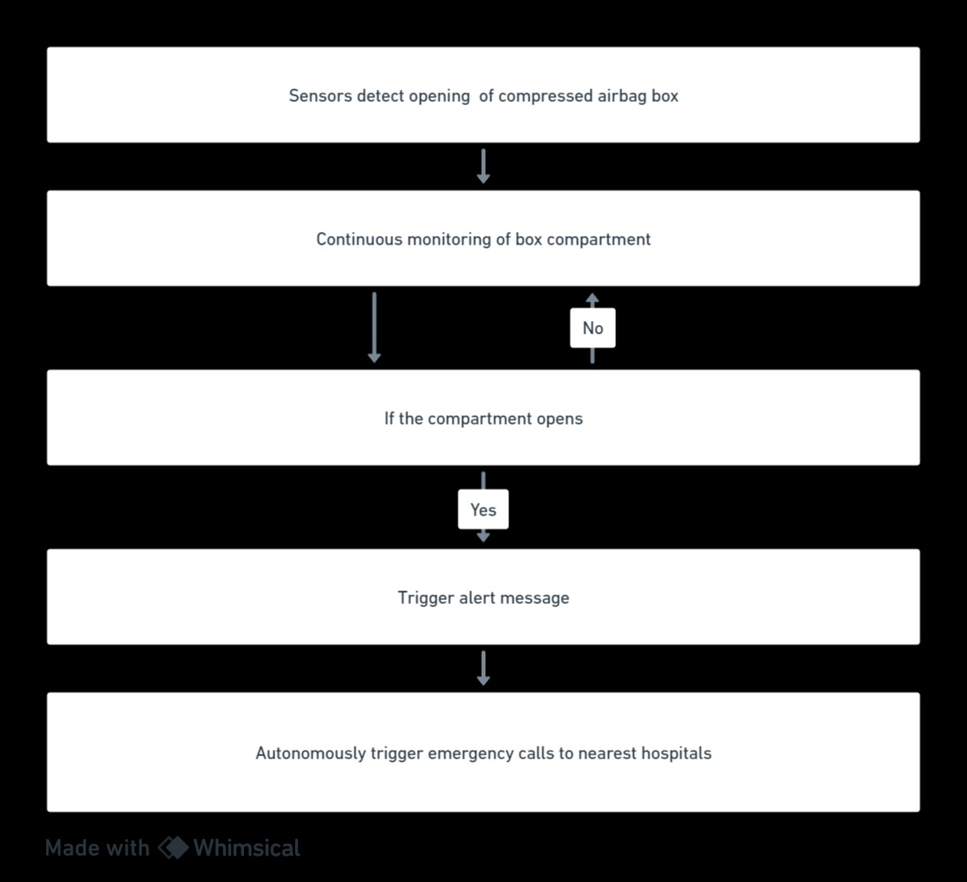
Block Diagram

Slide 12
Implementation Plan/Working Model
Project Scope and Objectives:
Define functionalities and goals for RES Q Harmony.
Collect stakeholder input for comprehensive coverage.
Integrate Components:
Develop interfaces for SRS computing, EDR, and magnetic read switches.
Ensure seamless communication and real-time data retrieval.
Incorporate GPS Technology:
Integrate GPS for accurate accident location tracking.
Develop mechanisms for data retrieval and transmission.
Build Data Fetching Mechanism:
Design robust mechanism for real-time accident data retrieval.
Optimize processes to reduce latency.
Design Alert Message Algorithm:
Develop algorithm for generating alert messages with key accident details.
Establish Communication Protocol:
Create secure and efficient communication protocol for relay of alert messages.
Ensure encrypted data transmission.

Slide 13
Implementation Plan/Working Model
Conduct Testing and Validation:
Perform comprehensive testing to validate system accuracy.
Test under various scenarios to identify issues.
Develop User-Friendly UI:
Design intuitive interface for emergency responders.
Prioritize ease of use in high-pressure situations.
Deployment in Targeted Locations:
Deploy RES Q Harmony in targeted locations.
Conduct thorough system checks post-deployment.
Provide Training and Documentation:
Develop user training materials.
Conduct training sessions and create documentation for ongoing support.
Establish Monitoring and Maintenance System:
Implement continuous monitoring to track system performance.
Regularly update and maintain the system.

Slide 14
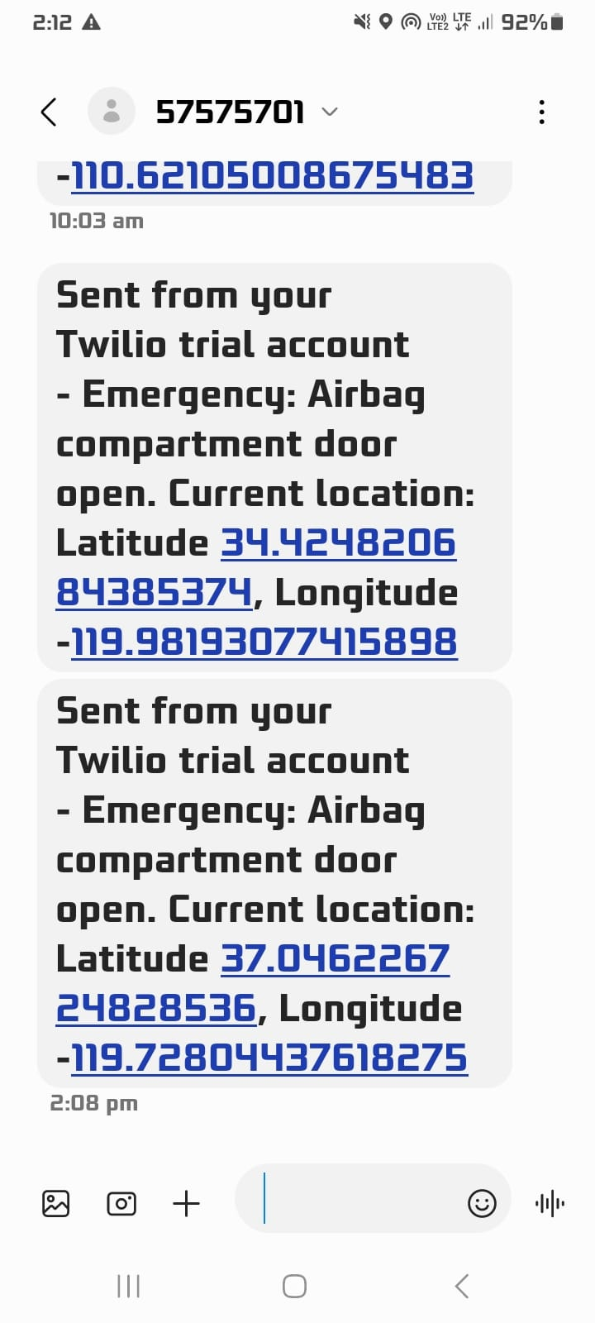

Slide 15
References
Advanced Sensor Technology in Vehicles:
J. G. Webster, "Medical Instrumentation: Application and Design," John Wiley & Sons, 2009.
Algorithm Development for Data Analysis:
Trevor Hastie, Robert Tibshirani, and Jerome Friedman, "The Elements of Statistical Learning," Springer, 2009.
Seamless Communication Protocols for Emergency Alerts:
Andreas Willig, "Wireless Communication Technologies: New Multimedia Systems," John Wiley & Sons, 2002.
Automotive Safety Technology:
Paul C. VanBuskirk, "Automotive Safety Handbook," SAE International, 2003.

Slide 16

THANK YOU

