Slide 1

DETECTING PNEUMONIA IN CHEST XRAYS USING CNN
GitHub: Sangavisambathkumar/Pneumonia-Detection (github.com)

Slide 2
I
Pneumonia is a common and potentially serious lung infection that can affect people of all ages. It occurs when the air sacs in the lungs become inflamed and filled with fluid or pus, leading to symptoms such as cough, fever, difficulty breathing, and chest pain. Pneumonia can be caused by various infectious agents, including bacteria, viruses, and fungi, with bacterial and viral pneumonia being the most prevalent types.
Early detection of pneumonia is paramount for effective treatment and improved patient outcomes. Here's why:
Prevention of Complications
Optimized Antibiotic Therapy
Reduced Hospitalization Rates
Improved Patient Outcomes
Prevention of Spread
NTRODUCTION

Slide 3

dataset
aggle
This dataset provides a valuable resource for researchers and medical professionals to develop and evaluate deep learning models for pneumonia detection using chest X-ray images.
Total Images: 5,875
Categories:
Normal Images: 1,585
Virus-Infected Pneumonia Images: 1,493
Bacteria-Infected Pneumonia Images: 2,780
The dataset is split into train and test subsets, with further subdivisions for validation during training.

Slide 4
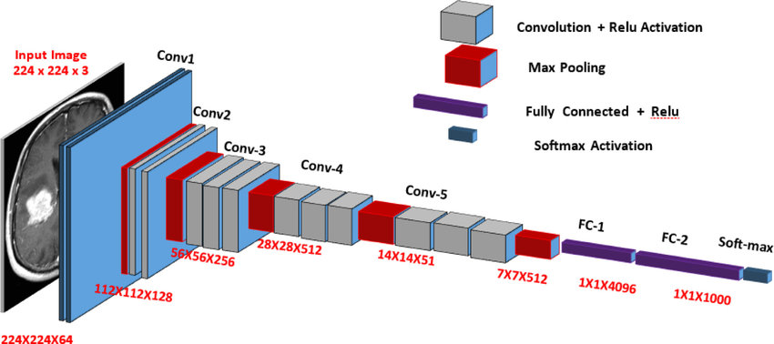
MODEL ARCHITECTURE & OVERVIEW
- VGG16
VGG16(Visual Geometry Group 16) is powerful convolutional neural network (CNN) designed for image classification tasks, classifying them into various categories.
VGG16 consists of 16 layers in total:
Convolutional Layers - 13, 3x3 filter size with a stride of 1 pixel.
Pooling Layers - 5 max-pooling, 2x2 max-pooling layers with a stride of 2.
Fully Connected Layers - 3 fully connected (dense) layers.

Slide 5
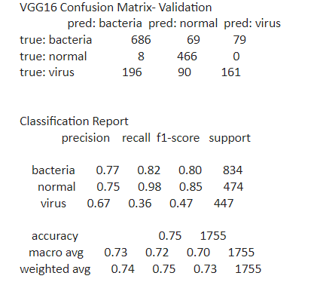
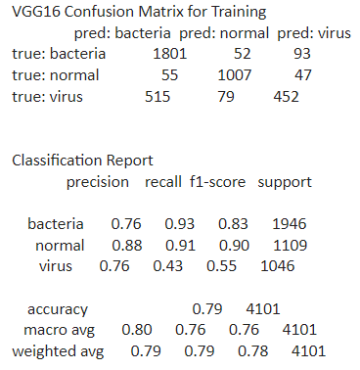
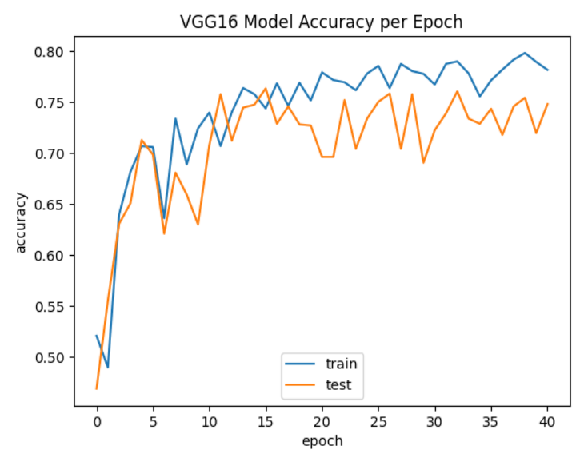
EVALUATION METRICS
Confusion Matrix Analysis
Model Accuracy
Validation
Training

Slide 6
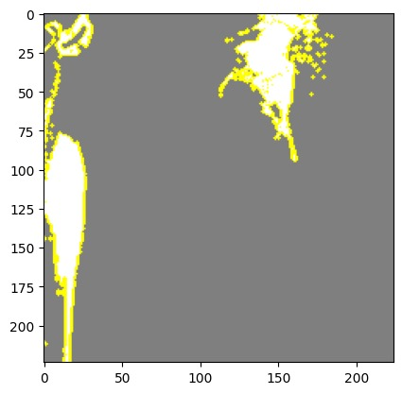
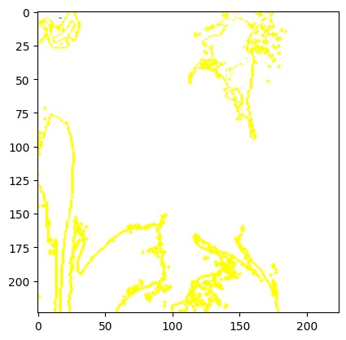
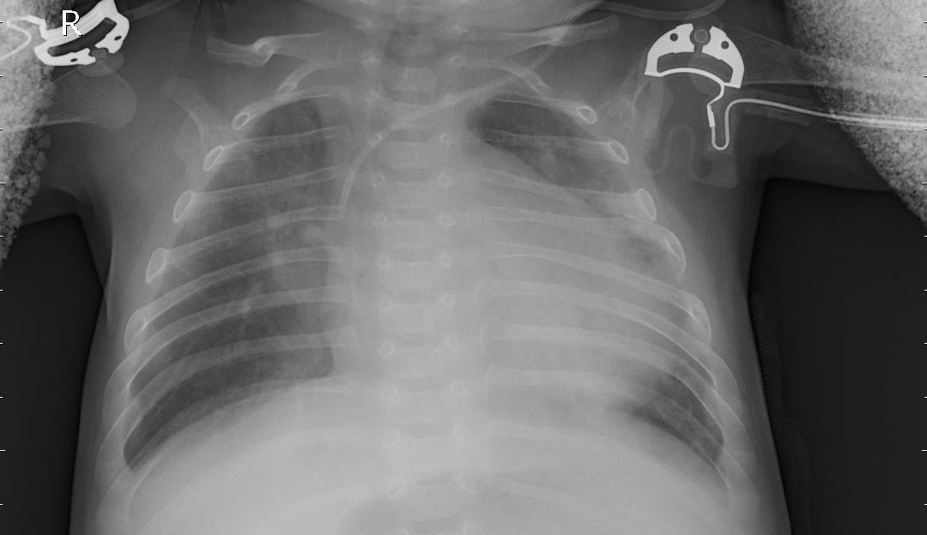
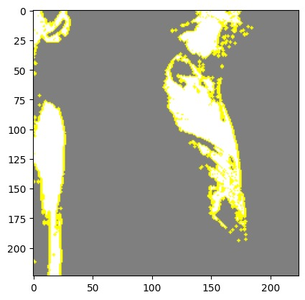
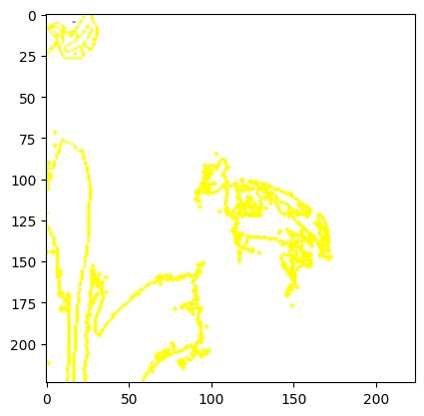
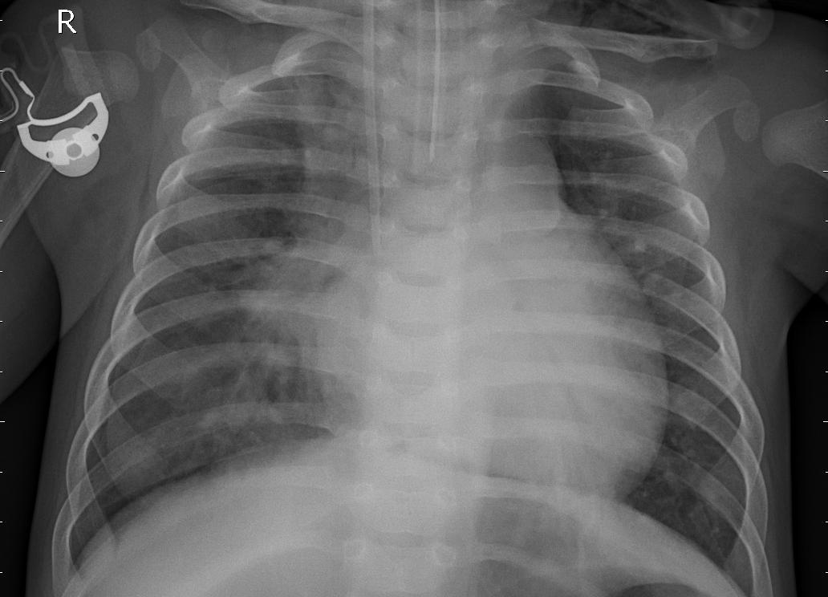
MODEL INTERPRETABILITY
LIME (LOCAL INTERPRETABLE MODEL-AGNOSTIC EXPLANATIONS)
Model interpretability in medical applications ensures trust, validation, and error detection, enabling transparent and informed decisions.
Following are the tuning visualization using LIME:
VIRAL
BACTERIAL

Slide 7

Utilizes the Dash framework to create web applications, enabling easy integration of data analysis and machine learning models.
Imports a pre-trained TensorFlow model (VGG16_model.h5) for pneumonia detection, likely trained on X-ray images, enabling real-time predictions.
The dashboard provides a user-friendly interface for uploading X-ray images, enabling users to drag, drop, or select files easily.
The application processes uploaded images in real-time, predicts using the model, and displays results alongside resized images for immediate user feedback.
Incorporates a utility function (resize_base64_image) to preprocess and resize uploaded images, ensuring compatibility with the model's input.
DASH – Python Framework for Web Application

Slide 8

WEB APPLICATION LINK: https://yokeshwar-p-d.hf.space/

Slide 9

SUBMITTED BY:
YOKESHWAR BOOPATHY
SNEGA MURUGAN
ANAND VINOY
ARAVINDSAMY
MUTHU LAXMAN
ABHEY GILL SINGH
SANGAVI SAMBATHKUMAR

