Slide 1
PSYCHOLOGICAL TRAUMA AND THEIR COGNITIVE EMOTIONAL REGULATION OF COLLEGE STUDENTS - A STATISTICAL PERSPECTIVE
Under the Guidance of Dr. A. Jabarali
Assistant Professor
Department of Statistics
Madras Christian College
Presented by Snega & Kezial Rajamani
M.Sc., Statistics
Department of Statistics
Madras Christian College
In collaboration with Mrs. Jemima Wesley Williams
Student Counselor
Madras Christian College

Slide 2
BACKGROUND OF THE STUDY
Many of the risk factors for mental health and behavioral problems begin during adolescence.
The onset of mental disorders typically occurs in childhood and adolescence, with 20% of the world's children and adolescents experiencing mental disorders, half of those beginning prior to age 14.
To be specific, substance abuse, conduct problems, and various mental disorders in adolescence are often triggered by psychological trauma, either by direct experience of a traumatic event such as interpersonal violence or through secondary traumatic stress that occurs when a close family member or friend has experienced a traumatic event.
The kind, number, and complexity of traumas experienced in early life have a differential impact on psychological and behavioral difficulties.
In addition, children exposed to trauma may continue to develop new symptoms over time as they encounter additional developmental or environmental challenges and stressors.
Yet, it is still unclear as to why some young adolescents exposed to trauma develop emotional and behavioral problems while others do not.

Slide 3
Importance of the study
This study was proposed is carried out in an effort to bridge the research gap between the adverse experiences that children encounter and the effects that these experiences have on their ability to cope with their emotions, which has a substantial influence on their cognitive wellbeing such as perception, attention, learning, memory, reasoning, and problem-solving, etc.

Slide 4
Objective
To assess the Adverse Childhood Experiences among college students.
To study the association between Adverse Childhood Experiences in terms of demographic characters
To study the significant difference between Adverse Childhood Experiences in terms of demographic characters
To assess the Cognitive and Emotional Regulation of college students.
To study the Cognitive Emotional Regulation among college students based on various demographic characters
To study the association between Cognitive Emotional Regulation and demographic characters
To study the significant difference between Cognitive Emotional Regulation and demographic characters
To assess the impact of Adverse Childhood Experiences on Cognitive Emotional Regulation
To study the association between Cognitive Emotional Regulation in terms of Adverse Childhood Experiences.
To study the significant difference between Cognitive Emotional Regulation in terms of Adverse Childhood Experiences.
To develop the dashboard for a better understanding of the mental health of college students based on Adverse Childhood Experiences in terms of Cognitive Emotional Regulation.

Slide 5
METHODOLOGY: Sample Design, Study Design & Tools for Data Collection
Descriptive and Diagnostic Research design to be used in this study to collect the primary data on college students who studying at Madras Christian College through a simple random sampling technique.
This study adopted the quantitative methodology to collect the data from primary sources through google forms (in both Tamil and English versions) along with participants’ consent to share their personal experiences about Adverse Childhood Experiences and Cognitive Emotional Regulation.
The minimum sample size of 276 is required for this study which was calculated under the prevalence of the study is 25%, 95% confidence interval for a single population proportion, and a 5% level of precision under the population size is 6837. (Cochran, 1997)
Basic Information about Respondents
Age, gender, class, name of the course, urbanity, annual income, family type, first graduate, current degree percentage, and whether respondents grownup with Parents.
The modified version of the Adverse Childhood Experiences questionnaire and Cognitive Emotional Regulation questionnaire, both of which are based on Standardized measures, were utilized as research tools.

Slide 6
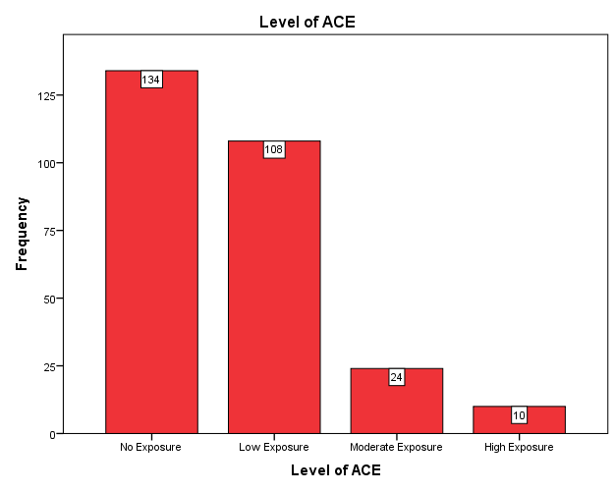
Results: Reliability & Validity, Frequency Measure
Variable | Reliability of the Scale | Inter-item Correlations |  | Validity of the Content
 |  | Min | Max | Kaiser-Meyer – Oklin (KMO) | Bartlett's Test for Sphericity | p-Value
Adverse Childhood Experience | 0.785 | 0.078 | 0.510 | 0.837 | 612.706 | 0.000
Cognitive Emotion Regulation | 0.920 | -0.021 | 0.709 | 0.893 | 3474.542 | 0.000
Overall | 0.912 | -0.133 | 0.709 | 0.868 | 4369.143 | 0.000

Slide 7
Results: Association between Adverse Childhood Experience with Demographic Characters
First Graduate in the Family is associated with the level of Adverse Childhood Experience(0.000<0.001) whereas the remaining demographic characters are not associated with a level of adverse childhood experience.

Slide 8
Results: Mean Comparison between Adverse Childhood Experience and Cognitive Emotional Regulation with Demographic Characters
Table: Test for Two Groups of Demographic Variables and Adverse Childhood Experience & Cognitive Emotion Regulation (5% Level of Significance)
It is found that there exists a significant difference between ACE and the students who are all under the category of First Graduate of the family.
Grouping Variable | Mann-Whitney Test - Asymptotic Significance
 | Adverse Childhood Experience | Cognitive Emotion Regulation
Gender | 0.752 | 0.251
Class | 0.343 | 0.759
Urbanity | 0.404 | 0.336
Growing Up with Parent | 0.424 | 0.463
First Graduate of the family | 0.021* | 0.773
Table: Test for More than Groups of Demographic Variables and Adverse Childhood Experience & Cognitive Emotion Regulation (5% Level of Significance)
Grouping Variable | Kruskal-Wallis Test - Asymptotic Significance
 | Adverse Childhood Experience | Cognitive Emotional Regulation
Annual Income to of the Family | 0.638 | 0.717
Family Type | 0.082 | 0.028*
College Grade | 0.231 | 0.309
It is found that there exists a significant difference between CER and the family type(Nuclear, Joint family or living alone) of the students.

Slide 9
Results: Relationship between Adverse Childhood Experience and Cognitive Emotional Regulation
Table: Correlation Co-efficient between Adverse Childhood Experience & Cognitive Emotion Regulation (5% Level of Significance)
 |  |  | ACE | CER
Spearman's rho | ACE | Correlation Coefficient | 1.000 | .240**
 |  | Sig. (2-tailed) | . | .000
 |  | N | 276 | 276
 | CER | Correlation Coefficient | .240** | 1.000
 |  | Sig. (2-tailed) | .000 | .
 |  | N | 276 | 276
**. Correlation is significant at the 0.01 level (2-tailed).
Adverse Childhood Experience & Cognitive Emotion Regulation are significantly correlated and Correlation Co-efficient between Adverse Childhood Experience & Cognitive Emotion Regulation is 0.240

Slide 10
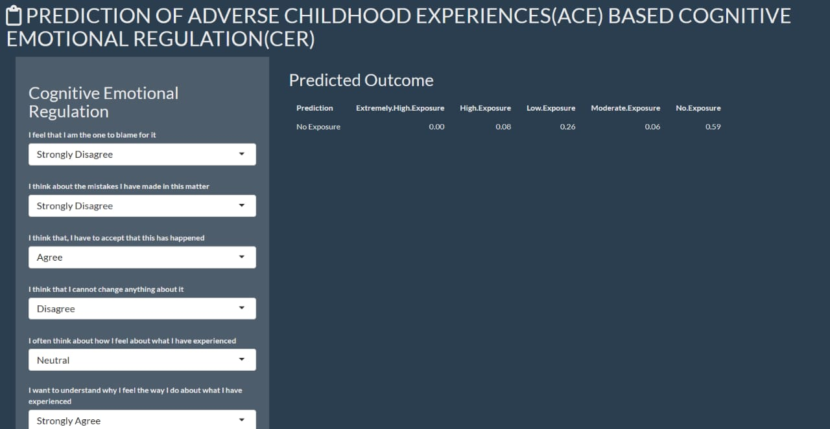
Results: Dashboard for Predict the Adverse Childhood Experience based on Cognitive Emotional Regulation
For the Dashboard creation, we have worked with one of the ensemble learning algorithms, Random Forest Classifier. Randomly selected subsets of our dataset are trained and their predictions were combined to get the final outcome. This classifier shows the highest accuracy of 68% when compared to other classifiers for our dataset.

Slide 11
Conclusion
➢ The level of exposure to ACE is related to the students from first
graduate and non-first graduate in their family and also, first
graduate and non-first graduate college students mean
a score of adverse childhood experiences is not the same.
➢ The Cognitive Emotional Regulation of college students is
depending on their family types (Nuclear/Joint Family/Living
Alone).
➢ The correlation co-efficient between ACE & CER is 24%.
➢ The dashboard has been constructed based on cognitive emotion
regulation of college students to predict the level of the
adverse childhood experience to reduce the impact of
psychological and behavioral difficulties of students in the early
stage of life.

Slide 12
Suggestions
Among 275 college students taken as a sample from the Madras Christian College, 10 students were under high exposure, and 24 students were found to have moderate exposure to adverse childhood experiences. i.e. , one-tenth of students have adverse childhood experiences at Madras Christian College. So, they have recommended college management offer the following:
With immediate effect as a short period solution, the identified students are advised to be offered trauma-informed psychotherapy from the College, with the consent of those students.
Awareness camps about the impact of childhood trauma could be conducted along with the faculty members and students of various departments of the college.
In the long run, Trauma-informed care modules for faculties and students need to be provided to improve their mental well-being from the college counselor.

