Slide 1



Laptop Price Analysis
Understanding Factors Affecting Laptop Prices Using Regression Models
By : Sneh Patel

Slide 2

CONTENTS
Problem Statement & Objective
Dataset Overview
Exploratory Data Analysis (EDA)
Key Observations from EDA
Feature Engineering & Preprocessing
Model Building
Model Comparison & Insights
Technology & Tools
Conclusion

Slide 3

Problem Statement & Objective
storage
internet
Goal: Analyze laptop specifications to identify price drivers.
Build predictive models to estimate laptop prices.
Use regression techniques to compare model performance.
remote
word
word
word

Slide 4

Dataset Overview
Rows: 975 | Features: 22
Target column: Price_euros (Laptop price in Euros)
Key features: Company, Product, Type, RAM, Inches, Weight, OS, Screen details, CPU/GPU, Storage.

Slide 5
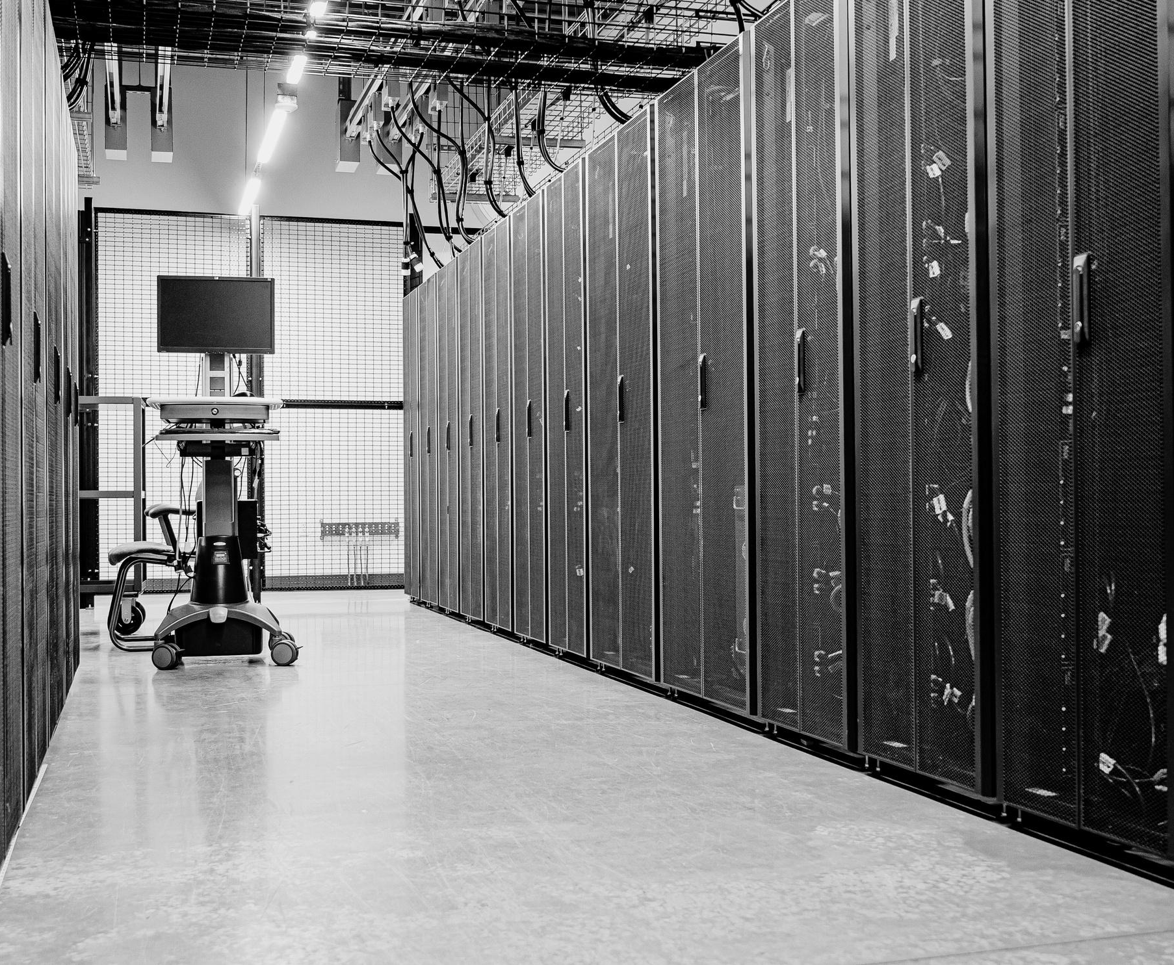
Exploratory Data Analysis (EDA)
Top 3 brands: HP, Dell, Lenovo
Most common OS: Windows 10
Most used CPU: Intel Core i7
Outliers handled using IQR
Visuals used: histograms, scatterplots, boxplots, heatmaps.

Slide 6

Key Observations from EDA
SSD and higher RAM strongly associated with higher prices.
Weight, screen size, and CPU frequency influence pricing.
Retina display has minimal effect.

Slide 7
Feature Engineering & Preprocessing
Label encoding for categorical features.
Missing values imputed using SimpleImputer
Feature scaling using StandardScaler.

Slide 8


Model Building
Linear Regression: R² ≈ 0.699, moderate accuracy.
Random Forest Regressor: R² ≈ 0.85, better accuracy and lower RMSE.
Feature importance: RAM > Weight > CPU frequency > Inches > Primary Storage.

Slide 9
Model Comparison & Insights
Random Forest clearly outperformed Linear Regression.
RAM was the most critical factor impacting price.
Screen type and GPU had lower importance compared to CPU and storage.

Slide 10

Technology & Tools
Python Libraries: Pandas, NumPy, Scikit-learn, Matplotlib, Plotly.
Environment: Jupyter Notebook.
Methods Used: Regression, Encoding, Scaling, Feature Importance.

Slide 11

Conclusion
Key takeaways:
RAM, CPU frequency, and storage are primary price drivers.
Models can predict laptop price ranges with reasonable accuracy.

