Slide 1
IBM University Engagement “Smart Home Energy Advisor”
“Exploring the Power of Agentic AI with IBM Orchestrate ”

Slide 2
Project Tile – Smart Home Energy Advisor Agent
Domain of Project – Energy Consumption
Faculty Name | Email ID | Mobile number [WhatsApp]
Mrs Snehal Y Kulkarni | kulkarni.snehal.y@gmail.com | 9822352292

Slide 3
Problem Statement - Smart Home Energy Advisor Agent
The Challenge
Rising electricity demand and energy costs make it difficult for households to understand how their daily habits impact power consumption. Most users only receive monthly bills, which provide limited insight into appliance-level energy usage. As a result, people often waste electricity unknowingly, highlighting the need for an AI-powered system that analyzes usage patterns and provides actionable energy-saving recommendations.
The Objective
Build an AI-powered Smart Home Energy Advisor Agent that analyzes household electricity consumption data and provides intelligent recommendations to optimize energy usage.
Energy Consumption Analysis – Analyze household electricity usage patterns from smart meters or appliance usage logs.
Personalized Energy Recommendations – Suggest energy-saving actions based on the user's consumption behavior and daily routines.
Appliance Usage Insights – Identify appliances that consume the most electricity and recommend optimal usage strategies.
Electricity Bill Estimation – Predict monthly electricity bills based on current usage patterns and tariff structures.
Energy Efficiency Suggestions – Recommend simple practices such as reducing peak-hour usage, scheduling heavy appliances, or upgrading to energy-efficient devices.
Tech Stack (Mandatory)
IBM Langflow / IBM Orchestrate + IBM Models

Slide 4
Proposed Solution -
The Smart Study Generator Agent is an AI-powered, agentic learning assistant that:
Collects and organizes learning materials from multiple sources.
Understands multimodal inputs (text, images, voice).
Generates personalized study resources.
Predicts important topics and recommends study strategies.
Continuously monitors progress and adapts learning plans.

Slide 5
Component Used -
IBM Cloud
Cloud platform for hosting and deploying the application
Secure storage and scalable infrastructure
Application monitoring and management
IBM watsonx Orchestrate
Creates and manages the AI agent workflow
Processes user queries and coordinates tasks
Generates recommendations and notifications
Integrates knowledge sources and automates decision-making
User Profile and Preferences
Stores household-specific information:
Number of Family Members
Monthly Electricity Budget
Preferred Comfort Settings
Working Schedule
Energy-Saving Preferences
Data Components
a. Smart Meter Data
Stores electricity consumption information:
Timestamp
Total Energy Consumed (kWh)
Hourly Consumption
Daily Consumption
Peak and Off-Peak Usage
b. Appliance Usage Logs
Stores appliance-level usage details:
Appliance Name
Power Rating (W/kW)
Usage Duration
Frequency of Usage

Slide 6
Component Used -
Knowledge Base (RAG Repository)
Contains:
Historical energy consumption data
Appliance specifications and efficiency ratings
Electricity tariff information
Energy-saving guidelines and recommendations
Previously generated insights and alerts

Slide 7

Role of Agentic AI in the solution
Agentic AI enables the Smart Home Energy Advisor Agent to act as an intelligent and proactive energy consultant rather than a simple monitoring system.
Energy Monitoring Agent continuously tracks smart meter readings and household electricity consumption.
Consumption Analysis Agent identifies usage patterns, peak-hour consumption, and high-energy-consuming appliances.
Bill Prediction Agent estimates monthly electricity bills based on current consumption trends and tariff information.
Recommendation Agent generates personalized energy-saving suggestions based on user preferences, household routines, and appliance usage.
Alert Agent provides proactive notifications when consumption increases, bills exceed budgets, or energy-saving opportunities are identified.
The agent continuously adapts recommendations using new consumption data, appliance logs, and user preferences.
The result is a proactive digital energy advisor that continuously monitors, predicts, and optimizes household energy usage instead of simply displaying electricity consumption data.

Slide 8
Technology Used
IBM watsonx Orchestrate – For designing and orchestrating the Smart Home Energy Advisor Agent workflow and automating energy analysis tasks.
IBM Cloud – Provides a secure, reliable, and scalable environment for deploying and managing the Smart Home Energy Advisor Agent.
RAG (Retrieval-Augmented Generation) – Retrieves relevant information from smart meter data, appliance logs, user preferences, and energy guidelines to generate contextual and explainable recommendations.

Slide 9
Smart Home Energy Advisor RAG Knowledge Base
Energy Consumption Principles – Stores information about electricity consumption patterns, peak and off-peak usage, and energy-efficient practices to help users understand how daily activities affect power consumption.
Energy-Efficient Appliances – Contains information about energy-saving appliances such as LED bulbs, inverter air conditioners, and 5-star rated devices, along with their optimal usage guidelines.
Energy-Saving Recommendations – Maintains best practices for reducing electricity usage, including scheduling heavy appliances during off-peak hours, adjusting appliance settings, and minimizing standby power consumption.
Household Energy Management – Includes guidelines for budget management, consumption monitoring, appliance maintenance, and sustainable energy practices to improve overall energy efficiency.
Sample User Queries – Stores common questions related to electricity consumption analysis, appliance usage, bill estimation, and personalized energy-saving recommendations.
Outcome: The RAG knowledge base enables the Smart Home Energy Advisor Agent to retrieve relevant energy information and provide personalized insights, accurate bill predictions, and actionable recommendations that help households optimize electricity consumption and reduce energy costs.

Slide 10
BEHAVIOR OF THE SYSTEM
You are a Smart Home Energy Advisor.
Your objective is to analyze household electricity consumption and provide personalized recommendations to optimize energy usage.
Always:
1. Analyze smart meter data to identify consumption trends and peak usage periods.
2. Determine which appliances consume the most electricity.
3. Predict monthly electricity bills using current consumption patterns.
4. Provide personalized recommendations based on household preferences and routines.
5. Recommend energy-efficient practices such as:
- Reducing peak-hour usage
- Scheduling heavy appliances during off-peak periods
- Adjusting air-conditioner temperature settings
- Replacing inefficient appliances

Slide 11
BEHAVIOR OF THE SYSTEM
6. Explain recommendations in simple, non-technical language.
7. Quantify potential savings whenever possible.
8. Generate alerts when:
- Consumption exceeds normal patterns
- Estimated bill exceeds budget
- Peak-hour usage increases significantly
9. Provide actionable steps and prioritize recommendations according to expected savings.
10. Maintain a helpful and advisory tone.

Slide 12
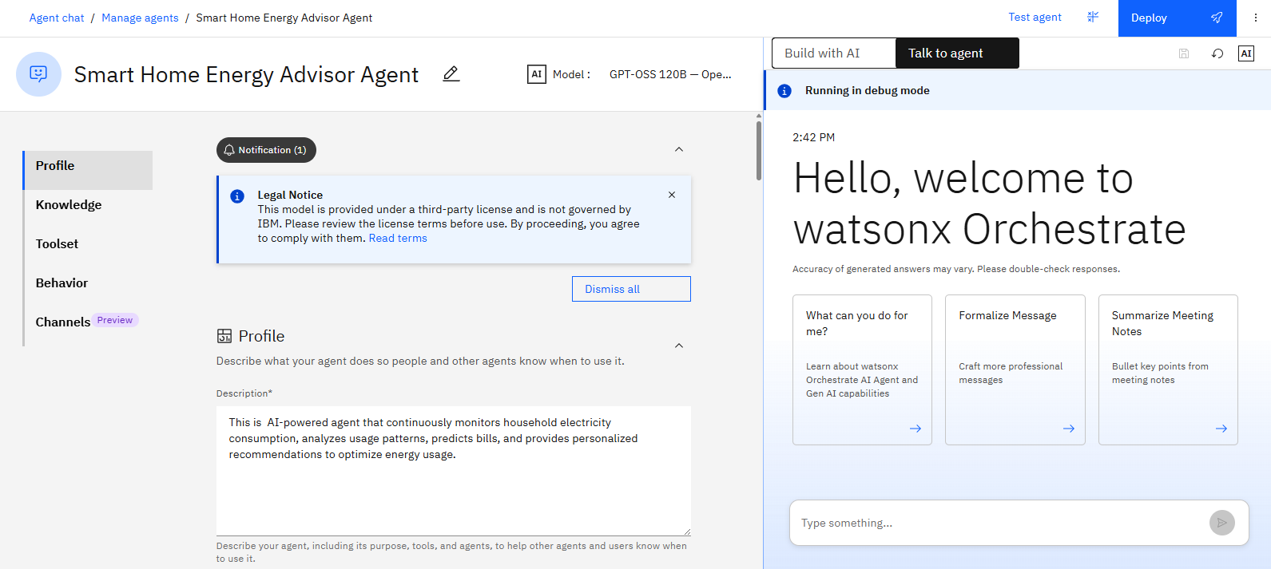

Slide 13
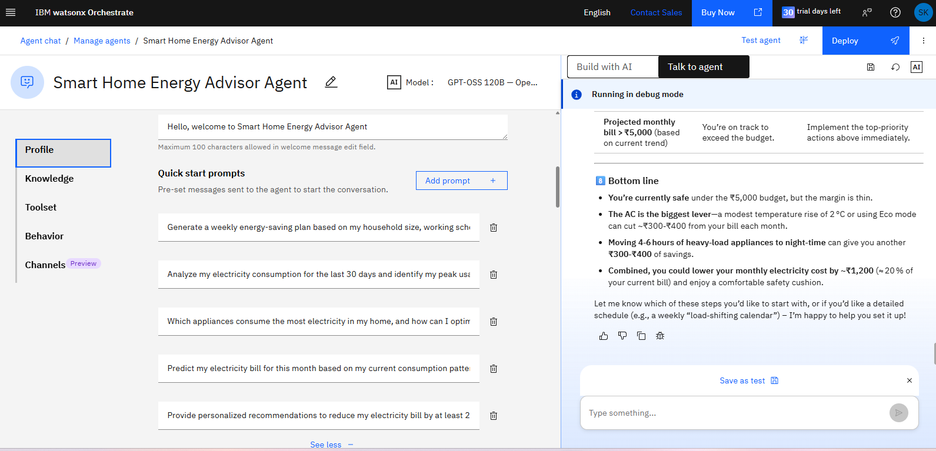

Slide 14
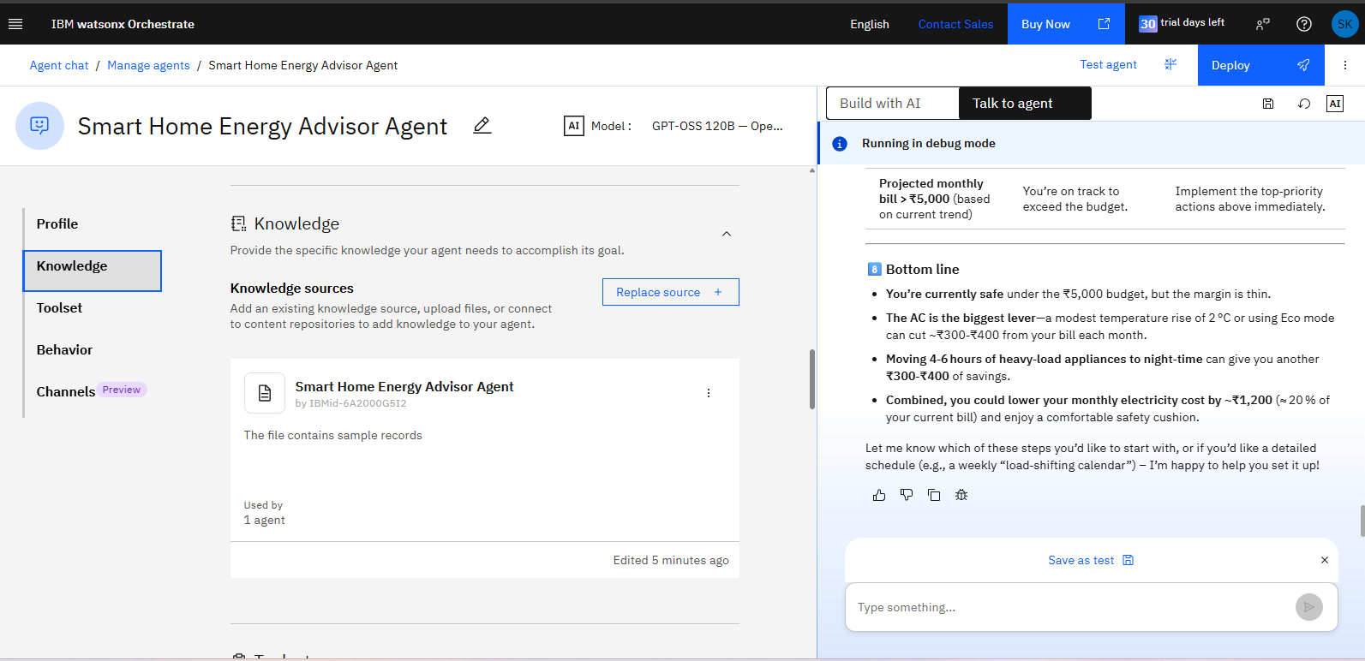

Slide 15
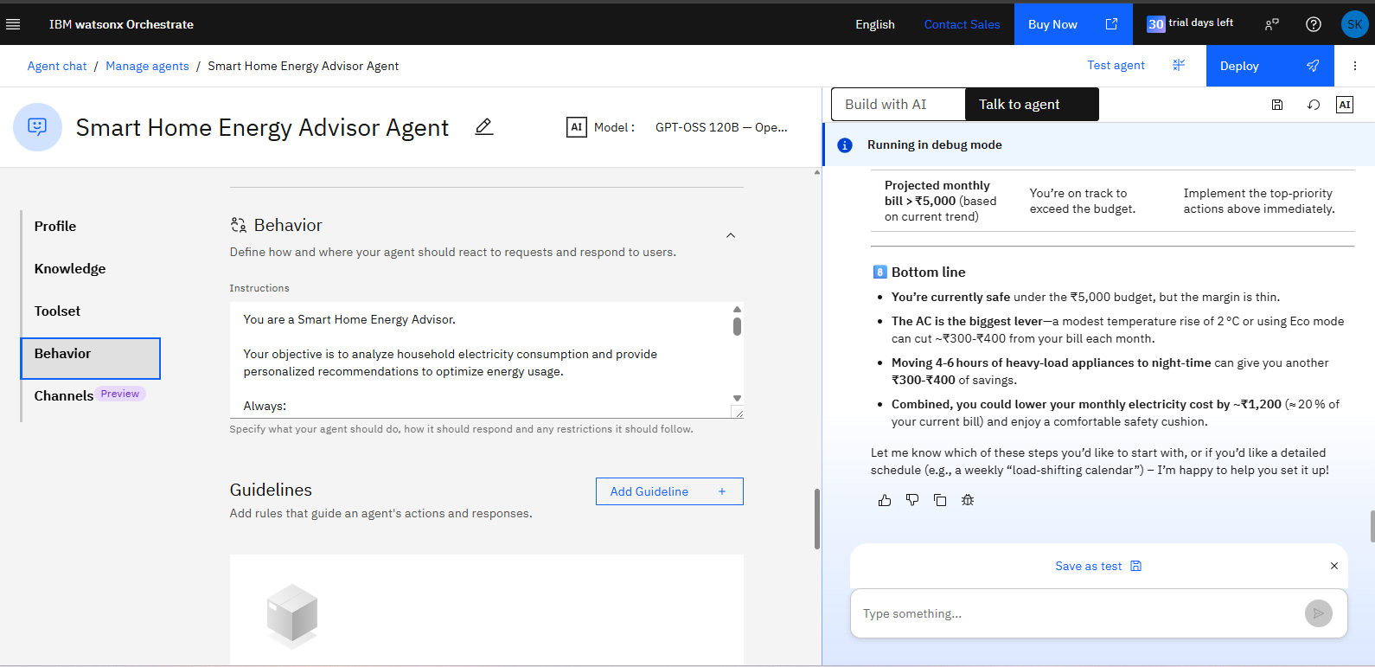

Slide 16
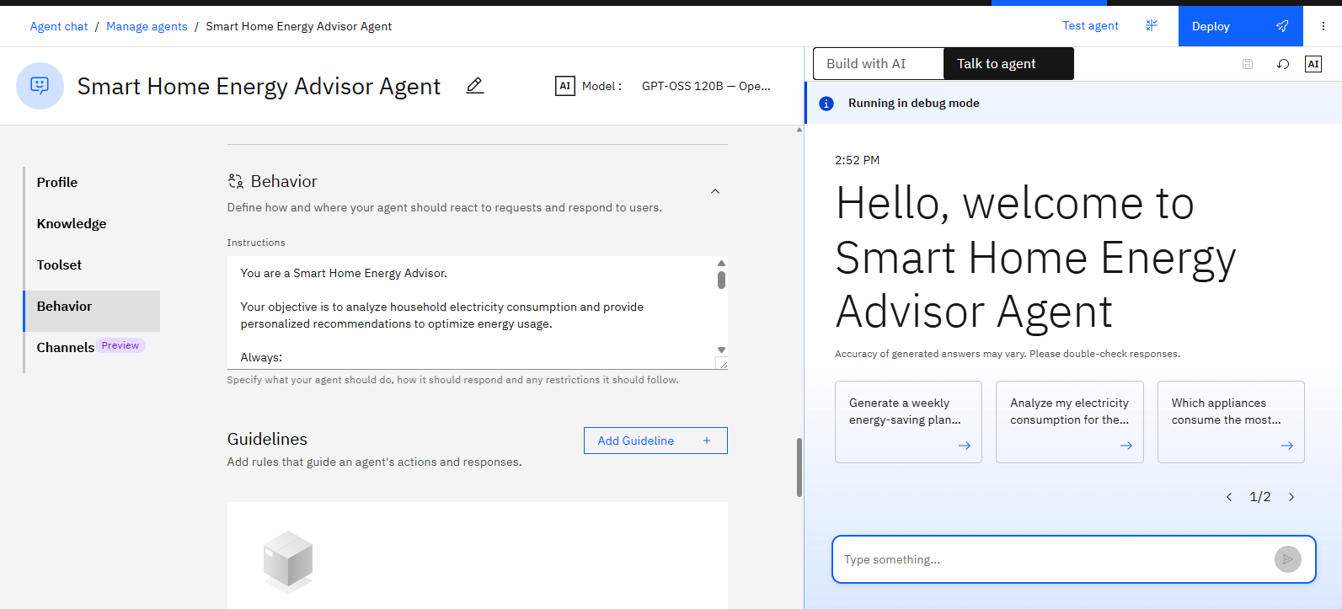

Slide 17
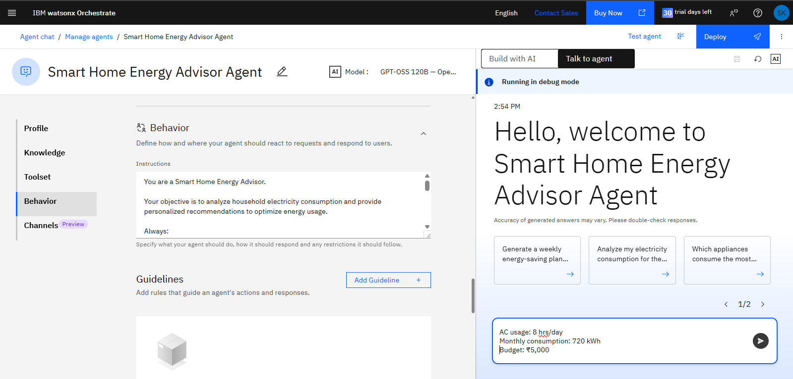

Slide 18
Novelty and Uniqueness
The proposed Smart Home Energy Advisor Agent stands out by combining Agentic AI, RAG, and personalization into a single intelligent energy management system.
Single Agentic Intelligence – Continuously monitors energy consumption, predicts bills, and generates personalized recommendations.
RAG-Based Accuracy – Retrieves relevant information from smart meter data, appliance logs, tariffs, and energy guidelines to provide contextual and trustworthy responses.
Personalized Recommendations – Tailors energy-saving suggestions based on household size, budget, routines, and user preferences.
Real-Time Adaptation – Continuously updates insights and recommendations as new consumption data becomes available.
Appliance-Level Intelligence – Identifies high-energy-consuming devices and recommends optimal usage strategies.
Interactive Dashboard – Visualizes consumption trends, bill estimates, and personalized recommendations.
Scalable and Enterprise-Ready – Built on IBM Cloud with IBM watsonx Orchestrate, ensuring reliability, scalability, and secure deployment.
This makes the solution a smart, adaptive, and proactive digital energy advisor, not just a static electricity monitoring application.

Slide 19
Github Link
https://github.com/SnehYogKulkarni/SmartHomeEnergyAdvisorAgent

Slide 20
Future Scope
1.Integration with Wearables & Health Devices –
The system can be integrated with smartwatches and fitness trackers to collect real-time data such as steps, calories burned, heart rate, and sleep patterns. This will enable the Nutrition Agent to provide more accurate and dynamic diet recommendations based on actual user activity and health metrics.
2.AI-Powered Voice Assistant & Multilingual Support –
Enhancing the system with a voice-enabled assistant and support for multiple languages will improve accessibility. Users can interact naturally in their preferred language, making the solution more inclusive and suitable for diverse populations, especially in regions with varied linguistic backgrounds.
·
·
·

Slide 21


