Slide 1


employment data analysis and skill gap identification
A Data Analytics Major Project
Tools Used: Excel, SQL, Power BI,EDA
Presented by: Abhijay Das
Shivani
Sneha
sutharsanan
Jhansi

Slide 2

Project Overview
Aim: To analyze unemployment trends and factors influencing employability and salary.
Focus: Education, Experience, AI Risk, and Industry impact.
Project Type: Descriptive & Inferential Analytics.

Slide 3

Objectives
Identify key factors influencing unemployment.
Analyze education, age, and experience effects on employability and salary.
Evaluate AI risk perception across industries.
Provide insights for workforce and policy planning.

Slide 4
Dataset Description
Data includes Age, Education, Job Title, Industry, Salary, Employment Status, and Platform.
Structured and clean dataset suitable for Regression, ANOVA, Chi-Square.
Contains both categorical and numerical variables.

Slide 5
Tools & Techniques
Tools: Excel (EDA), SQL (Data Queries), Power BI(Visualization)
Techniques: Regression Analysis, ANOVA, Chi-Square Testing.

Slide 6
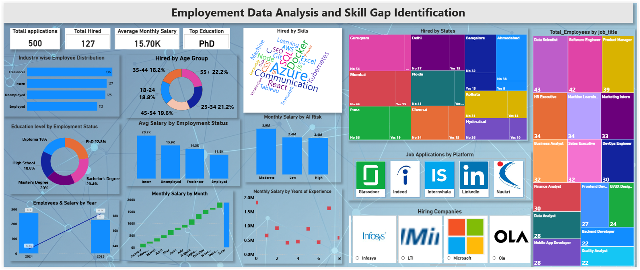
Visual Representation:

Slide 7
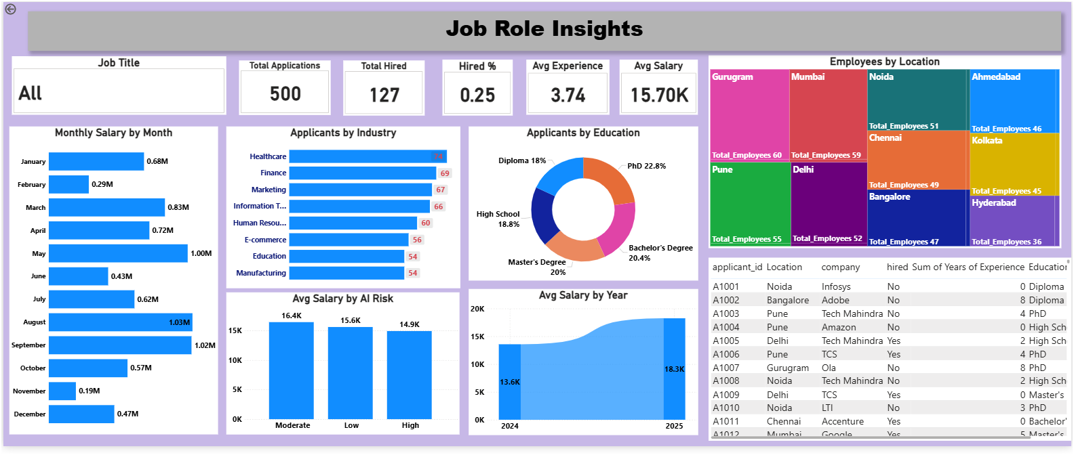
JOB ROLE INSIGHTS

Slide 8
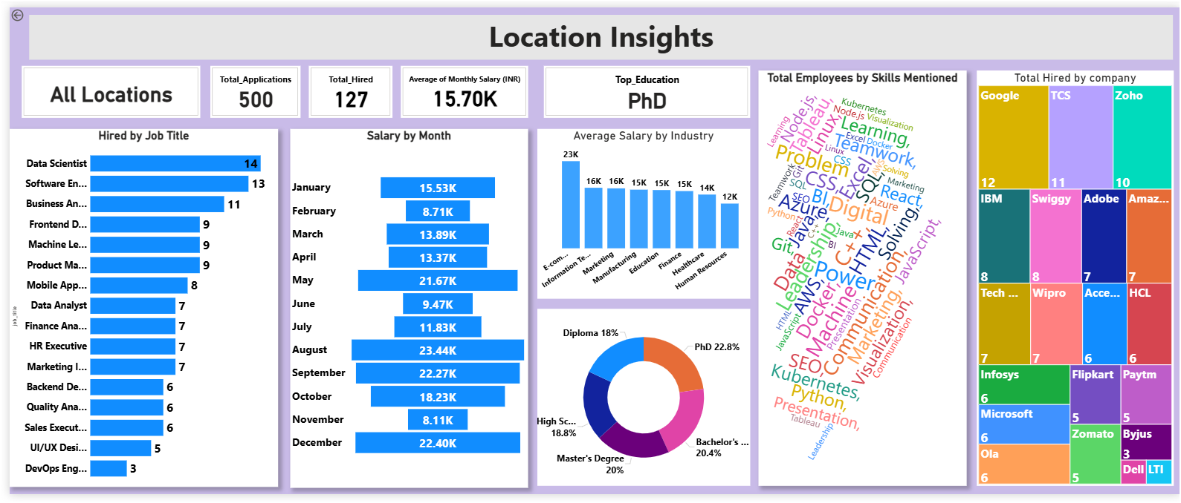
LOCATION INSIGHTS

Slide 9
SQL Analysis
1. Show all hired applicants.
2. Count applicants by company.
3. Average salary by industry.
4. Platforms with most applications.
5. Top 5 job titles with highest average salary.

Slide 10
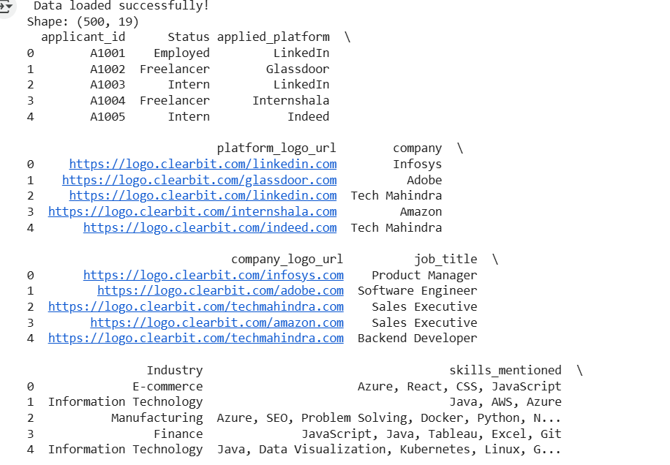
SQL OUTPUT

Slide 11
Exploratory Data Analysis (EDA)
Data cleaned and formatted using Excel.
Created pivot tables and charts for insights.
Analyzed salary, employability, and hiring trends across industries.

Slide 12
Regression Analysis Results
Monthly Salary vs Years of Experience → Not Significant (p=0.1868).
Monthly Salary vs Education → Not Significant (p=0.7526).
Interpretation: Experience and Education do not significantly affect salary.

Slide 13
ANOVA & Chi-Square Tests
Employability vs Education → Highly Significant (p=0.0000).
Education vs Age → Highly Significant (p=0.000004).
AI Risk vs Industry → Tested using Chi-square (df=12).

Slide 14
Key Insights
Education strongly influences employability.
Experience and education have little impact on salary.
AI risk perception may vary by industry.
Data selection has minimal impact on dependent variables.

Slide 15
Professional Recommendations
Invest in education and upskilling programs.
Avoid relying only on experience/education for salary models.
Tailor AI awareness programs based on industry risk levels.

Slide 16
Conclusion
Education = Key driver of employability.
Salary influenced more by job role & industry.
Supports data-driven workforce and policy decisions.
Future Scope: Use ML models and expand dataset for deeper insights.

