Slide 1
ALCOHOL DETECTION WITH VEHICLE CONTROLLING
BY
SNEHA BHAMBURE(121)
SONALI BORKAR(126)
KISHOR MITTAL(137)

Slide 2
Contents
Objectives
Abstract
Literature Survey
Specifications
Design Aspect
Advantages & Disadvantages
Applications
Conclusion
References

Slide 3
Objectives
The main purpose behind this project is “Drunk driving detection”.
Now a days, many accidents are happening because of the alcohol consumption of the driver or the person who is driving the vehicle.
Another objective behind this project is to provide a economical solution in the field of alcohol detection.

Slide 4
ABSTRACT
The number of drunken drivers have increased and the deaths due to drunken drivers is increasing day by day.
The main reason is that the police cannot check each and every vehicle. So this system is a remedy for this problem.
In this alcohol detection system the engine’s ignition system is controlled by a circuit, with alcohol sensor.
The sensor circuit is used to detect whether alcohol was consumed by the driver recently.

Slide 5
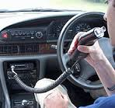
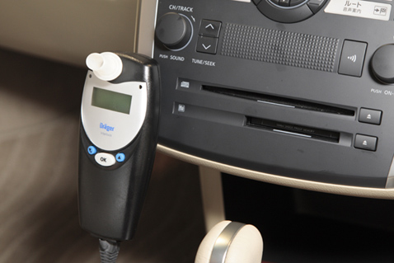
LITERATURE SURVEY

Slide 6
BLOCK DIAGRAM :
89s52
LCD 16*2
ALCOHOL SENSOR
BUZZER
RELAY

Slide 7
DESCRIPTION
The main unit of this project is an “Alcohol sensor”.
If the person inside car has consumed alcohol then it is detected by the sensor.
Sensor gives this signal to adc. The output of adc is connected to the microcontroller.
Microcontroller is the heart of this project. It is the CPU of the complete circuit.
Microcontroller gives high pulse to the buzzer circuit and the buzzer is turned on.
At the same time a relay is turned off. Due to this the ignition of the car is deactivated.

Slide 8
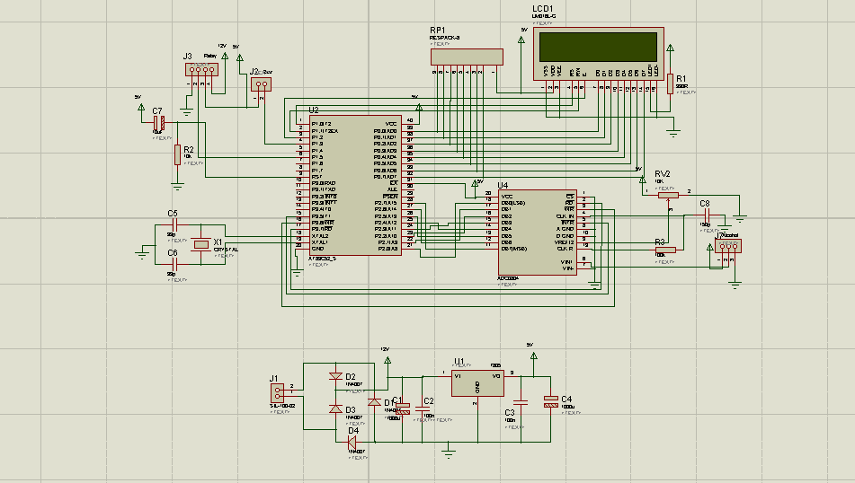
CIRCUIT DIAGRAM

Slide 9
SPECIFICATIONS
89S52 Features:
Compatible with MCS-51® Products
8K Bytes of In-System Programmable (ISP) Flash Memory
Endurance: 1000 Write/Erase Cycles
4.0V to 5.5V Operating Range
Fully Static Operation: 0 Hz to 33 MHz
Three-level Program Memory Lock
256 x 8-bit Internal RAM
32 Programmable I/O Lines

Slide 10
• Three 16-bit Timer/Counters
• Eight Interrupt Sources
• Full Duplex UART Serial Channel
• Low-power Idle and Power-down Modes
• Interrupt Recovery from Power-down Mode
• Watchdog Timer
• Dual Data Pointer
• Power-off Flag
• Fast Programming Time
• Flexible ISP Programming (Byte and Page Mode)

Slide 11
HOW MQ3 SENSOR WORK’s:
MQ3 sensor is an analog sensor and the output is in analog form.
So the output of this sensor is provided to the input of the ADC which will convert this analog output in digital input to the microcontroller . Sensitive material of MQ-3 gas sensor is SnO2, which with lower conductivity in clean air.
When the target alcohol gas exist, The sensor’s conductivity is more higher along with the gas concentration rising.
MQ-3 gas sensor has high sensitivity to Alcohol, and has good resistance to disturb of gasoline, smoke and vapour .

Slide 12
FLOWCHART
START
Initialize LCD
Display project Name
Select channel 1
Read ADC
Store &Display alcohol on LCD
Relay ON
Buzzer OFF
NO
If
Alcohol>90
?
YES
Relay OFF
Buzzer ON
Wait for 4 sec.

Slide 13
ADVANTAGES
It can provide an automatic safety system for cars and other vehicles.
Fully automate system
Low power requirement
Efficient
Economical
Time saving kit
Portable
It requires less space.

Slide 14
DISADVANTAGES
Limited range.
If any person other than the driver has consumed alcohol and if the system detects it even then it will not allow the car to start.
Due to heating of coil in the sensor , the sensor takes time to initialize.

Slide 15
APPLICATIONS
Drunk driving detection system is incorporated in vehicles.
Alcohol detector project can be used in various vehicles for detecting whether the driver has consumed alcohol or not.
This project can also be used in various companies or organization to detect alcohol consumption of employees.
It can implement GSM technology to inform the relatives or owners of the vehicle about the alcohol consumption.
We can implement GPS technology to find the location of the vehicle

Slide 16
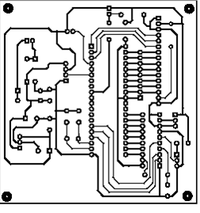
PCB LAYOUT

Slide 17
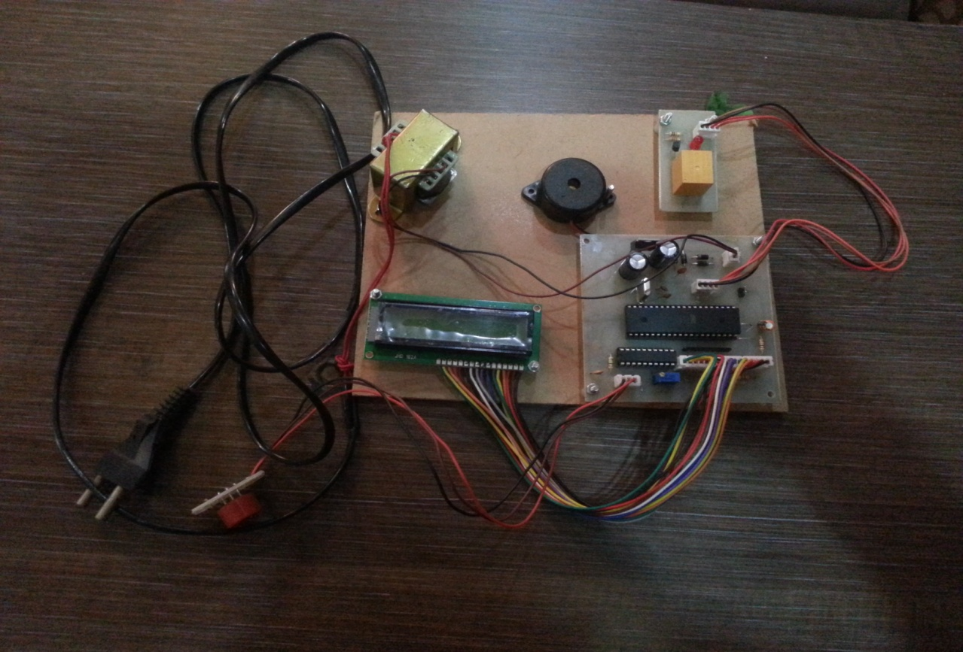
FINAL PROJECT SNAPSHOT

Slide 18
REFERENCES
http://www.datasheetcatalog.org/SGSThomsonMicroelec/mXtyyvx.pdf
http://www.8051projects.info/exp9.asp
http://www.swedetrack.com/obstact.htm

Slide 19
THANK YOU

Slide 20
ANY QUESTIONS?

