Slide 1


SMT. KASHIBAI NAVALE COLLEGE OF ENGINEERING
Generic turn based games service on Android platform using Google App Engine
Project On:- STOPWATCH
USING MICROCONTROLLER
Generic turn based games service on Android platform using Google App Engine
Submitted by:
1) Sneha Bhambure
2) Shivanjali Jadhav
3) Swati Ambekar
4)Ankita Jadhav
Guided by:
Prof. JAGDALE

Slide 2
Contents
Contents
1
Introduction
INTRODUCTION
2
C DIAGRAM
3
COMPONENTS
4
PIN DIAGRAM OF AT89S51
5
A APPLICATIONS

Slide 3
INTRODUCTION
> A stopwatch is a handheld timepiece designed to measure the amount of
time elapsed from a particular time when activated to when the piece is
deactivated.
> The timing functions are traditionally controlled by two buttons on the case.
> Pressing the top button starts the timer running, and pressing the button
a second time stops it, leaving the elapsed time displayed.
> A press of the second button then resets the stopwatch to zero.
> The second button is also used to record split times or lap times.

Slide 4
> When the split time button is pressed while the watch is running,
the display freezes, allowing the elapsed time to that point to be read,
but the watch mechanism continues running to record total elapsed
time.
> Pressing the split button a second time allows the watch to
resume display of total time

Slide 5
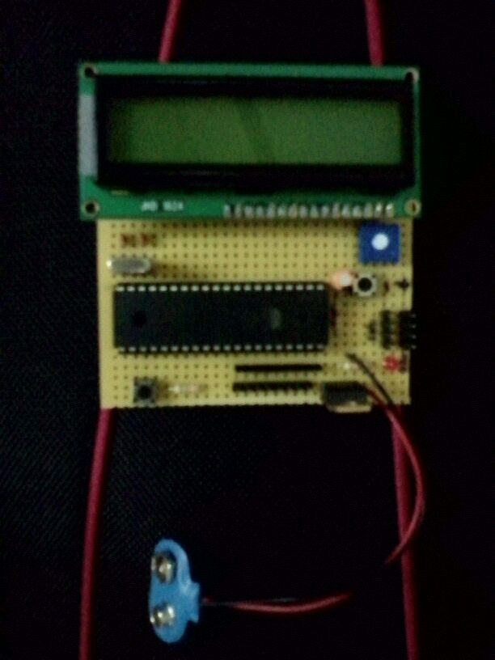
DIAGRAM OF STOPWATCH USING MICROCONTROLLER

Slide 6
> Mechanical stopwatches are powered by a mainspring, which must be
periodically wound up by turning the knurled knob at the top of the watch.
> Digital electronic stopwatches are available which, due to their crystal
oscillator timing element, are much more accurate than mechanical
timepieces.
> Because they contain a microchip, they often include date and time-of-day
functions as well.
> Some may have a connector for external sensors, allowing the stopwatch to
be triggered by external events, thus measuring elapsed time far more
accurately than is possible by pressing the buttons with one's finger.

Slide 7
COMPONENTS
> Now here we have used components like
1) microcontroller AT89S51
2) crystal oscillator
3) Potentiometer
4) switch
5)LCD

Slide 8
WORKING
Simple digital stopwatch using at89s51 Microcontroller
Operation:
The display will show 00 at the startup
Press the switch to get the watch to run
Press the 2nd switch to stop the watch
To reset the watch press the switch again.

Slide 9
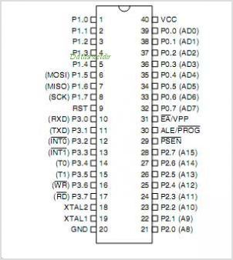
PIN DIAGRAM FOR AT89S51

Slide 10
APPLICATIONS
1 ) The primary Stopwatch display screen with user configurable data fields.
2) A stopwatch is very commonly used in racing competitions and other gaming activities.
3 A large digital version of a stopwatch designed for viewing at a distance,
is used in a sports stadium

Slide 11
Flow chart
START
PORT INITIALISATION
LCD COMMAND INITIALISATION
DISPLAY STRING ‘STOP WATCH’
START THE TIMER
CONVERSION TO ASCII CODE
DISPLAY ON LCD
No
Yes
Stop the stop watch
If switch is open
Continue stop watch
stop

Slide 12
CONCLUSION
From this case study we have learned the
circuit diagram and working of stopwatch
using microcontroller AT89S51

Slide 13
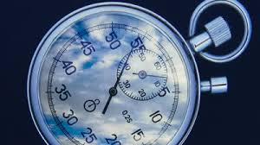
THANK YOU

