Slide 1

Project Title –Seasonal Agriculture Performance Analysis
Student Name- SNEHA TYAGI
College Name-Indira Gandhi National Open University
AICTE STU ID : STU6a6835ca74e4a1785214410

Slide 2

PROBLEM STATEMENT
Agricultural activities are influenced by seasonal variations in environmental conditions, farming practices, resource availability and market conditions. As a result, agricultural performance may differ from one season to another.
However, raw agricultural data does not clearly explain how agricultural performance changes across seasons or what patterns can be observed in different seasonal conditions.
The problem is to analyze the given agricultural dataset and investigate seasonal differences in agricultural performance by identifying meaningful patterns, trends, relationships and variations within the available data.

Slide 3
Project Description
Overview: An end-to-end exploratory data analysis (EDA) framework built to clean, process, and analyze 4,000 unique farm records across 8 states and 8 major crop types.
Methodology Details:
Data Integrity Checks: Evaluated missing data patterns (Rainfall 1.2%, Soil Moisture 1.0%, Yield 0.8%) and performed Median Imputation to retain dataset balance without outlier distortion.
Outlier Strategy: Inspected highly skewed distributions (Production, Revenue, Profit) using the Interquartile Range (IQR) method and safely preserved them as valid agricultural biological variances rather than data errors.
Feature Engineering: Derived high-value KPIs to judge structural farm performance across different sizes: Profit Margin (%), Cost per Tonne, Revenue per Hectare, and Profit per Hectare.

Slide 4

WHO ARE THE END USERS?
Agricultural Policy Makers & Government Bodies: To plan regional resource allocations and design target financial safety schemes based on seasonal performance drops.
Farming Cooperatives & Agronomists: To identify optimal crop choices and select sustainable irrigation methods tailored to regional weather baselines.
Agricultural Financial Analysts: To model market price sensitivities, manage economic risks, and evaluate cost-to-revenue ratios per season.

Slide 5

Technology Used
Programming Language: Python
Data Processing & Manipulation:
pandas (Dataframe loading, cleaning, aggregating, grouping)
numpy (Numerical operations and indexing handling)
Data Visualization & Analytics:
matplotlib.pyplot (Building specialized bar charts, line plots, and subplots)
seaborn (Plotting detailed correlation heatmaps and distributional boxplots)

Slide 6
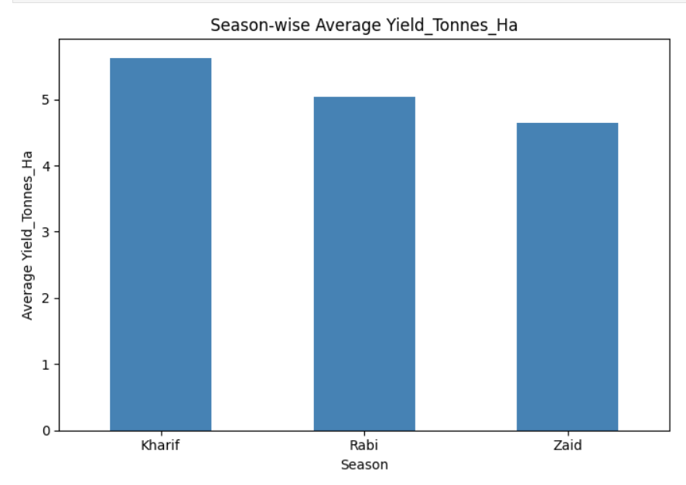
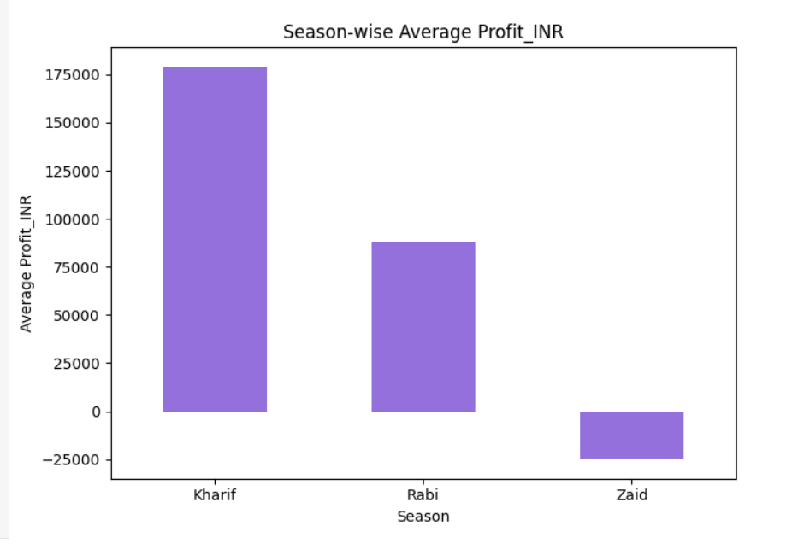
RESULTS
Kharif is the most successful season, leading in both crop yield (5.63 Tonnes/Ha) and average profit.
Rabi shows steady, safe, and positive returns.
Zaid is a difficult season for farmers, showing a negative average profit (-₹24,804.82).

Slide 7
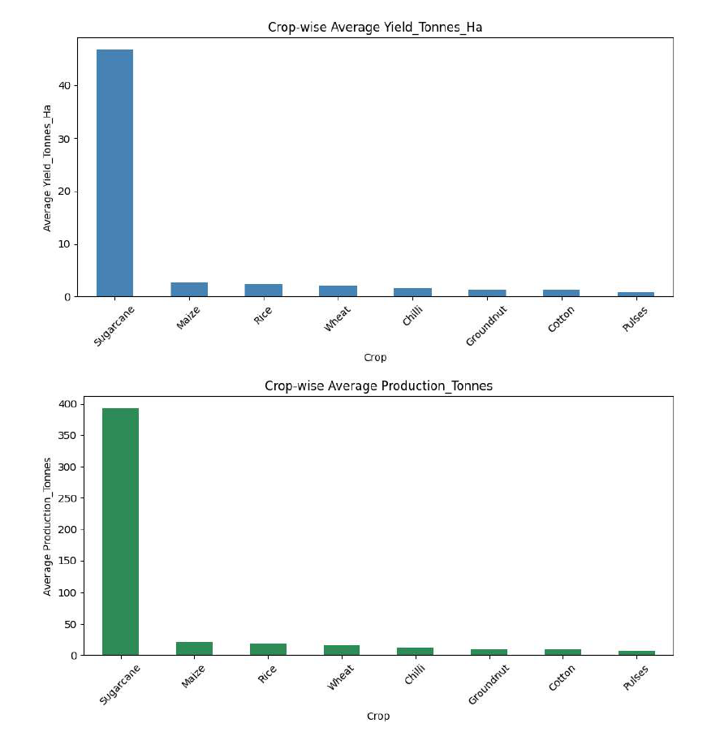
RESULTS
Sugarcane easily dominates the dataset in physical output size and absolute profit.
Chilli stands out as a highly profitable commercial crop option.
Daily staples like Wheat, Rice, and Maize unexpectedly trended into negative average profit zones in this dataset.

Slide 8
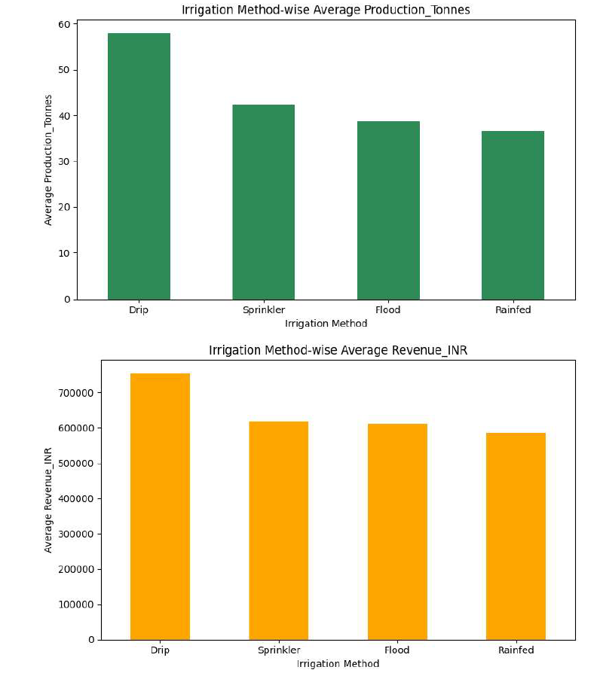
RESULTS
Drip Irrigation is the absolute clear winner over all other watering tactics.
It delivers the maximum average yield (6.58 Tonnes/Ha) and the highest financial profits.
Traditional flood methods and basic rainfed farming generated much lower overall efficiency.

Slide 9
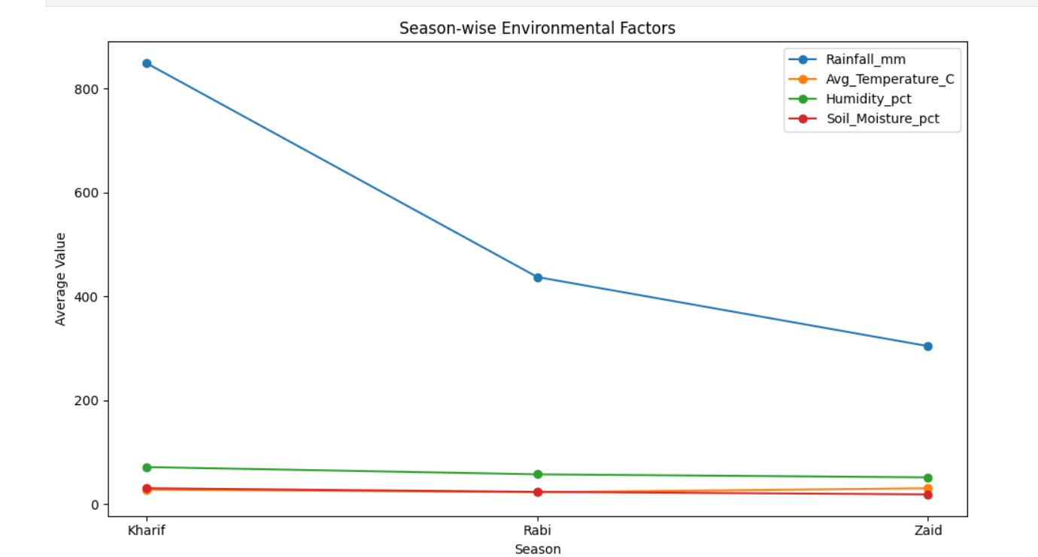
RESULTS
Kharif thrives because it benefits from optimal natural monsoon rain (849.20 mm) and natural humidity.
Zaid (Summer) forces farmers to pump massive amounts of costly artificial water (6,419.89 m³) due to blistering average temperatures.
This high water dependency explains why summer farming costs spike up, erasing net profits.

Slide 10
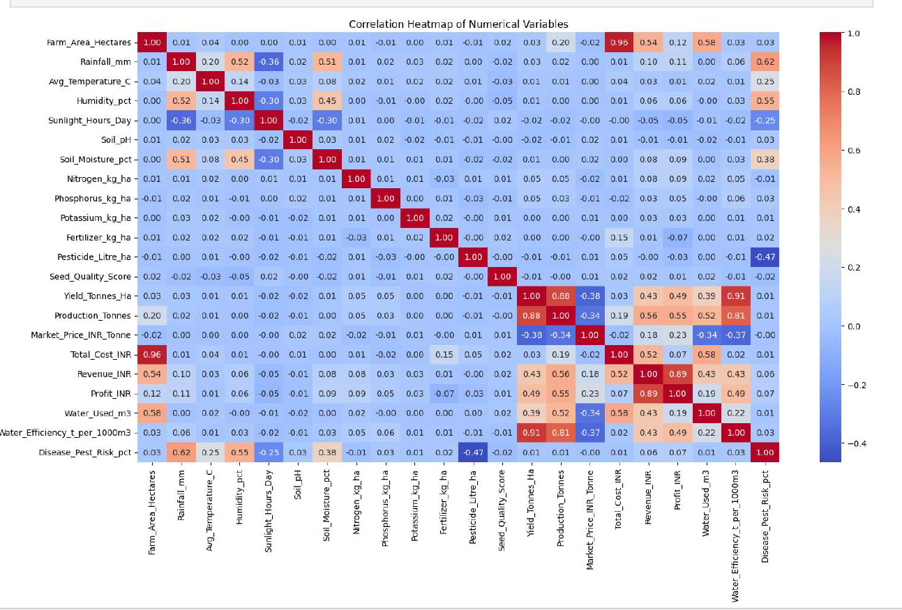
RESULTS
I used this map to see how different parameters move together.
Water Used has the biggest positive impact on final crop yield out of all raw field inputs (0.39 positive correlation).
Interestingly, adding extra Fertilizer showed a minor negative correlation with final profit (-0.07), meaning excessive inputs just drive up overhead costs without guaranteeing returns.

Slide 11
Future scope
Predictive ML Modeling: Train machine learning regression models (e.g., Random Forests, XGBoost) to predict dynamic crop yields and net farm profits using early weather indicators.
Interactive Dashboard Deployment: Migrate fixed exploratory chart systems into web applications (using Streamlit or Dash) for real-time exploratory data modeling.
Anomalous Market Detection: Expand feature parameters to ingest live regional wholesale crop pricing APIs to generate optimized, automated dynamic sowing recommendations.

Slide 12
GitHub Link
MY GitHub Repo

Slide 13
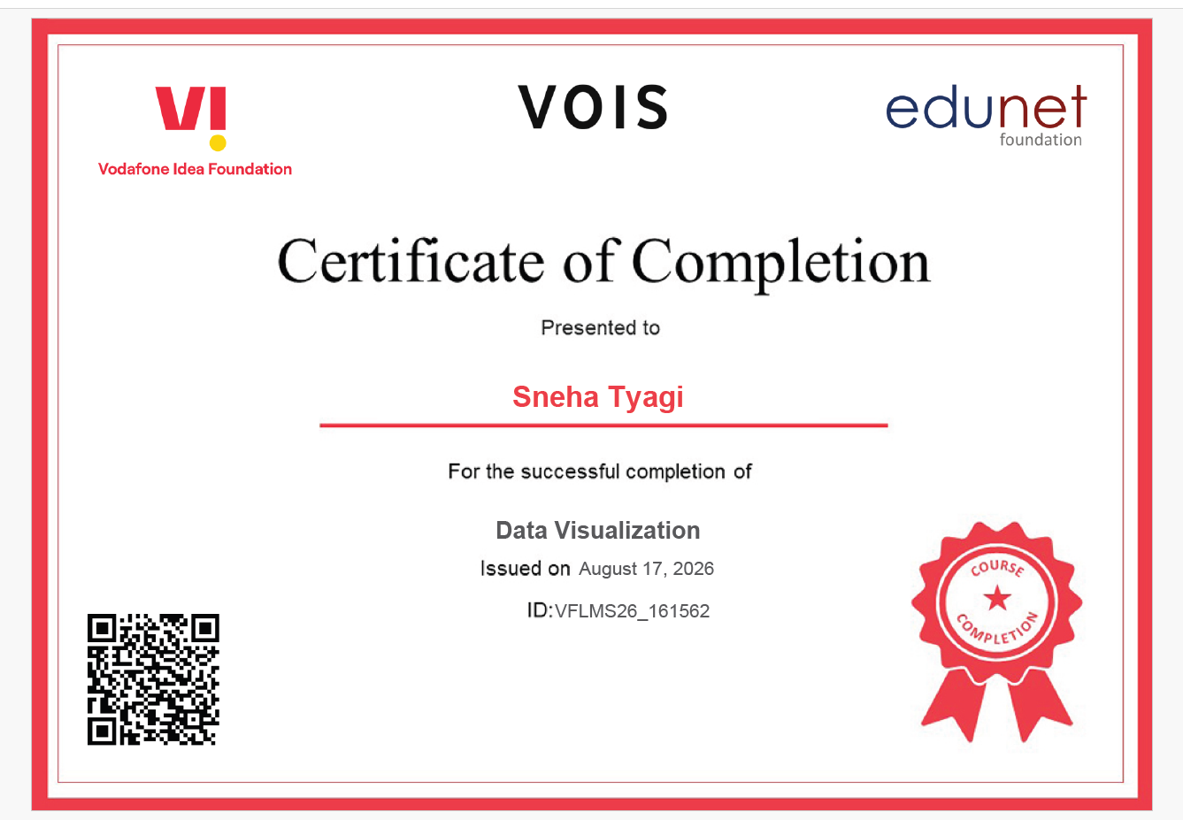
VOIS Course completion certificate - Course name- Data Visualization

Slide 14
Conclusion
Doing this project taught me how data analysis can find practical solutions for real-world farming.
Thank You! 🎓 Special thanks to Edunet Foundation for the Data Visualization training.
.
.

